Slide 1
The Electromagnetic Spectrum

Slide 2

Light – what is it?
Notes:
Introduce the concept of light.
Establish and discuss what is light - how does it travel to us, how do we use light and what information can we gain from light.

Slide 3
Spectrums – what are they?
Notes:
2. Introduce the word spectrum and its meaning.
Activity – Ask the students to create a height spectrum of themselves from shortest to tallest.

Slide 4
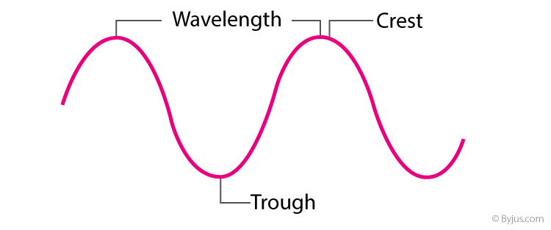
Wavelengths of Light
Notes:
3. Investigate different features of a light wave.
Discuss what is a wavelength and how we would measure it (crest to crest).
Activity – Experiment with slinkies to create wavelengths of different sizes. Get students to note the size of the wavelength and how much energy they need to input to create the wave.

Slide 5
Electromagnetic Spectrum
Notes:
4. Create the Electromagnetic Spectrum.
Establish that there are different types of light based on the size of their wavelength (and energy/frequency they have) and that it can be sorted into a spectrum
Activity – Create the Electromagnetic Spectrum by using the labels and the interactive poster to introduce each part of the spectrum – with each new type of light discuss how the wavelength/frequency changes; reflect real world examples.

Slide 6
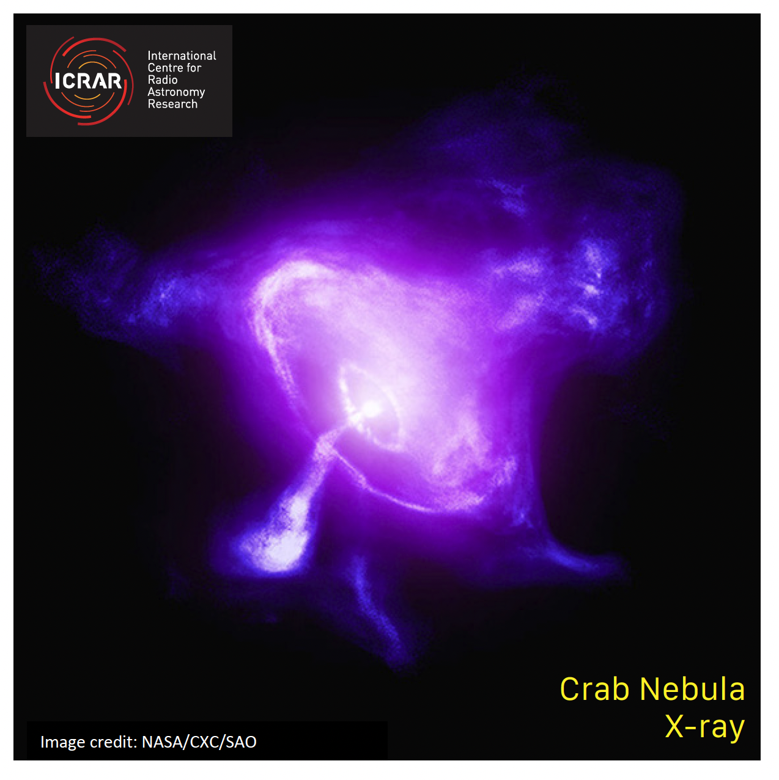
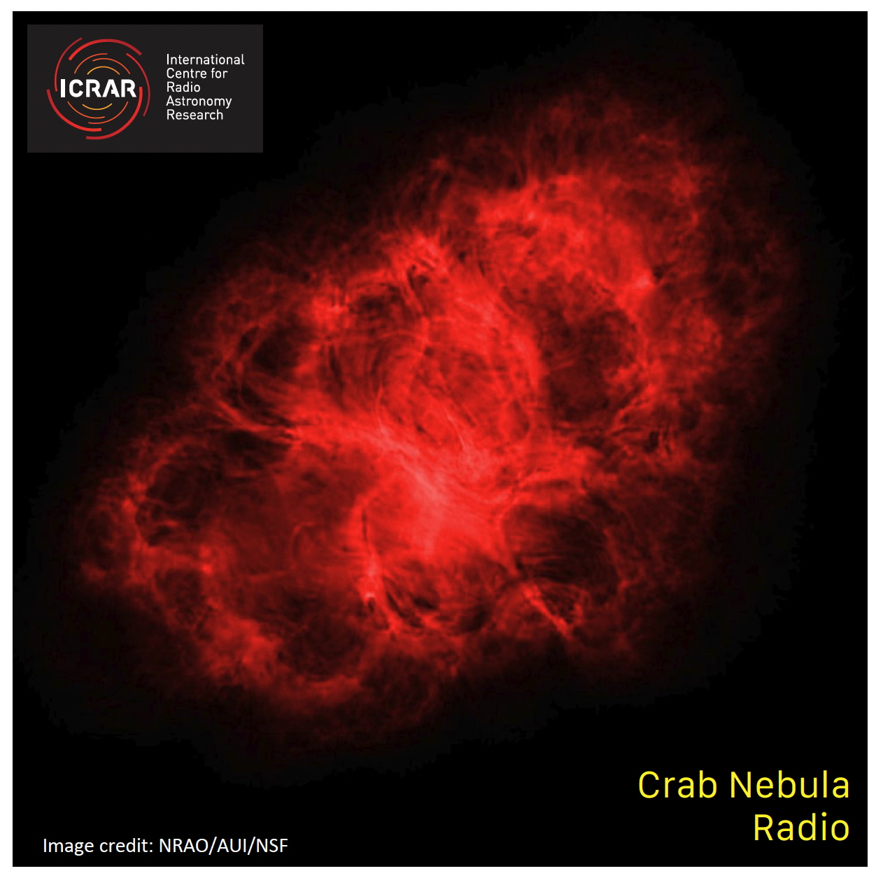
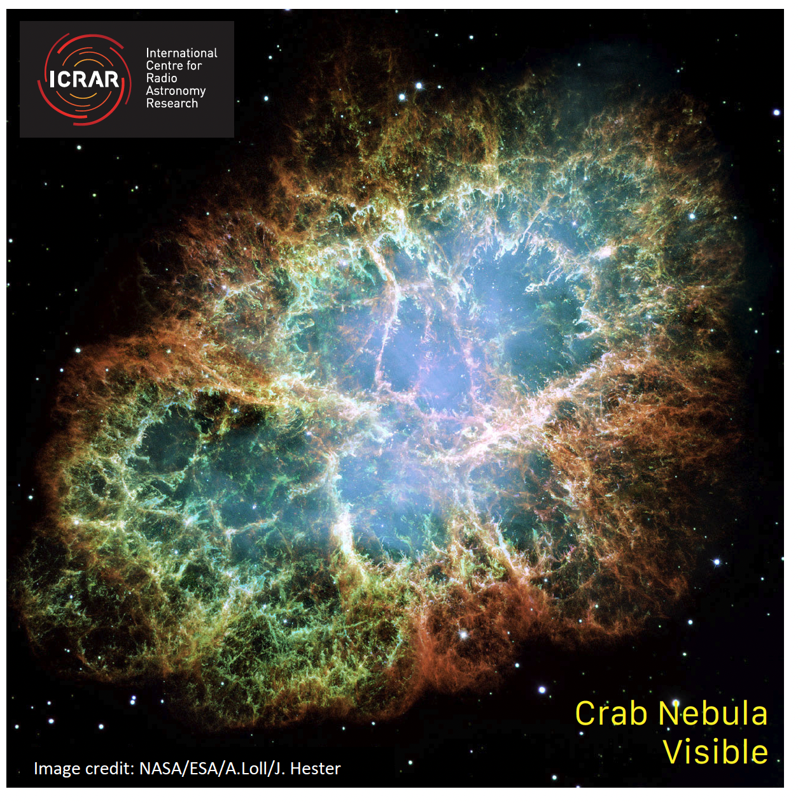
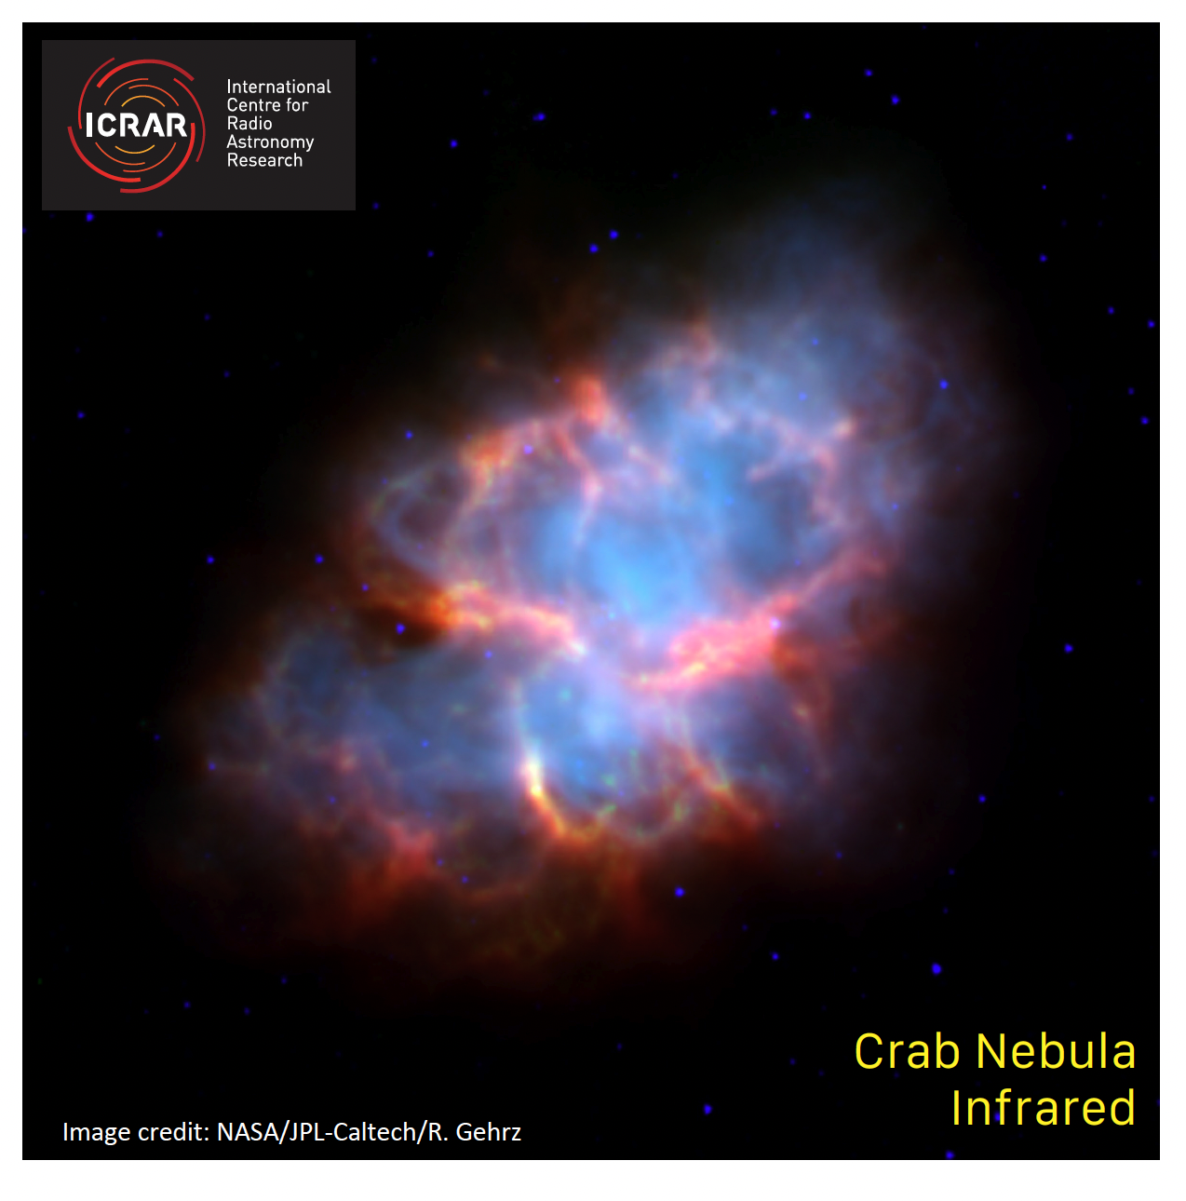
Using the EM Spectrum in Astronomy
Multiwavelength Astronomy -
Observing objects in space using different types of light.
Notes:
5. Applications of the Electromagnetic spectrum – Multiwavelength Astronomy.
Discuss the concept of multiwavelength astronomy and observing objects in different kinds of light. Demonstrate this by using the Crab Nebula cards and seeing what it looks like in visible, infrared, radio and x-ray light. (Alternate example is Jupiter).
Activity – Provide the other card sets to the students and ask them to work together in groups to identify and label which image represents each visible, infrared, radio and x-ray. Once completed, go through the answers together as a class.

Slide 7
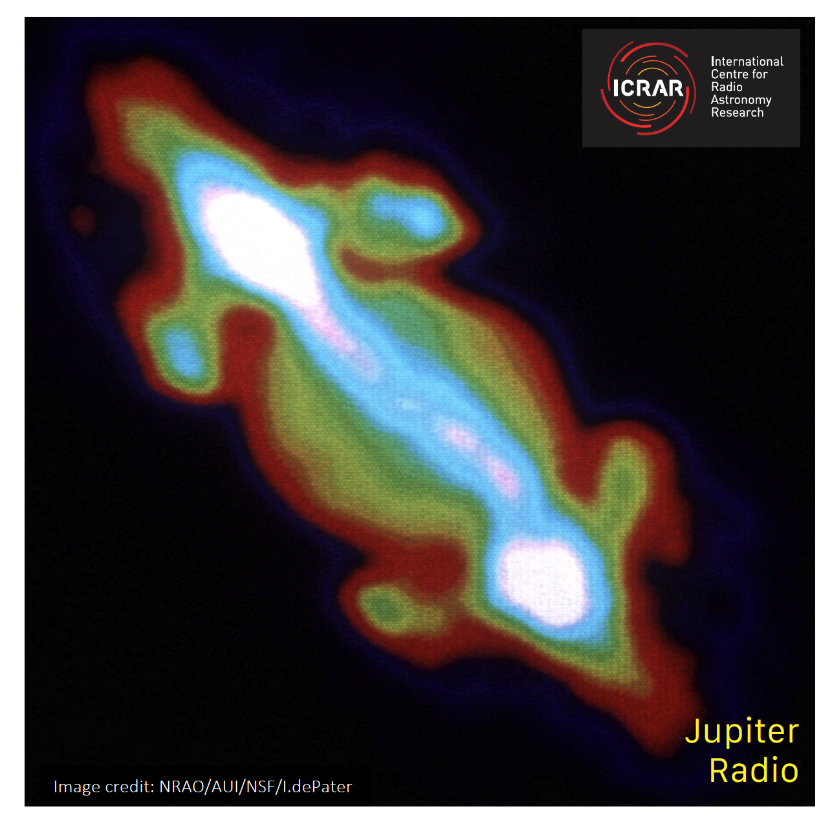
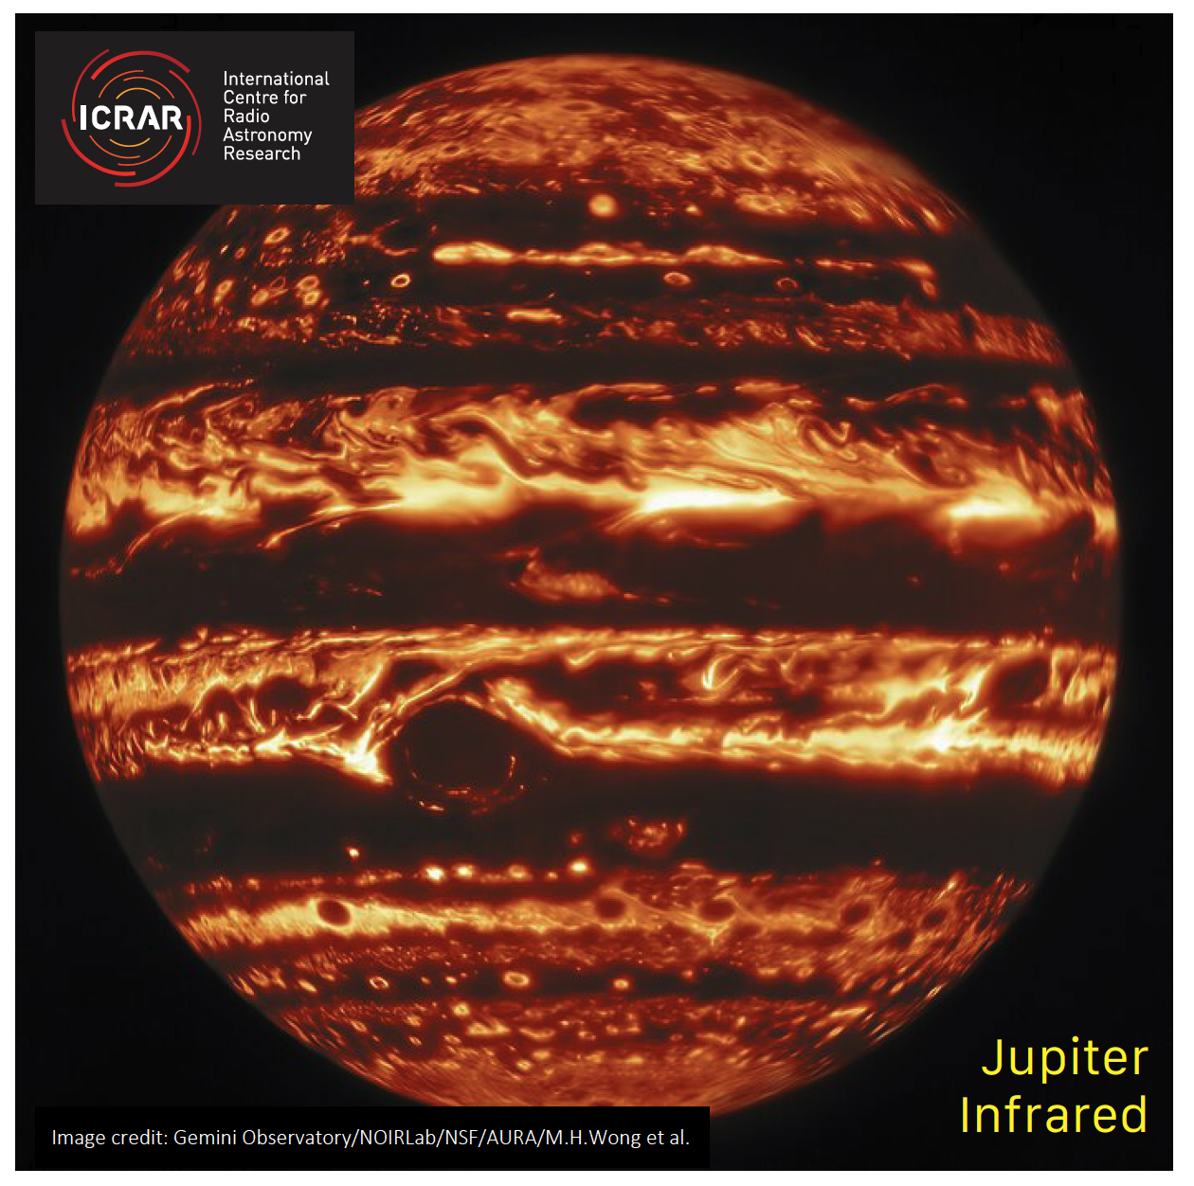
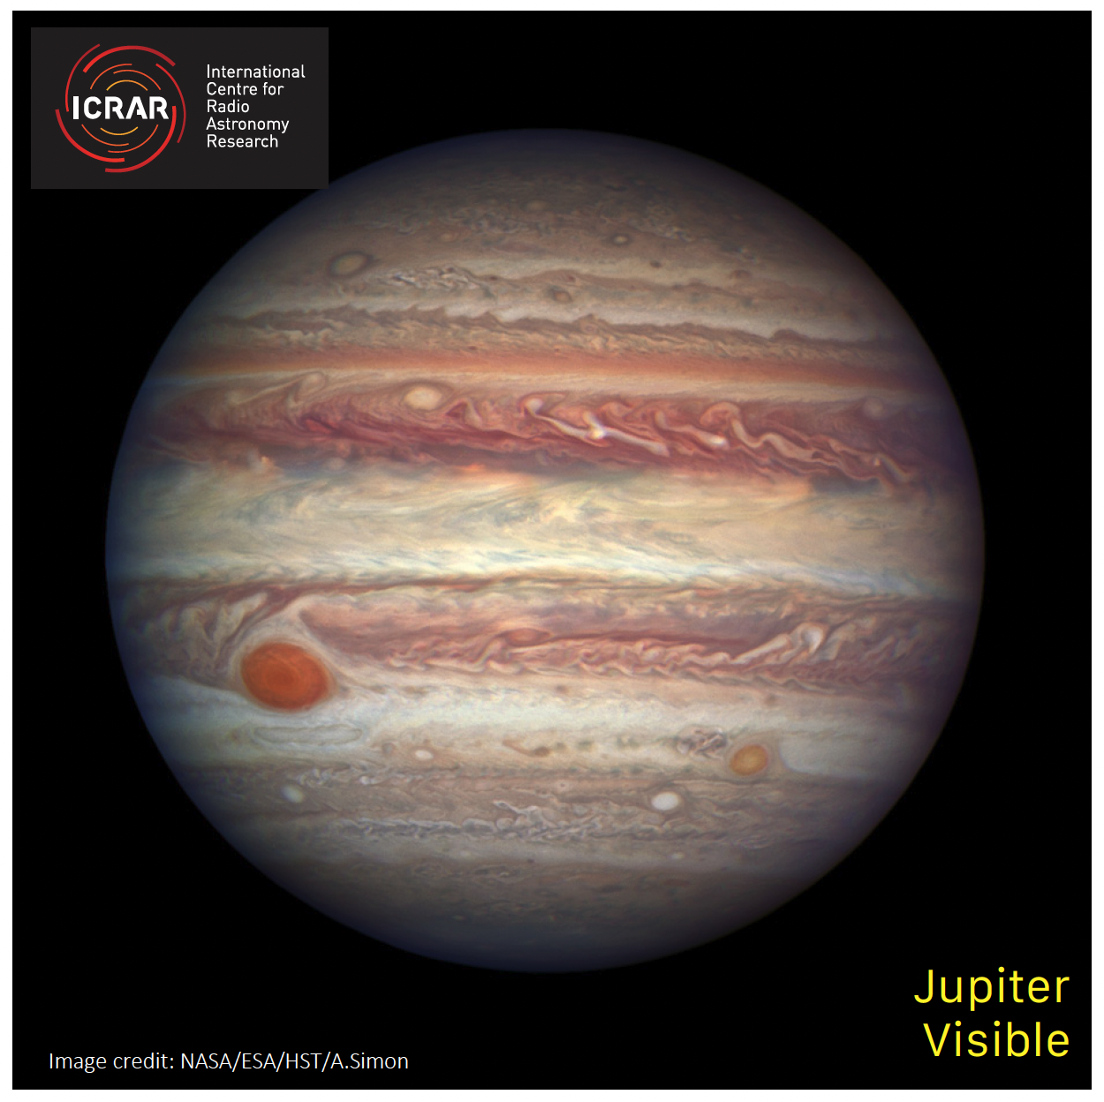
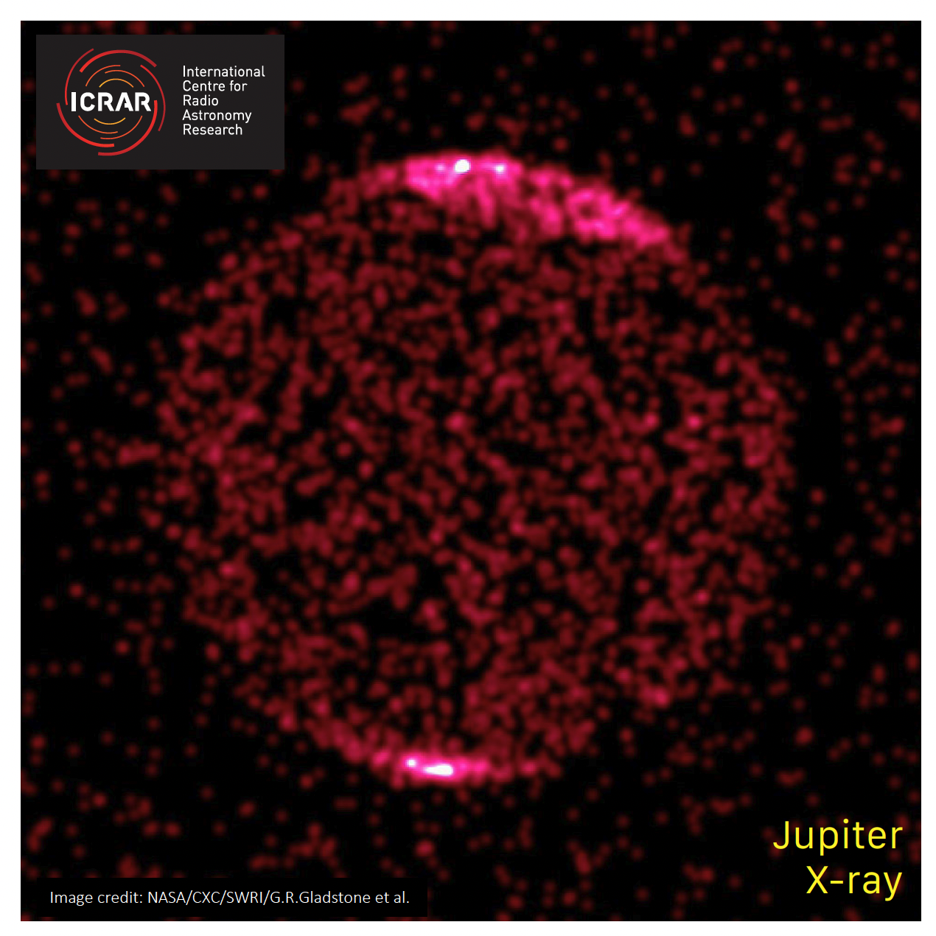
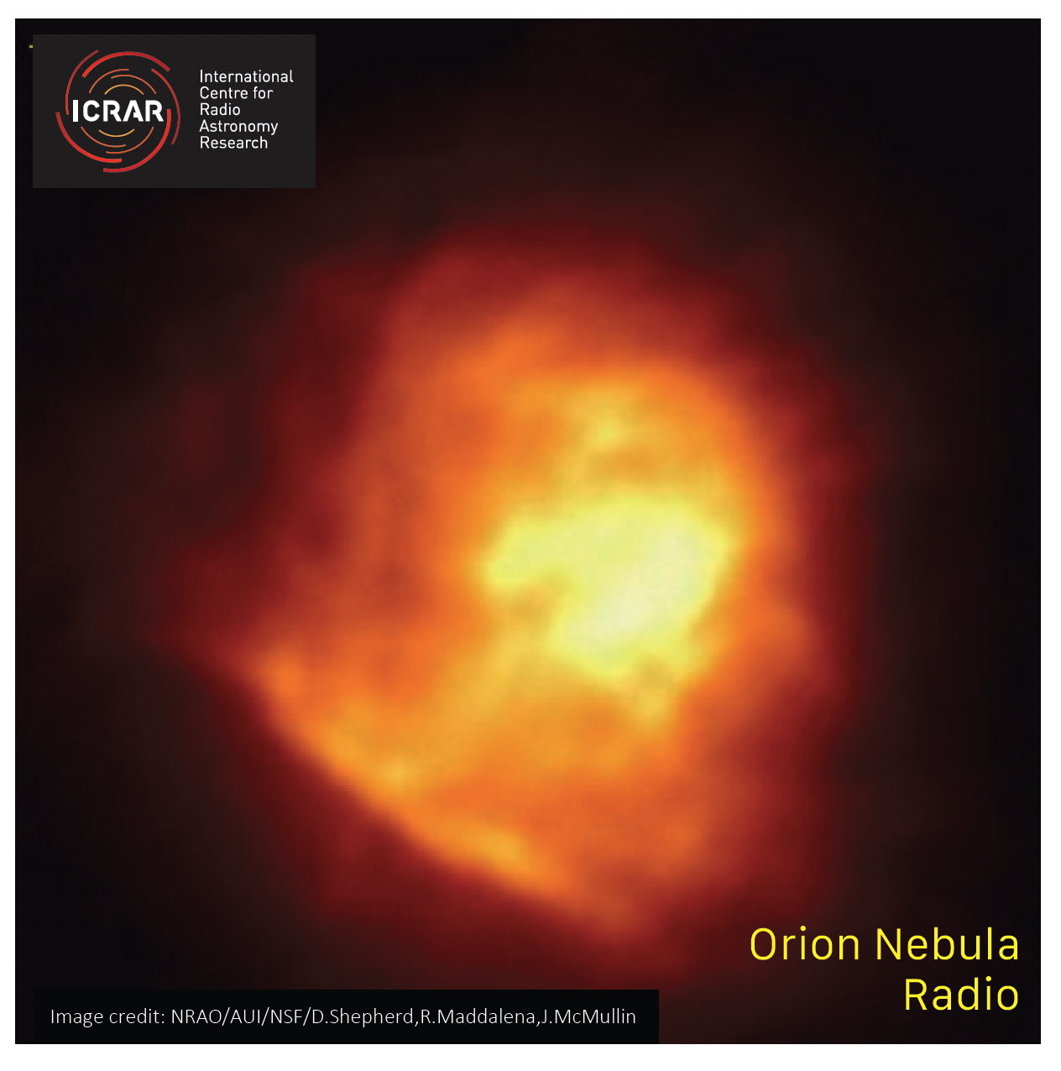
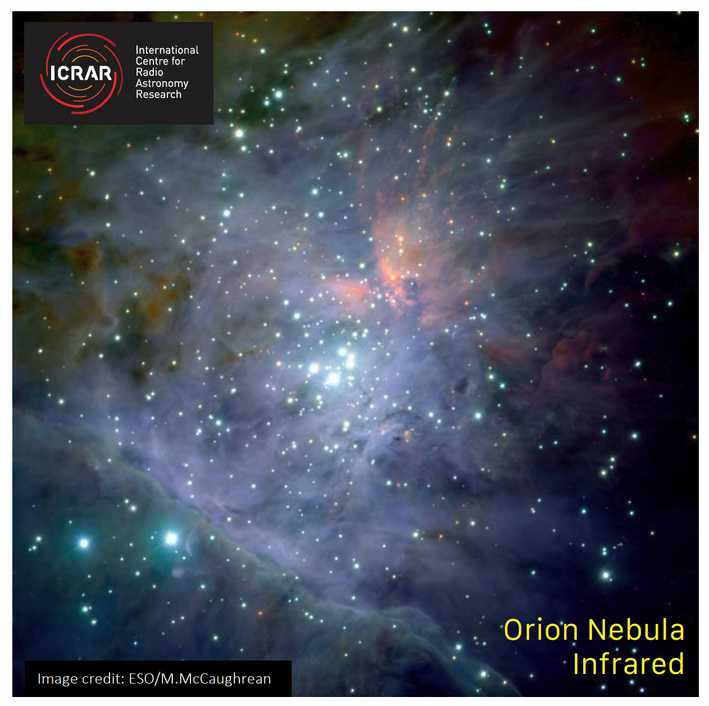
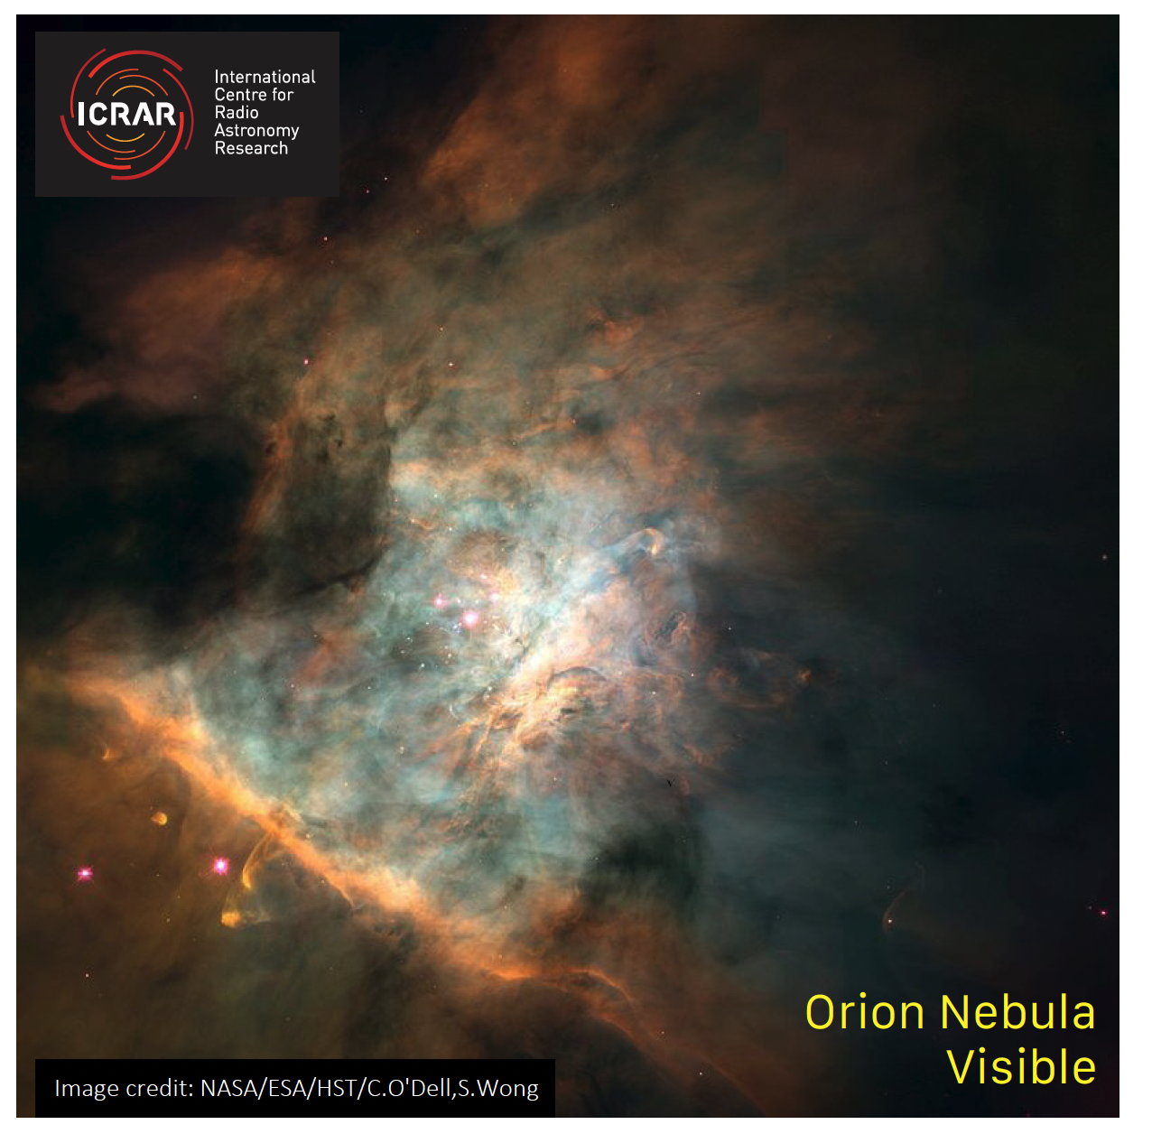
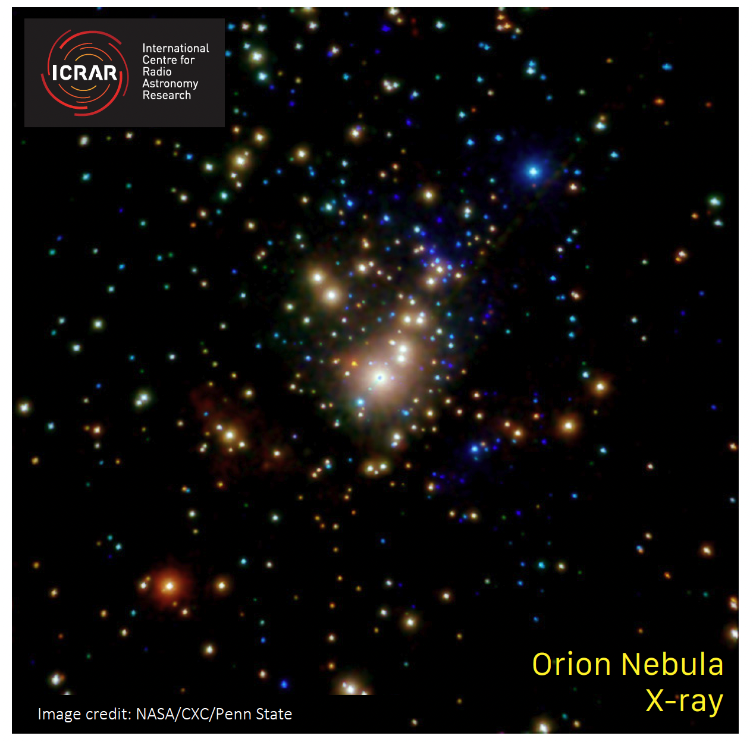
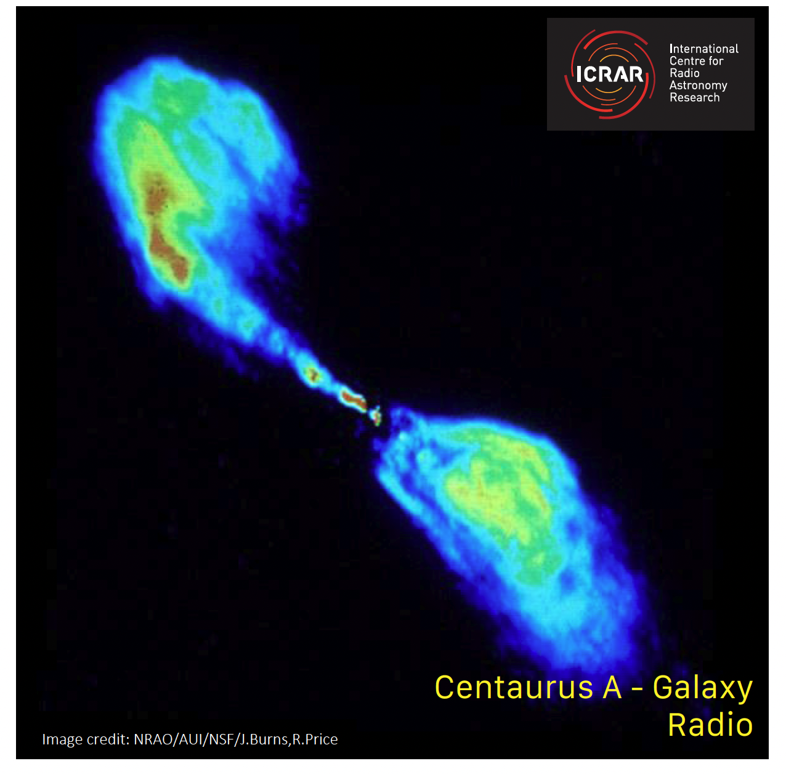
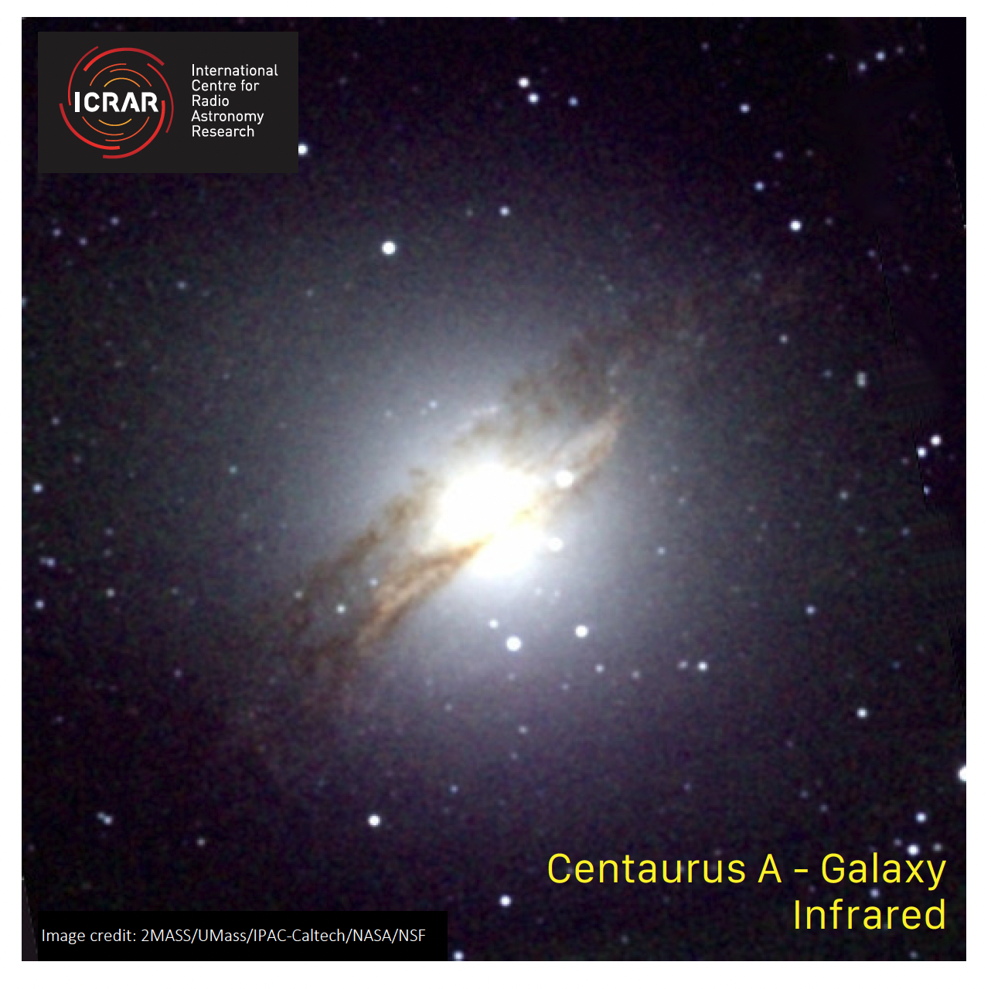
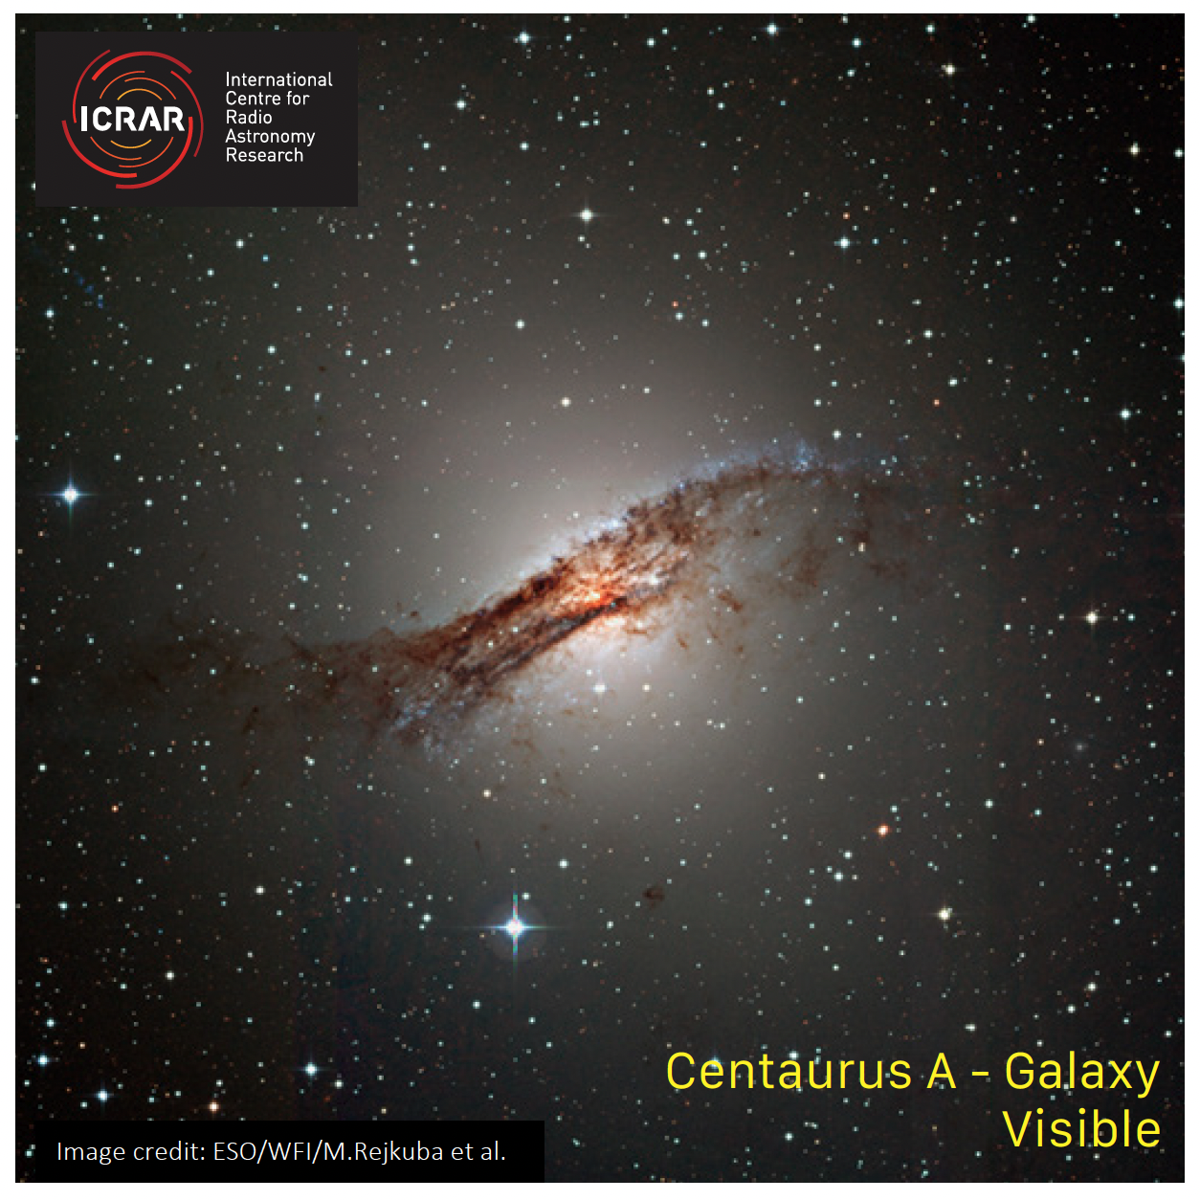
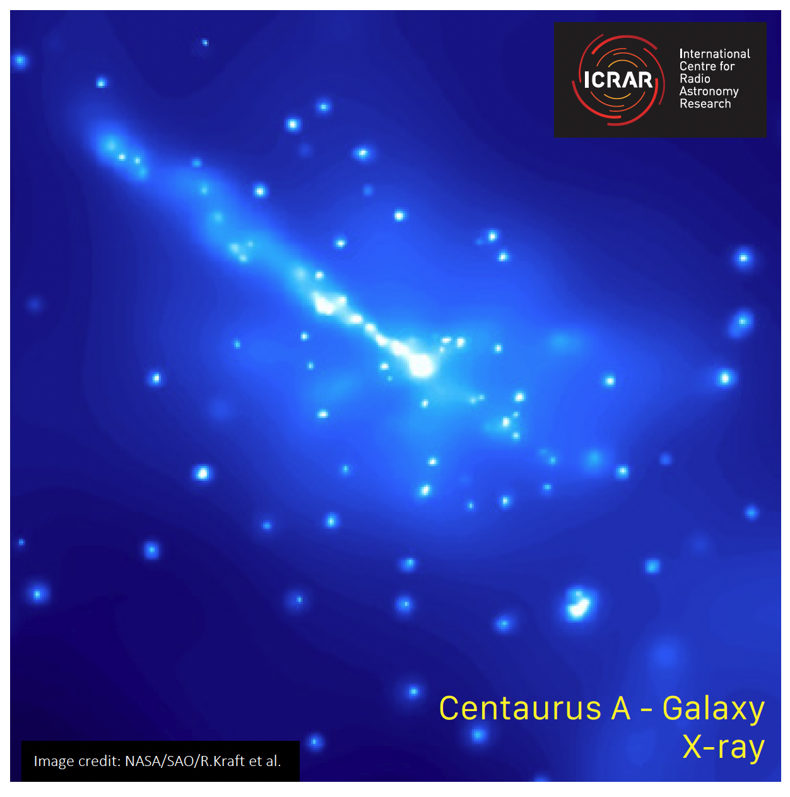
Multiwavelength Astronomy
Radio
Infrared
Visible
X-ray
Notes:
6. The science behind multiwavelength astronomy.
Using the card sets, discuss what science we are learning from each different type of wavelength and how scientists combine this knowledge together to further understand the physics of our Universe.
_________________________________________________________________________________________________________________________________
The science behind multiwavelength astronomy.
Visible Light
We detect the objects that we see with our eyes, including planets, stars, gas and dust. When we observe galaxies (like Centaurus A), some have these dark patches across the plane of the galaxy – these are dust clouds that are so dense it is blocks out the surrounding starlight. Dust clouds are significant because these are the building blocks of star formation.
Infrared Light
Detects heat/thermal energy, so we are typically observing the “hot” objects in space in infrared (predominantly stars). The wavelength of infrared light is the right size to pass through dust clouds, so when we observe galaxies and nebulas in infrared light we are peering through the dust clouds and seeing all of the stars present.
Notably with Jupiter, we are observing the warmer parts of the atmosphere. We see the similar cloud bands as we do in visible light, but thanks to the fast rotation speed of Jupiter (once every 10 hours), that angular momentum creates an incredible amount of friction, which is what we are observing in infrared light.
Radio Light
Typically detects the cooler/less energetic gas (like neutral hydrogen) present in objects. Hydrogen gas is present throughout the Universe and is significant for the formation of objects like stars and galaxies. However, observations in radio light also highlight objects with interesting physics at play, as we can see in the Jupiter and Centaurus A images. These emissions are bright in radio light but are completely invisible in visible light.
In Jupiter’s image, the beams of radio light create a lizard-shaped emission. This is due to charged particles interacting with Jupiter’s large magnetic field and creating a ring of radio emissions around the centre of the planet.
In Centaurus A we see jets of radio light emitting from the centre of the galaxy as material is being ejected from the black hole’s accretion disk and interacting with the surrounding material at the galaxy’s centre. Not all galaxies behave like this though, and scientists are still trying to understand why this is the case.
X-ray Light
Detects objects in the Universe that are emitting high forms of energy. These emissions are typically associated with some of the most chaotic objects in the Universe, like supernova explosions and supermassive black holes.
Jupiter’s image is highlighting the permanent aurora phenomenon that occurs on this planet. The aurora are created by energetic particles from the Sun being caught up in the planets magnetic field and being directed back towards the poles. The aurora are permanent on Jupiter (unlike the Earth) because of its large magnetic field.
In Centaurus A, a bright jet of x-ray radiation is being emitted from the core, likely aligned with the supermassive black hole at the centre of the galaxy. Objects such as these are called Active Galactic Nuclei (AGN), but the physics behind these objects are still being understood.
Multiwavelength Astronomy is so significant, because each wavelength forms part of the puzzle that tells us a complete story of the Universe. So much information is missing, if we simply relied on the part of the electromagnetic spectrum that our eyes can detect.
And furthermore as humans we have been able to create machines (telescopes) that detects the light we can’t observe with our eyes, to help us better understand what we discover.

