Slide 1
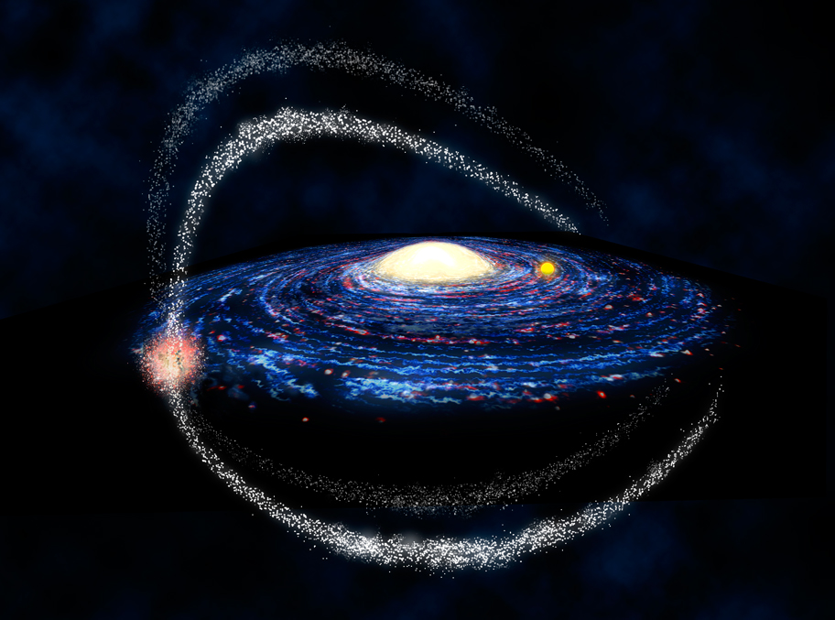
Dark Matter in Galactic Remnants and Dwarf Galaxies
Lister Staveley-Smith, Kenji Bekki et al.

Slide 2
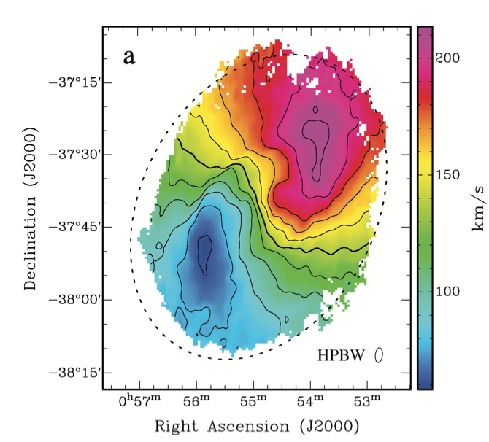
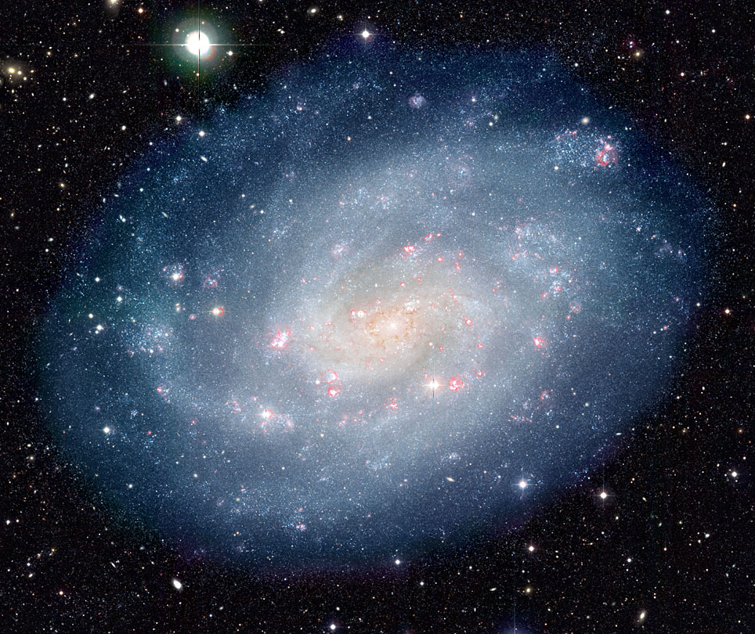
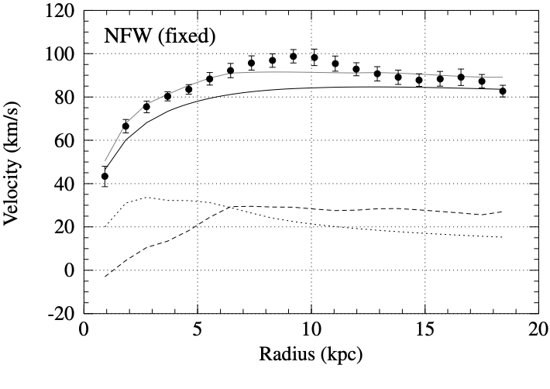
Galactic dark matter
NGC 300 (ESO)
dark halo
edge of stellar disk
gas
stars
Westmeier+ (2011)

Slide 3
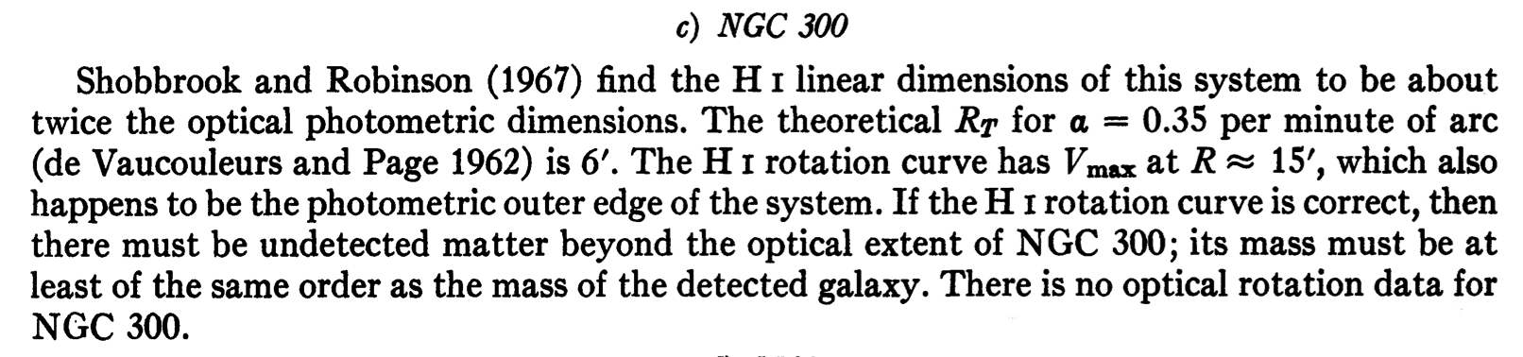
Freeman (1970)

Slide 4
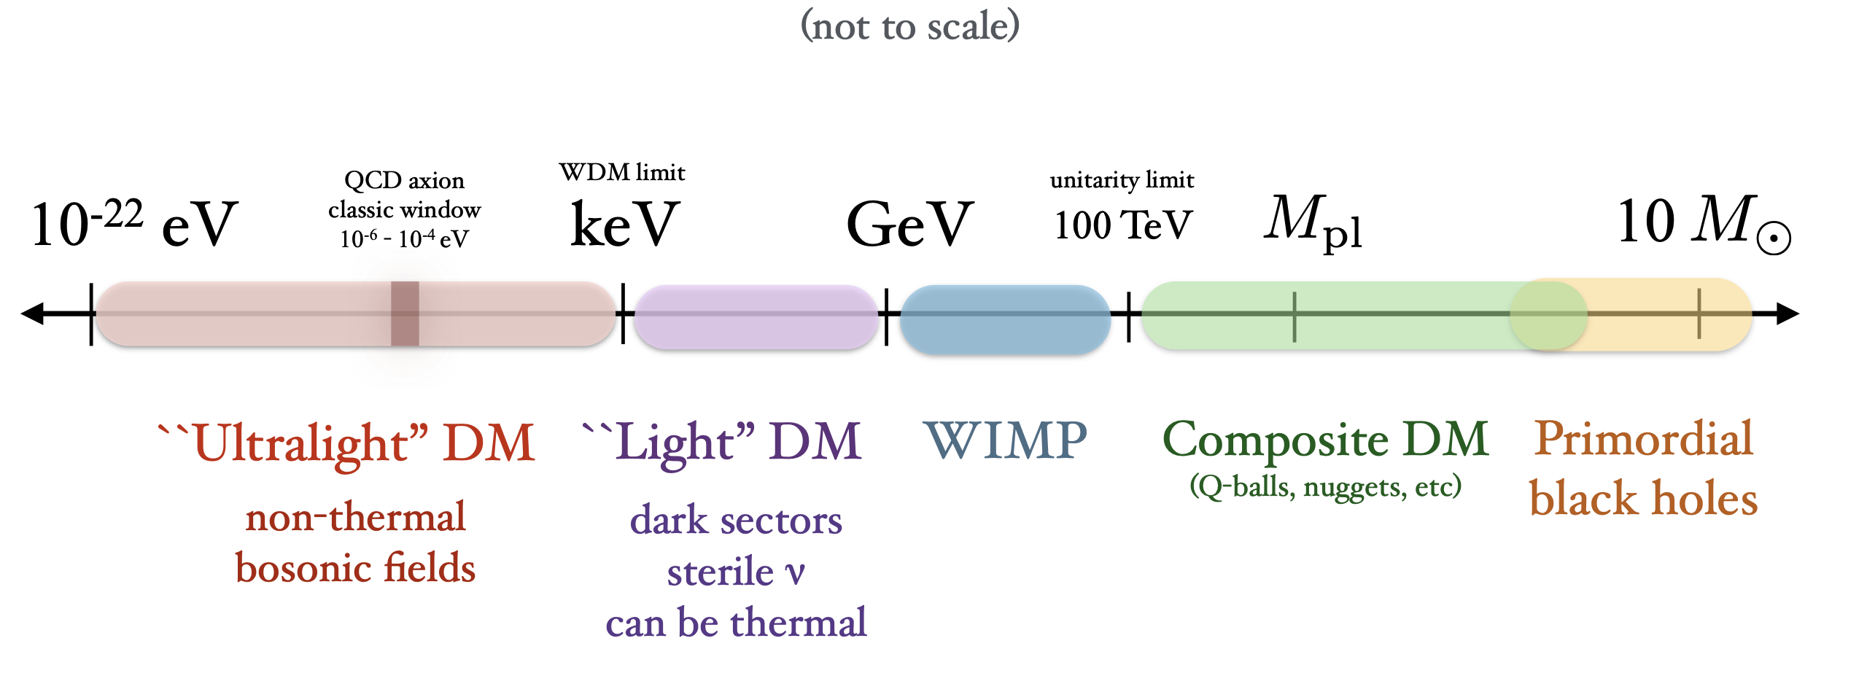
Mass scale of dark matter
MACHOs (e.g.Alcock+
1995-2005; after Paczynski 1986)
Tongyan Lin (arXiv:1904.07915)

Slide 5
Mass scale of dark matter
MACHOs (e.g.Alcock+
1995-2005 ; after Paczynski 1986)
Tongyan Lin (arXiv:1904.07915)

Slide 6
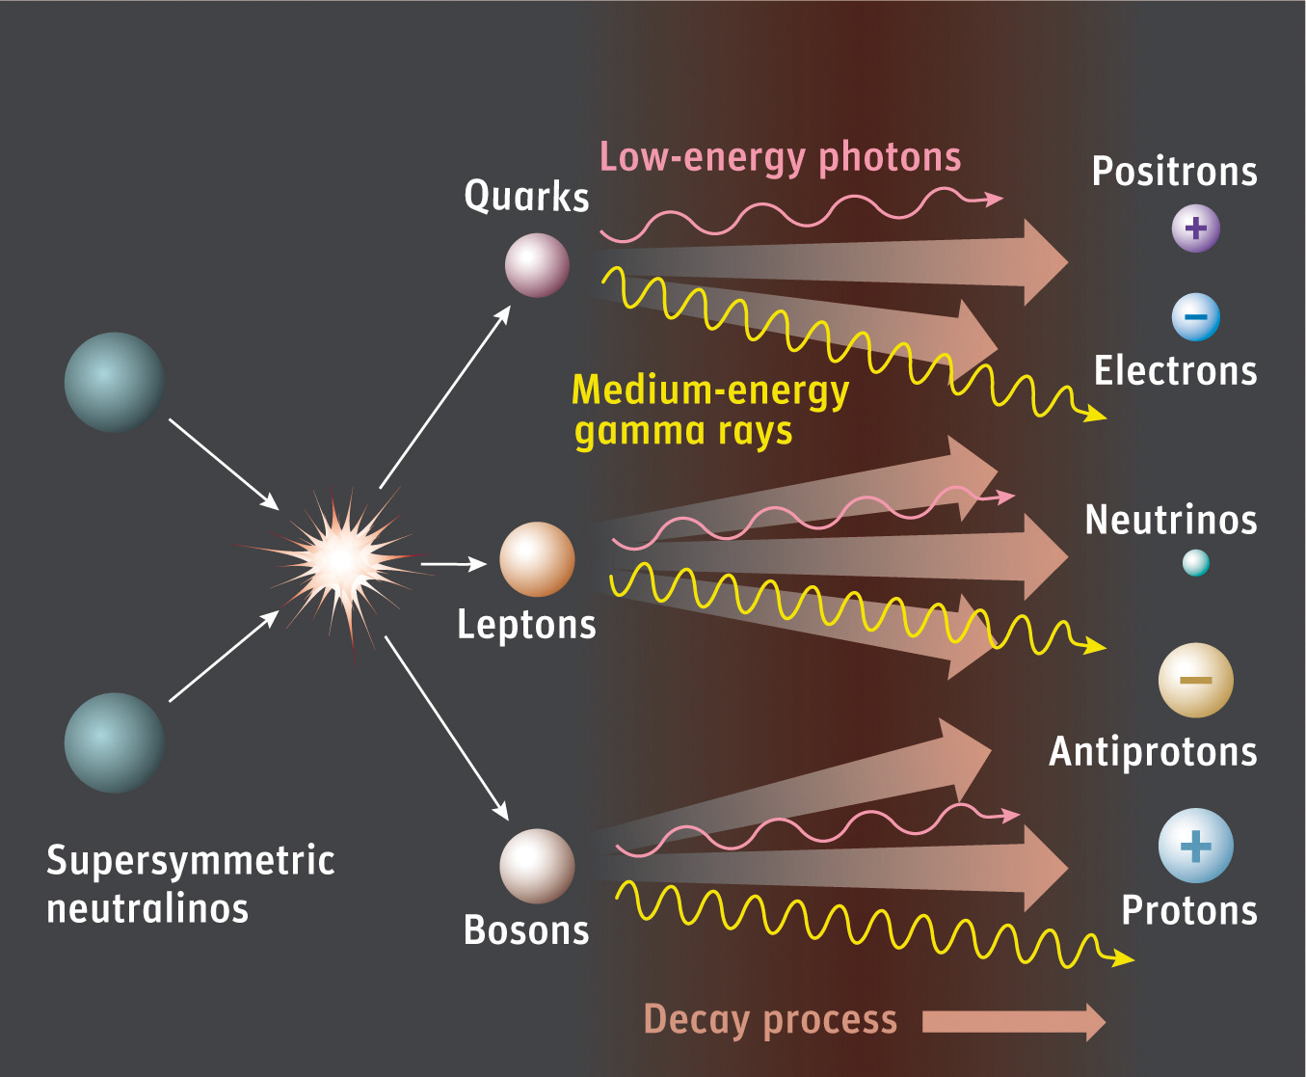
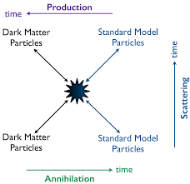
Dark matter decay/annihilation channels
DM decay/annihilation channels:
    Decaying DM (Picciotto & Pospelov 2005)
    Light (MeV) DM direct annihilation (Boehm et al. 2010)
    XDM excitation (Finkbeiner et al. 2007)
Notes:
Direct annihilation into e-e+ pairs
Collisions, then deexcitation into ground state

Slide 7
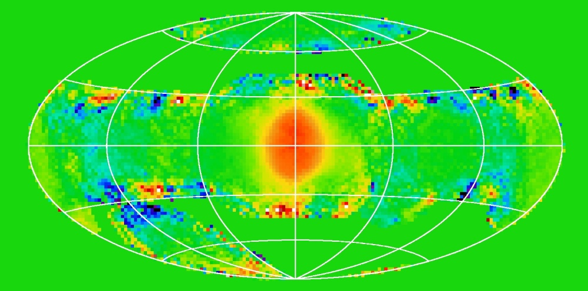
Galactic Centre
Siegert et al. (2016)
SPI/INTEGRAL

Slide 8
Other positron formation processes
Conventional (non-DM) channels:
    Black holes/Microquasars (pair production)
    Gamma ray bursts (pair production)
    Neutron stars (curvature radiation)
    Type I supernovae (radioactive decay – ⁵⁶Ni, ⁴⁴Ti, ²⁶Al, ¹³N)
    Cosmic rays

Slide 9
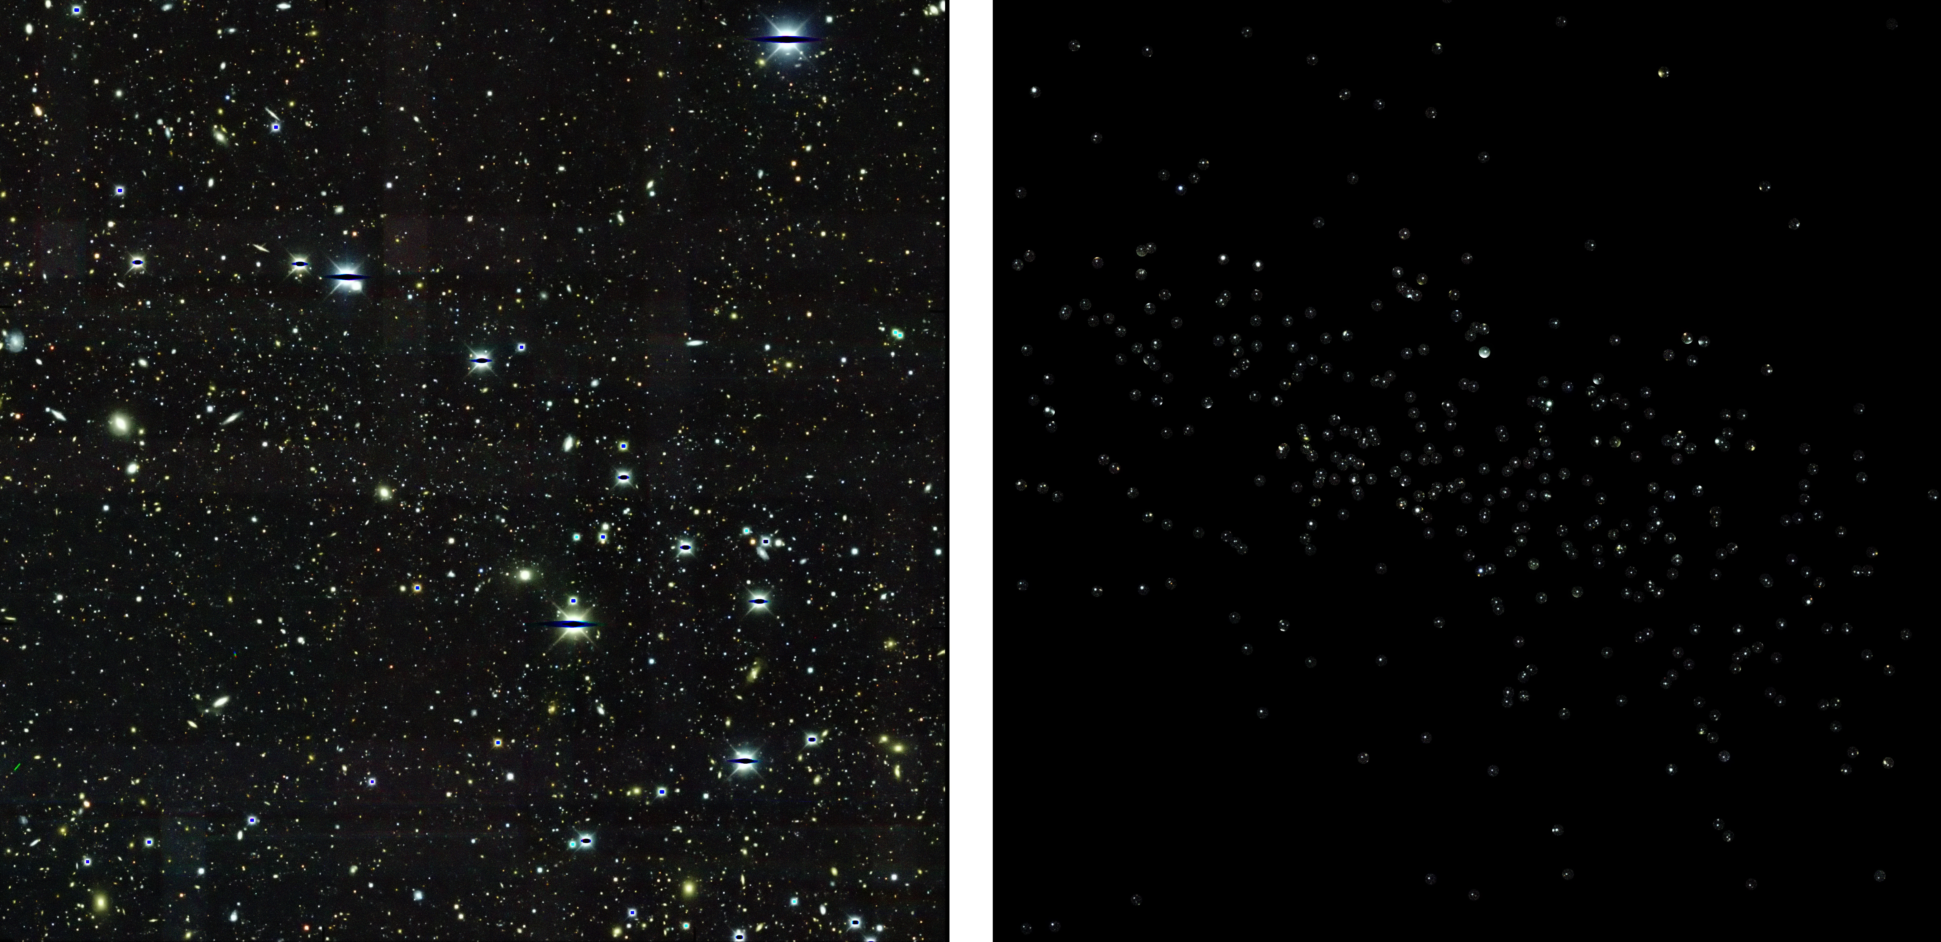
Reticulum II: ultra-faint dwarf galaxy
DES field
Ret II stars
Dark Energy Survey

Slide 10
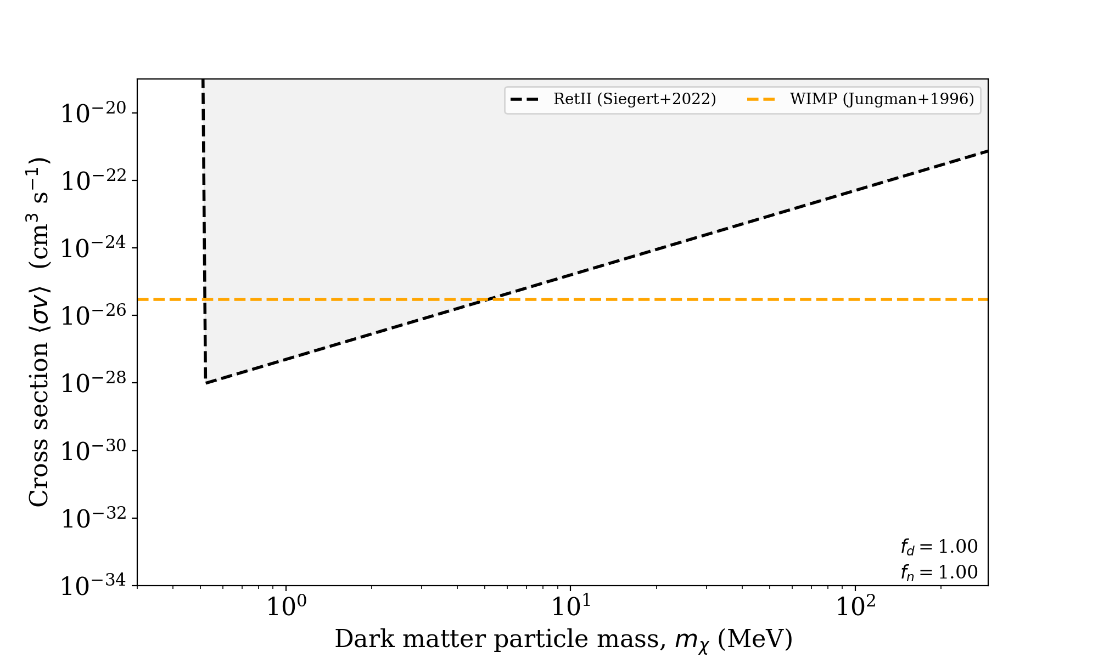
Excluded by gamma-ray limits

Slide 11
Tidal stripping of dwarf companion
Stellar and Dark matter core remains
(Peebles 1984; Freeman 1993; Wirth et al. 2020)
Forms massive globular cluster?
Credit: SDSS

Slide 12
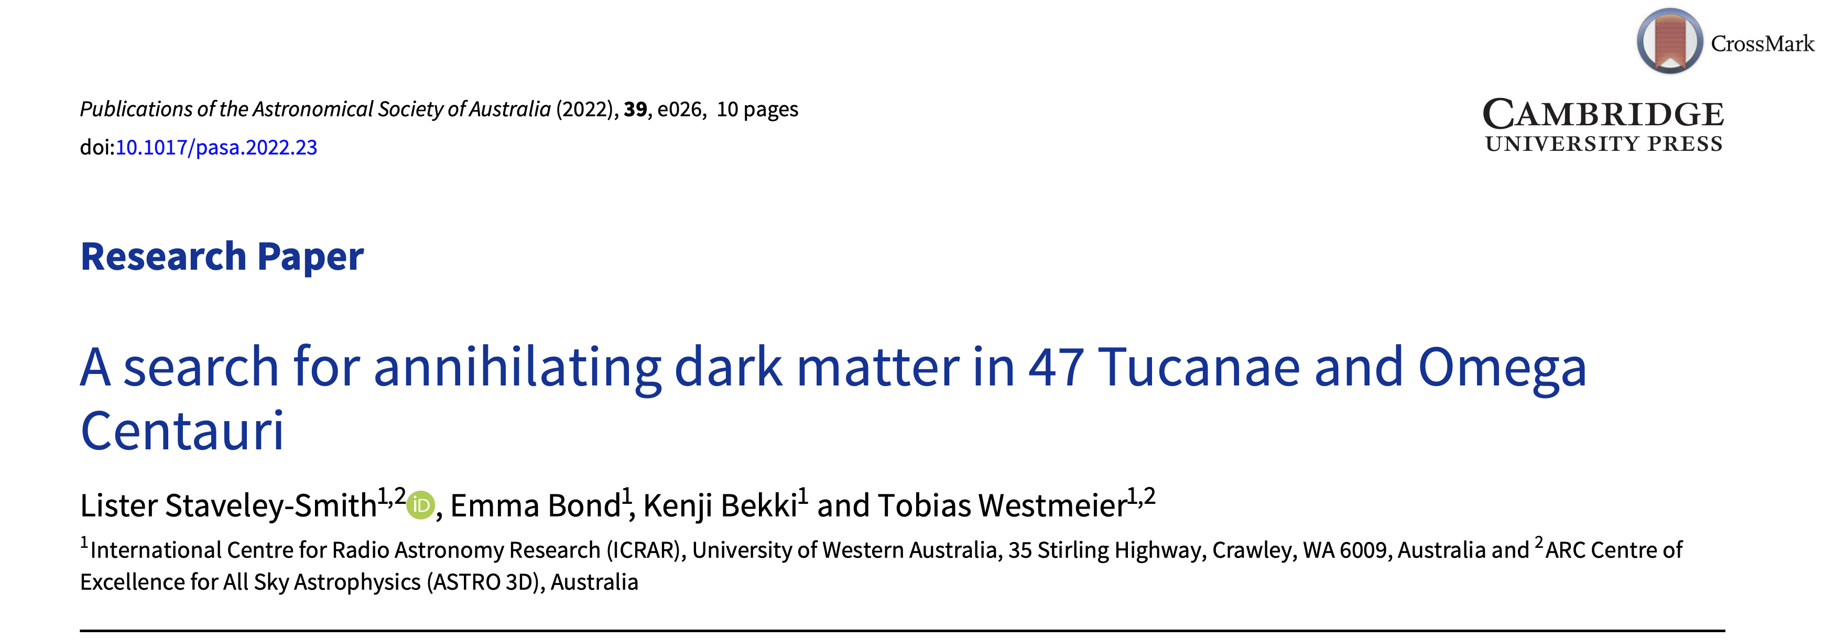

Slide 13
Galactic Centre
Siegert et al. (2016)
SPI/INTEGRAL

Slide 14
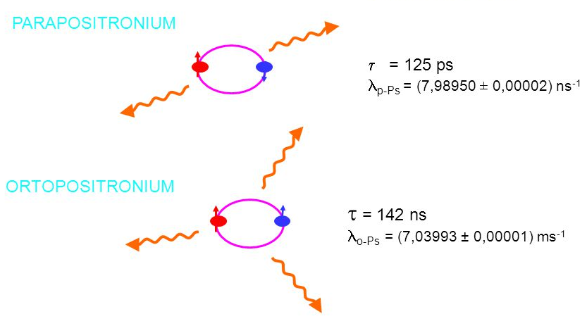
Positronium (Ps)
    Annihilation line (0.511 MeV)
    Hyperfine transition (λ1.48mm)
    Recombination lines

Slide 15
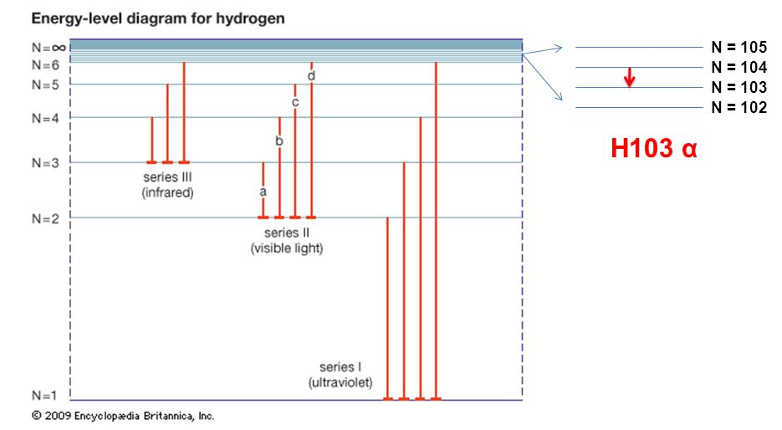
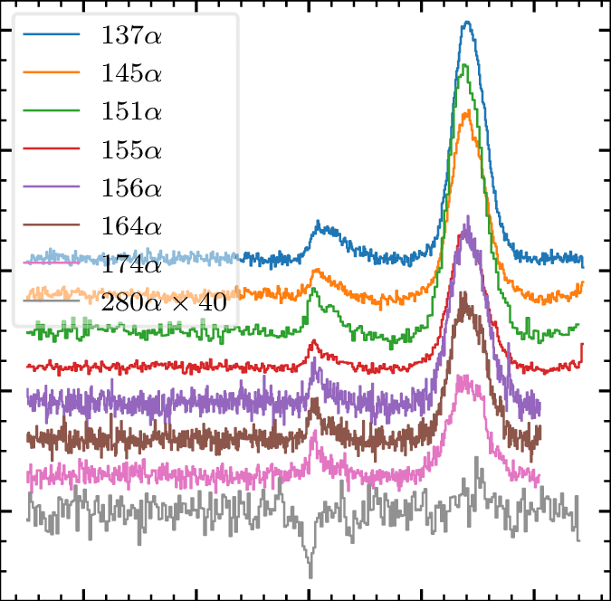
Radio recombination lines

Slide 16
Parkes observations
Galactic Centre
Reynolds et al. (2017) used an ASKAP phased array feed on Parkes and obtained:
3-sigma upper limit 90mK
Recombination rate <3x10⁴⁵ s⁻¹
(SPI Milky Way rate: 5x10⁴³ s⁻¹)

Slide 17
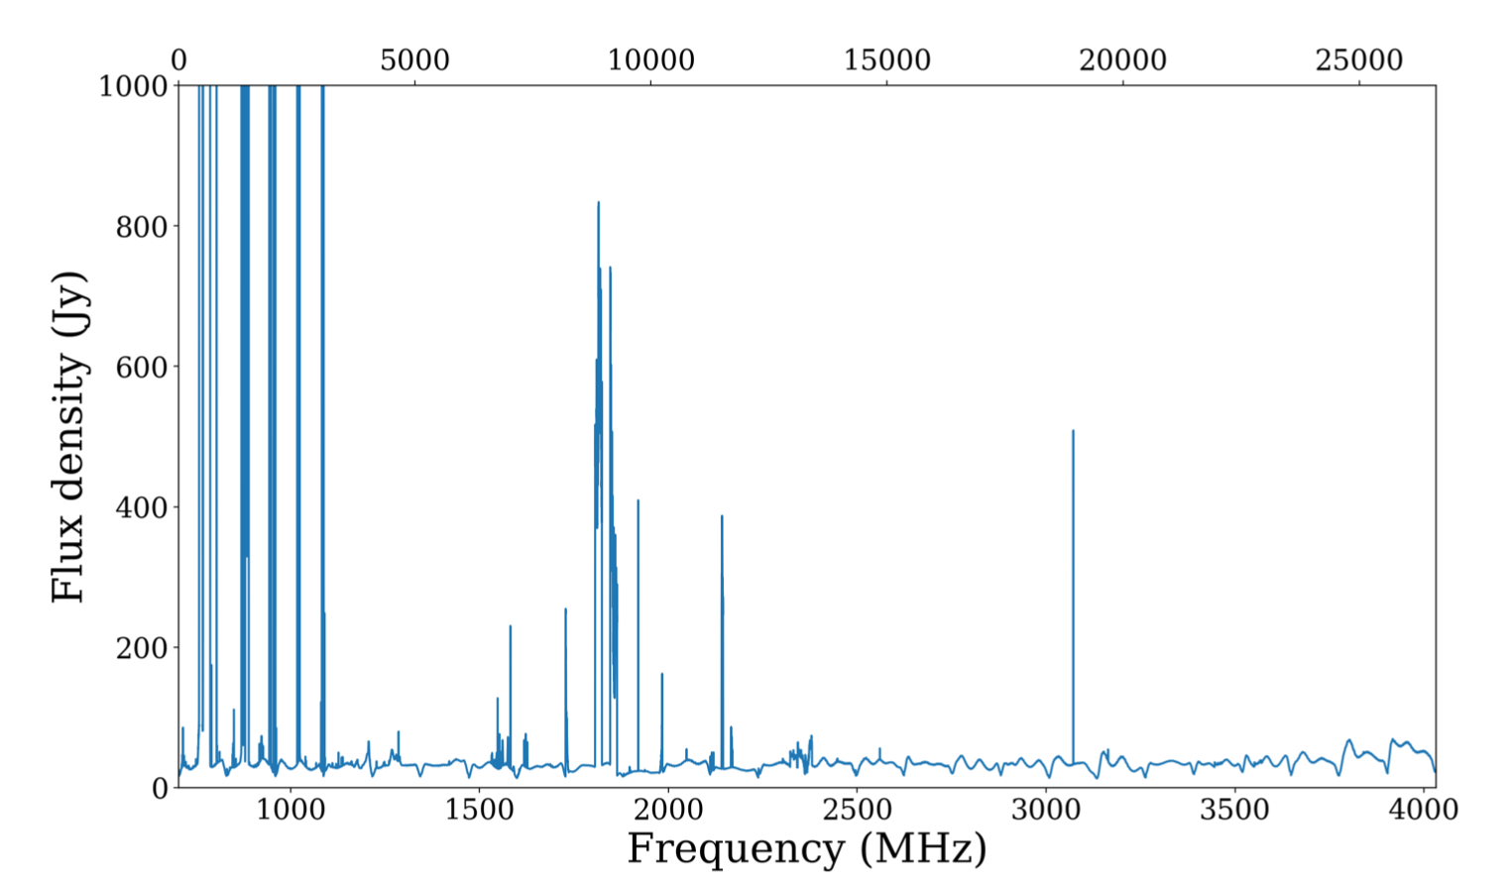
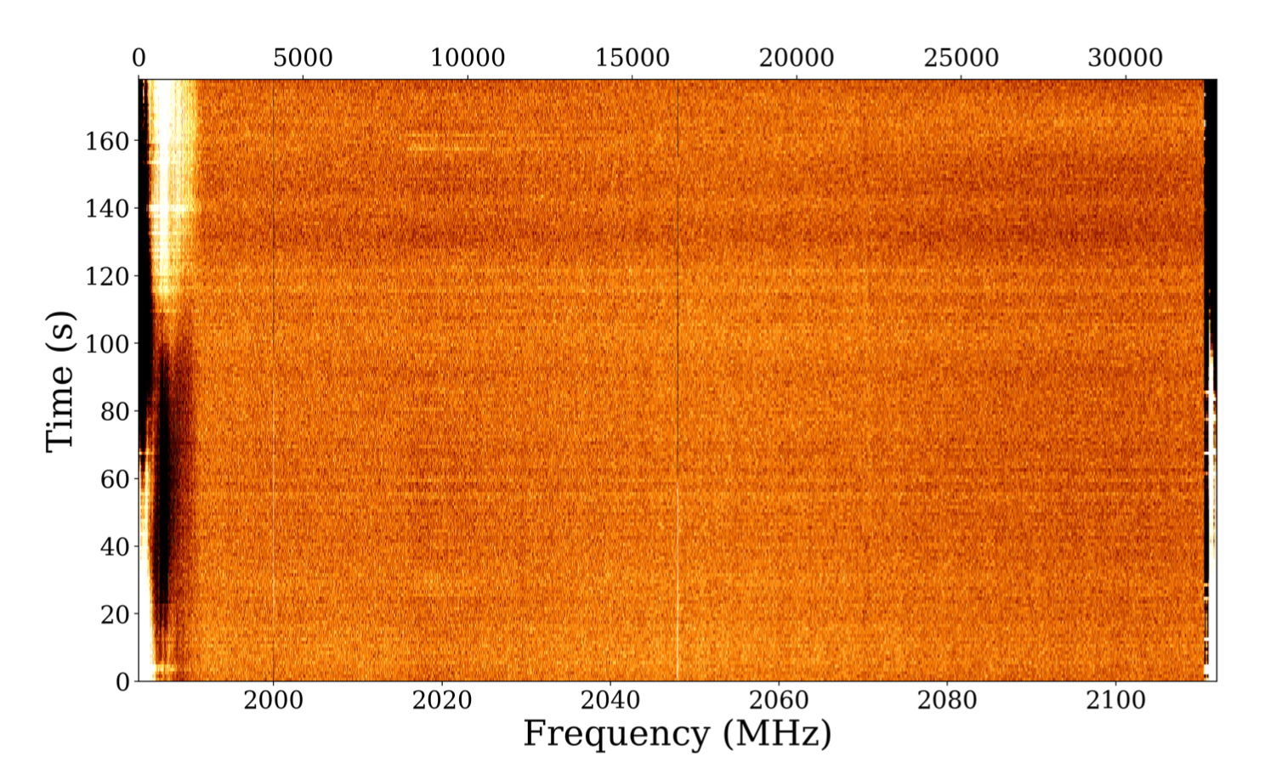
RFI
Parkes UWL spectrum of 47 Tuc (2020 Oct)
RFI

Slide 18
Stacking
Data (median-)averaged over time
    25 hrs on 47 Tuc
    20 hrs on Omega Cen
Also (median-)averaged over transition number
    20 lines for 47 Tuc (out of 73 in band)
    26 lines for Omega Cen
Equivalent to 1000 hrs of observing time

Slide 19
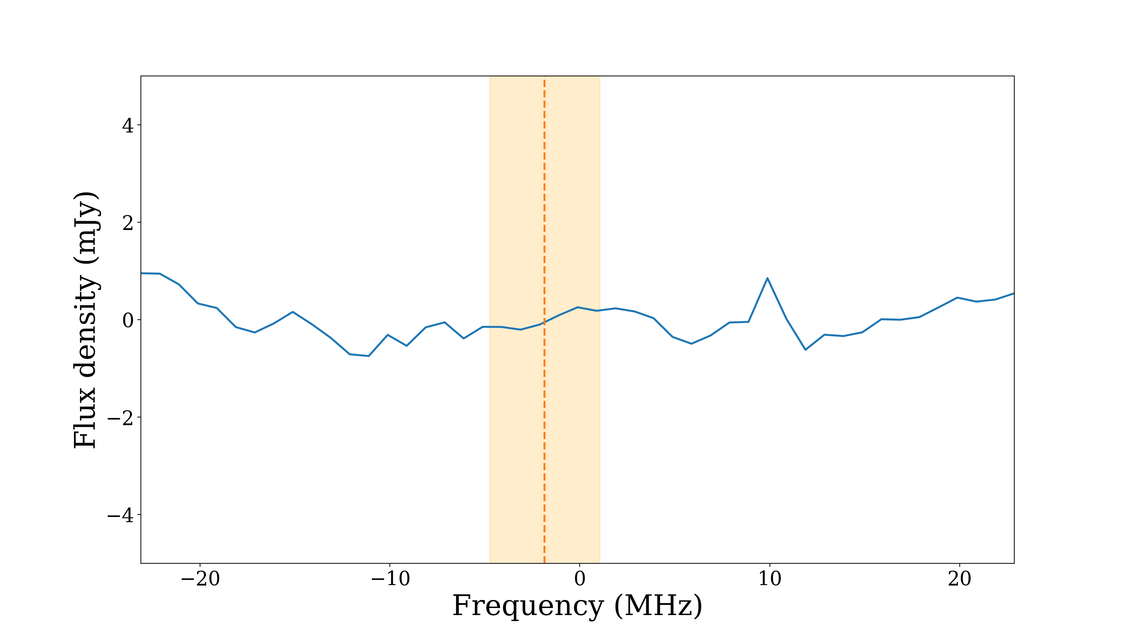
100x tighter limits than Reynolds+ (2017)
Final stacked spectrum (Omega Cen)

Slide 20
Implications (e.g. Omega Cen)
Light Dark Matter (LDM) density
    < 50 M⦿pc⁻³
LDM mass
    < 10⁵ M⦿
LDM-to-stellar mass ratio
    < 1%
LDM annihilation cross-section
    < 10⁻³⁰ cm³ s⁻¹

Slide 22
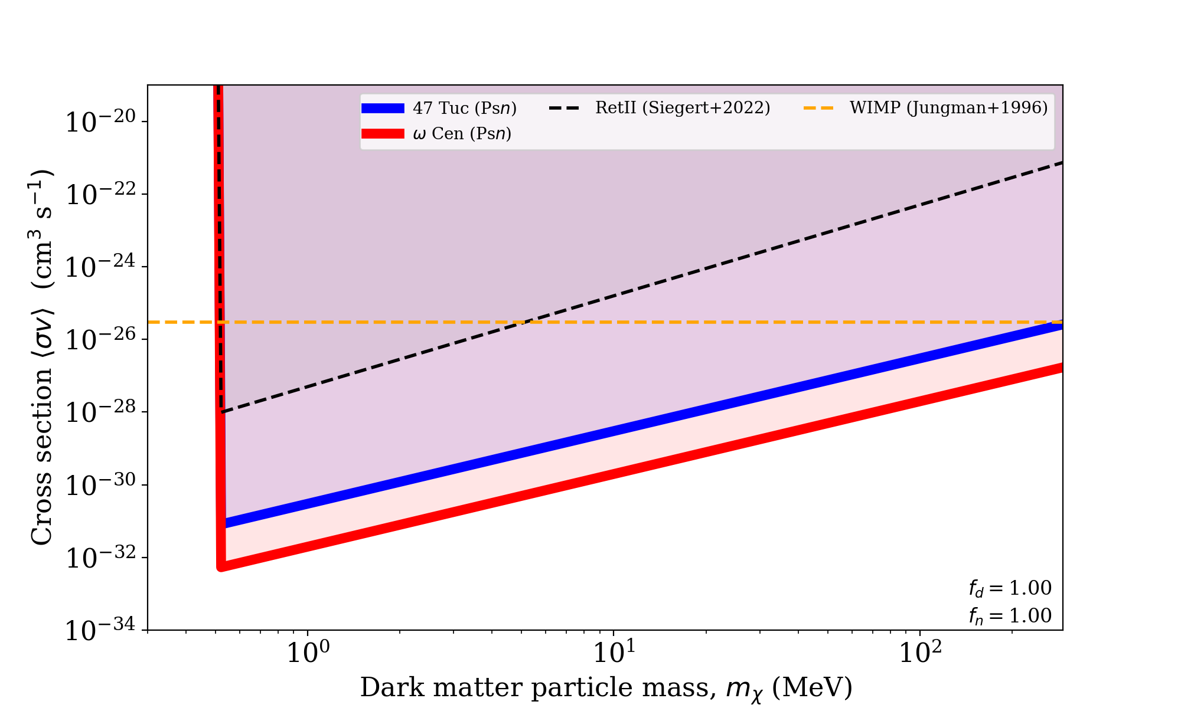

Slide 23
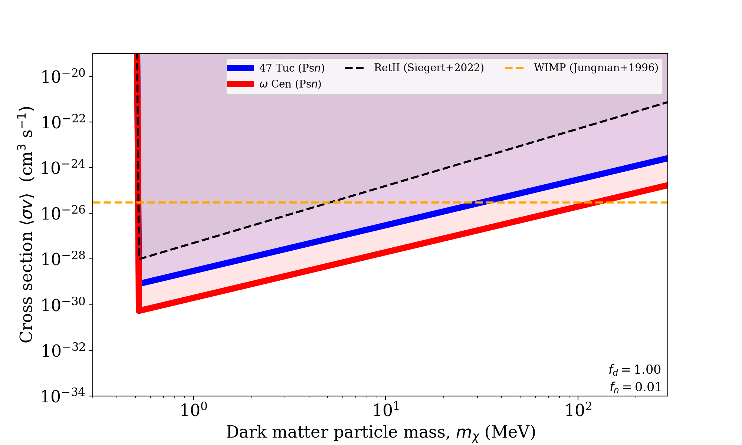

Slide 24
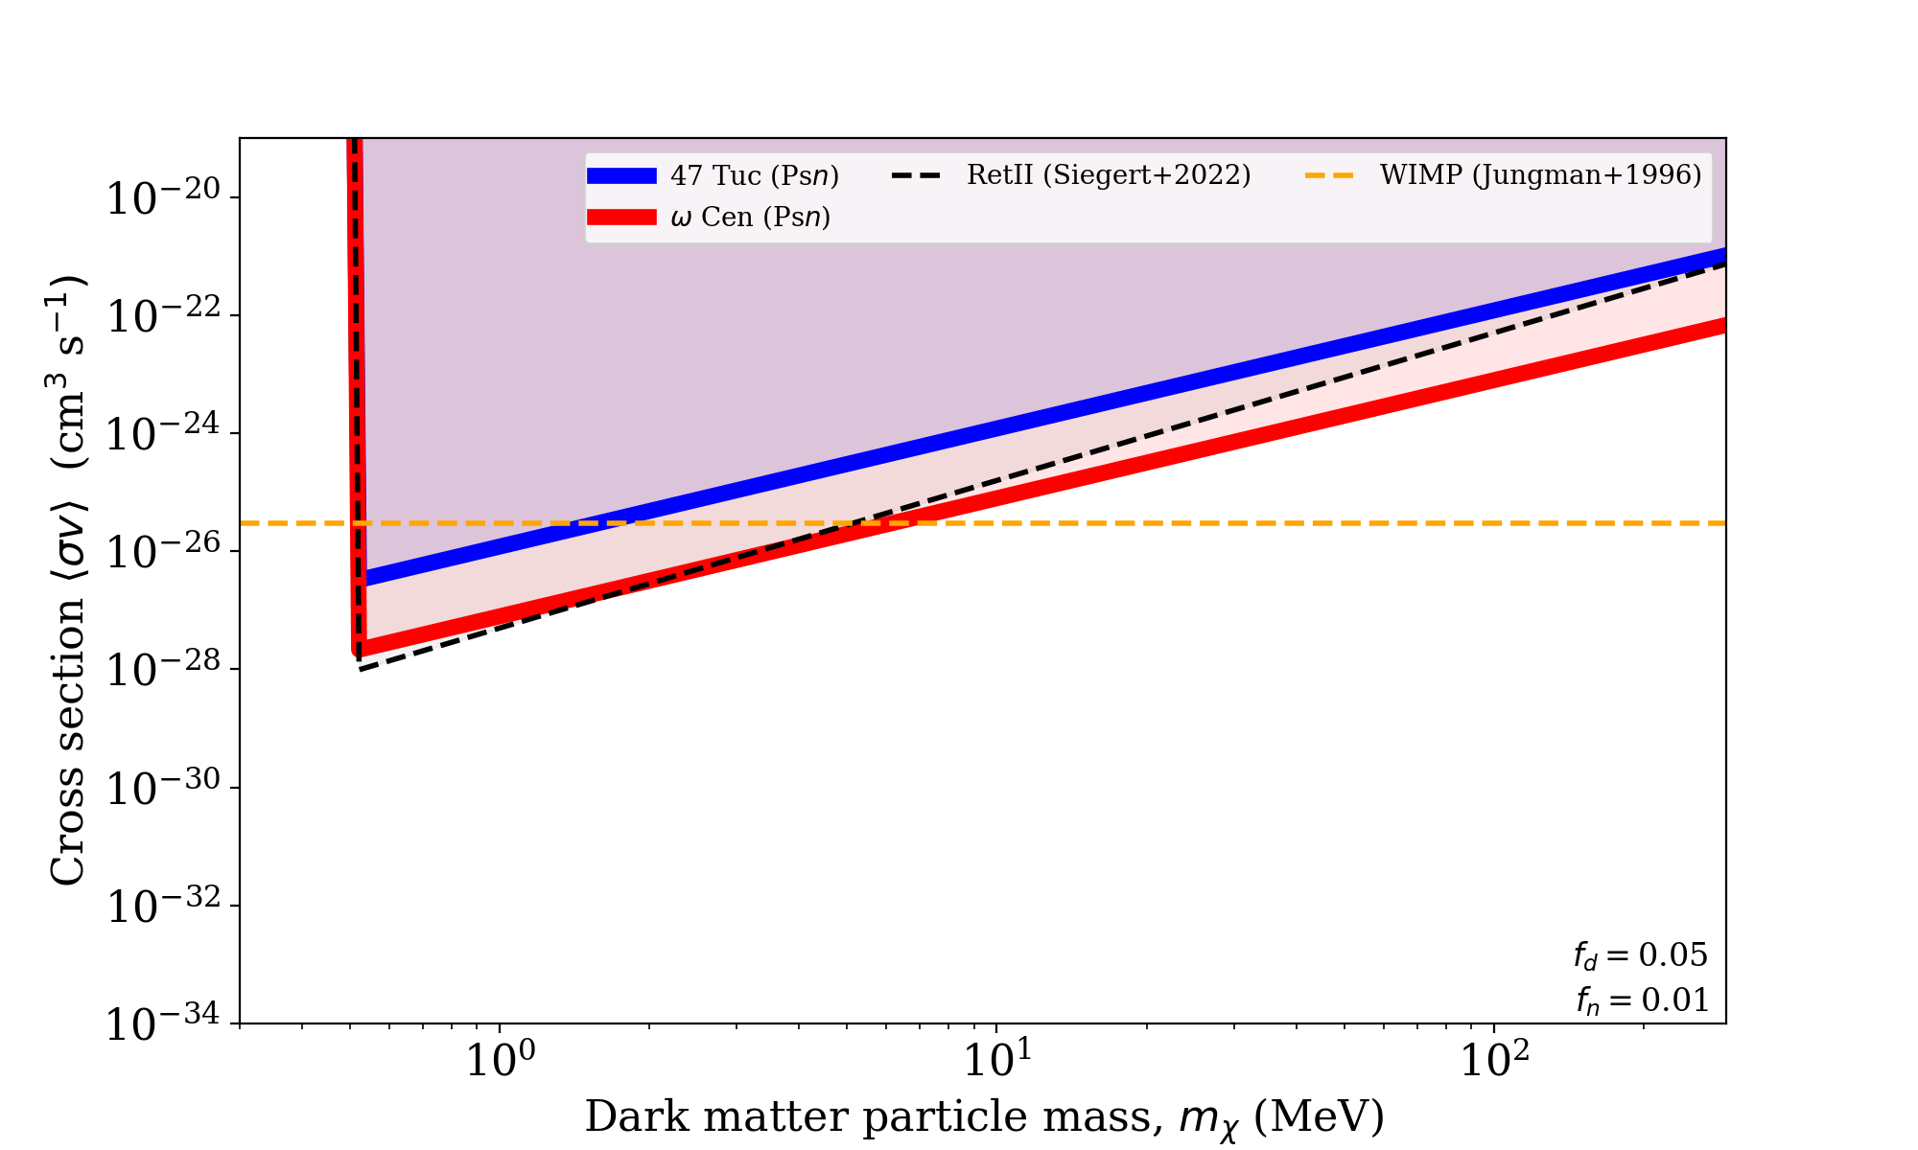

Slide 25
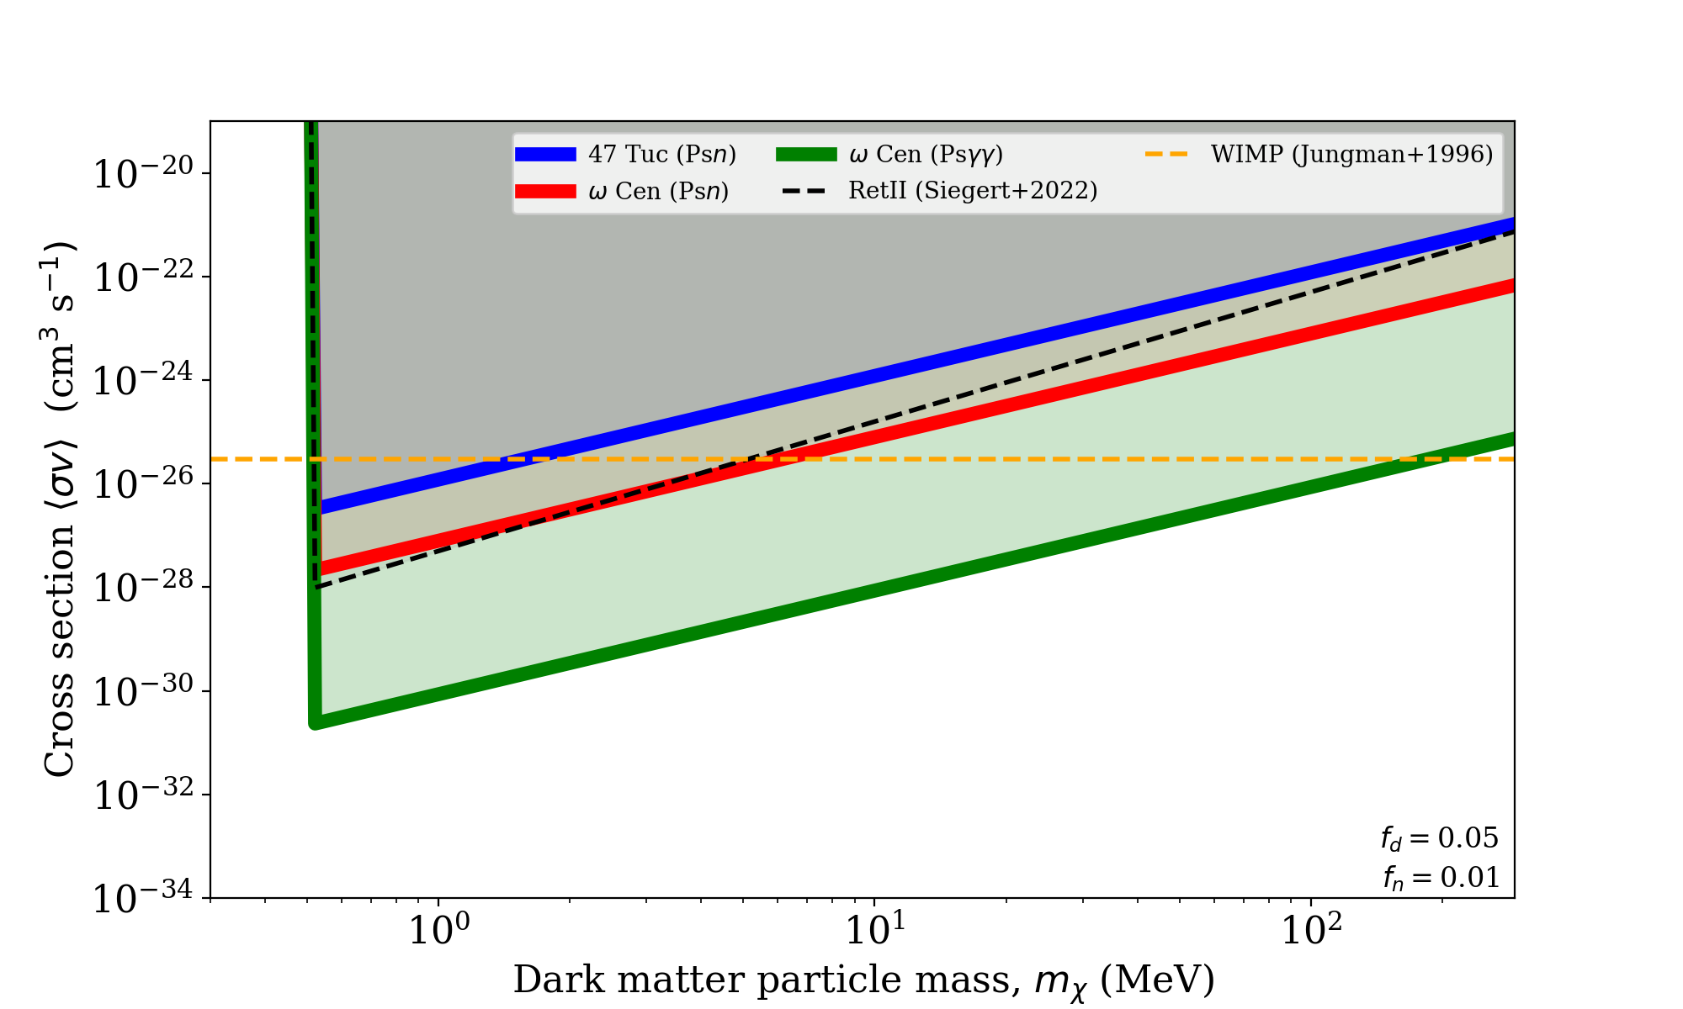

Slide 26
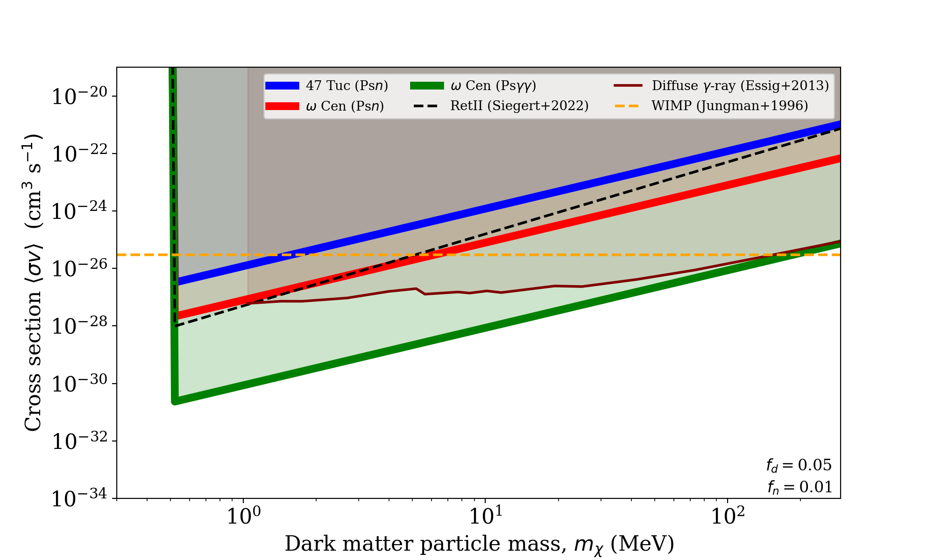

Slide 27
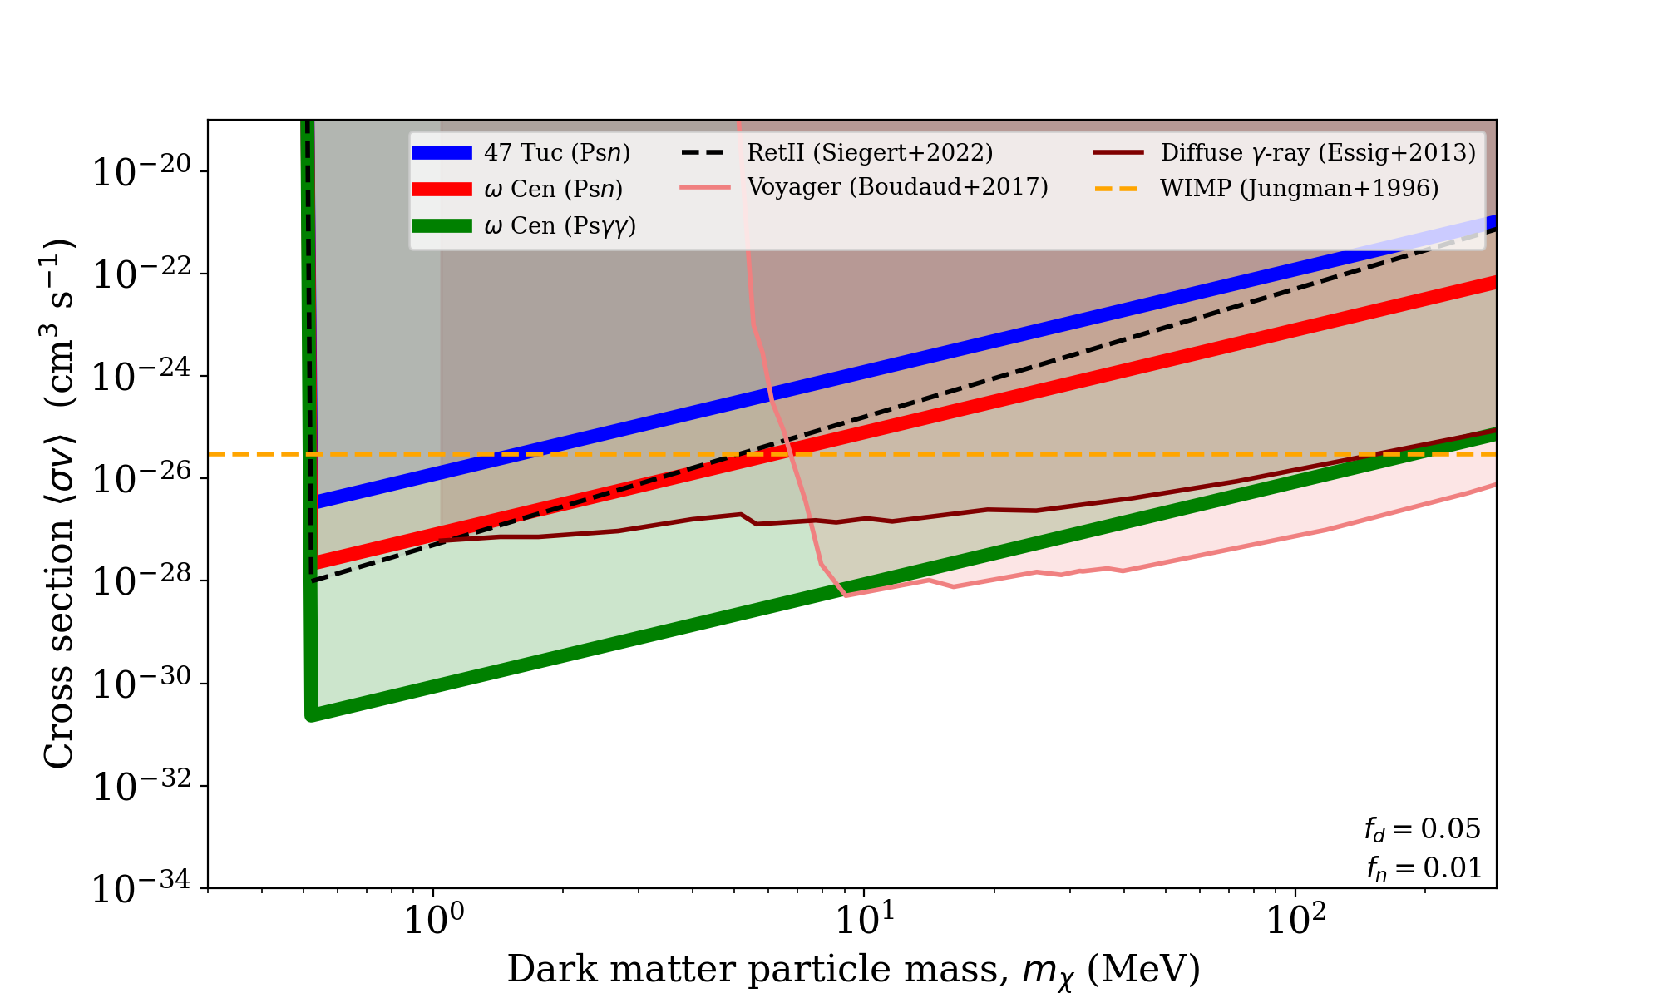

Slide 28
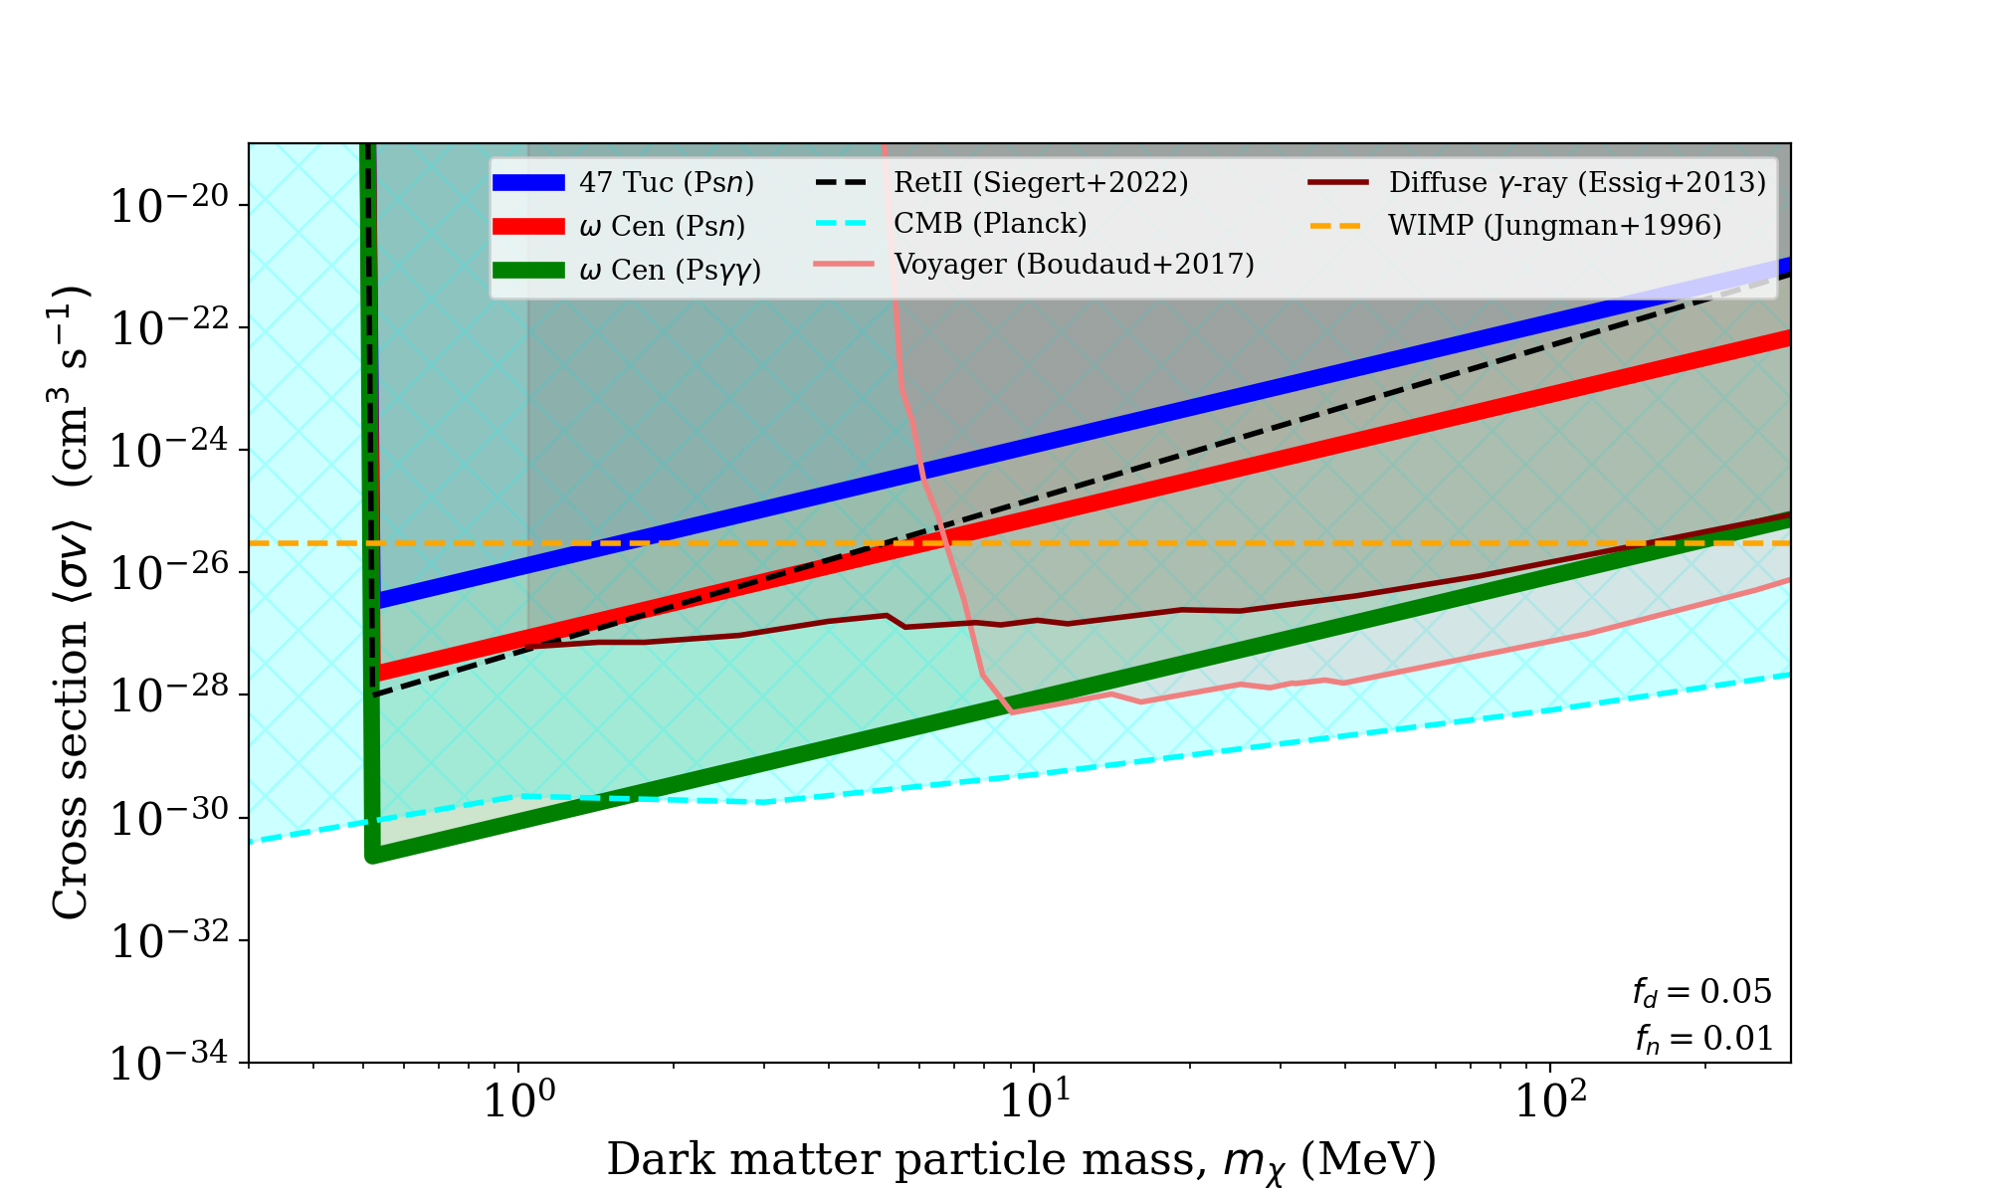

Slide 29
Summary and future prospects
    Some of best limits for MeV dark matter self-interactions
    Better gamma-ray telescopes needed (COSI: 2025+)
    Radio spectral calibration still 10x worse than theoretical (light atom = broad lines)
      new calibration methods and receivers needed
    Need better HST/GAIA/spectroscopic observations of globular clusters to better understand DM fractions
    Need improved understanding of:
      Ps level populations as a function of T and H & dust content
      Radiative combination cascades
    WALLABY (ASKAP survey) will find lots of local gas-rich dwarfs
    Thanks to Ken for his contributions to the study of dark matter!

