Slide 1
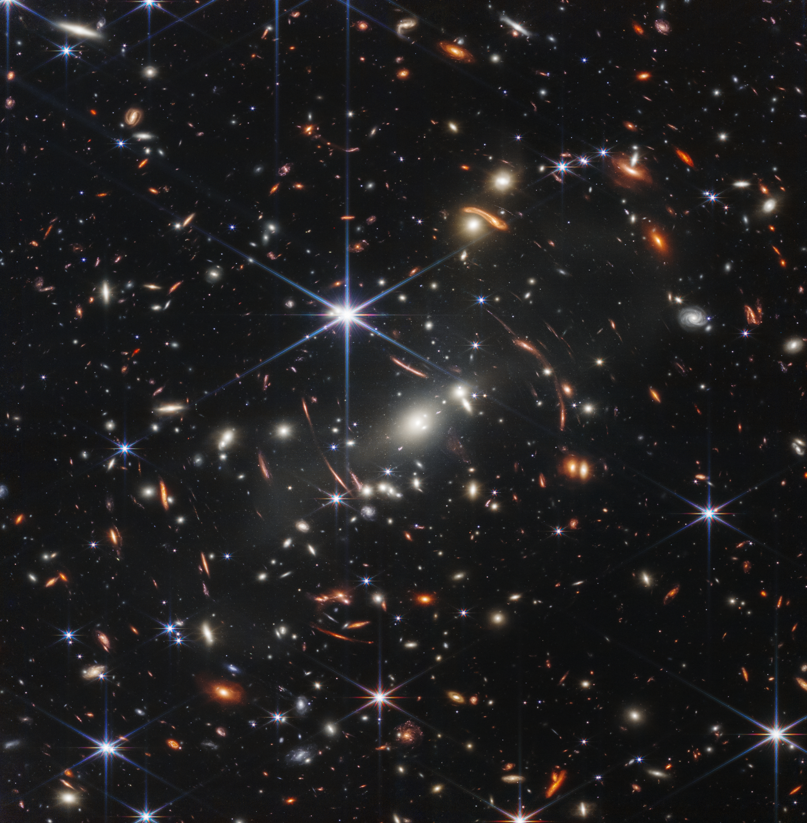
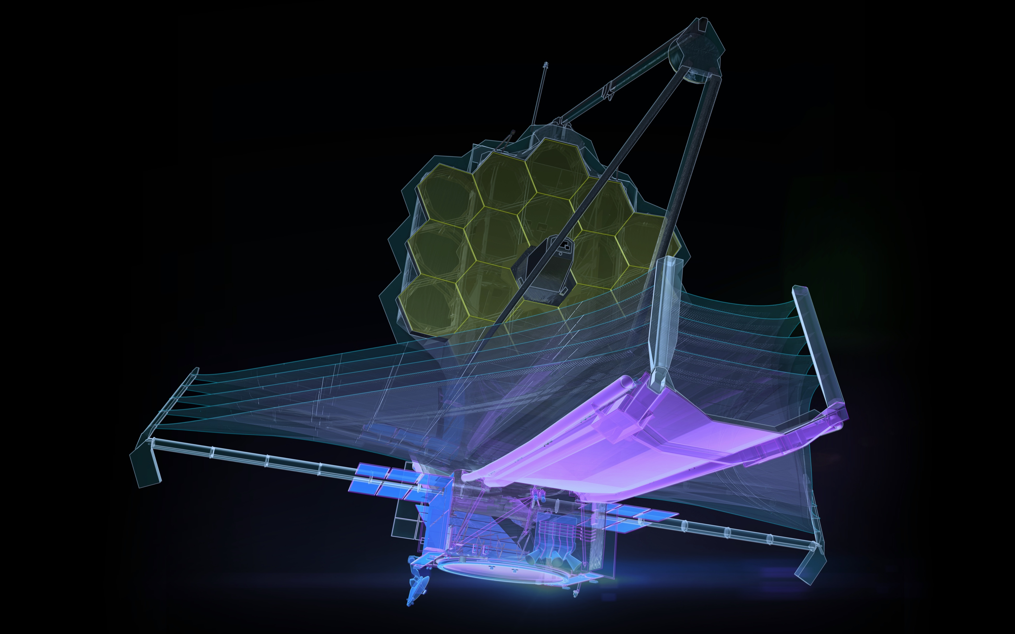
.
KCF@80+
Perth 09/2022
JWST’s First Insights into Galaxy Formation and Growth
NGST’s 1990s goal of seeing “First Galaxies” is being realized …….sort of……
numero uno
año 1973 (ret?)
gdi

Slide 2
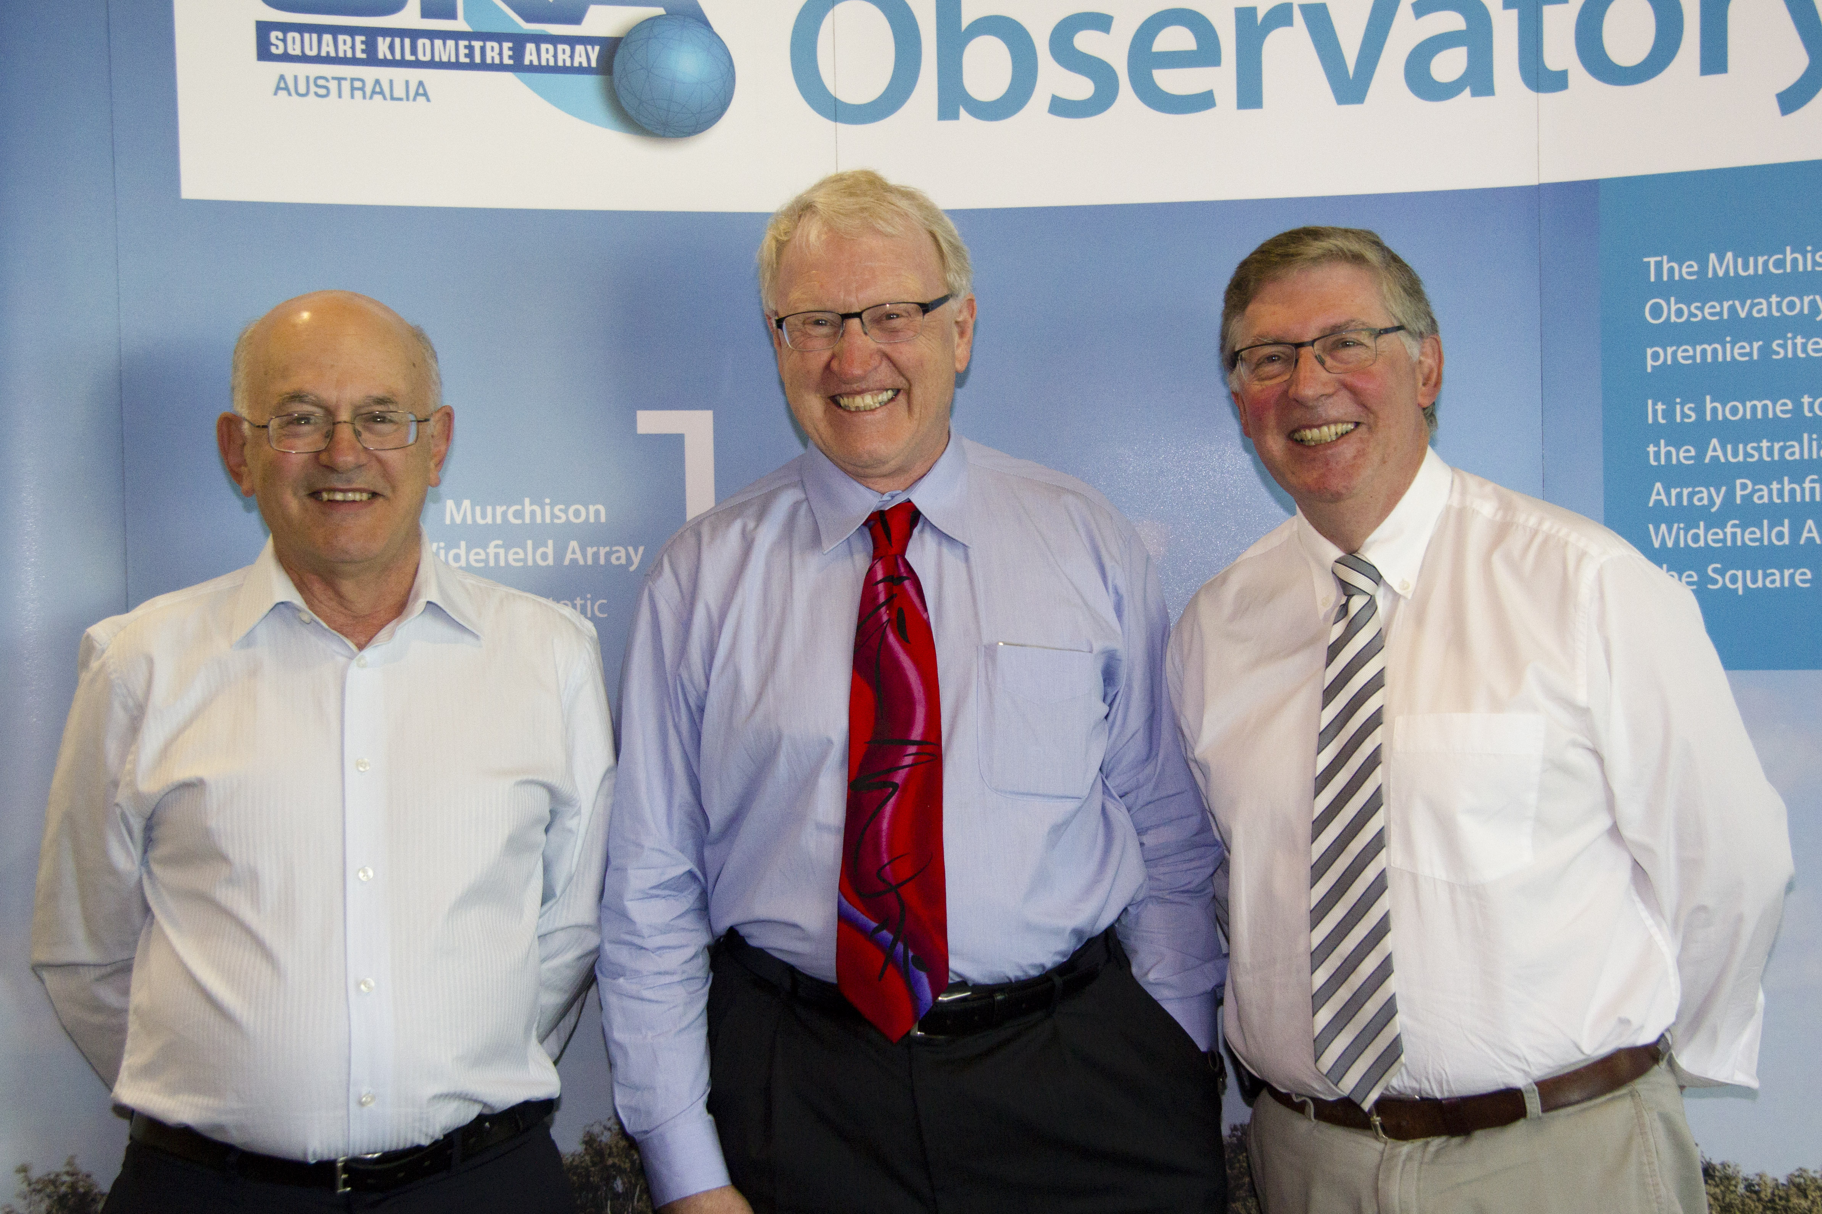
.
KCF@80+
Perth 09/2022
JWST’s First Insights into Galaxy Formation and Growth
thanks to Peter Quinn, the Organizers and the ICRAR staff for persevering on KCF@80
NGST’s 1990s goal of seeing “First Galaxies” is being realized …….sort of……
numero uno
ano 1973 (ret?)
gdi

Slide 3
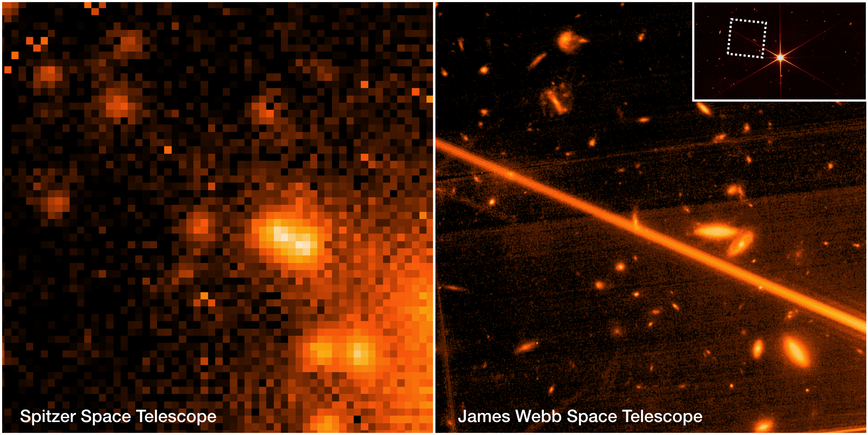
Spitzer-Webb comparison
gdi
image comparison from Gabe Brammer – 3 hrs Spitzer 30 min Webb

Slide 4
the enigma of Hubble’s GN-z11
gdi

Slide 5
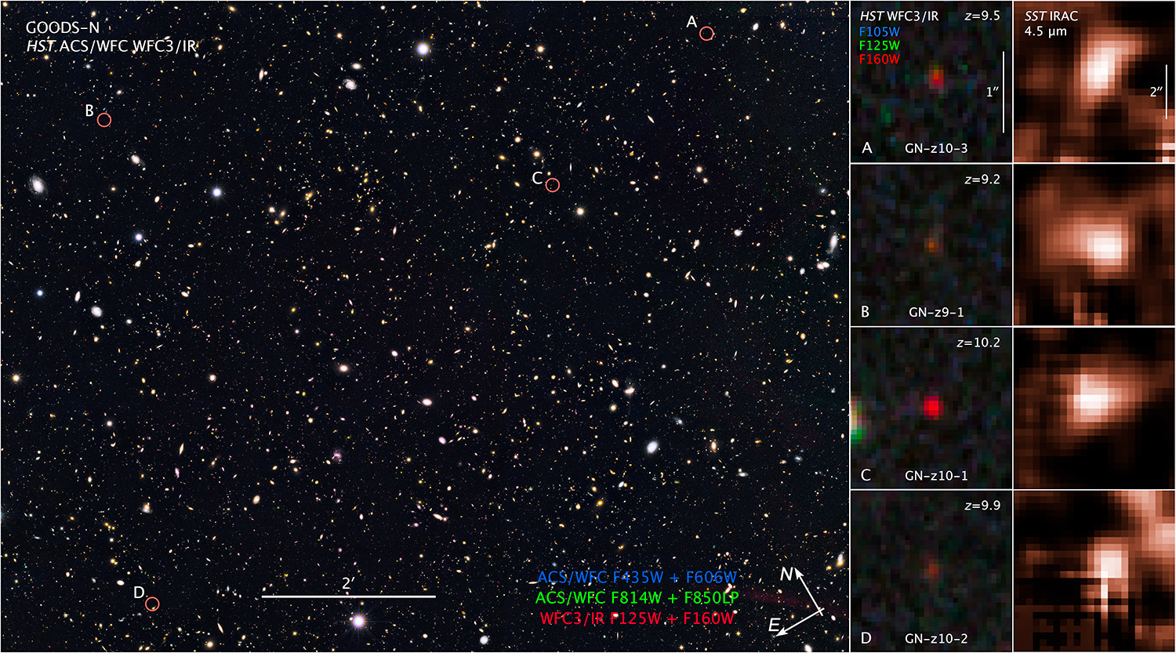
z~10 - 500 Myr
model spectra
gdi
Oesch + 2014
Hubble
Spitzer

Slide 6
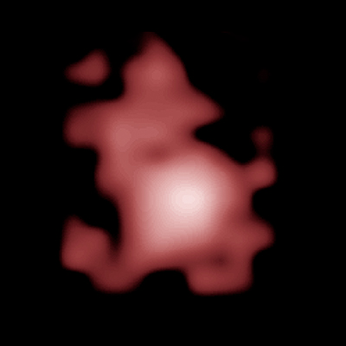
GN-z11
model spectra
gdi
Oesch + 2014, 2016
Hubble
Spitzer

Slide 7
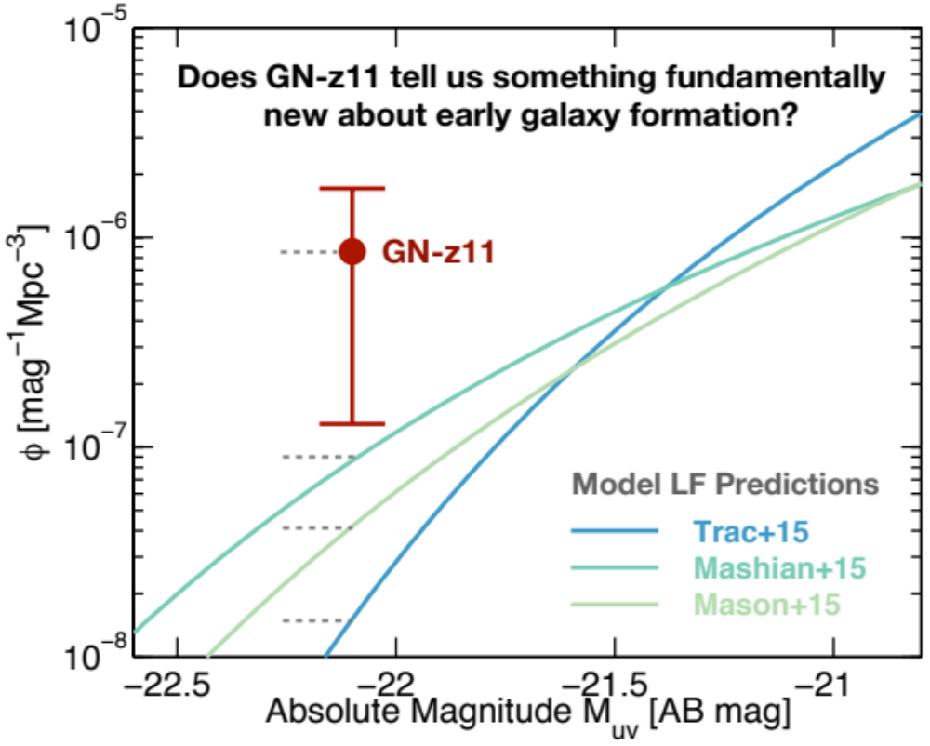
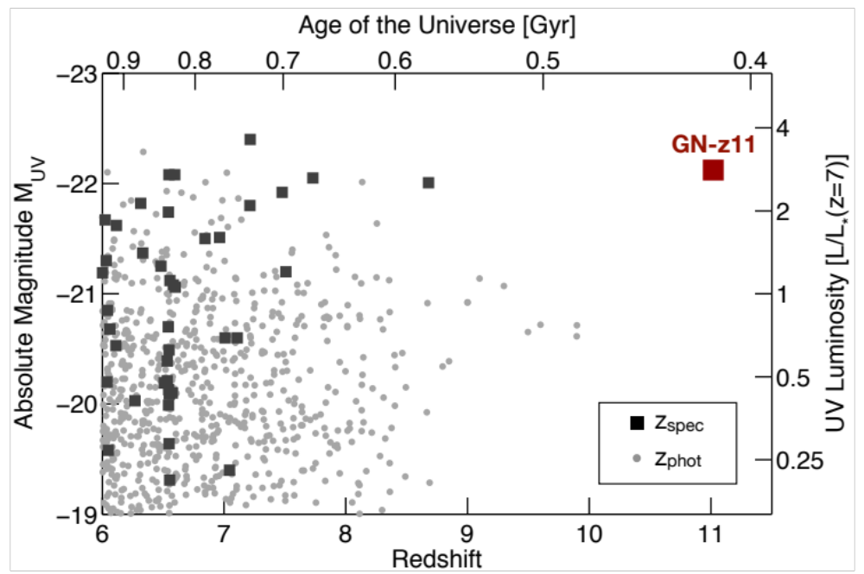
the most distant galaxy found to date
surprising discovery of GN-z11:
HST+Spitzer are reaching into JWST territory
model luminosity functions
Go JWST!
10 – 50x
◼︎
detection of GN-z11 in existing data is unexpected, given current models
Oesch+2016
gdi

Slide 8
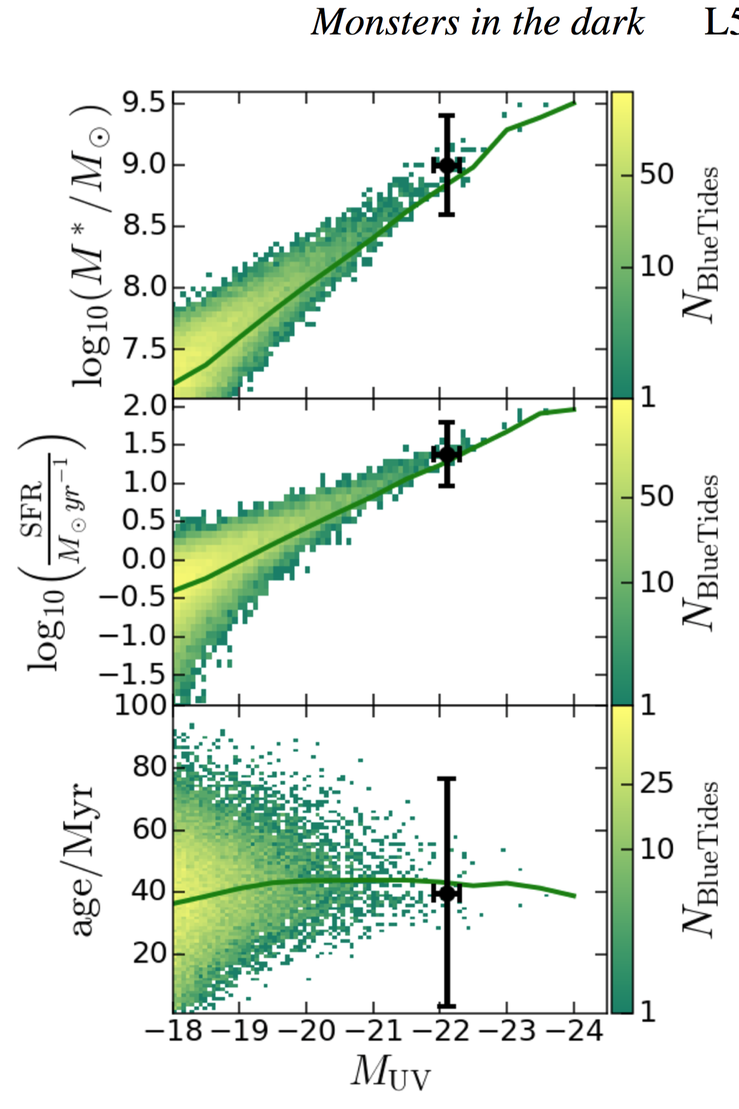
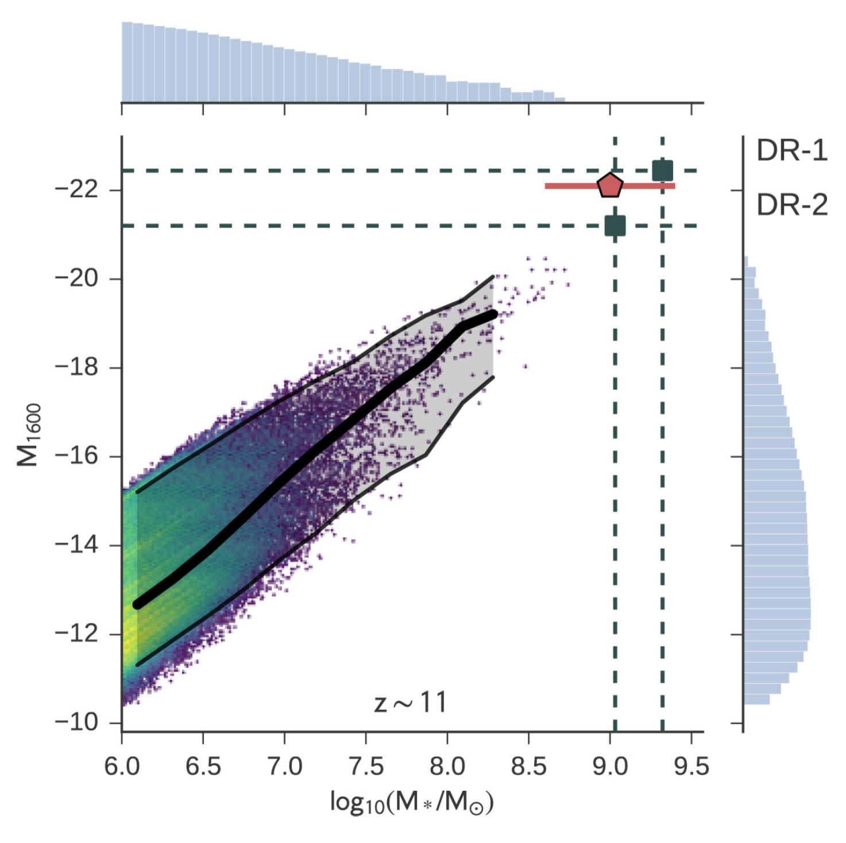
GN-z11
simulations show that galaxies as massive as GNz-11 at z~11 are rare but not unexpected per se
GN-z11 observed properties
mass 10⁹ M⨀ SFR 24 M⨀/yr
𝛽 -2.5 A_{UV} <0.2 mag age 40 Myr
BlueTides
Waters+2016
Mutch+2016
DRAGONS
gdi

Slide 9
GN-z11
simulations show that galaxies as massive as GNz-11 at z~11 are rare but not unexpected per se
GN-z11 observed properties
mass 10⁹ M⨀ SFR 24 M⨀/yr
𝛽 -2.5 A_{UV} <0.2 mag age 40 Myr
the derived physical properties of GN-z11 are consistent with expectations from large-volume simulations
but it is unexpected to find GN-z11 in such small search volumes/areas (by factor 10-100)?
BlueTides
Waters+2016
Mutch+2016
DRAGONS
gdi

Slide 10
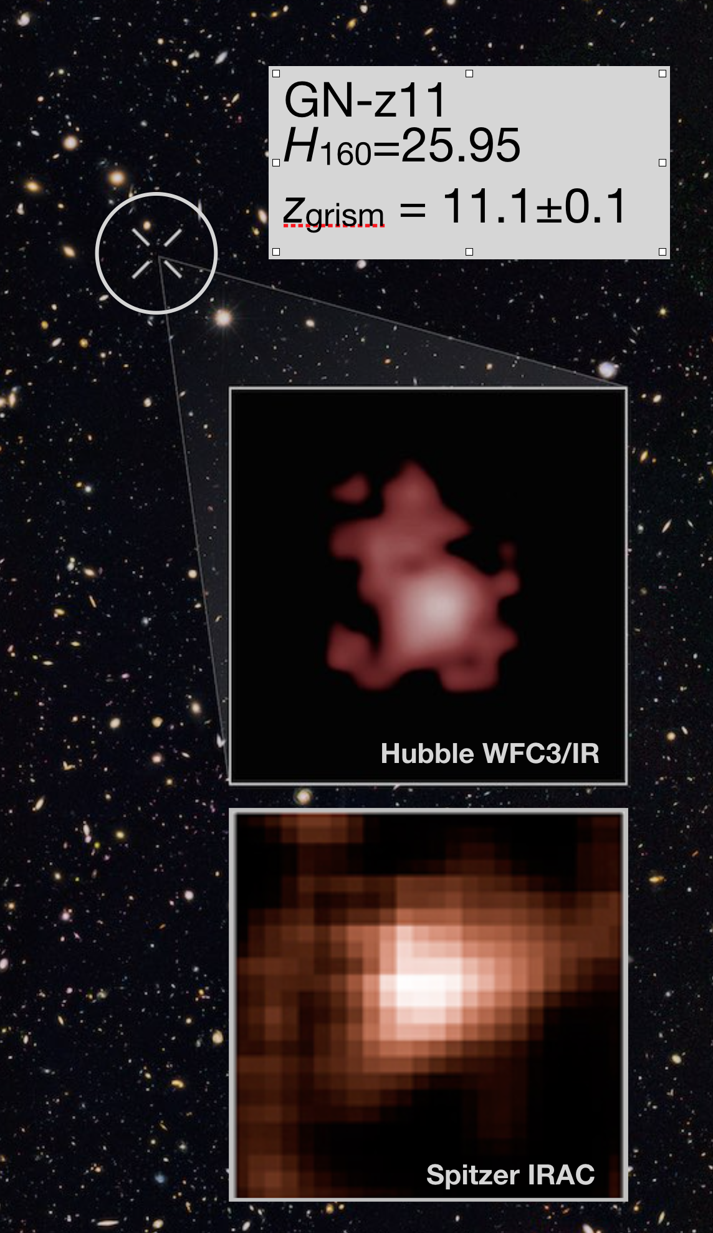
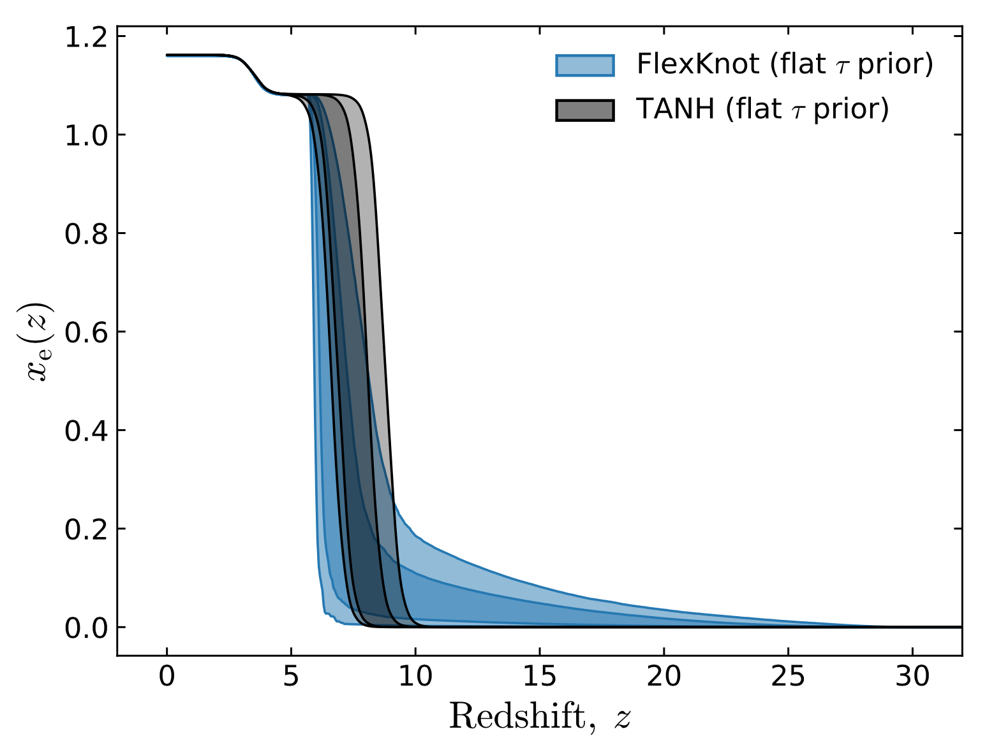
GN-z11 is a galaxy essentially in the pre-reionization epoch — an epoch we thought was inaccessible without JWST!
GN-z11
the most distant galaxy
free electron fraction
essentially all reionization takes place since z~10
free electron fraction
@ ~480 Myr
GN-z11 is a pathfinder for the earliest galaxies
GN-z11
@ 420 Myr
Planck Collaboration VI 2018
Planck Collaboration Results I, VI 2018
gdi

Slide 11
what Planck tells us
charts from a 2018/2019 talk
gdi

Slide 12
Planck 2016/2018
constraints on the reionization history
…Thomson optical depth: τ = 0.054 ± 0.007
…mid-point redshift at which reionization occurs is found to lie at z = 7.7 ± 0.7
…upper limit to the width of the reionization period of ∆z < 2.8.
…the Universe is ionized at much less than the 10% level at redshifts above z ≃ 10… (<1% above z ≃15)
…an early onset of reionization is strongly disfavored by Planck data
Planck Collaboration XLVII + 2016
Planck Results VI Cosmological Parameters + 2018
Planck Results I Overview and Legacy + 2018
these are quotes!
gdi

Slide 13
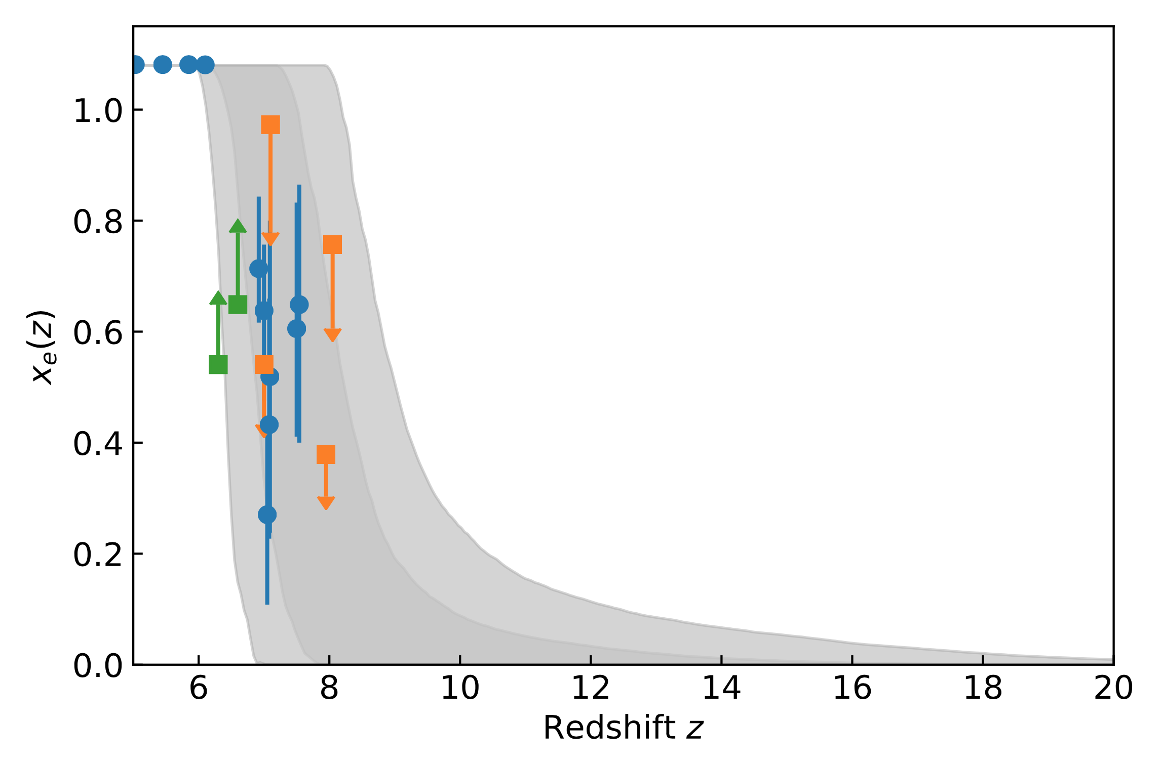
reionization constraints from Planck 2018
free electron fraction
essentially all reionization takes place between z~10 and z~6
free electron fraction
Planck Collaboration VI 2018
Planck Collaboration Results I + 2018
….Planck data prefer a late and fast transition from a neutral to an ionized universe…
….non-standard early galaxies or significantly evolving escape and clumping factors are no longer required.
….nor do the Planck results actually require any emission from high-redshift (z = 10–15) galaxies.
gdi

Slide 14
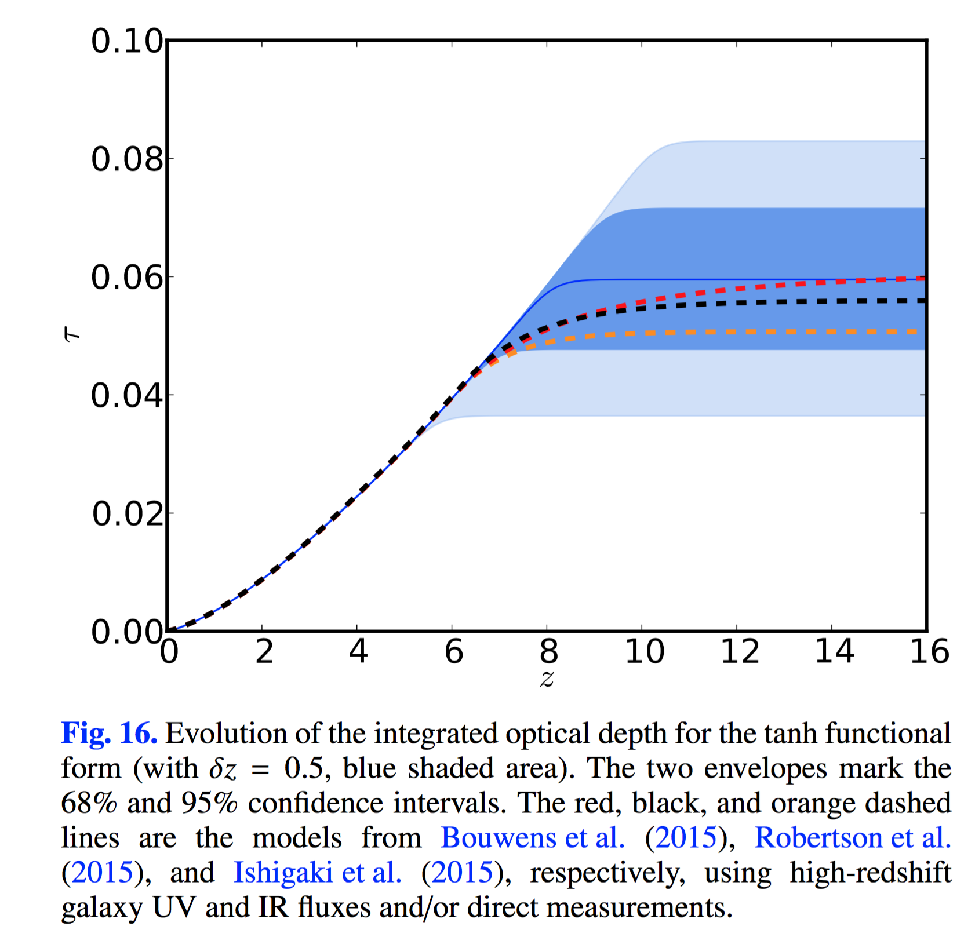
reionization history compared with observational astrophysical constraints
evolution of the Planck integrated optical depth
95%
68%
Bouwens+2015
Robertson+2015
Ishigaki+2015
Planck 2016 τ
Planck 2018 τ
Planck compared to galaxy results
striking consistency with Hubble results
indicates that galaxies were responsible for reionization
figure from Planck Collaboration XLVII + 2016
gdi

Slide 15
reionization history compared with observational astrophysical constraints
evolution of the Planck integrated optical depth
95%
68%
Bouwens+2015
Robertson+2015
Ishigaki+2015
Planck 2016 τ
Planck 2018 τ
Planck compared to galaxy results
“With the present value of τ, if we maintain a UV-luminosity density at the maximum level allowed by the luminosity density constraints at redshifts z < 9, then the currently observed galaxy population at M_{UV} < −17 seems to be sufficient to comply with all the observational constraints without the need for high-redshift (z = 10–15) galaxies.”
figure from Planck Collaboration XLVII + 2016
Planck intermediate results XLVII. Planck constraints on reionization history 2016
gdi

Slide 16
reionization constraints from Planck 2018
free electron fraction
essentially all reionization takes place between z~10 and z~6
free electron fraction
Planck Collaboration VI 2018
Planck Collaboration Results I + 2018
we now know when
galaxies really began to reionize the universe (at z<10)
this is a crucial piece of information re the epoch of the first galaxies
….Planck data prefer a late and fast transition from a neutral to an ionized universe…
….non-standard early galaxies or significantly evolving escape and clumping factors are no longer required.
….nor do the Planck results actually require any emission from high-redshift (z = 10–15) galaxies.
gdi

Slide 17
Webb’s astonishing luminous galaxies earlier than z~10 (~500Myr)
gdi

Slide 18
ERO #1: galaxies in the young universe
a cluster of galaxies about 4 billion years away – magnifying (and distorting) all galaxies behind it
deepest infrared image ever
12 hours on Webb is comparable to XDF which took hundreds of hours on Hubble
looking back over 13 billion years
close to the beginning of time
NIRCam image of SMACS 0723-73
gdi

Slide 19
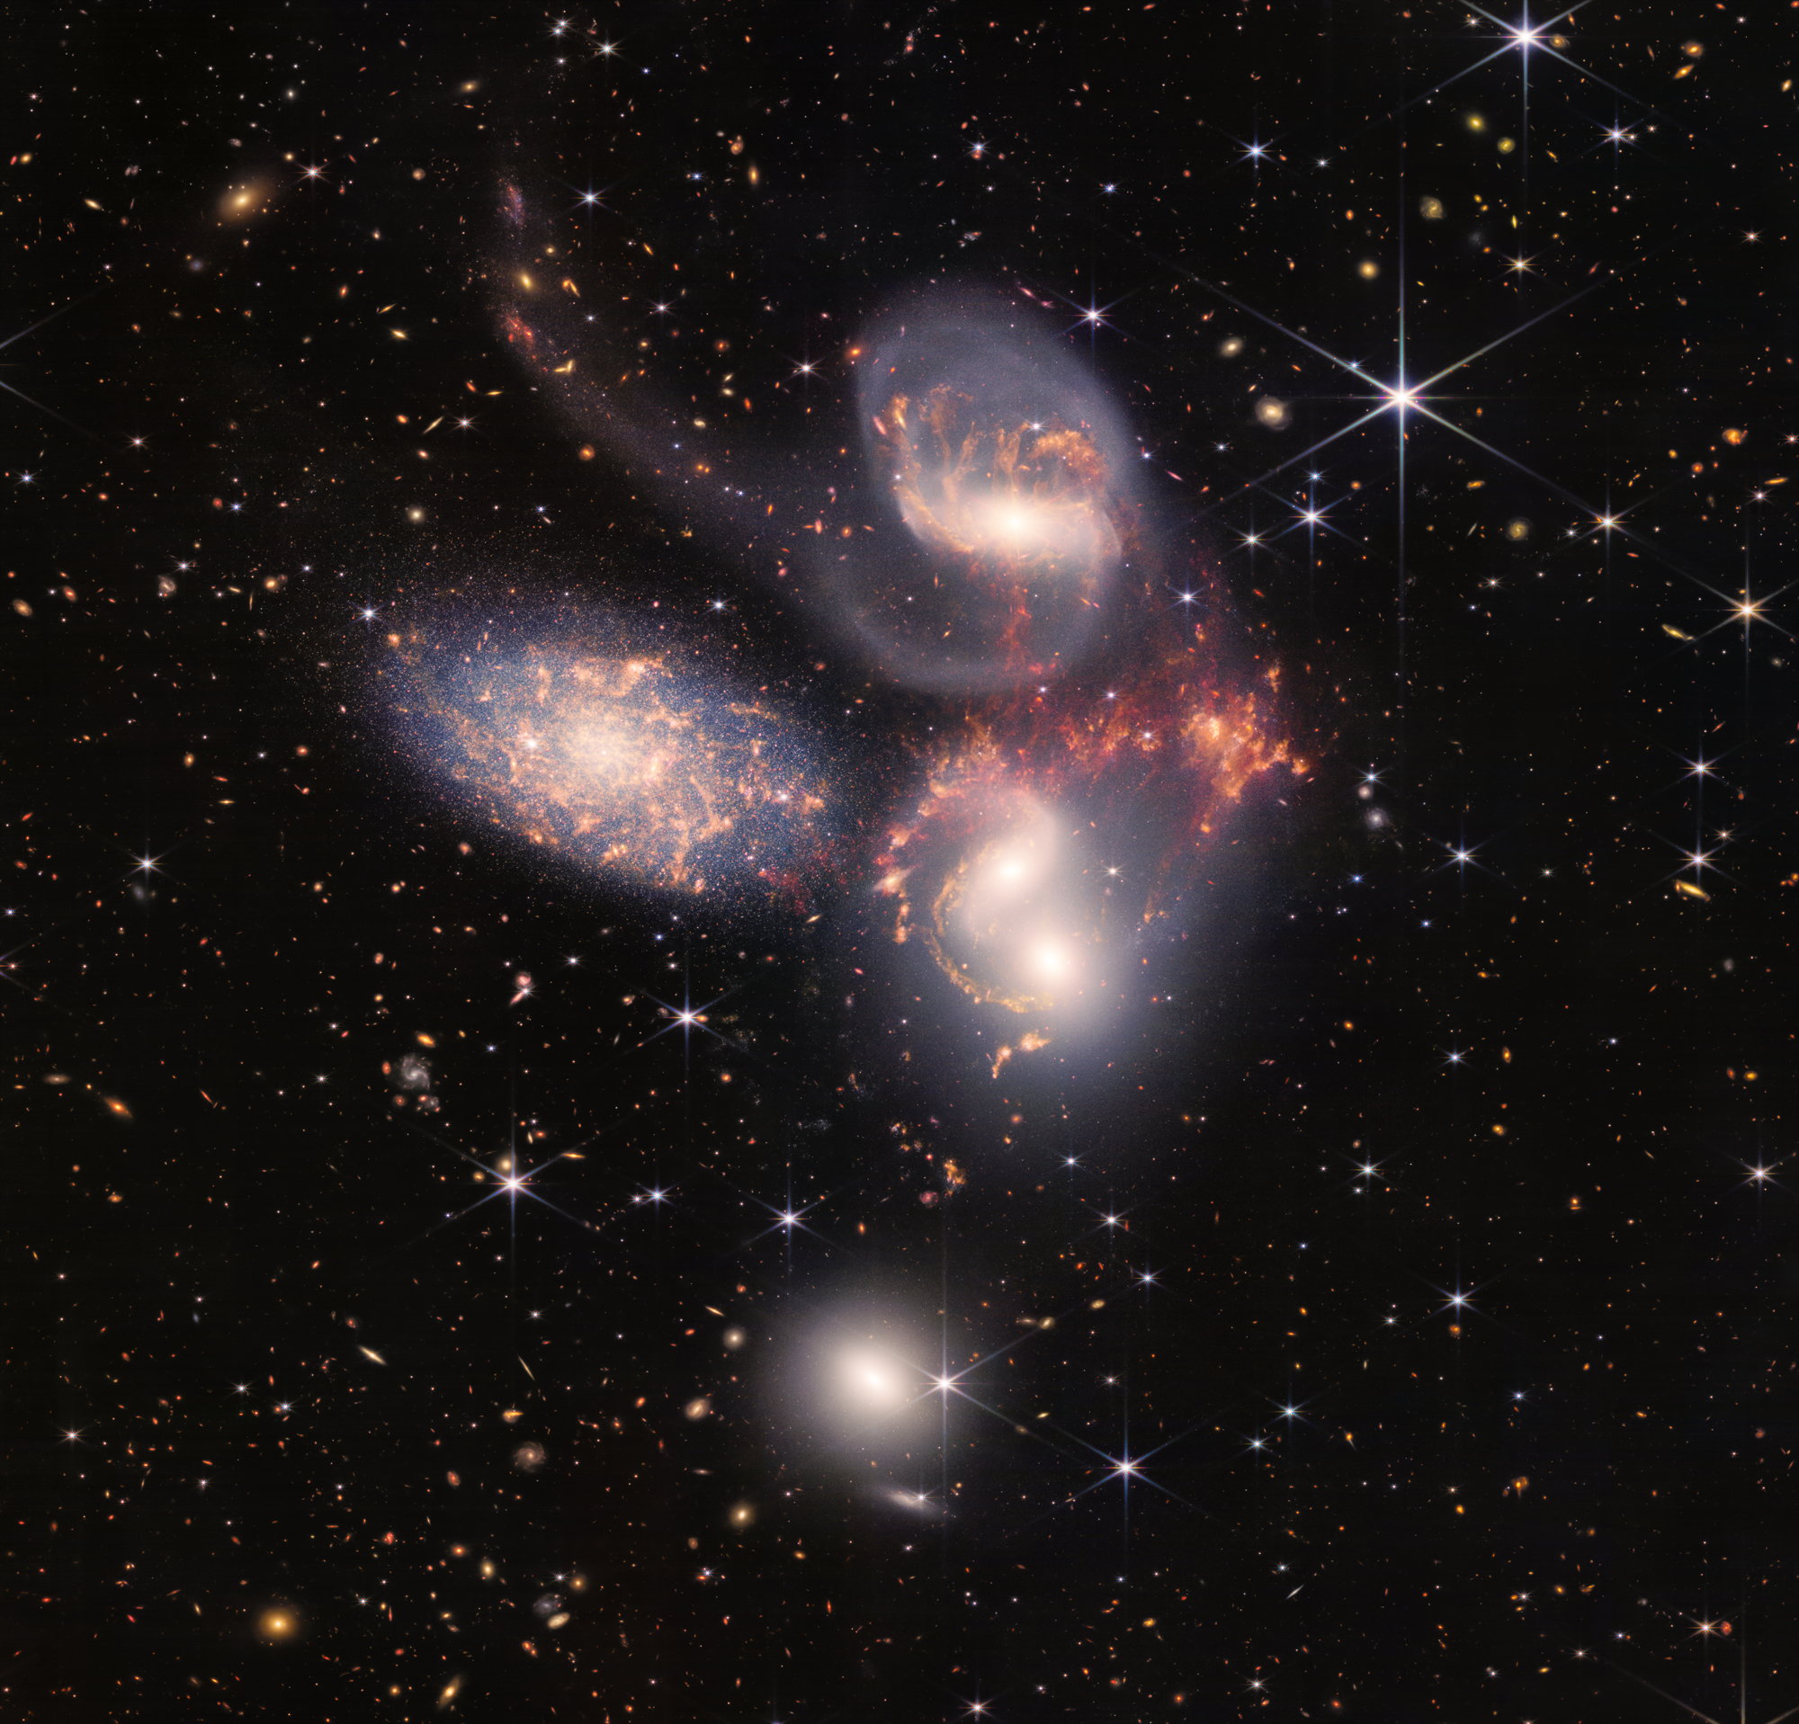
ERO #4: Stephan’s Quintet
dust-enshrouded AGN found in MIRI image in here too
a galaxy (car?) wreck in progress
galaxies tearing each other apart
“tidal” tails
colliding gas and forming stars
a nearby galaxy not in the group
40 million light years vs 290 Mlyr
NIRCam and MIRI composite image
gdi

Slide 20
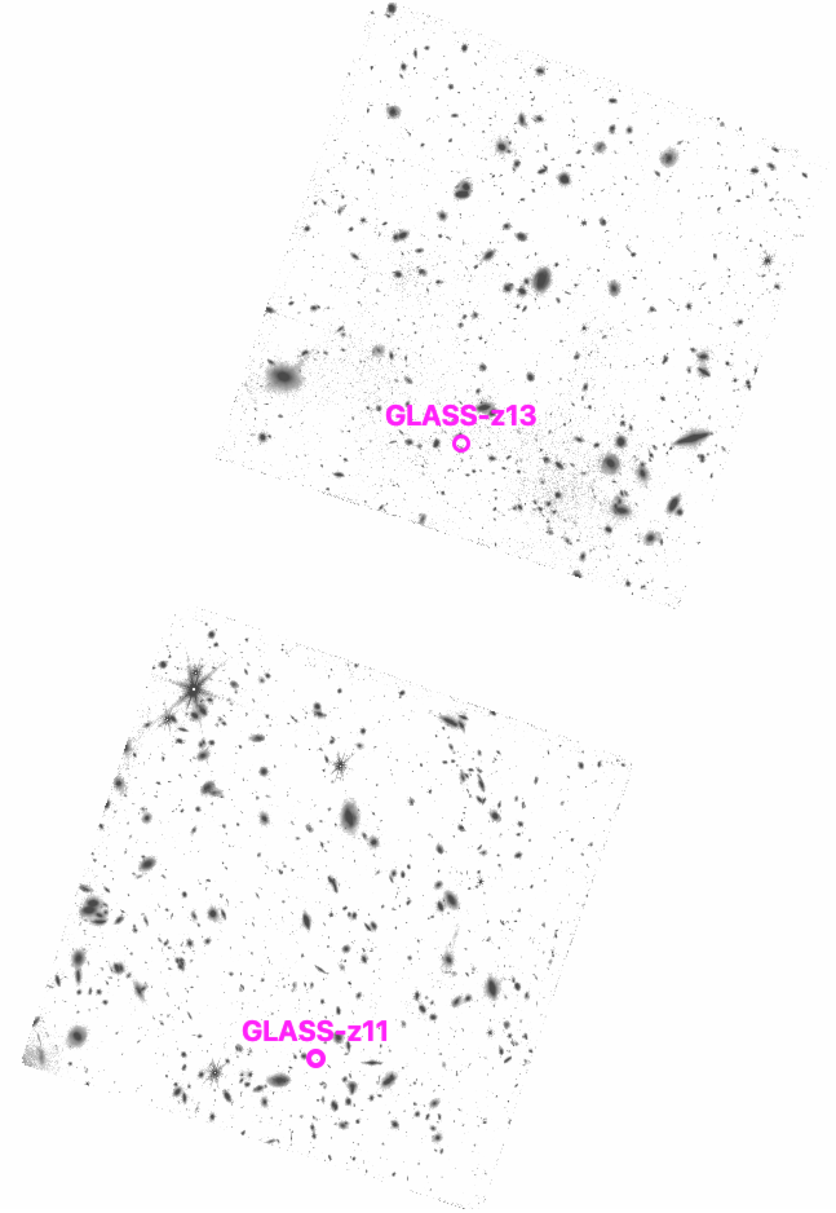
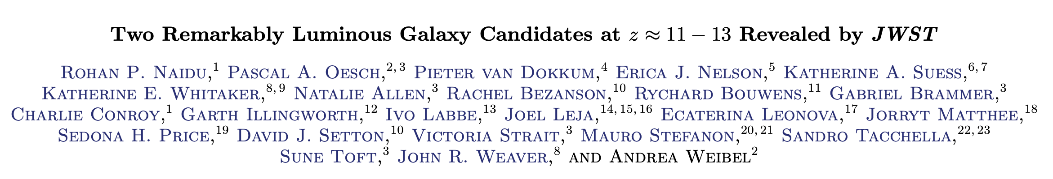
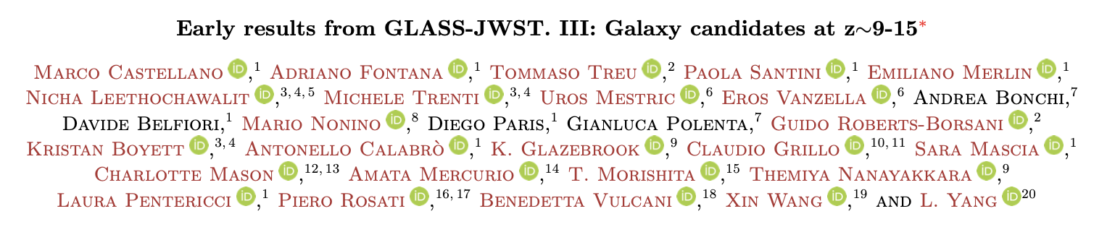
the earliest galaxies – beating Hubble’s record in just 5 days!
GLASS ERS data released July 14-15
Naidu, Oesch et al paper submitted July 19!
Castellano et al paper also submitted same day!
NIRCam image(s) of GLASS field – HFF A2744 parallel field
gdi

Slide 21
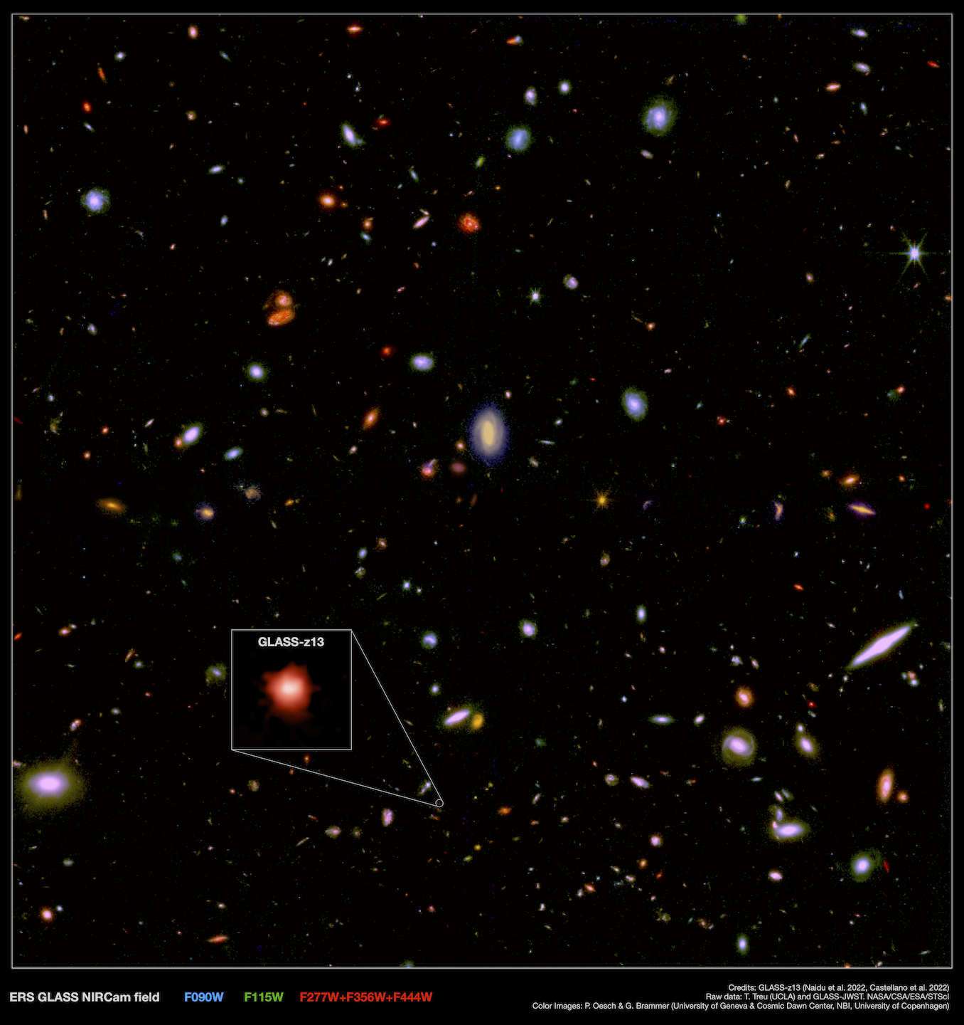
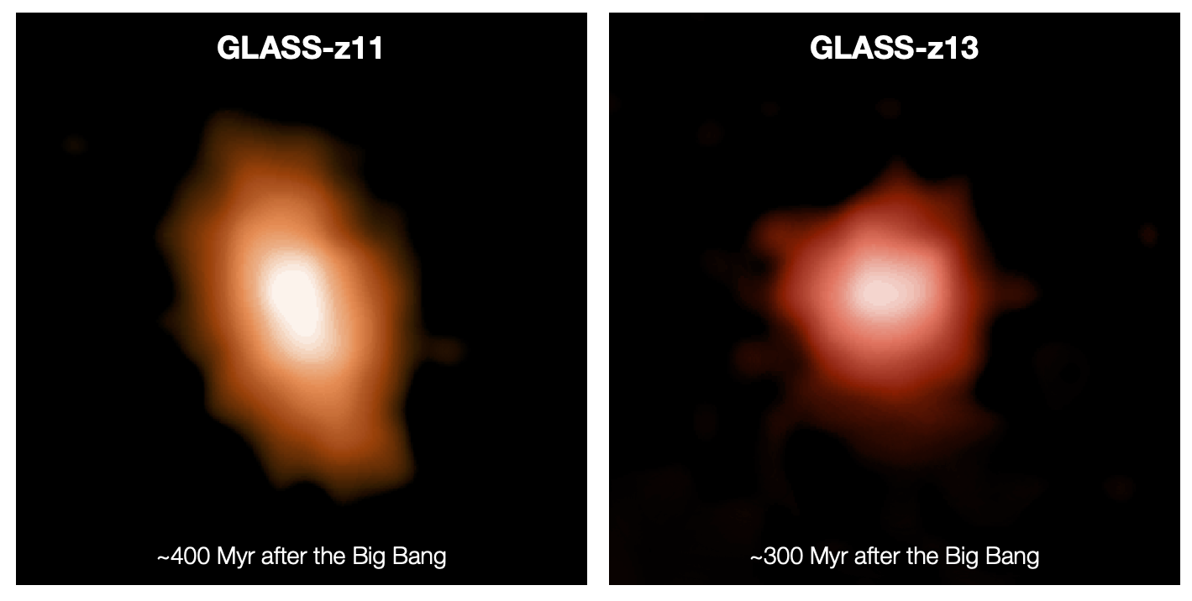
the earliest galaxies – beating Hubble’s record in just 5 days!
Hubble had GN-z11 at 400 Myr after the Big Bang
GL-z11 matches GN-z11 at ~400 Myr
but GL-z13 sets a new record at 300 Myr after the Big Bang
Naidu, Oesch et al 2022
400 Myr
300 Myr
also in this paper – same day!
looking back through 97% of all time to 13.4-13.5 billion years!
NIRCam image of GLASS field
gdi

Slide 22
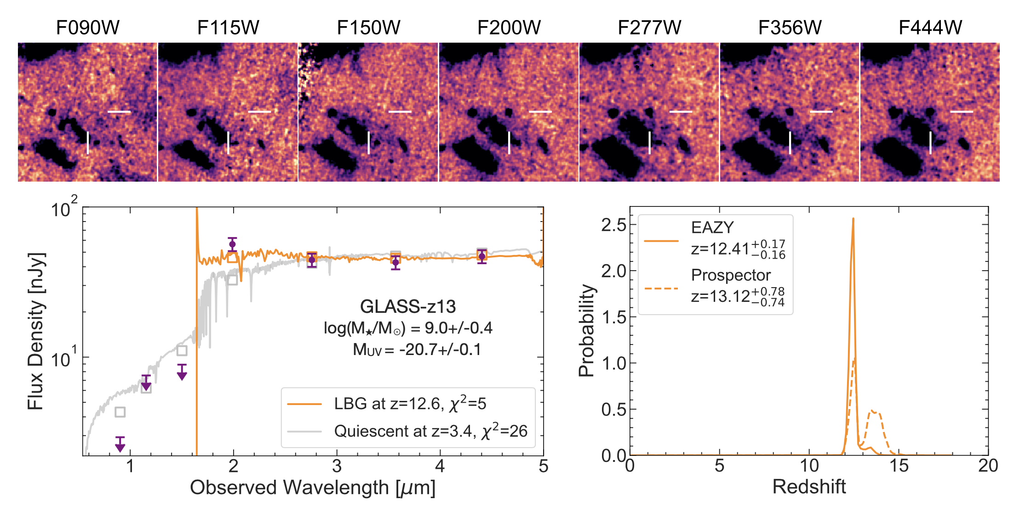
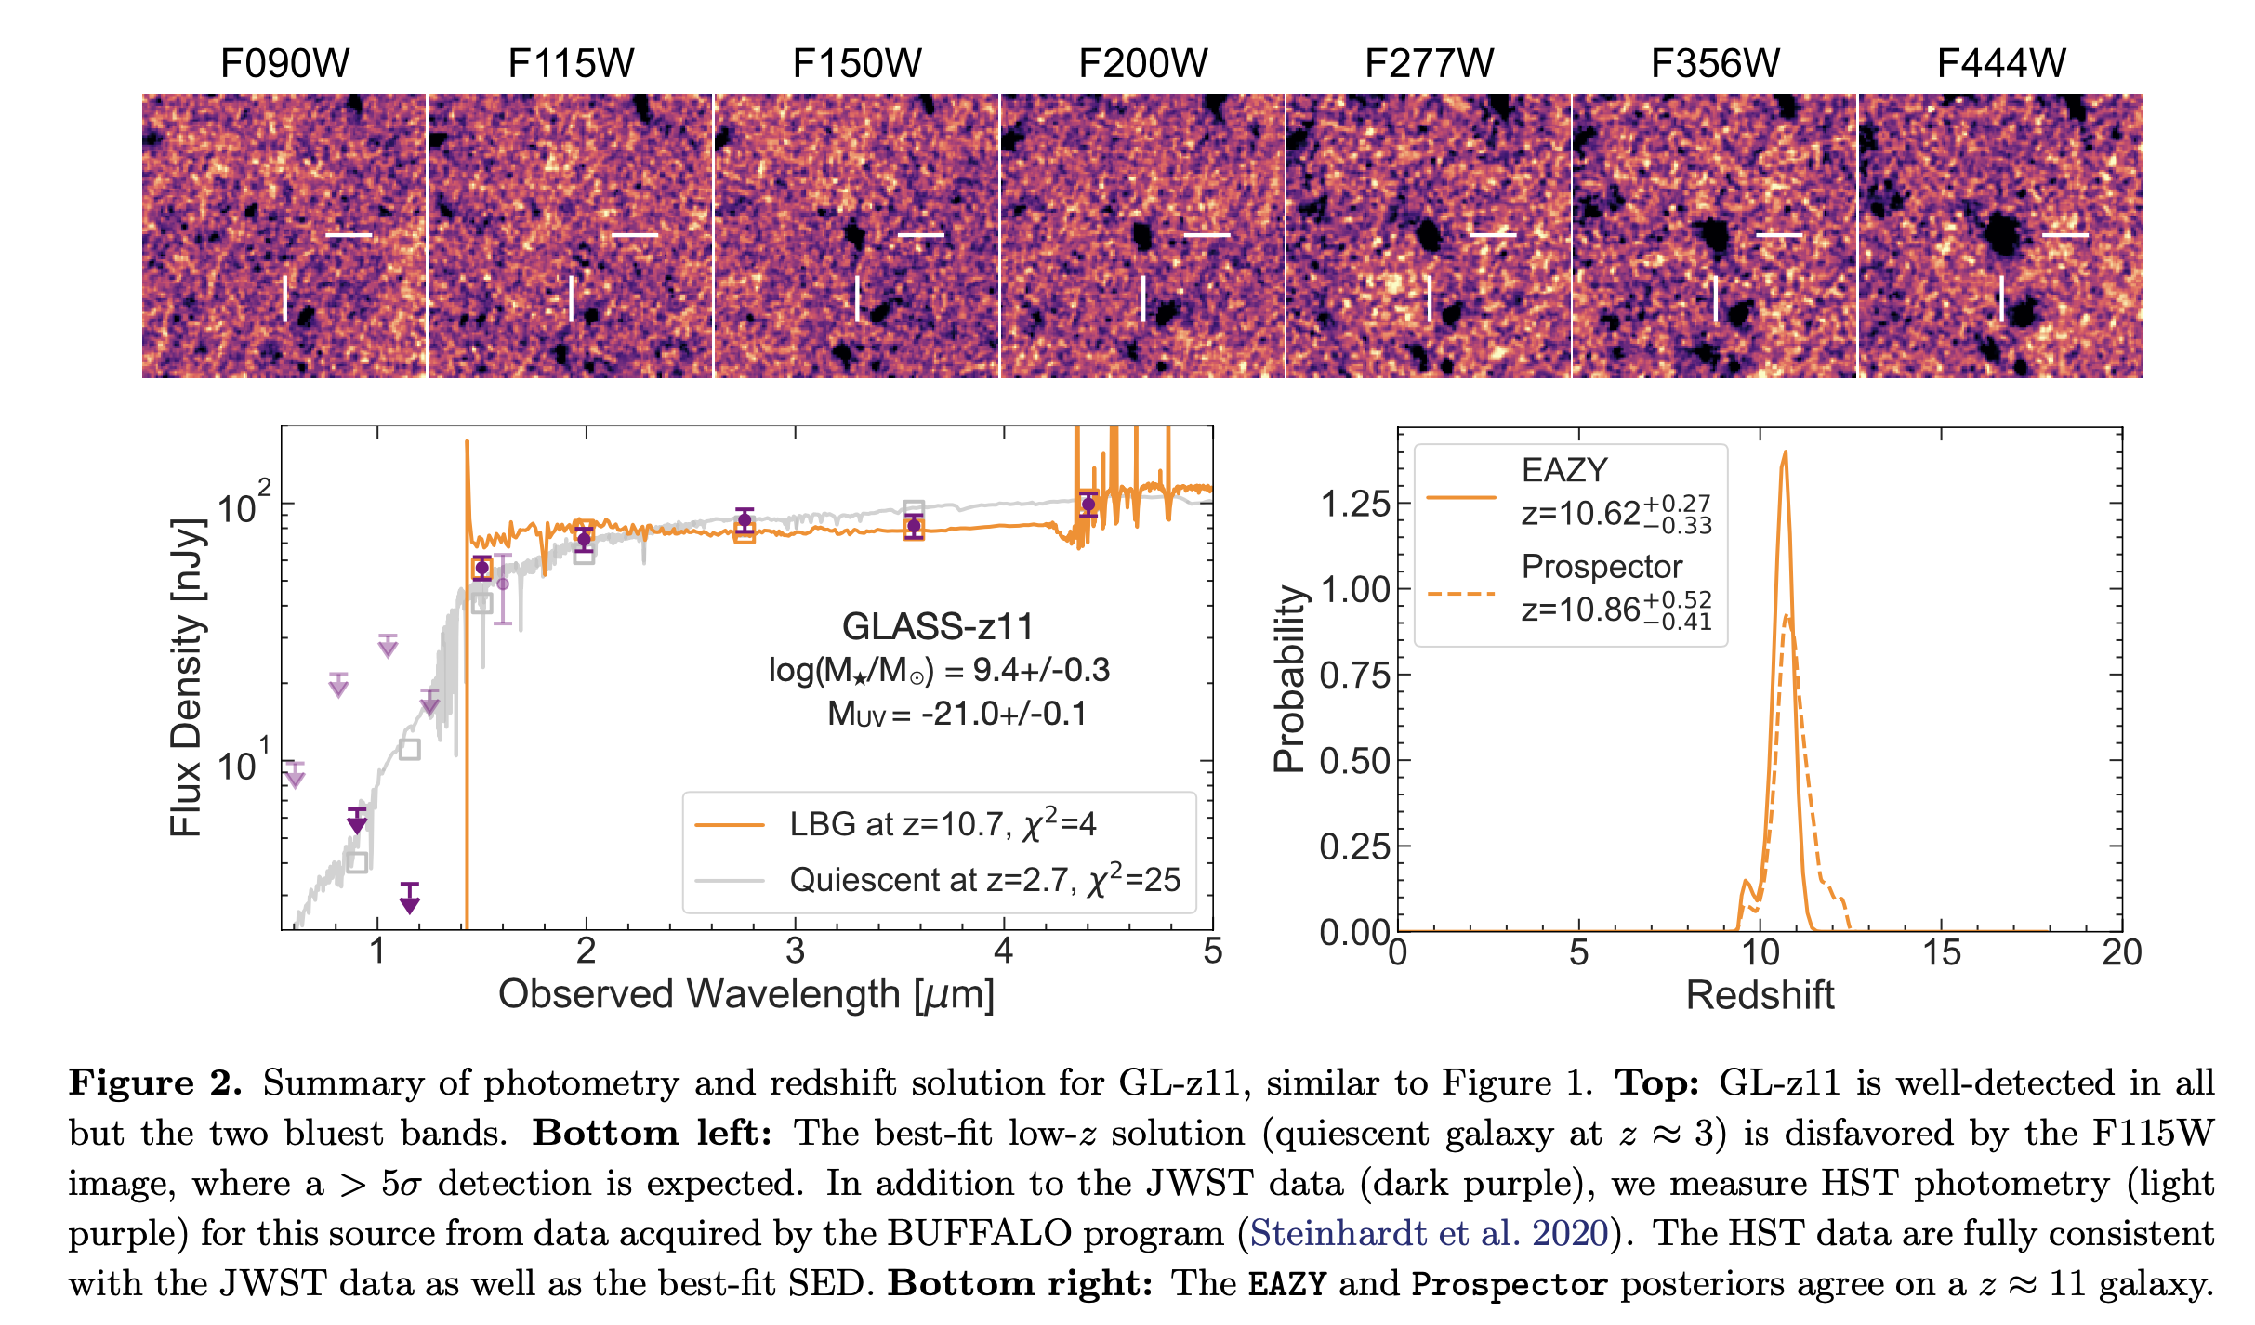
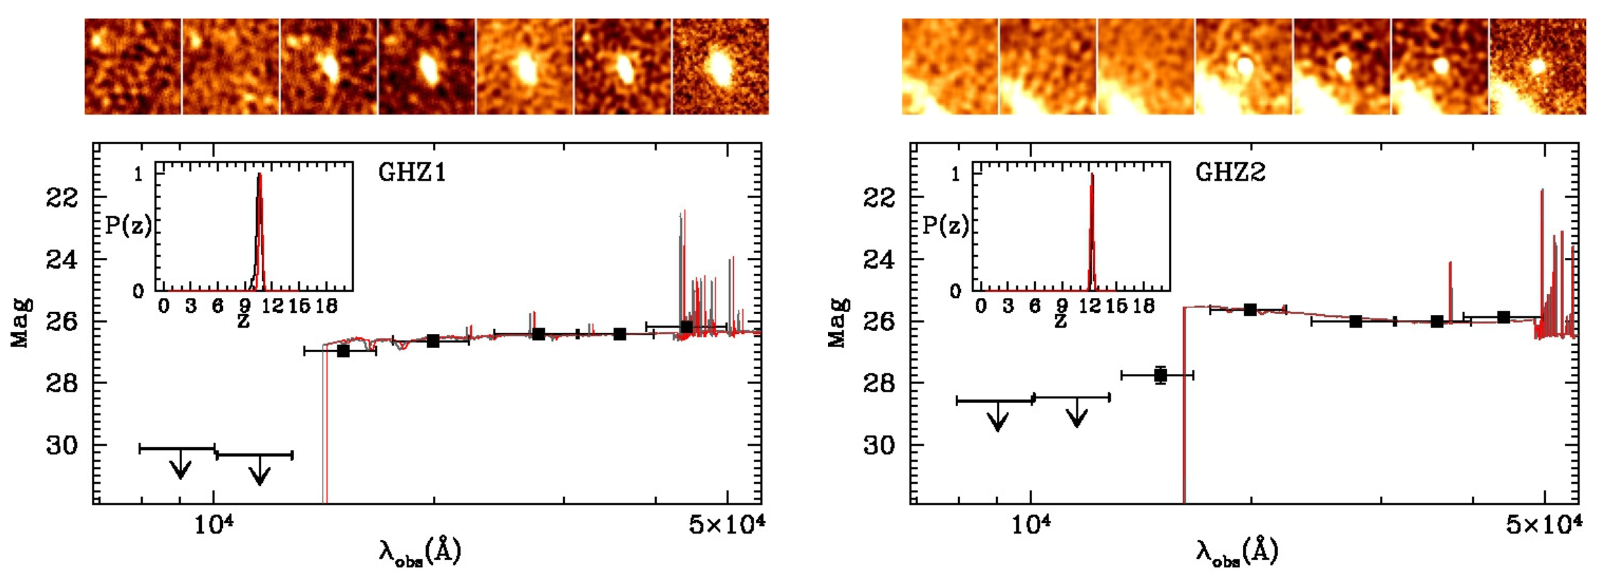
Naidu, Oesch et al.
Paper 1 July 19
z~10.6
z~12.4
Castellano et al.
July 19
gdi

Slide 23
GL-z11
Naidu, Oesch et al.
Paper 1
gdi

Slide 24
Naidu, Oesch et al.
Paper 1 July 19
NIRCam calibration issues have complicated interpretation of the work on very high redshift galaxies for all authors
Castellano et al.
July 19
gdi

Slide 25
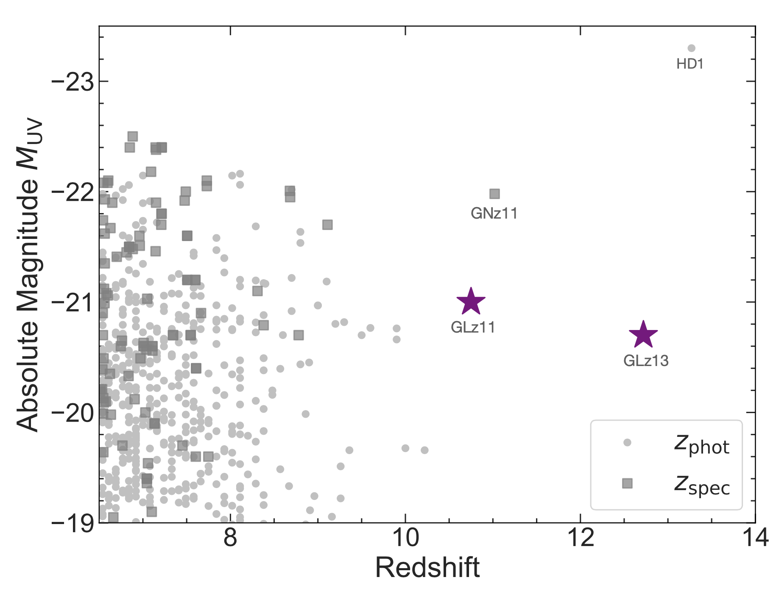
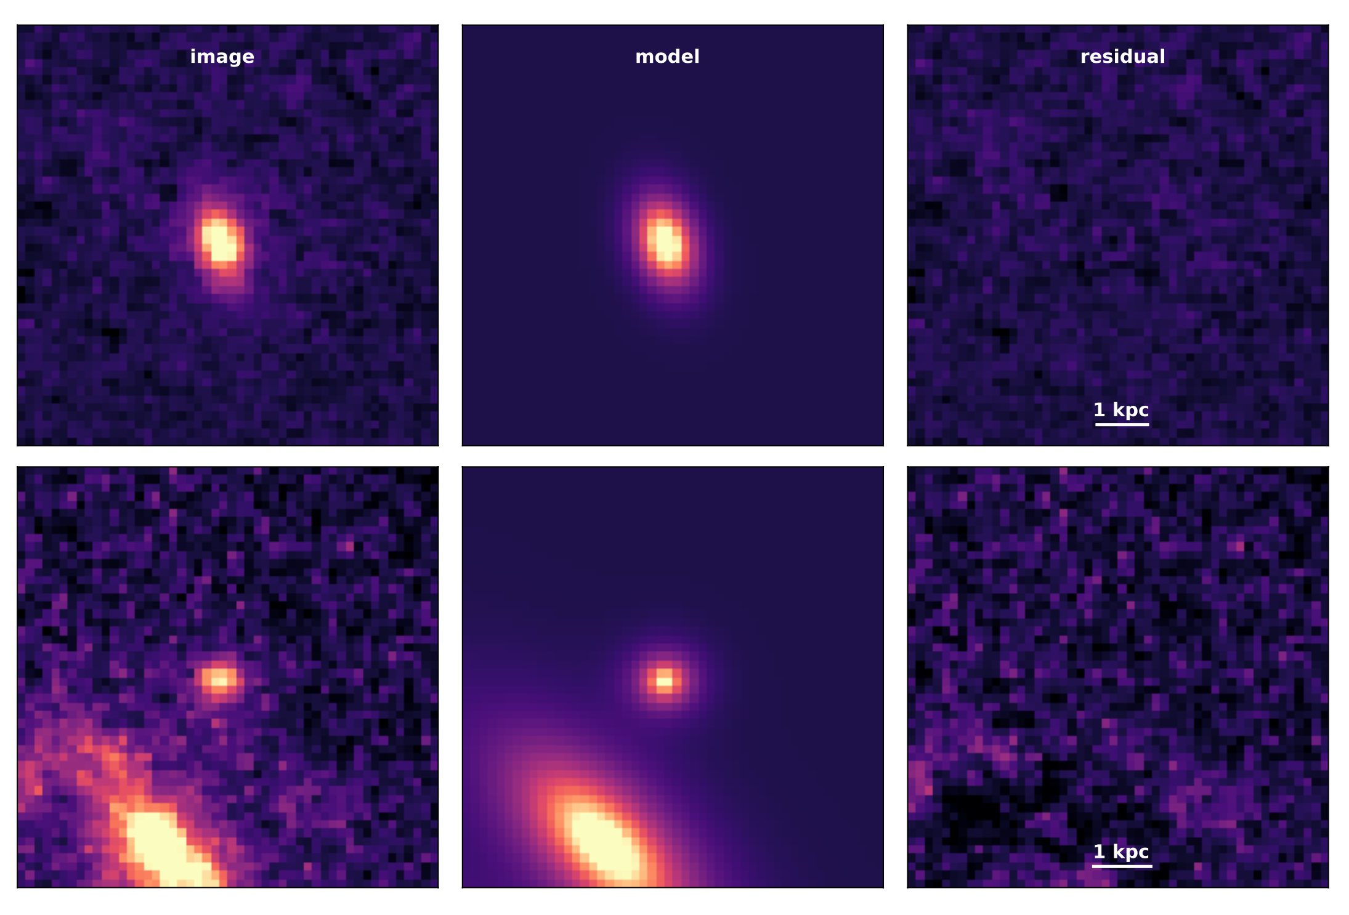
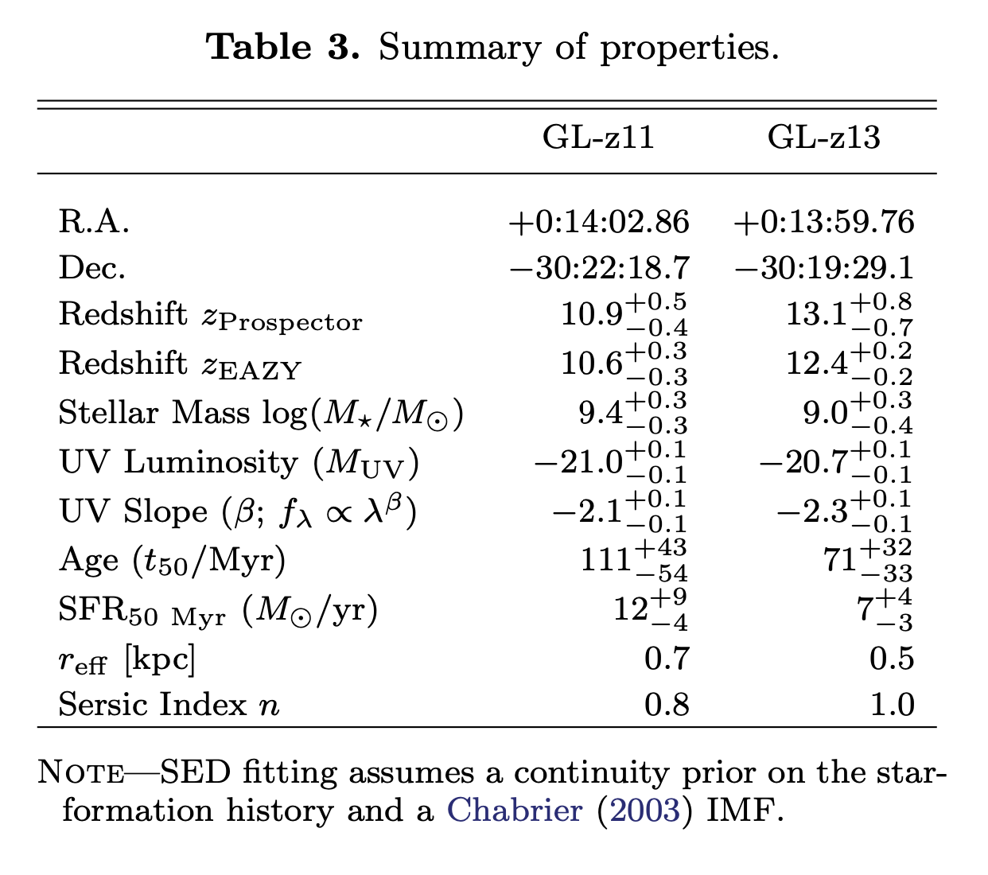
GL-z11: r_{eff} ~ 0.7 kpc, disk-like profile with n = 0.8
GL-z13: r_{eff} ~ 0.5 kpc, disk-like profile with n = 1
GL-z11
Sersic fits
GL-z13
?
?
?
Naidu, Oesch et al. Paper 1
gdi

Slide 26
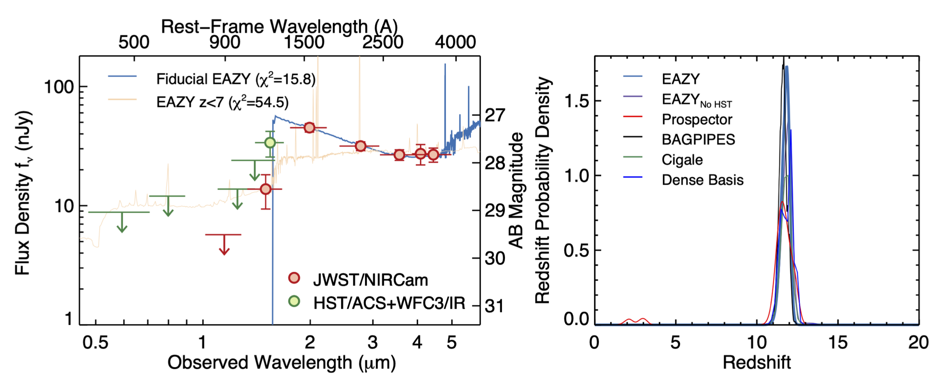
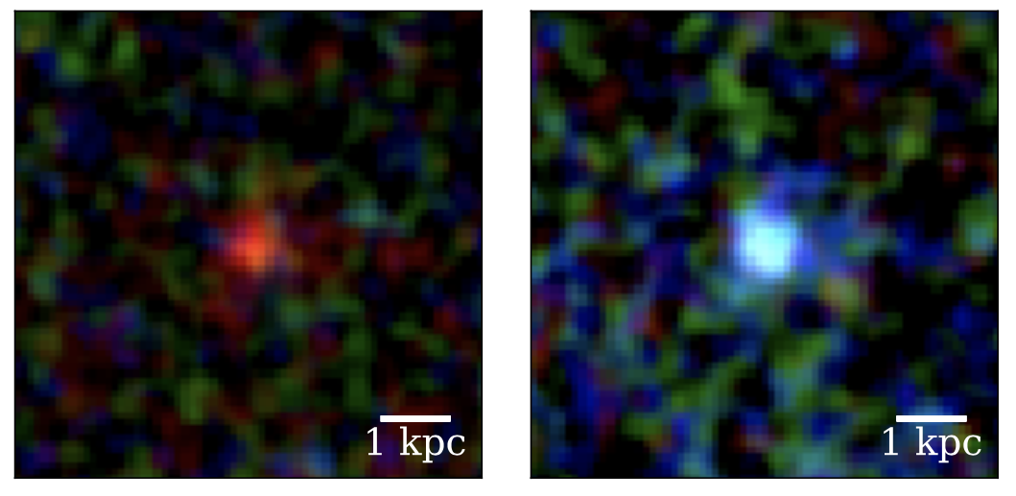
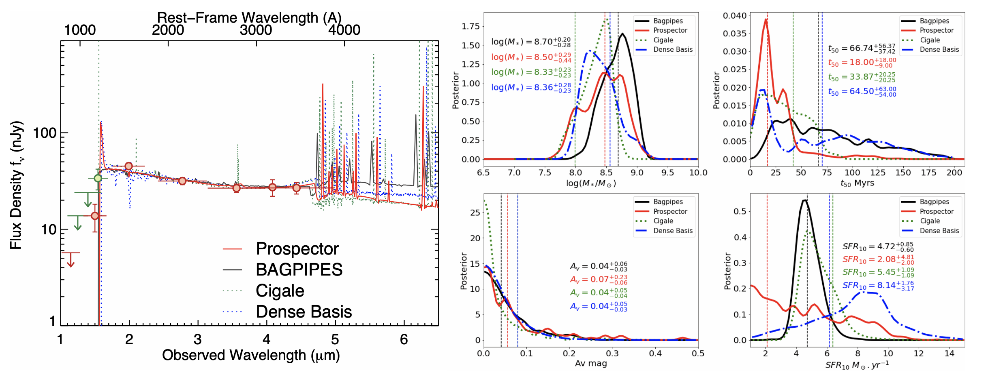
Finkelstein et al
July/Sept
z~14 => z~12
Maisie’s Galaxy
CEERS
Hubble EGS field
gdi

Slide 27
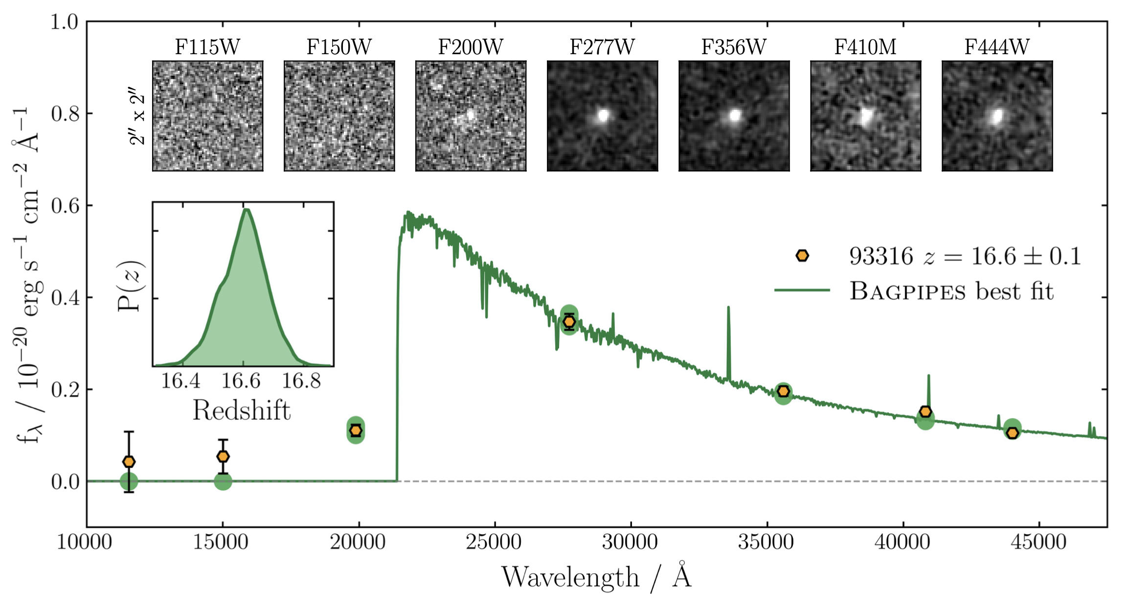
CEERS 93316
redshift z~17
@~230 Myr
Donnan et al. July 25
log₁₀(𝑀∗/M⊙) = 9.0 ± 0.4
log₁₀(SFR/yr⁻¹) = 1.1 ± 0.4
mass-weighted mean stellar age = 20+40 Myr
SF began between 120 - 220 Myr (𝑧 = 18 − 26)
rest-frame UV spectral slope, 𝛽 = −2.2 ± 0.1 (implies 𝐴_{V} ~ 0)
“cat amongst the pigeons” galaxy
gdi

Slide 28
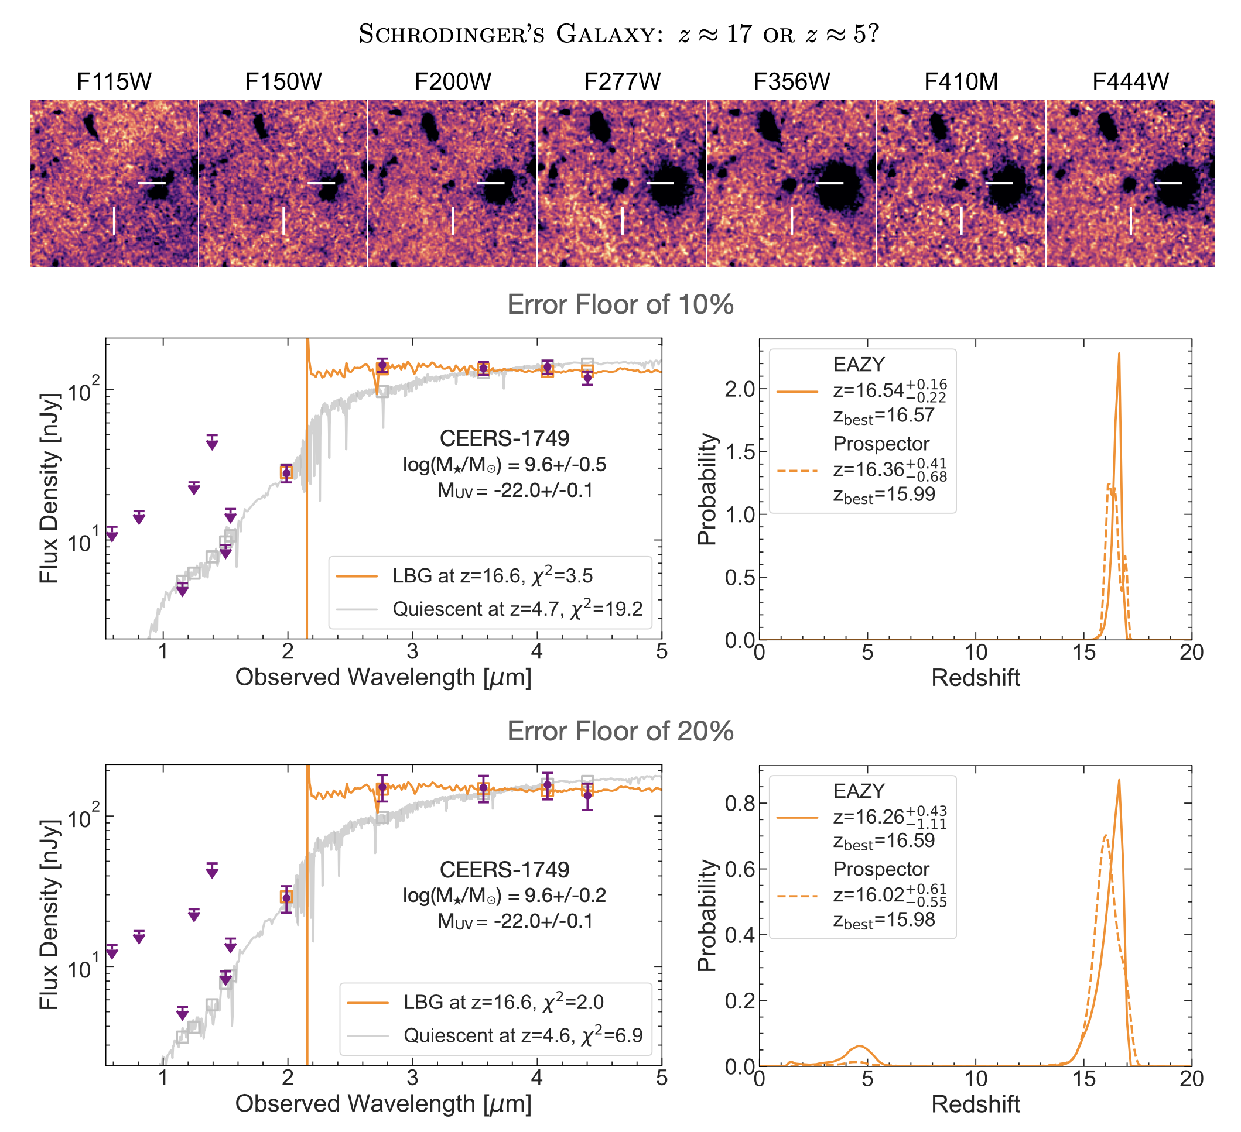
Naidu, Oesch et al.
Paper 2 Aug 4
CEERS 1749 in Naidu et al. is the same galaxy as Donnan et al. CEERS 93316
two redshift solutions
z~16.6 most likely
z~5 possibility if errors underestimated
gdi

Slide 29
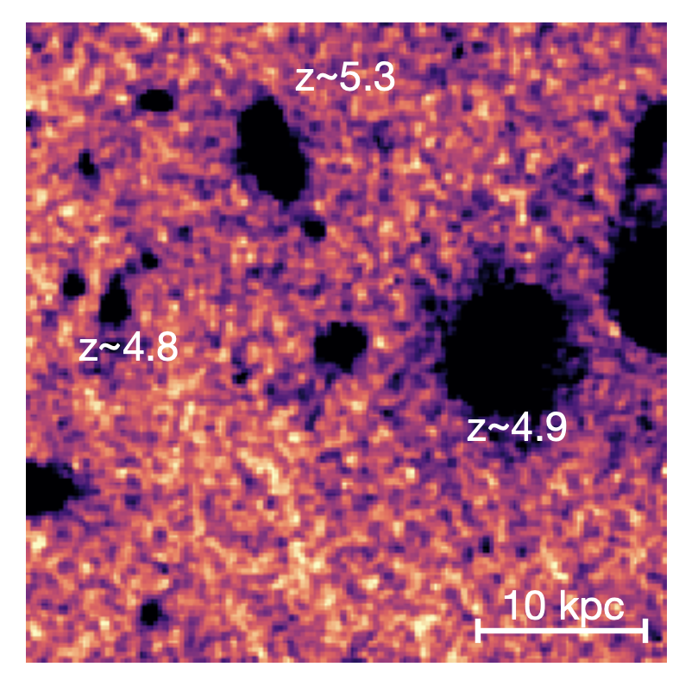
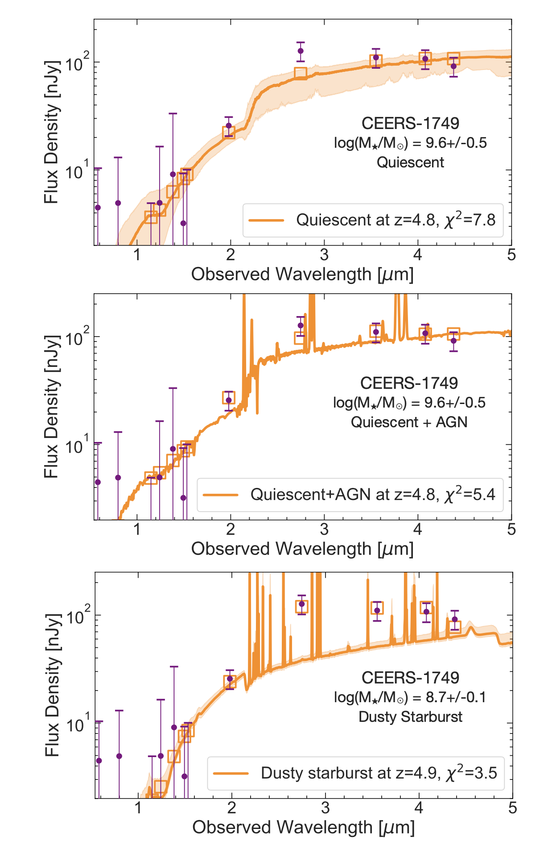
quiescent
Naidu, Oesch et al.
Paper 2
Naidu, Oesch et al.
Paper 2 Aug 4
quiescent
quiescent
+ AGN
possible z~5 solutions
z~16.6?
but is z~16.6 is real?
circumstantial indications that may be z~5
projected on or actually in z~5 group?
dusty starburst
gdi

Slide 30
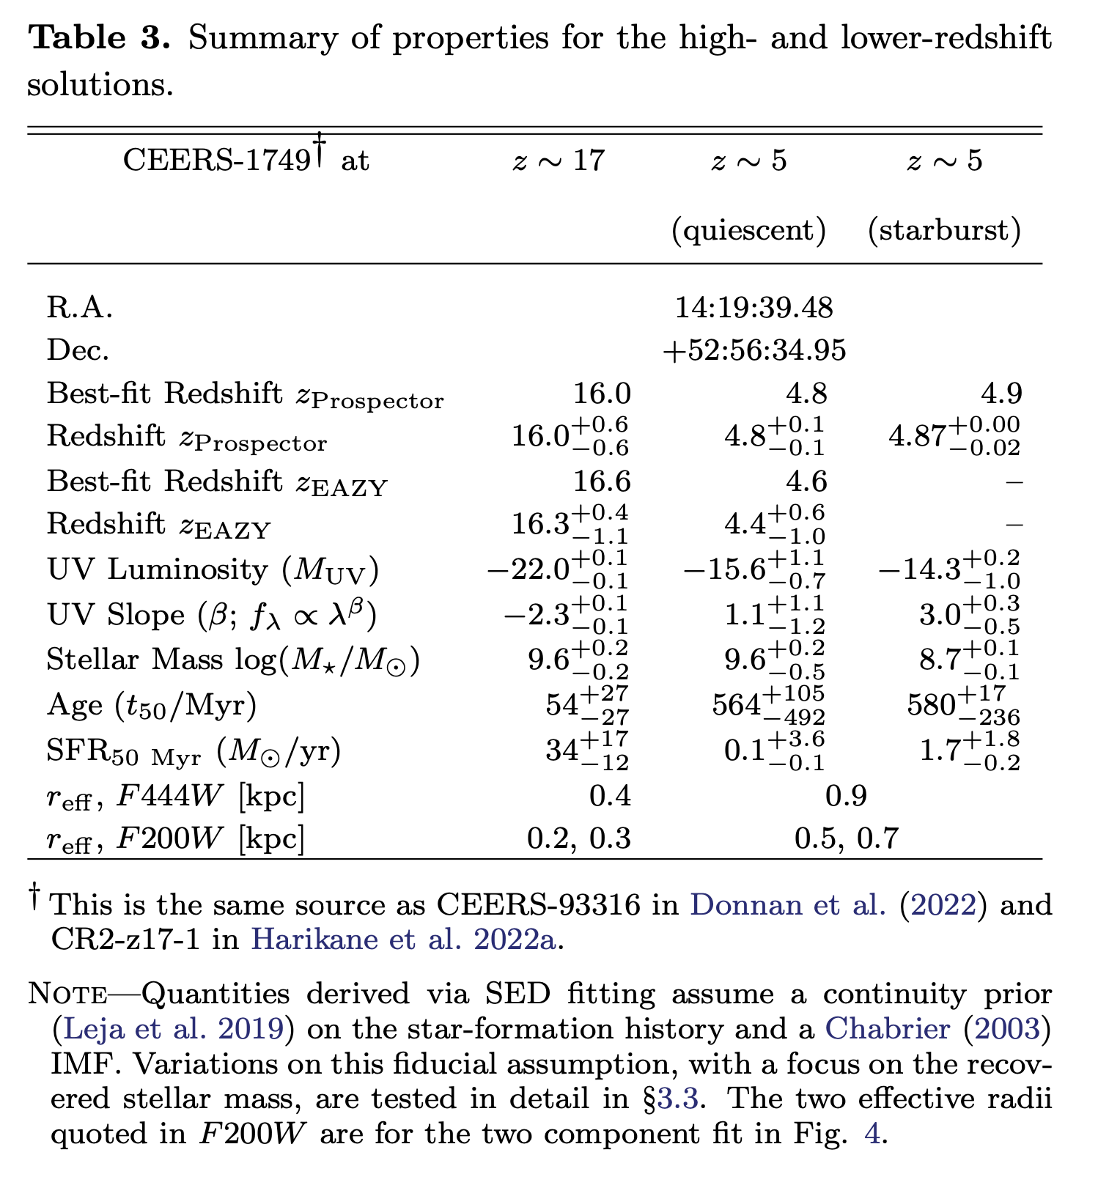
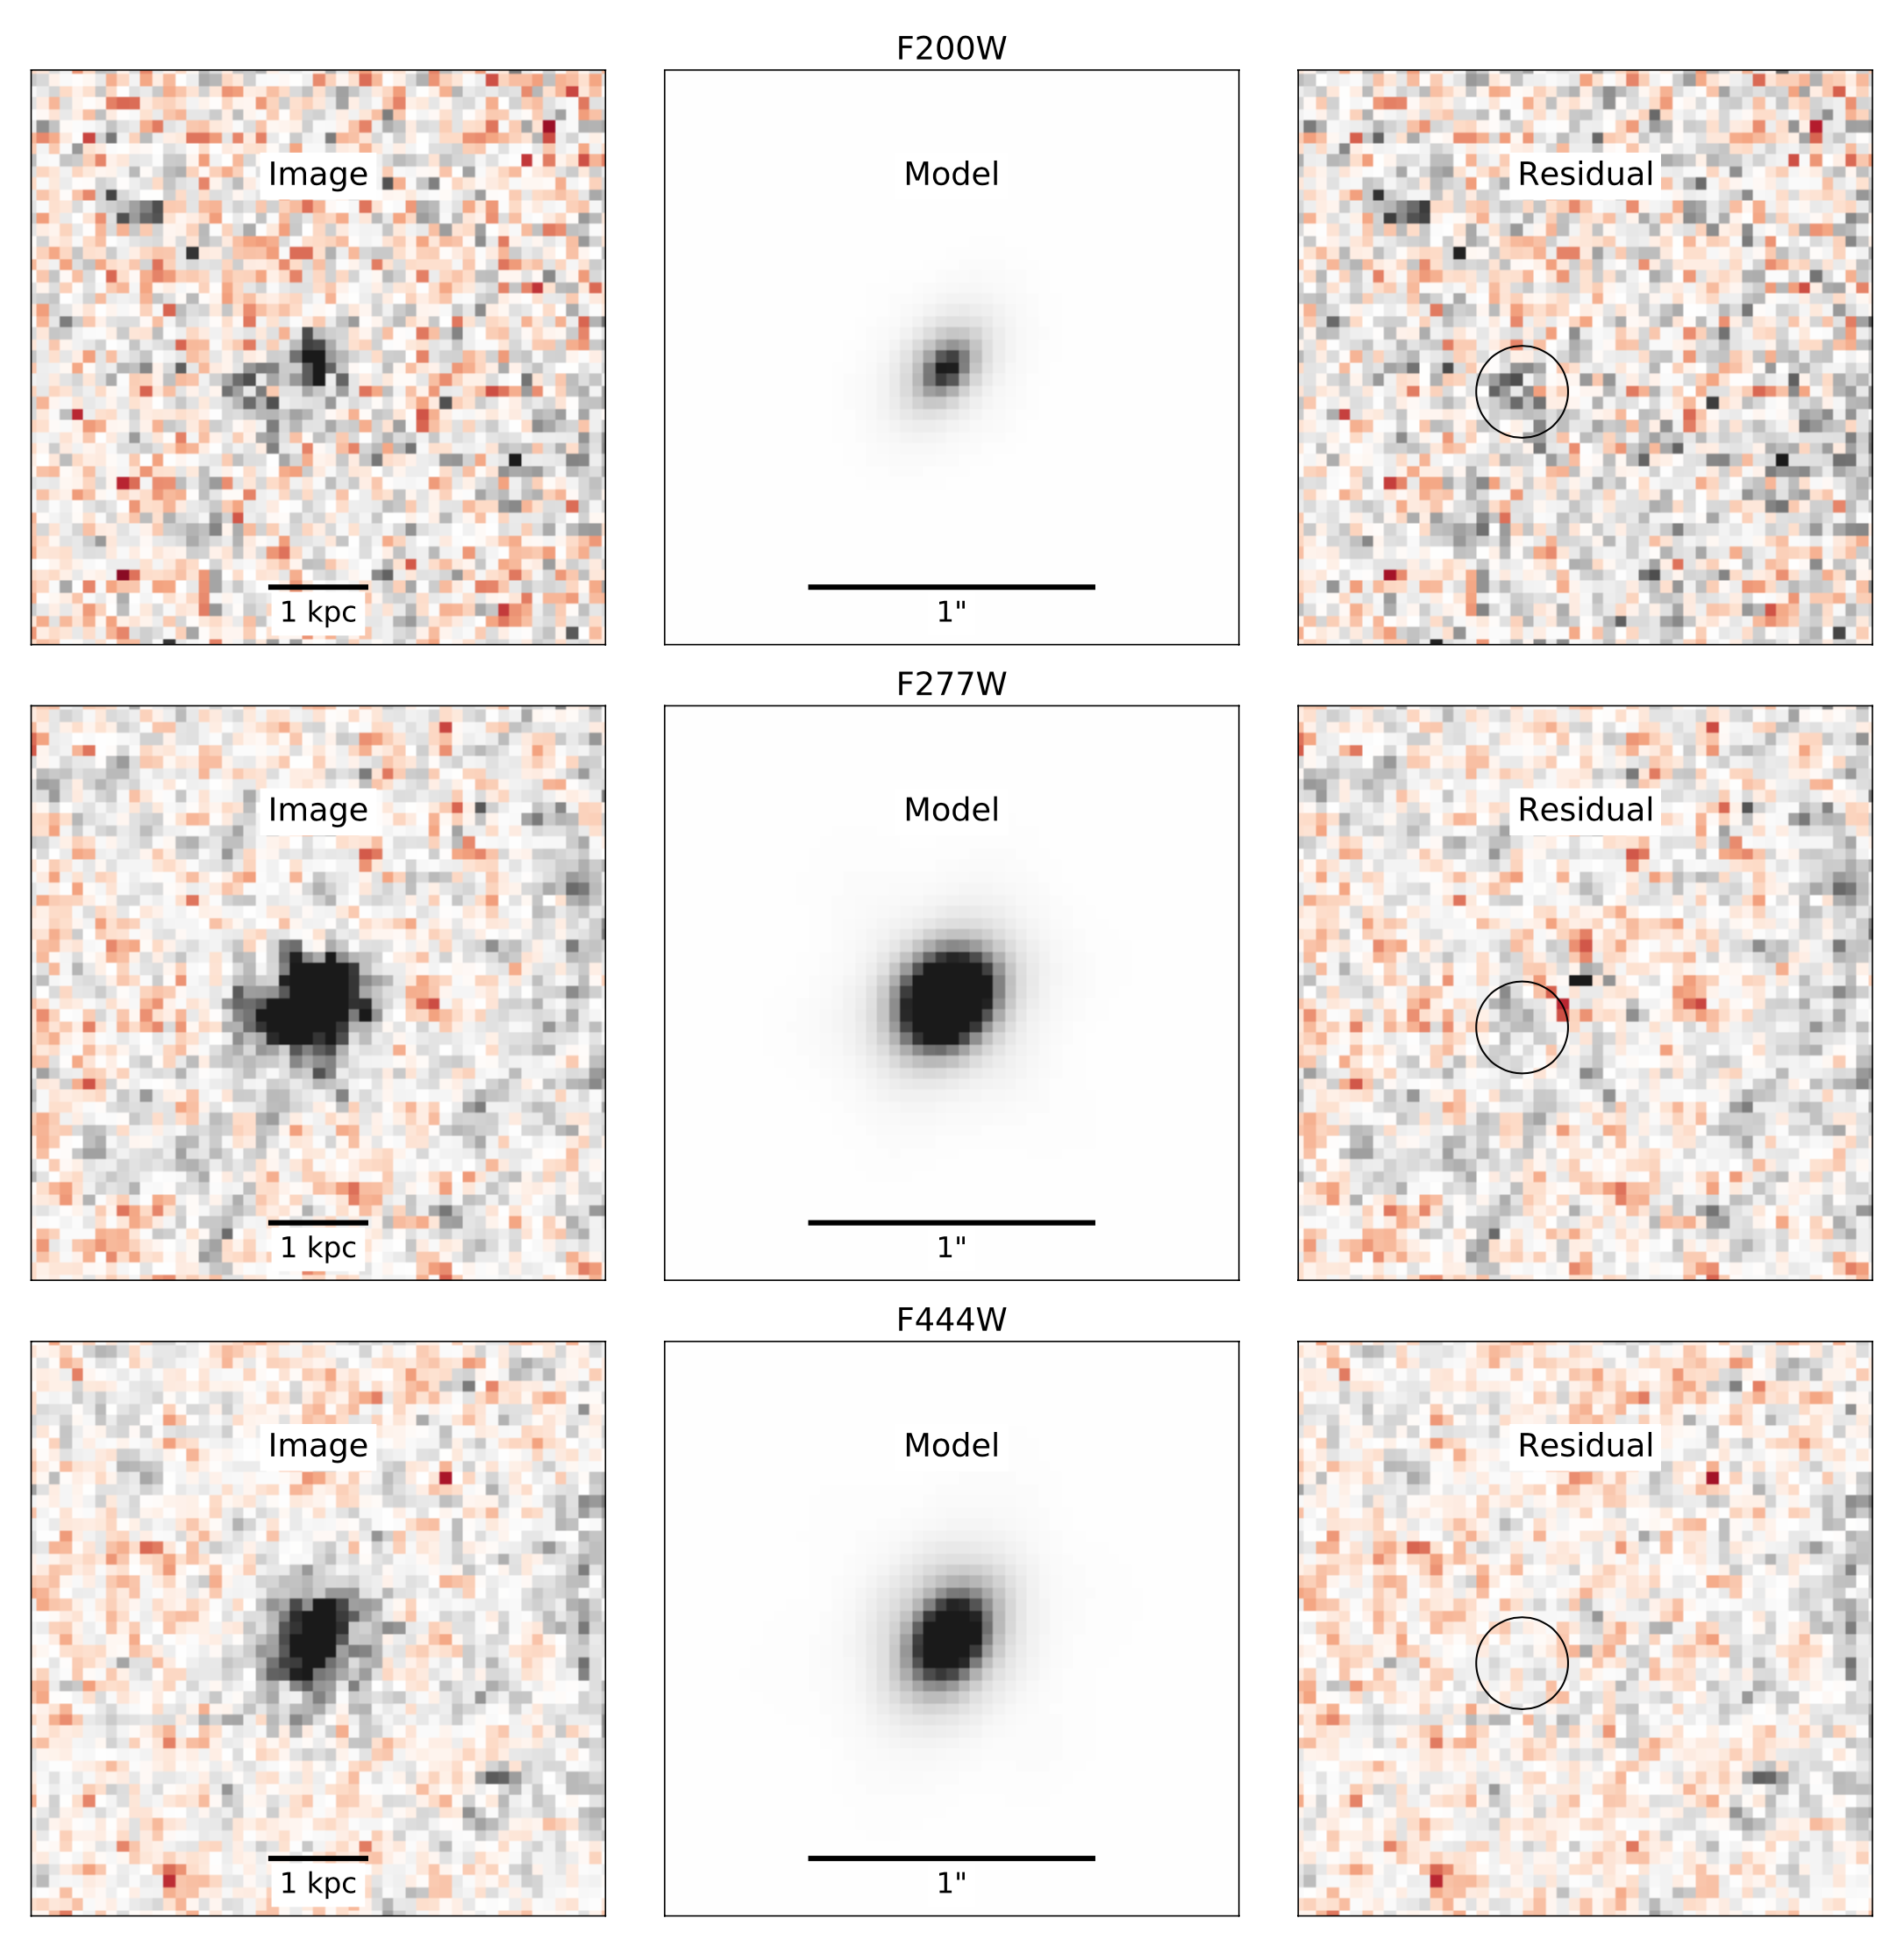
Naidu, Oesch et al.
Paper 2 Aug 4
Sersic: r_{eff} ~ 0.3-0.4 kpc, disk-like n = 1
?
?
?
gdi

Slide 31
where do we go from here?
gdi

Slide 32
where do we go from here?
finding surprisingly poor agreement in source selections between different teams
Rychard Bouwens is leading a paper (in the works) trying to understand the source(s) of the inconsistencies that he is finding
the lack of good high S/N blue data below the break is a challenge
resolve NIRCam calibration issues (largely done but but some to go)
higher S/N imaging (blue bands in particular)
JWST spectra (emission lines?)
ALMA data
keep an open mind about the potential limitations of SED fitting at z>~10 and the standard assumptions
I suspect a top-heavy IMF at early times and much lower total stellar mass will prove to be the norm – for the subset that are really at z>10
gdi

Slide 33
gdi

