Slide 1
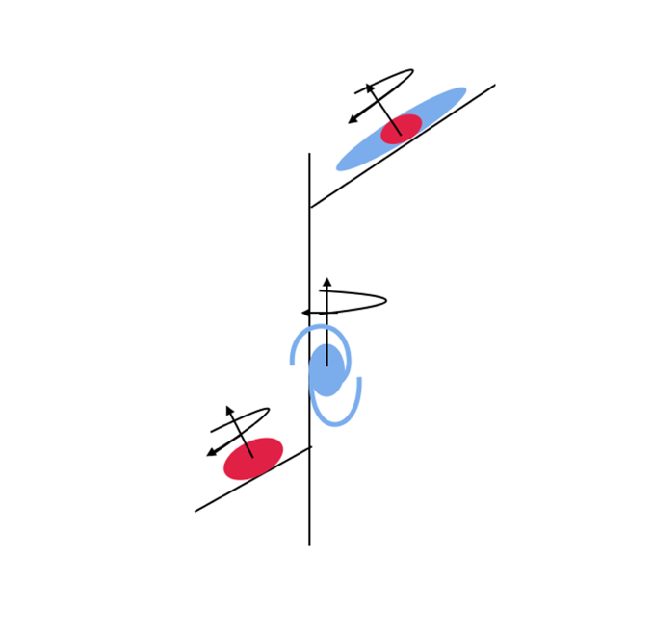

Spin-filament alignment flips are related to bulge assembly
Matthew Colless
KCF@80, Perth, 22 September 2022
ARC Centre of Excellence for
All Sky Astrophysics in 3D

Slide 2
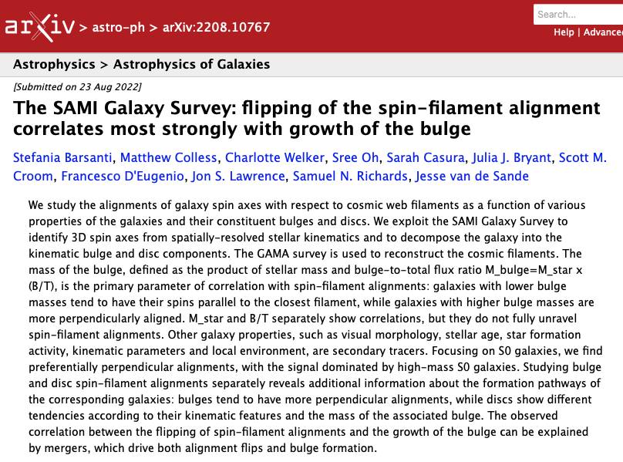

Barsanti et al., 2022, MNRAS, 516, 3569
https://doi.org/10.1093/mnras/stac2405
Stefania Barsanti

Slide 3
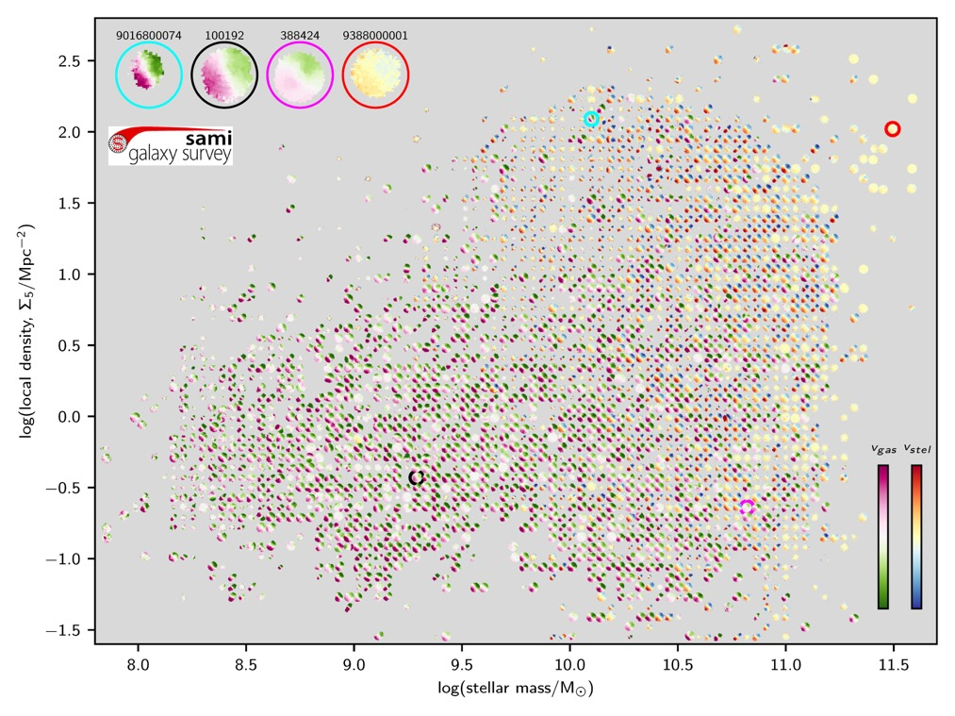
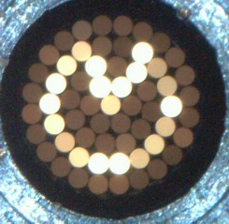


The SAMI Survey in a nutshell
Sydney-AAO Multi-object Integral-field spectrograph (SAMI)
  13 hexabundles each with 61 fibres, giving 15” IFUs
  spatial sampling = 1.6”/fibre (out to median 1.4 R_{e})
  FoV = 1 deg diameter; spectral range = 3700-7400 Å
  Spectral resolution: 𝜎_{red}=70 km/s, 𝜎_{blue}=30 km/s
3068 galaxies in GAMA (2180) and 8 cluster (888) fields
  Mass- and volume-limited selection (z<0.12, M★>10⁸)
  Full range of environments (field to rich clusters)
  Full range of morphology (spirals to ellipticals)
  Final dataset now available (DR3; Croom+2021)
Key science questions for the SAMI survey:
  What are the physical processes responsible for galaxy transformations?
  How do mass & angular momentum grow?
  Feeding & feedback: how does gas get into galaxies and how does it leave?
log(local density = Σ₅ [Mpc^{-2]})
log(stellar mass = M✭ [M⊙])
sami-survey.org

Slide 4
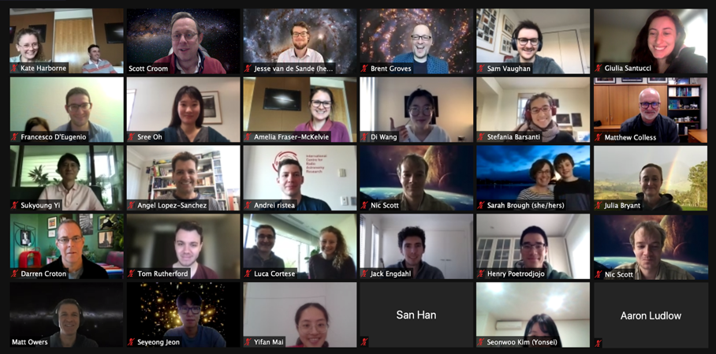
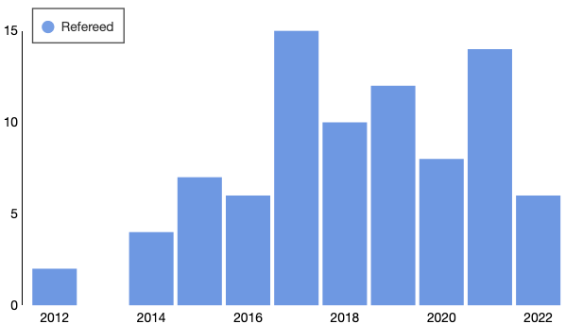
Recent results from SAMI
60 SAMI papers to date; recent papers on topics including:
  Stellar populations in SAMI and LEGA-C (Barone+2022)
  Gas vs stellar kinematics (Oh+2022)
  Schwarzschild modelling (Santucci+2022)
  Central surface brightness vs spin (Cortese+2022)
  [𝛂/Fe] vs morphology and environment (Watson+2022)
  Gas vs stellar metallicity (Fraser-McKelvie+2022)
  Flipping of the spin-filament alignment correlates most strongly with growth of the bulge (Barsanti+2022)
Some of the papers submitted or in progress:
  Spin-filament alignments of bulges and disks (Barsanti+)
  Correlation of galaxy flows and spin (Mai+)
  Stellar metallicities vs velocity dispersion (Vaughan+)
  Higher-order kinematics (D’Eugenio+)
  SAMI-HI: dynamical scaling relations (Catinella+)
  Star formation concentration and quenching (Wang+)
  Connecting spin, mass, age and environment (Croom+)
Published SAMI papers by year
Notes:
All the data from SAMI is now publically available following data release 3 that happened earlier this year. Access to the data is provided by data central. In this figure we show just one projection of the SAMI data, showing how velocity fields vary across the stellar mass and environment (using sigma 5) plane.

Slide 5
Motivation
  How do galaxies build up their angular momentum within the cosmic web?
A. Khalatyan/J. Fohlmeister/AIP
Notes:
How is the spinning of galaxies in the cosmic web related to their properties?

Slide 6
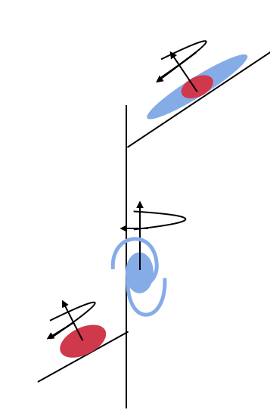
objectives
Theory and simulations predict that the alignment angle of a galaxy’s spin vector and the filaments of the cosmic web will correlate with galaxy properties, notably with galaxy mass
We investigate correlations of the spin-filament alignment with various galaxy properties, to find those properties that correlate most strongly and so may be physically related
We aim to illuminate the physical processes that determine the spin-filament alignment and their effects on galaxy structure & kinematics as well as star-formation history & stellar populations
We look at the spin filament alignments for entire galaxies and, separately, for their decomposed bulge and disk components
Notes:
How is the spinning of galaxies in the cosmic web related to their properties?

Slide 7
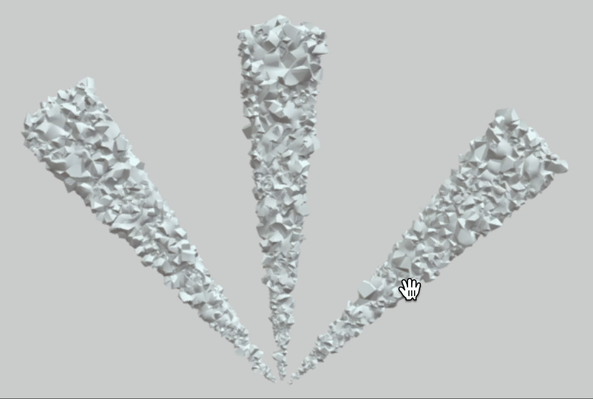
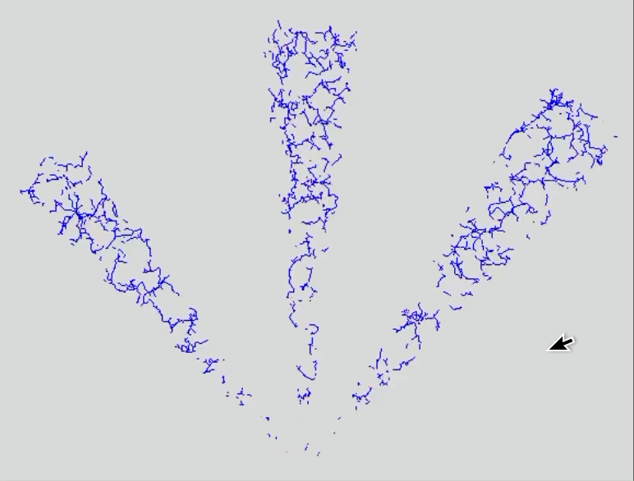
Identifying filaments with the GAMA Survey
GAMA z-survey of ∼36,000 galaxies at z<0.1
identify & reconstruct cosmic filaments
3D models in Sketchfab!
Density field in 3D via Delaunay tessellation
(Driver et al. 2011; Baldry et al. 2018)
DisPerSE structure extractor
Sousbie (2011a,b)

Slide 8
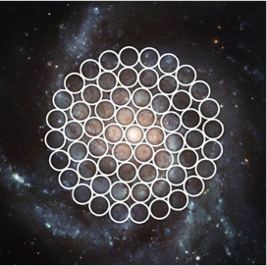

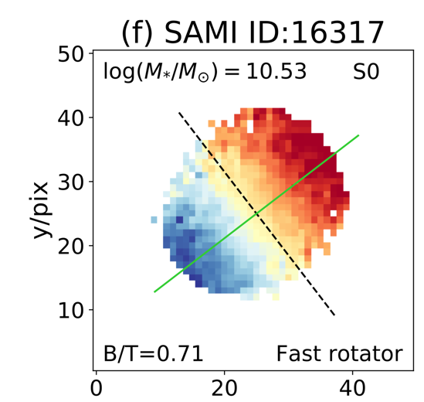
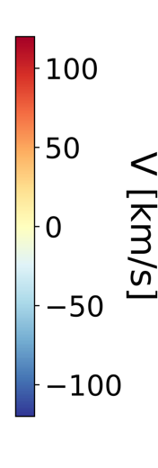

Measuring spin with The SAMI survey
Exploit spatially-resolved stellar kinematics from integral field spectroscopy to identify galaxy spin axes
Study spin-filament alignments of 1121 galaxies as a function of their properties
Examine correlations with stellar mass, bulge-to-total ratio, V/σ, bulge mass,
spin amplitude, stellar population age, local density, distance from filament, etc.
Bryant+2015; Croom+2021

Slide 9
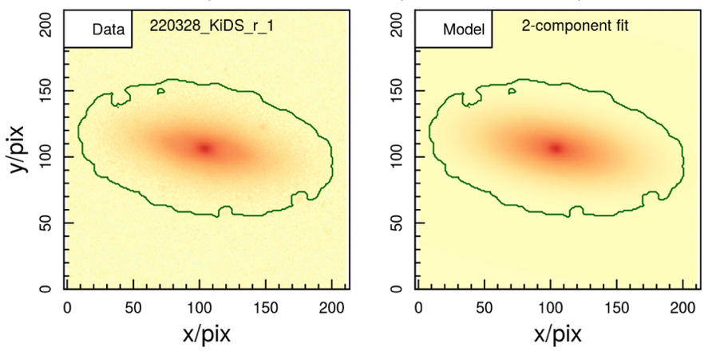
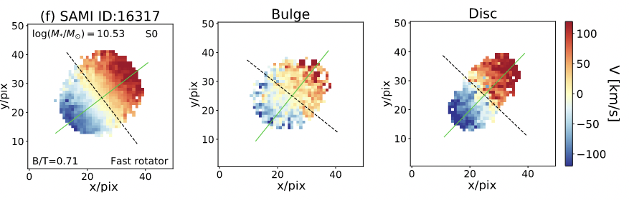
2D bulge/disk decompositions
Data
Model
Bulge/disk
photometric
decomposition
(Casura+2022, submitted;
Barsanti+2021)
Bulge/disk
kinematic
decomposition
(Oh+2020)

Slide 10
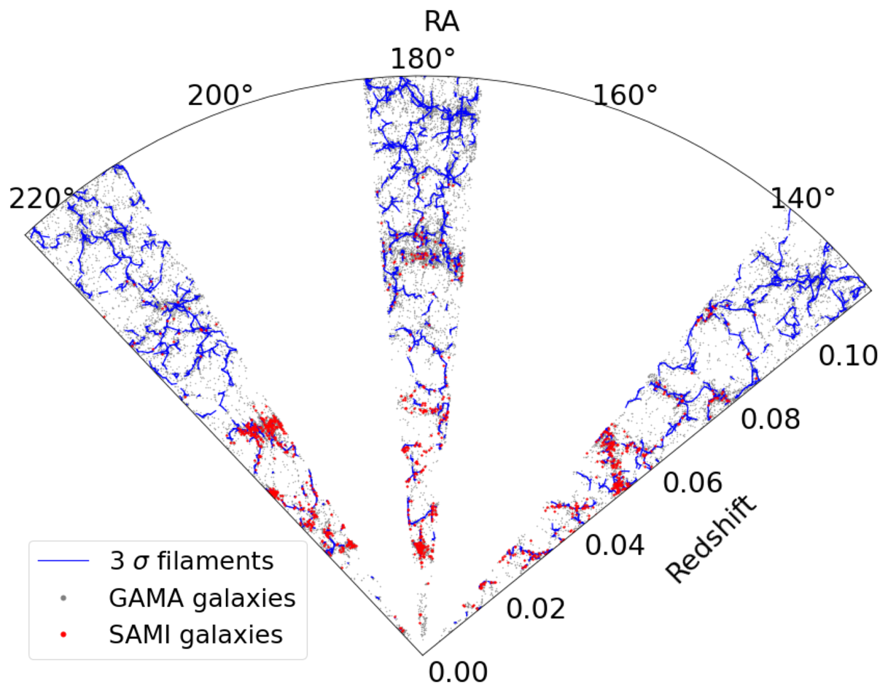
Filaments: GAMA & SAMI galaxies
Δ,

Slide 11
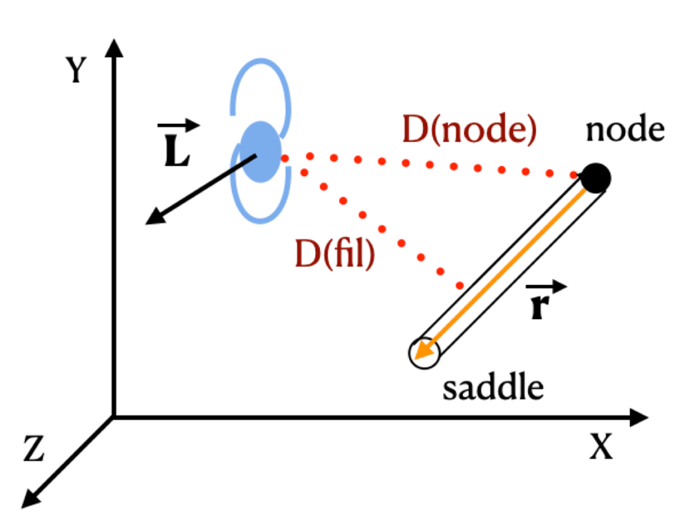
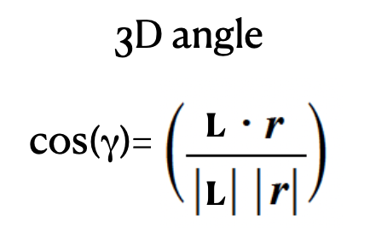




Galaxy spin-filament angle
Measure the alignment between each SAMI galaxy’s spin and the closest cosmic filament…
perpendicular
alignment
|
|
= 0
parallel
alignment
|
|
= 1

Slide 12
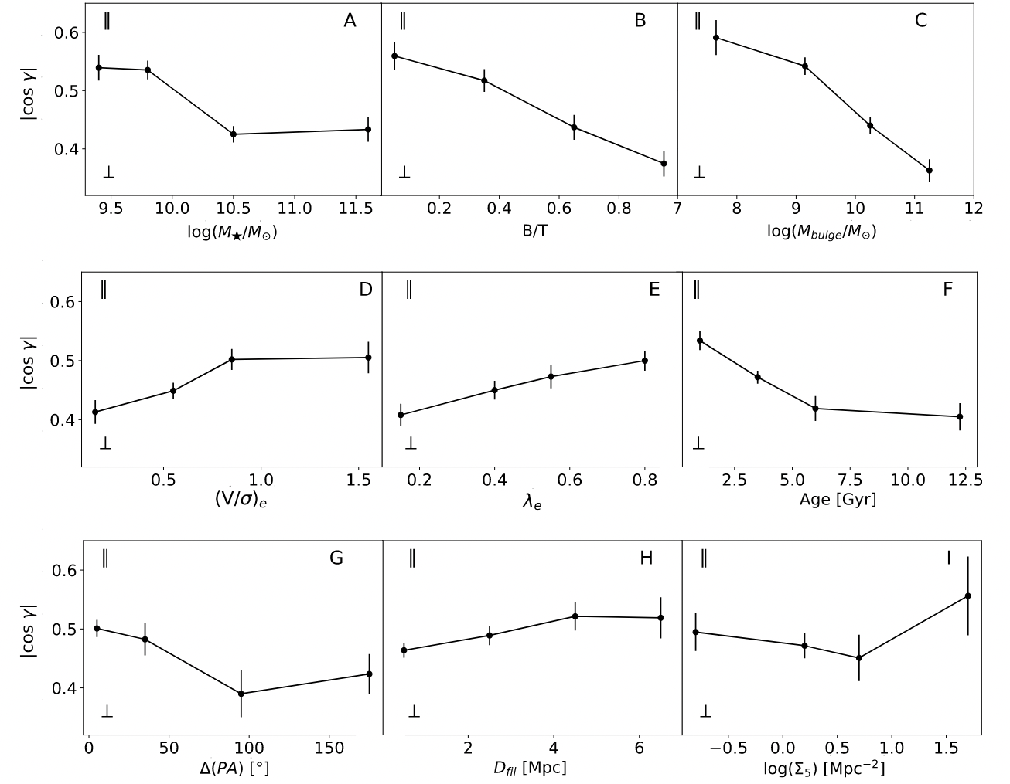
SPIN-Filament angle correlations
= parallel
Look for the strongest trends of |cos γ| with galaxy properties
Spearman tests show that |cos γ| has the strongest correlation with M_{bulge} = M★×(B/T)
Low-bulge-mass galaxy spins tend to be parallel to filaments while high-bulge-mass galaxy spins tend perpendicular
= perpendicular

Slide 13
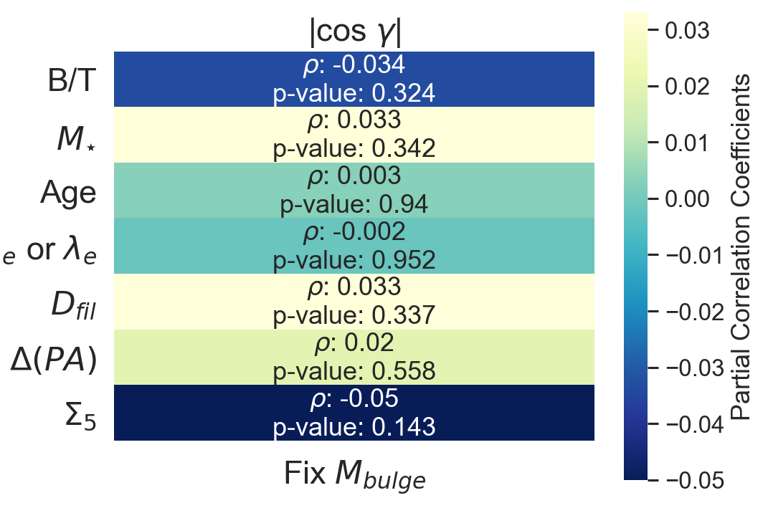

Bulge Mass is the primary correlation
After accounting for the correlation with bulge mass, there are no significant residual correlations with the other parameters
That is, all other trends are consistent with being due to indirect correlations between bulge mass and other properties

Slide 14
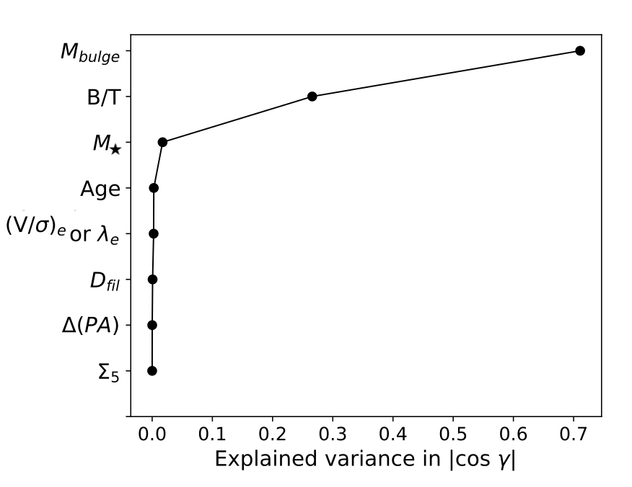
Bulge Mass is the primary correlation
Partial Least Squares (PLS) analysis finds that ∼70% of the variance in |cos γ| is explained by bulge mass
B/T accounts for most of
the remaining variance
  Maybe extra information
  in B/T not in M_{bulge}?
  Maybe B/T just retains information on M_{bulge}
  lost to errors in M★?
  M★ provides almost no extra information after accounting for M_{bulge}

Slide 15
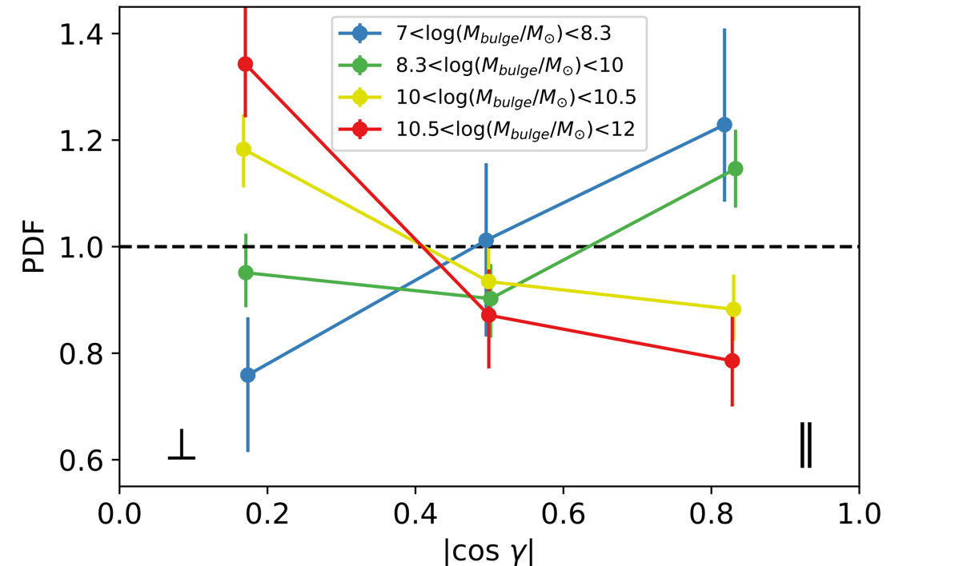

ORIGIN of the correlation with bulge mass
growth of
the bulge
MERGERS?
flipping of
spin-filament alignments
flip
perpendicular
alignment
Galaxies with high bulge mass
Most significant tendencies
K-S test: p-values < 0.05
parallel
alignment
Galaxies with low bulge mass

Slide 16
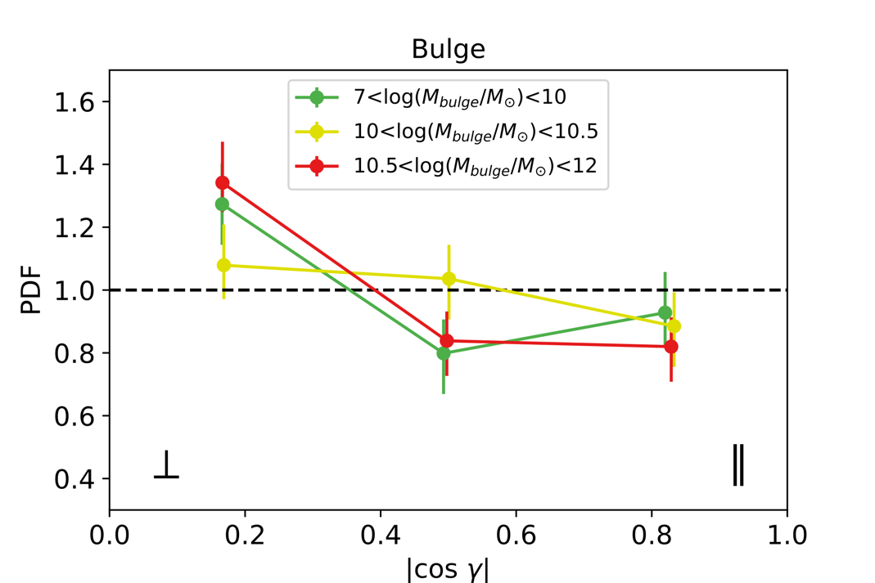
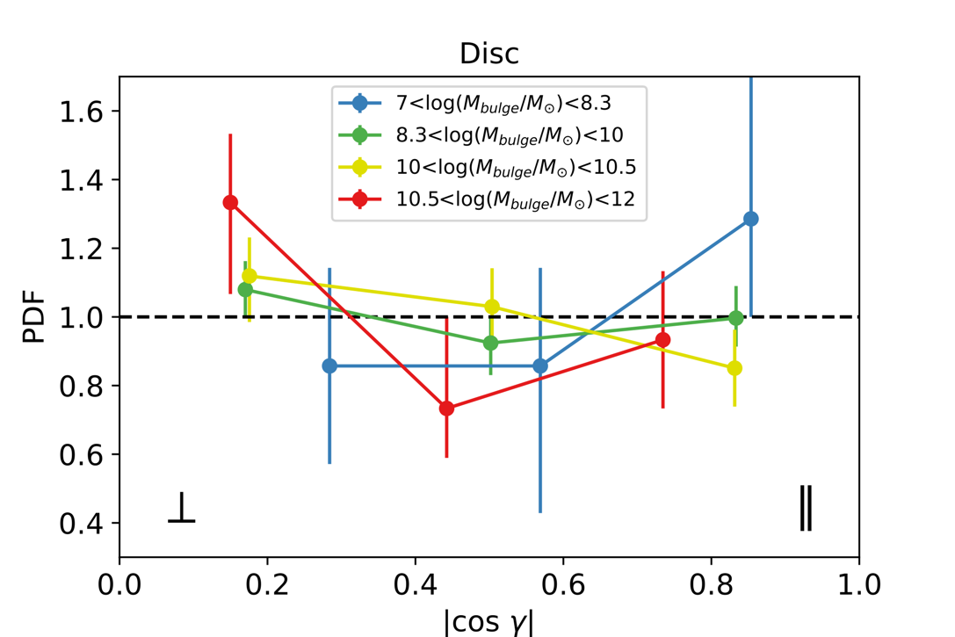

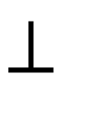

Bulge & disK spin-filament alignments
high bulge mass
alignment
Bulges
alignment
Disks
low bulge mass
alignment
Mergers
Multiple channels of formation
Notes:
How is the spinning of galaxies in the cosmic web related to their properties?

Slide 17
Summary: Bulge formation & spin-filament flips
Galaxy spin-filament alignments correlate most strongly with bulge mass
Low-bulge-mass galaxies tend to have spins parallel to filaments, while high-bulge-mass galaxies tend to have spins perpendicular to filaments
70% of the variance in alignments is explained by bulge mass; most of the residual variance can be explained by the bulge-to-total ratio
Correlations with other properties (where they exist) are secondary
The observed link between the flipping of the spin-filament alignments and the growth of the bulge could be explained by mergers
Studying bulge and disk spin-filament alignments separately reveals further clues about the formation pathways of these components
Barsanti, Colless, et al., 2022, MNRAS, 516, 3569

Slide 18

The Hector Survey
Julia Bryant

Slide 19
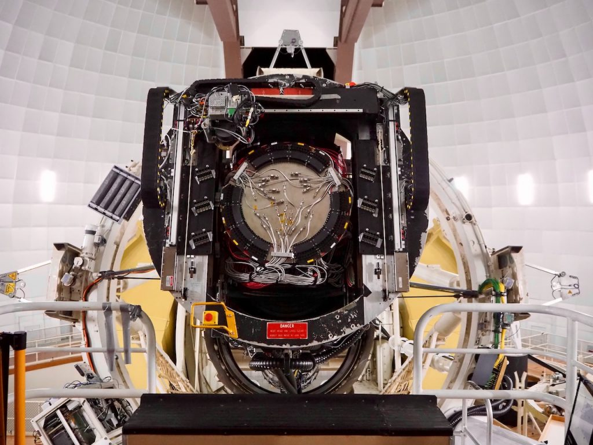

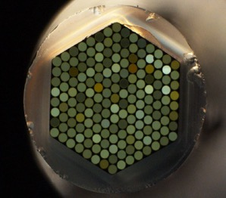
Hector in a nutshell
Credit: Jesse van de Sande
Hector instrument and survey led by Julia Bryant
Multi-IFU instrument with 21 IFUs of varying size (37-169 fibres) across a 2-degree diameter FoV
New Spector spectrograph with higher spectral resolution: blue: 𝜎_{blue} = 30 km/s, 𝜎_{red} = 27 km/s ;
also uses AAOmega spectrograph, as for SAMI
New robotic magnetic positioning system
Hector survey will cover regions in the 4MOST WAVES survey regions and in clusters
Aim: observe 10-15,000 galaxies over a wide range in environment, going to lower masses than SAMI
First light was achieved December 2021; currently completing commissioning and
beginning science verification
hector.survey.org.au

Slide 20
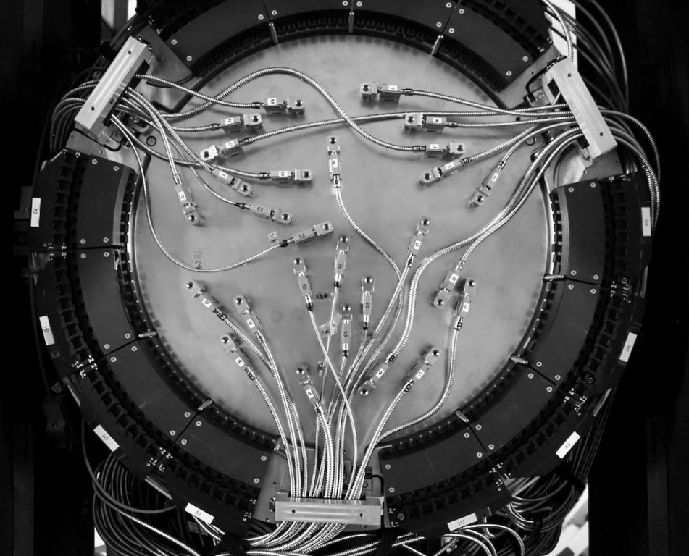
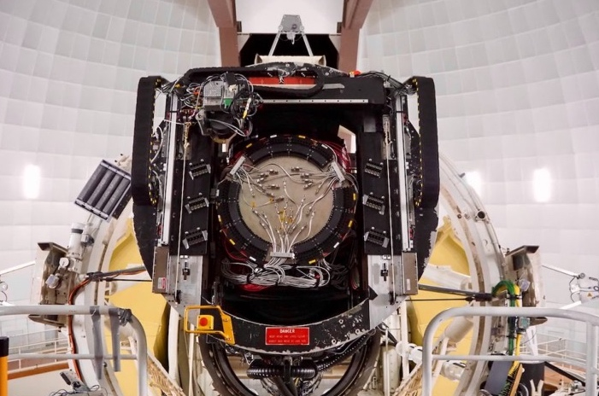




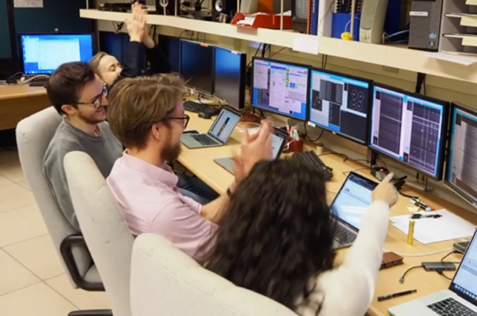
Hector commissioning & key people
Julia Bryant
Jesse
van de Sande
Sam Vaughan
Sree Oh
Madusha Gunawardhana
Credits: Jesse van de Sande and Sam Vaughan
Stefania Barsanti

Slide 21
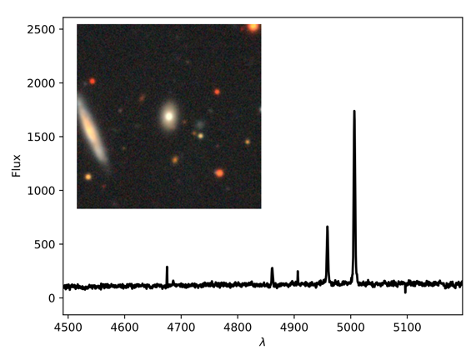
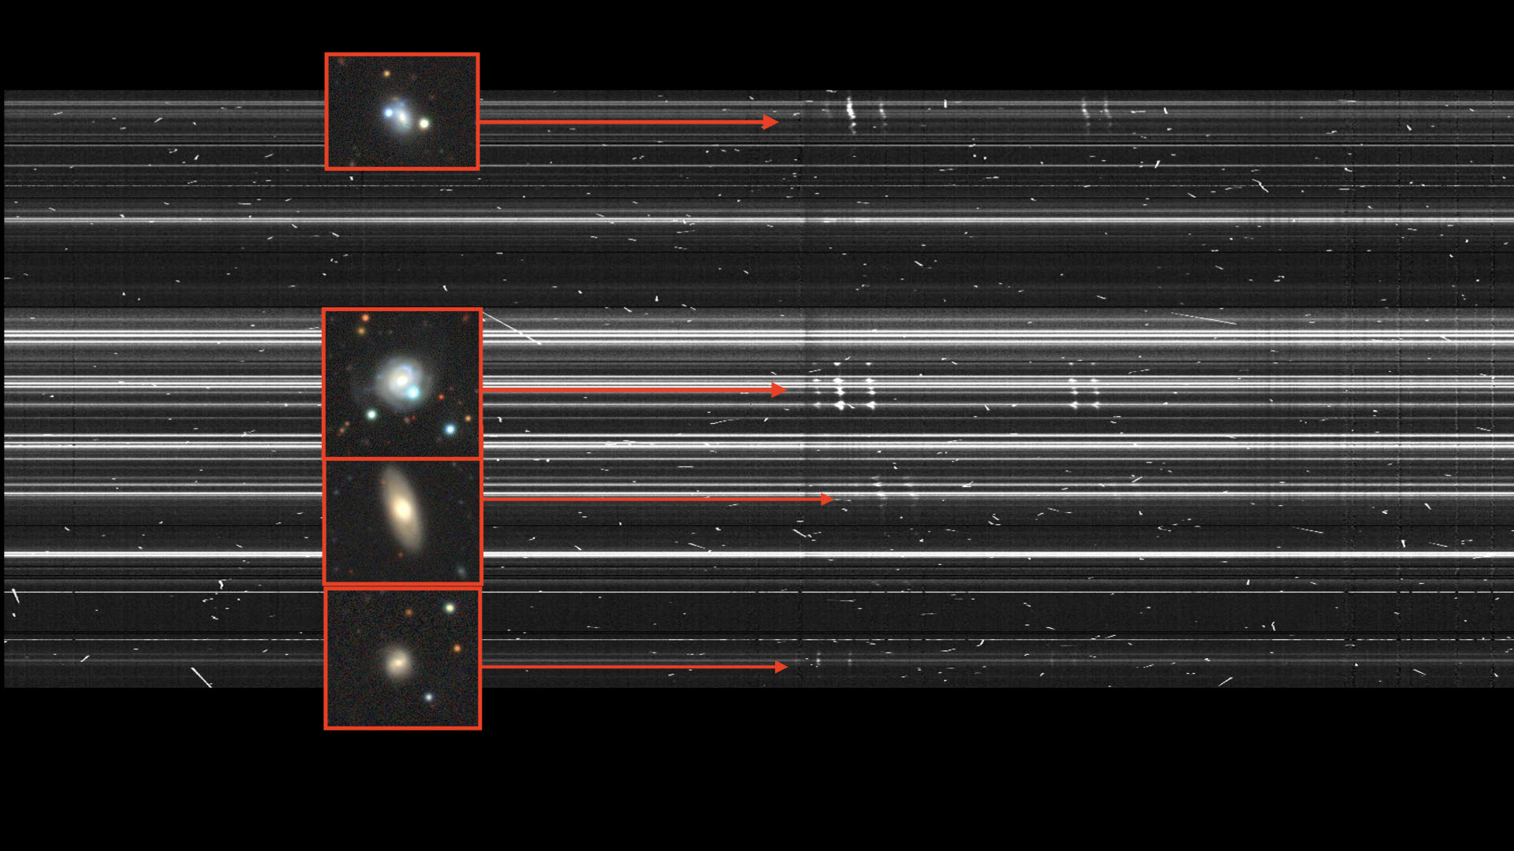
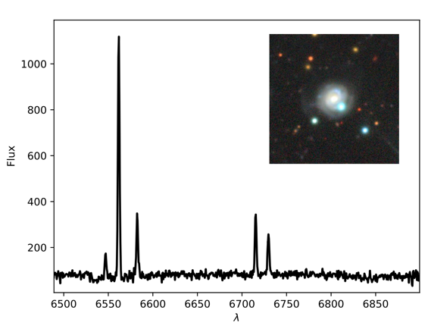
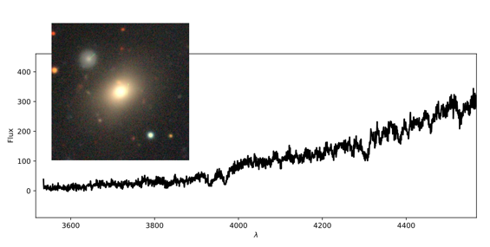
HECTOR commissioning
Credit: Madusha Gunawardhana

Slide 22
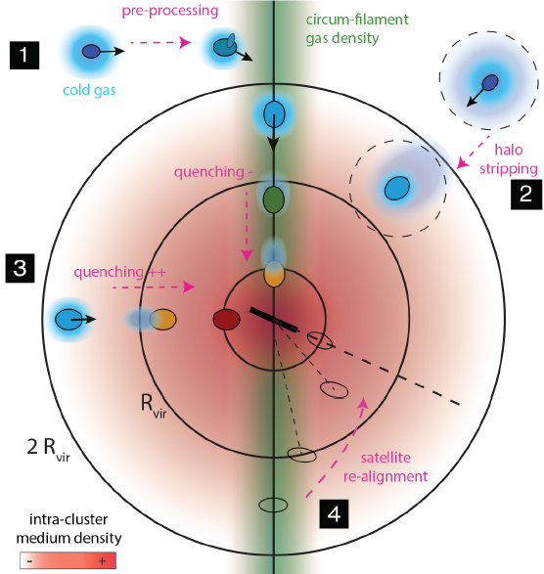
Summary: the Hector survey
The Hector survey is expected to start observations later this year
Early science studies will focus on…
  exploring the dynamics of
  low-mass dwarf galaxies
  determining kinematic properties of Milky Way analogues
  detecting and characterising inflows and outflows at large radii
  studying physical transformations
  in infalling group & cluster galaxies
Adapted from Welker+2018

