Slide 1
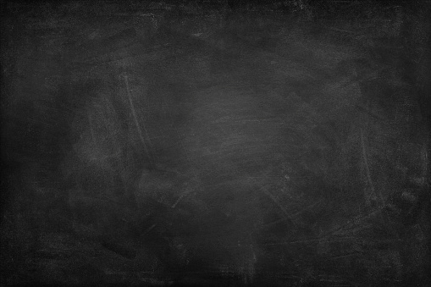
An investigation into the dark matter - galaxy angular momentum correlation
By Lilian Garratt-Smithson (Research Fellow based at UWA)
Working with Danail Obreschkow (UWA)

Slide 2
Angular momentum is a conserved quantity in a closed system. Therefore, the angular momentum of a galaxy has to come from what was there initially, or from extreme tidal torques.
Why study the evolution of angular momentum?

Slide 3
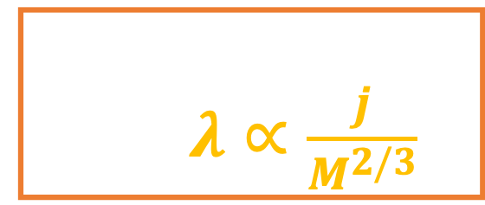

Spin parameter in the context of the j-M plane
j_{h} = J/M (in kpc km/s)
10³
j_{h}∝ M_{h}^{2/3}
10²
Scatter set by spin; $λ∝\frac{j}{M^{2/3}}$
10
10⁹
10¹⁰
10¹¹
M_{h} (in M$⊙$ )

Slide 4
A useful relationship to use in order to study the journey of angular momentum from a dark matter halo to the galaxy is therefore that between the spin of the galaxy and the spin of the dark matter halo.

Slide 5

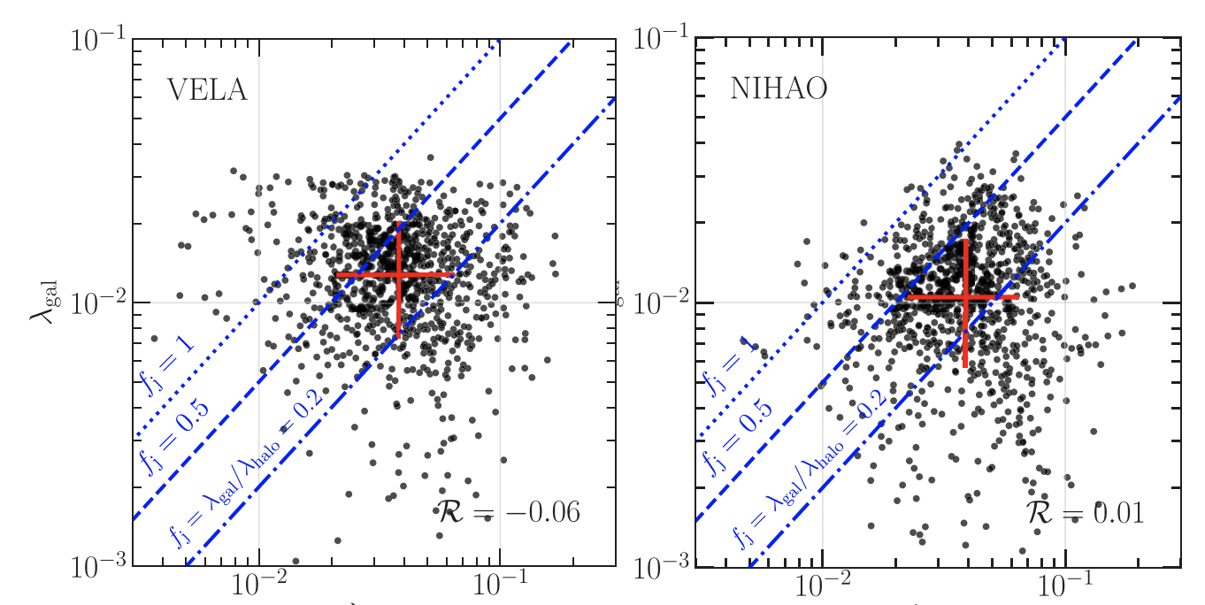
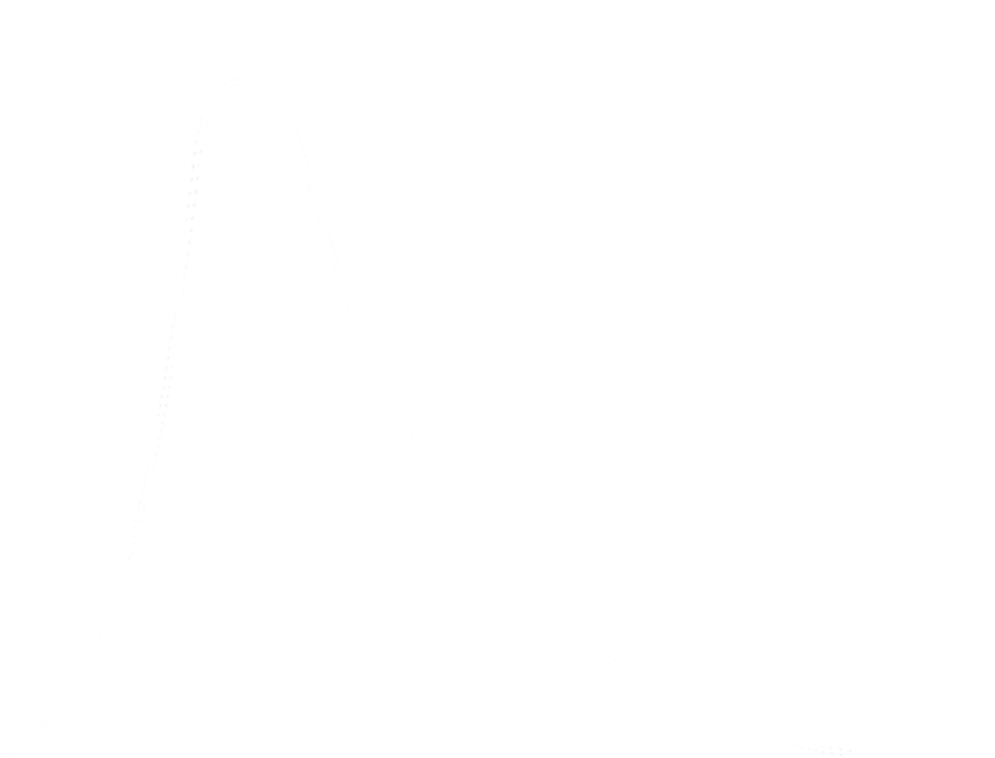
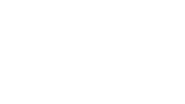

Importance of angular momentum and its journey to the galaxy
Jiang et al. 2019
Cosmological zoom simulations
$$Φ(λ)$$
$$λ$$

Slide 6
Importance of angular momentum and its journey to the galaxy
Jiang et al. 2019
Galaxy spin
$$Φ(λ)$$
$$λ$$

Slide 7
Importance of angular momentum and its journey to the galaxy
Galaxy spin – Jiang et al. 2019:
Dense (n_{H} > 10³ cgm⁻³) and cold (< 10⁴ K) gas + stars.
Also, they use a radial cut-off: 0.1R₂₀₀.
Galaxy spin
$$Φ(λ)$$
Galaxy spin – in this work:
We use an ISM/CGM conversion (discussed in Garratt-Smithson+2021).
Our radial cut-off: R₂₀₀.
$$λ$$
Jiang et al. 2019

Slide 8
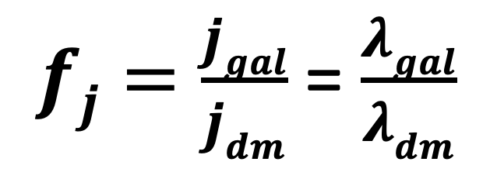
Importance of angular momentum and its journey to the galaxy
Galaxy spin
$$Φ(λ)$$
$fj=\frac{jgal}{jdm}$ = $\frac{λgal}{λdm}$
$$λ$$
Jiang et al. 2019

Slide 9
Importance of angular momentum and its journey to the galaxy
Jiang et al. 2019
16th-84th percentiles
$$Φ(λ)$$
$$λ$$

Slide 10
Importance of angular momentum and its journey to the galaxy
Jiang et al. 2019
Pearson correlation coefficient
$$Φ(λ)$$
$$λ$$

Slide 11
Importance of angular momentum and its journey to the galaxy
Jiang et al. 2019
Pearson correlation coefficient
$$Φ(λ)$$
*Different redshifts shown
$$λ$$

Slide 12
It is clear the correlation between the two spins is negligible from the zoom simulations.
But where/when does this de-correlation occur? Do other simulations agree?
We begin by looking at cosmological simulations for answers.

Slide 13
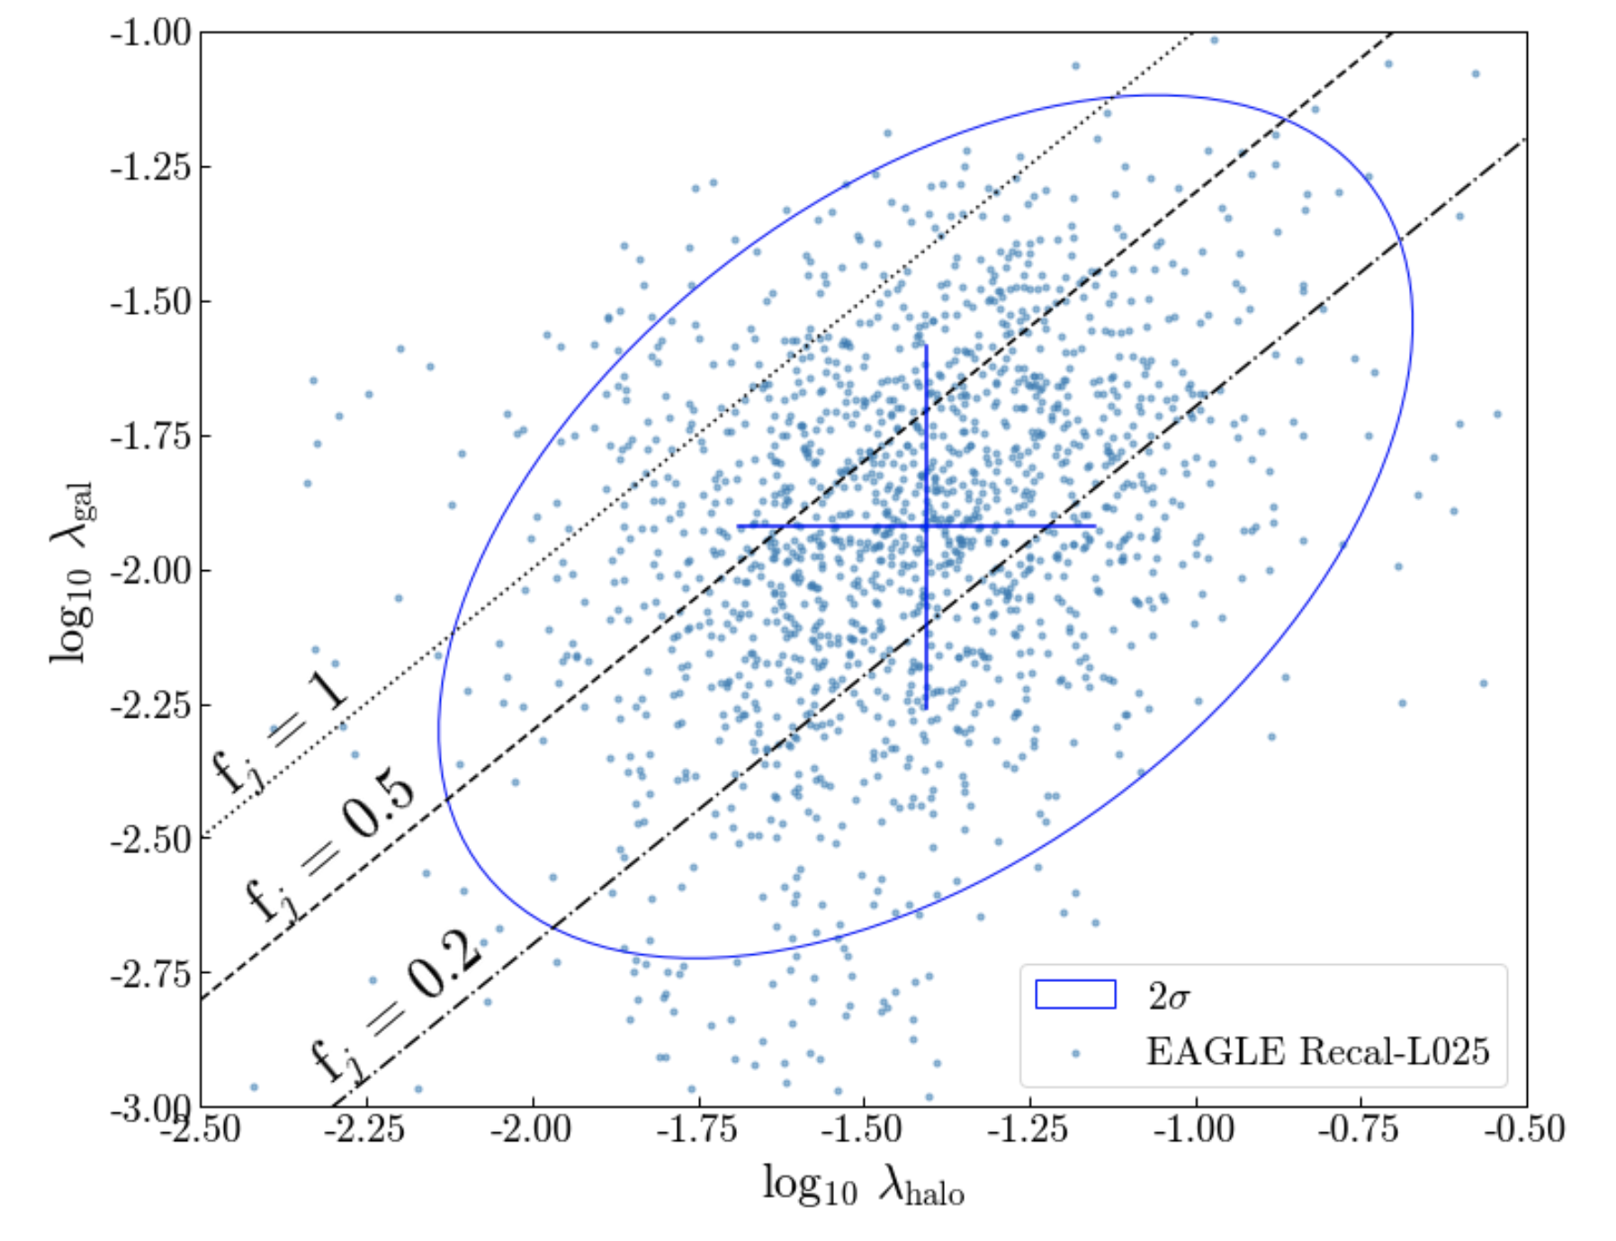

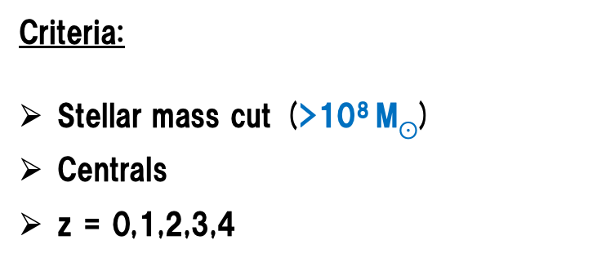
Cosmological simulations – what do they tell us about the $λgal$- $λdm$ correlation?
Criteria:
Stellar mass cut (>10⁸ M$⊙$)
Centrals
z = 0,1,2,3,4
Pearson correlation coefficient:
+0.47

Slide 14
Cosmological simulations – what do they tell us about the $λgal$- $λdm$ correlation?
Criteria:
Stellar mass cut (>10⁸ M$⊙$)
Centrals
z = 0,1,2,3,4
Pearson correlation coefficient:
+0.47
There are two things to note here:
This correlation is still relatively weak.
However, it is not negligible as in the zoom simulations.

Slide 15
Cosmological simulations – what do they tell us about the $λgal$- $λdm$ correlation?
Criteria:
Stellar mass cut (>10⁸ M$⊙$)
Centrals
z = 0,1,2,3,4
Pearson correlation coefficient:
+0.47
Is this positive correlation true for different cosmological simulations?

Slide 16
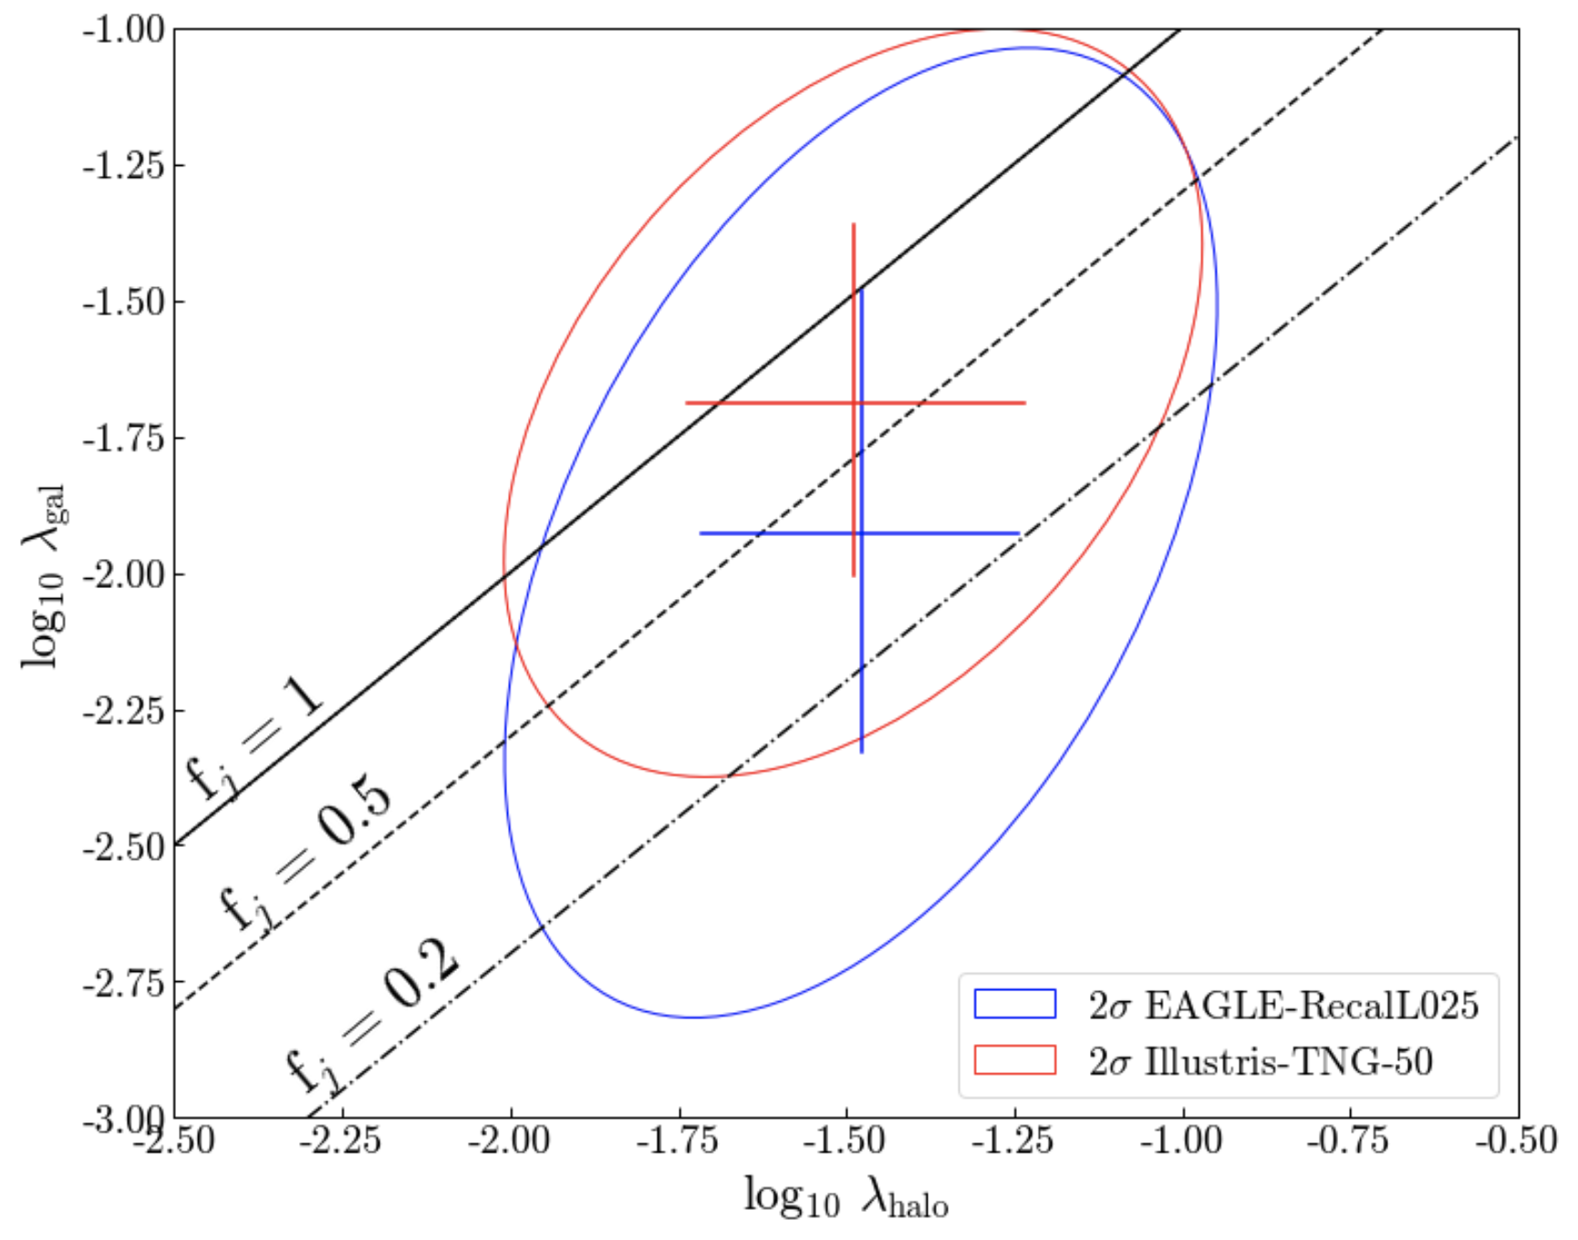
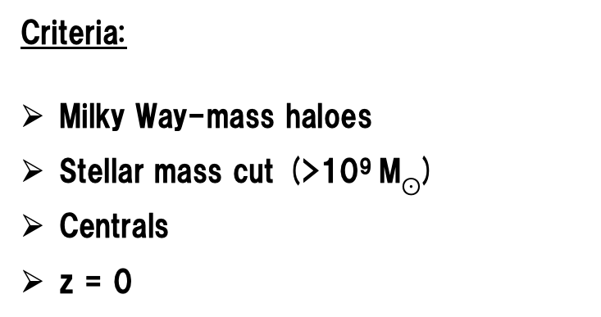
Cosmological simulations – what do they tell us about the $λgal$- $λdm$ correlation?
Criteria:
Milky Way-mass haloes
Stellar mass cut (>10⁹ M$⊙$)
Centrals
z = 0
Pearson correlation coefficient:
+0.47, +0.42

Slide 17
Cosmological simulations – what do they tell us about the $λgal$- $λdm$ correlation?
Criteria:
Milky Way-mass haloes
Stellar mass cut (>10⁹ M$⊙$)
Centrals
z = 0
Pearson correlation coefficient:
+0.47, +0.42
Fundamentally, the level of correlation is low, for both simulations. Further, the mean f_{j} value is below 1.

Slide 18
Crucially, the level of correlation between the spin of the galaxy and the dark matter is low in cosmological simulations. But, when does this de-correlation occur?
To answer this question, we need to understand the journey of angular momentum from the halo to the galaxy. A natural place to start looking is the CGM.

Slide 19
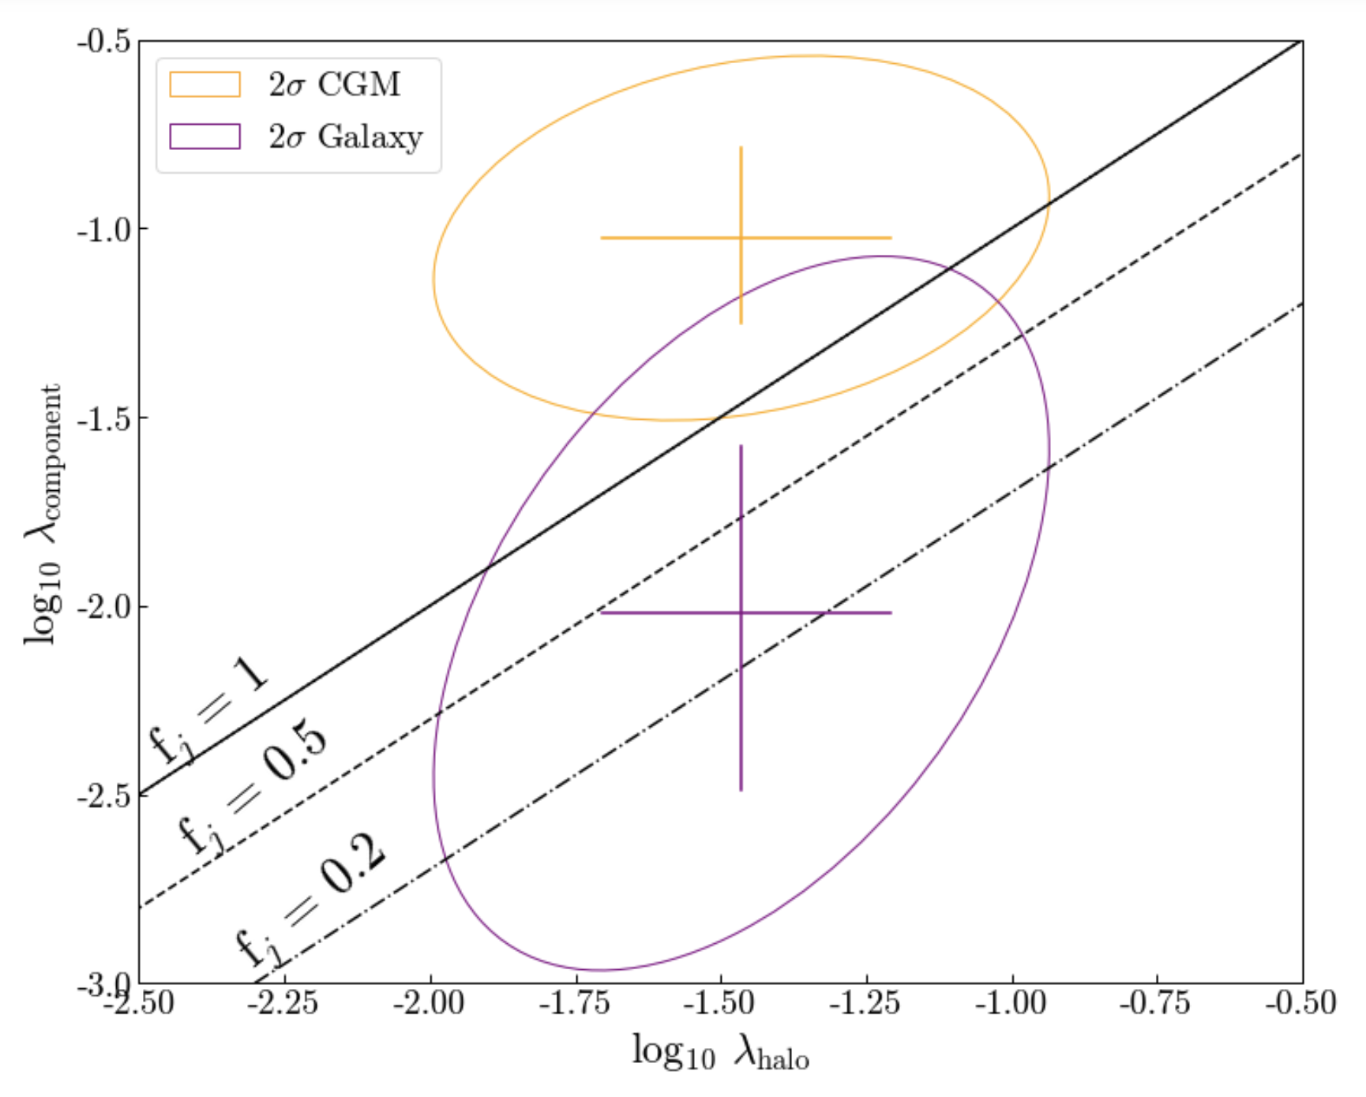
The angular momentum journey: the CGM
**z = 0
EAGLE
CGM – circumgalactic medium.

Slide 20
The angular momentum journey: the CGM
It is clear there is a CGM-galaxy disparity. It is also clear the journey of angular momentum from halo-galaxy is not linear.
CGM – circumgalactic medium.

Slide 21
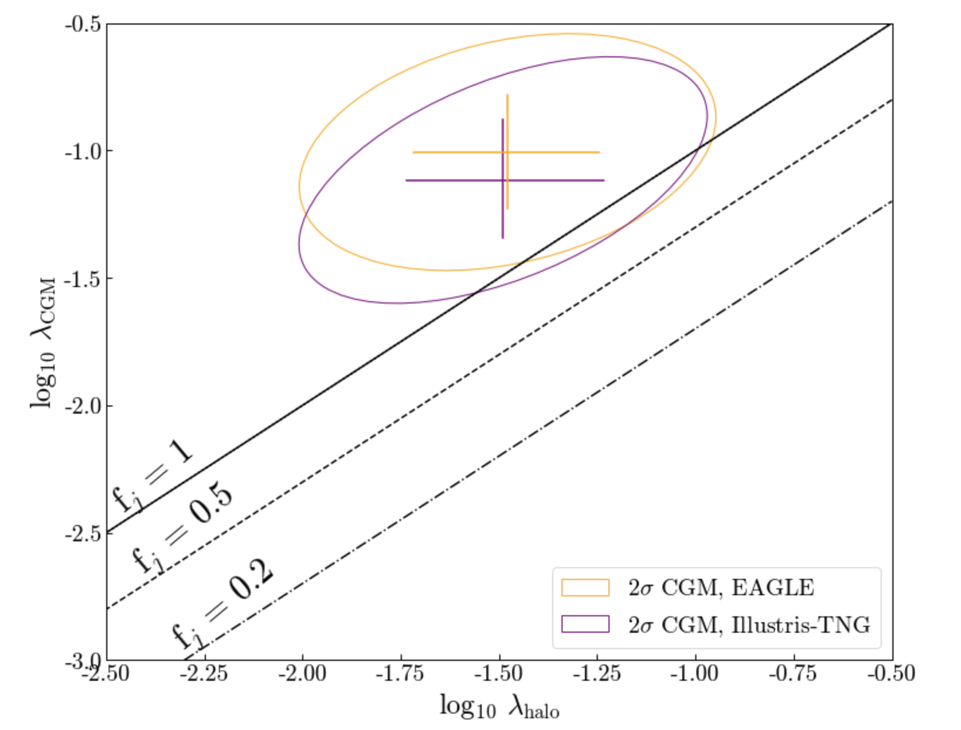
The angular momentum journey: the CGM
CGM – circumgalactic medium.

Slide 22
The angular momentum journey: the CGM
CGM – circumgalactic medium.
Pearson correlation coefficient:
+0.52, +0.29
Key takeaway: the CGM is already de-correlated, prior to in-fall onto the galaxy.

Slide 23
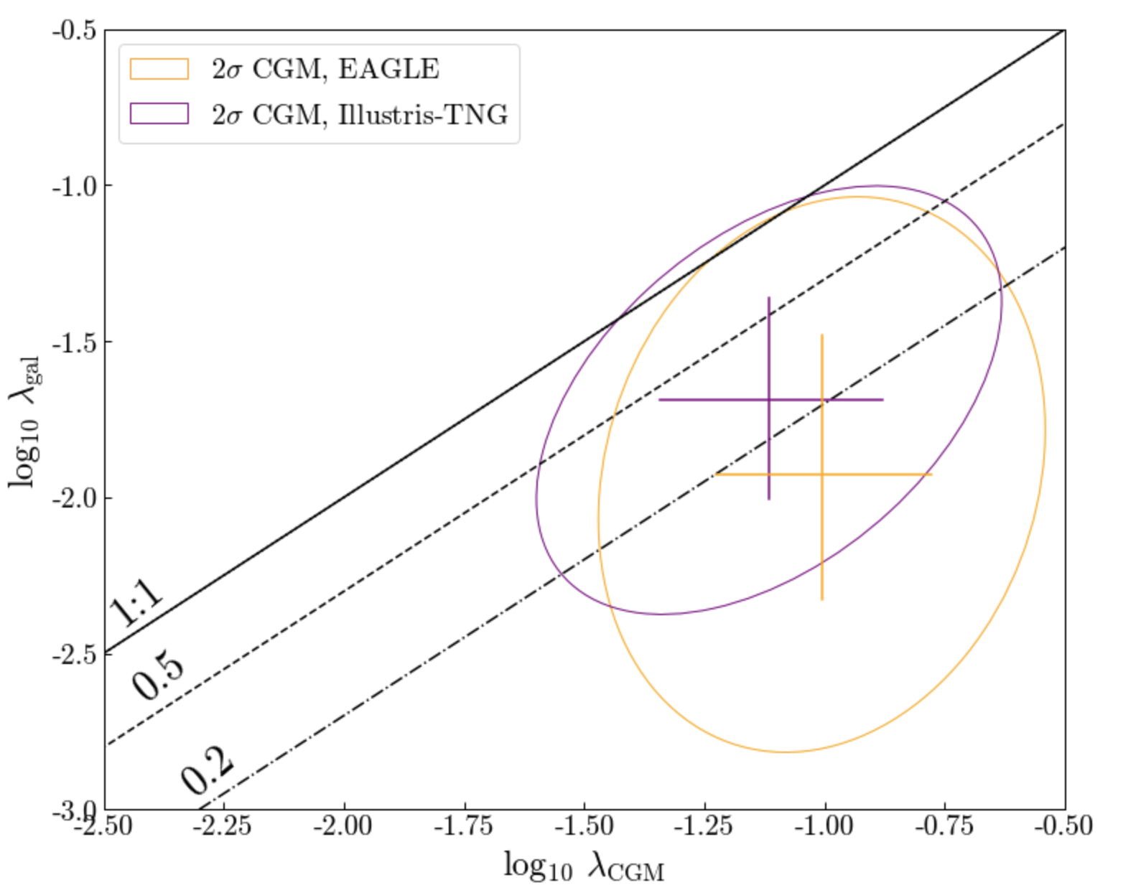
The angular momentum journey: the CGM
Pearson correlation coefficient:
+0.16, +0.46
The key takeaways here:
The level of correlation between the CGM spin and the galaxy spin is weak. The journey of angular momentum is complex.
The level of correlation is different depending on the cosmological simulation you analyse.
Galaxy
CGM

Slide 24
The angular momentum journey: the CGM
Pearson correlation coefficient:
+0.16, +0.46
The key takeaways here:
The level of correlation between the CGM spin and the galaxy spin is weak. The journey of angular momentum is complex.
The level of correlation is different depending on the cosmological simulation you analyse.
Galaxy
BUT is this difference physical (e.g. galaxy evolution physics)or numerical (e.g. hydrodynamic scheme OR halo identification inconsistencies) in origin?
CGM

Slide 25
We can use different types of simulation to isolate different aspects of the angular momentum journey.
We can begin using simulations which have removed the galaxy evolution physics.
Are our results sensitive to the hydrodynamic scheme used?

Slide 26
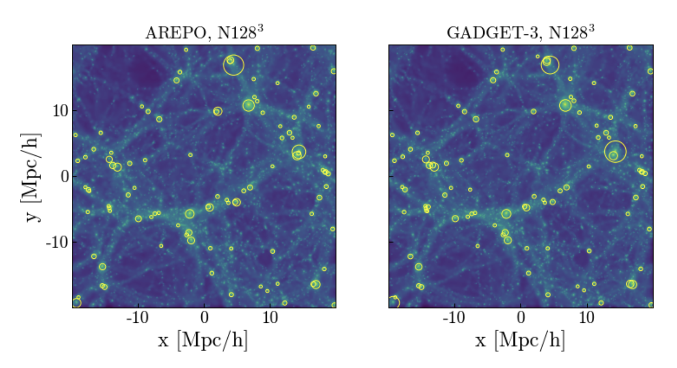
Understanding the angular momentum journey: without galaxy evolution
AREPO
GADGET-3
Non-radiative simulations of cosmological volumes.

Slide 27
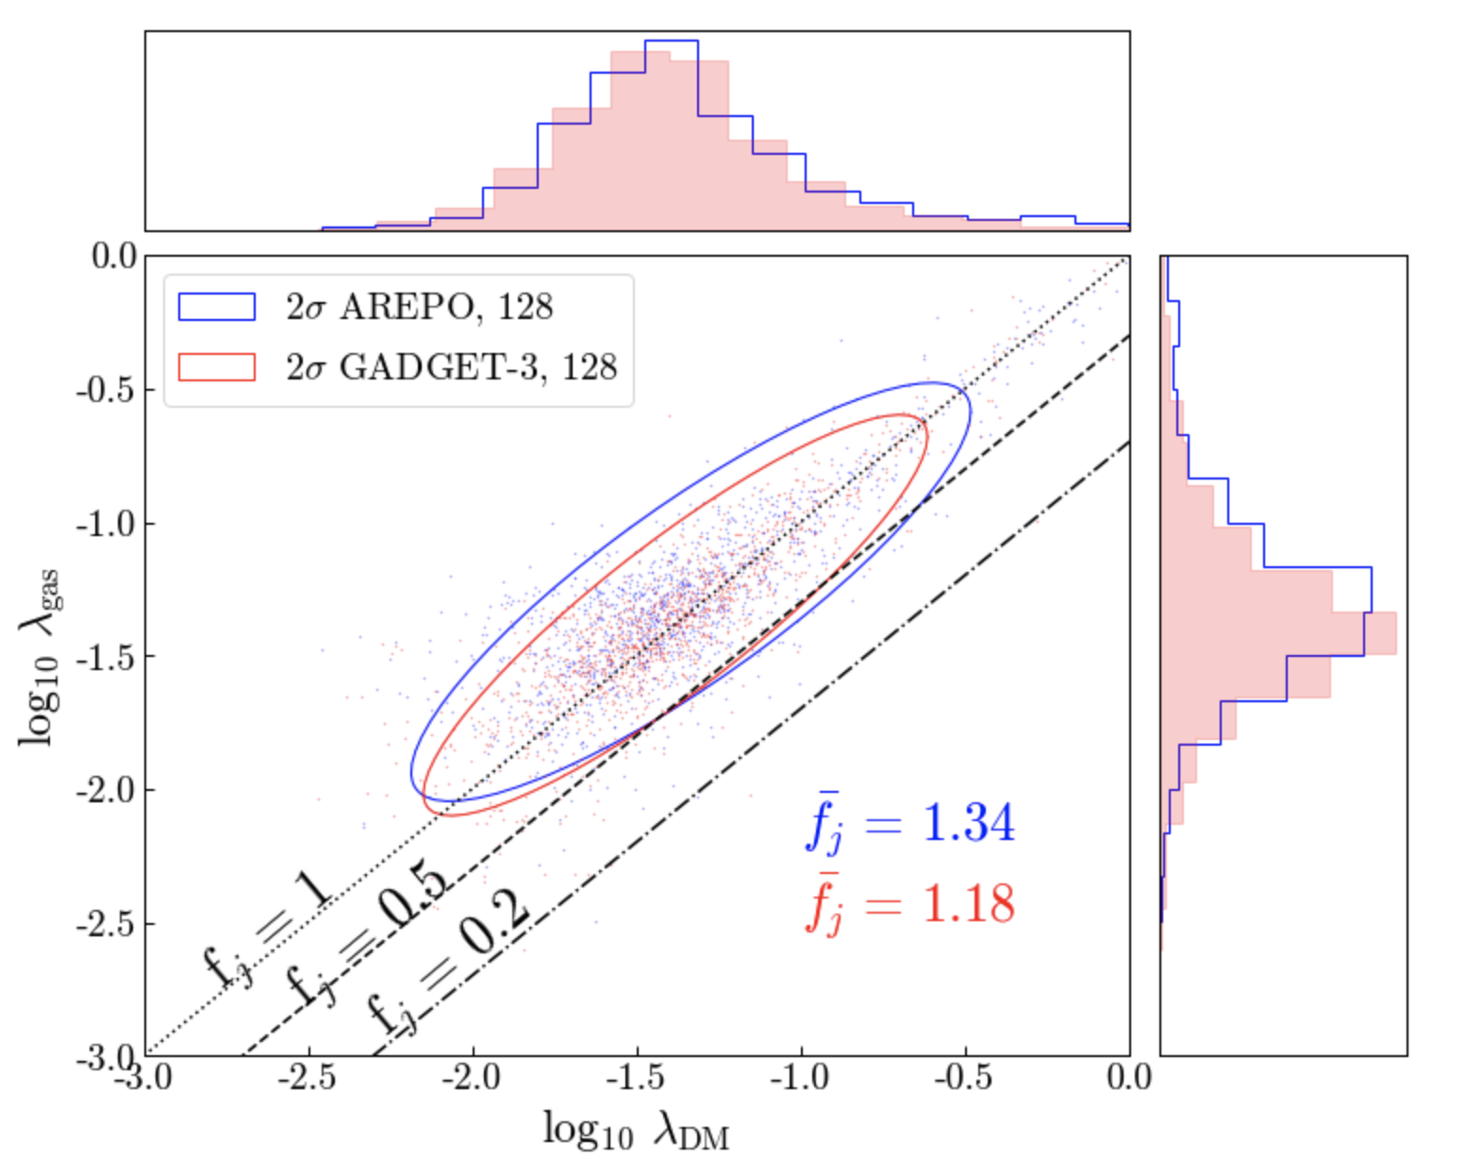
Understanding the angular momentum journey: without galaxy evolution
Pearson correlation coefficient:
+0.86, +0.89
Halo gas spin
Halo dm spin

Slide 28
Understanding the angular momentum journey: without galaxy evolution
Pearson correlation coefficient:
+0.86, +0.89
Halo gas spin
*Compare this with:
f_{j} = 3.6 – EAGLE
(all gas in halo)
Halo dm spin

Slide 29
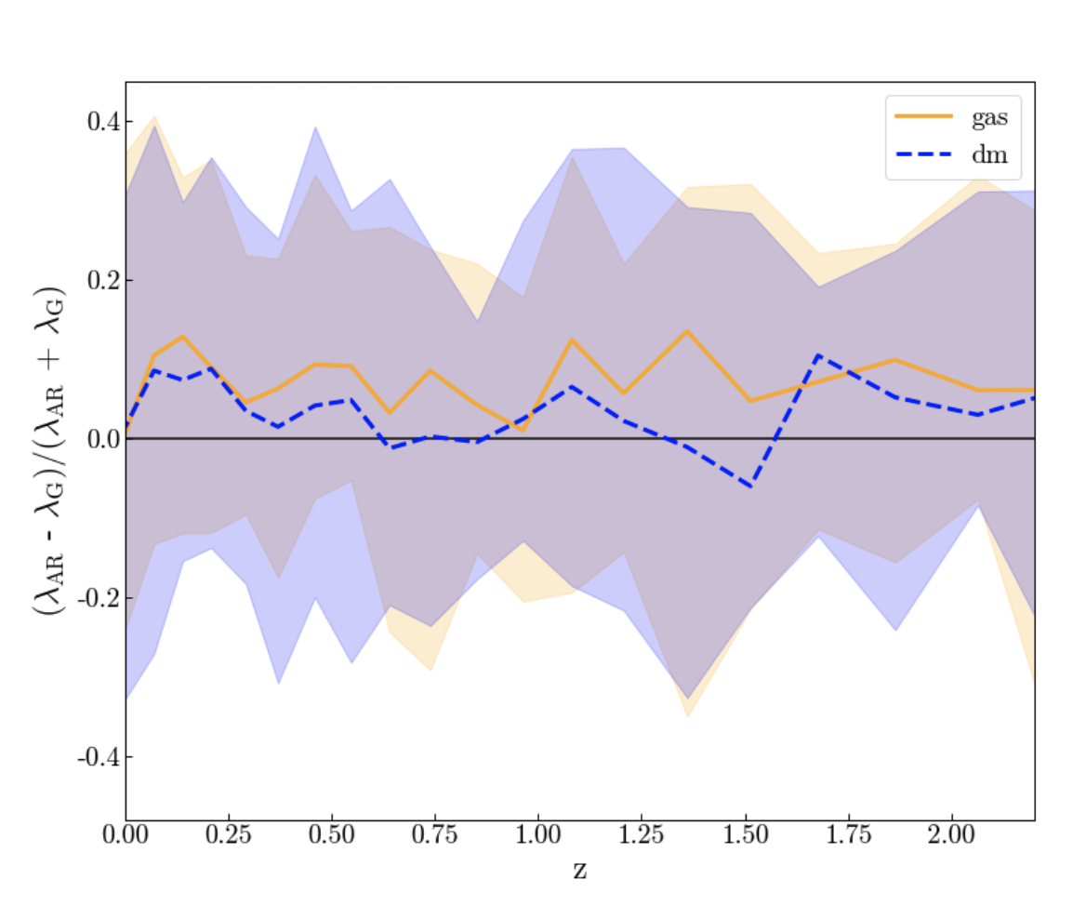
Understanding the angular momentum journey: a closer look at the hydrodynamic scheme
*Though there is a systematic increase in the gas spin in the AREPO run compared with the GADGET-3 run, we can also see there is an inherently large scatter in the relative spins.
It is therefore worth investigating what is driving this scatter.

Slide 30
We hypothesise the scatter in spin values seen between snapshots for individual haloes is driven by a) tidal torques acting on particles/cells or b) accretion of matter onto the halo/tidal stripping/numerics such as Poisson noise associated with the FOF algorithm.

Slide 31
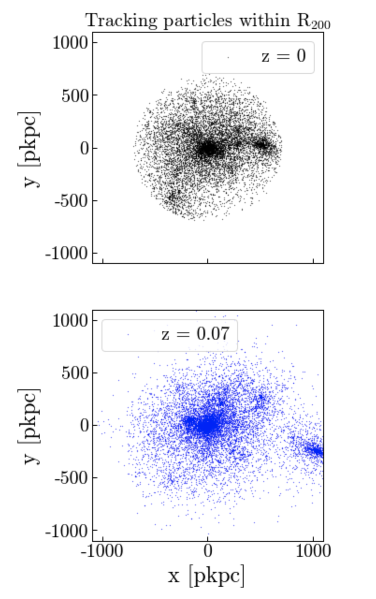
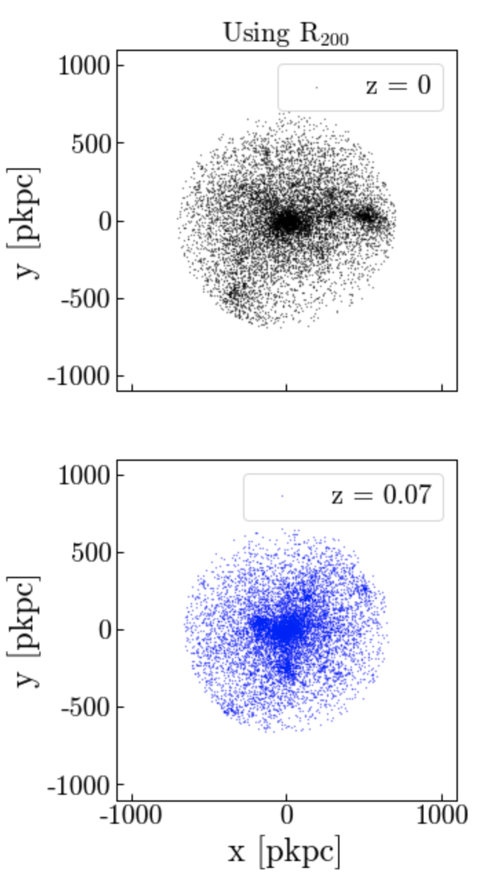
Understanding the angular momentum journey: the inherently large scatter in spin
We can attempt to investigate whether it is tidal torques driving the scatter, by measuring the scatter in spin values for haloes between adjacent snapshots by a) tracking particles and b) measuring the spin within the virial radius at each snapshot.

Slide 32
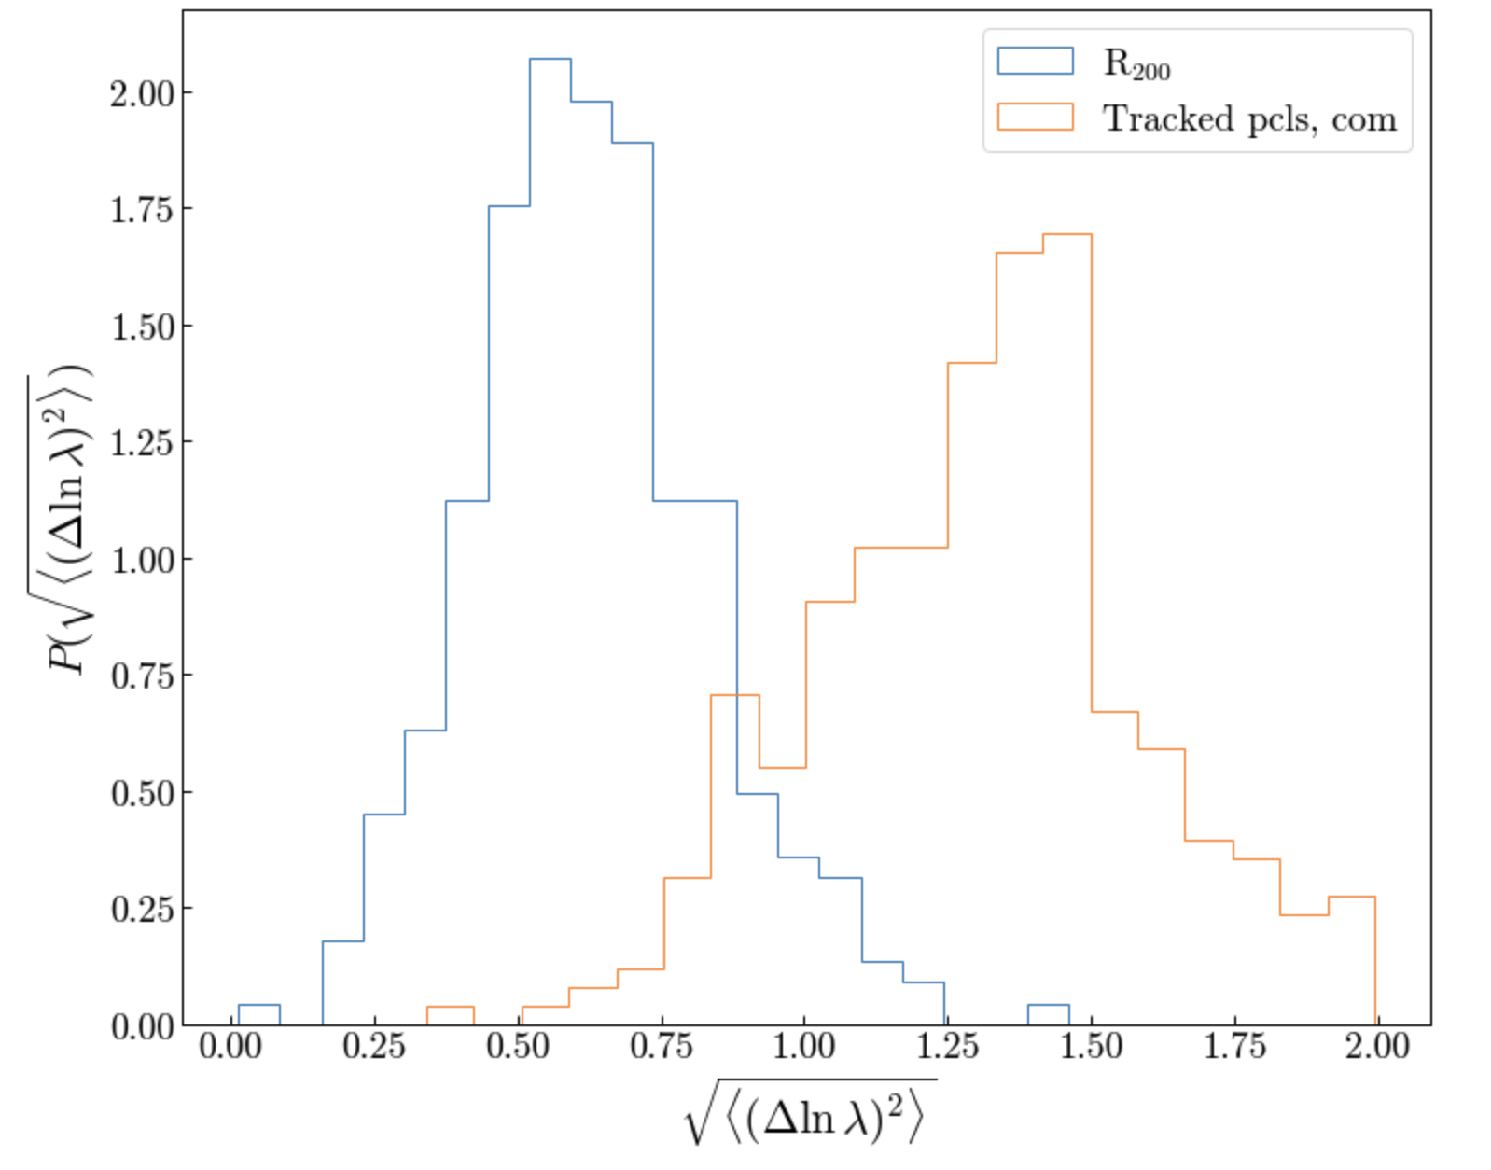
Understanding the angular momentum journey: the inherently large scatter in spin
This result implies that, when an aperture of R₂₀₀ is used, the scatter is being driven by tidal torques, as opposed to Poisson noise associated with the FOF algorithm etc.

Slide 33
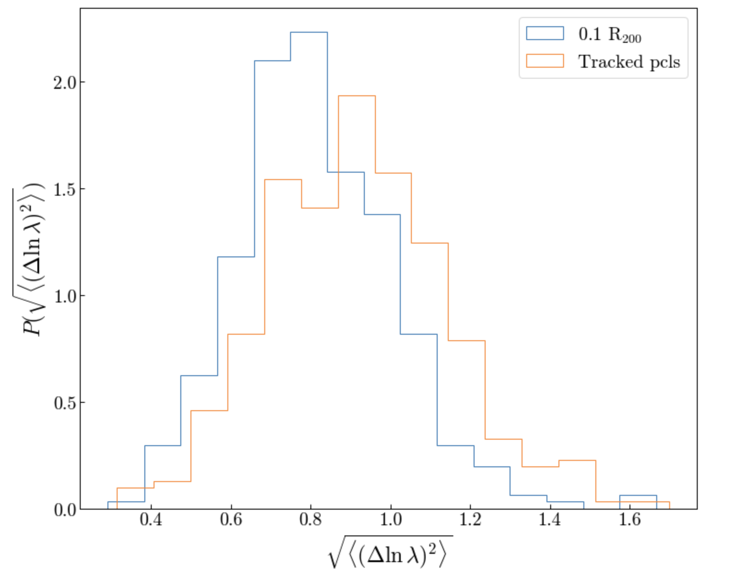
Understanding the angular momentum journey: the inherently large scatter in spin
However, were we to use an aperture of 0.1 R₂₀₀ instead, the scatter driven by Poisson noise/accretion/tidal stripping is comparable to that of the large-scale tidal torques.

Slide 34
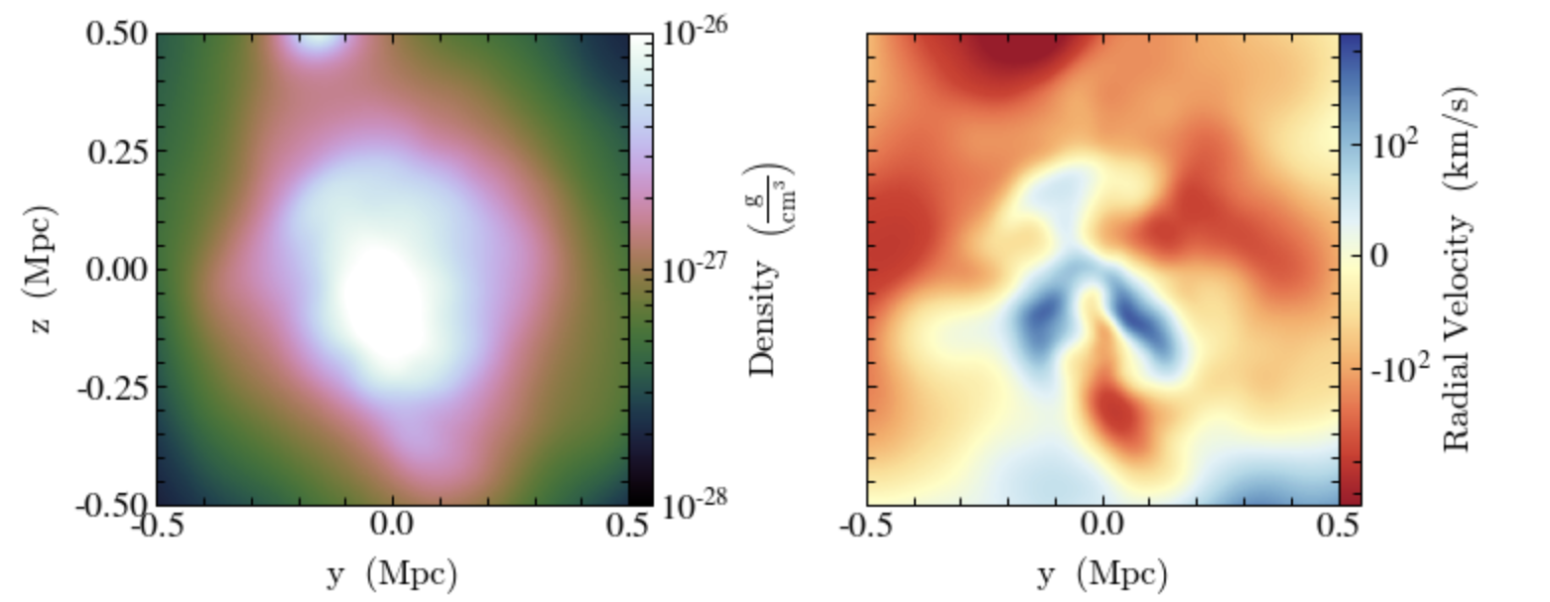
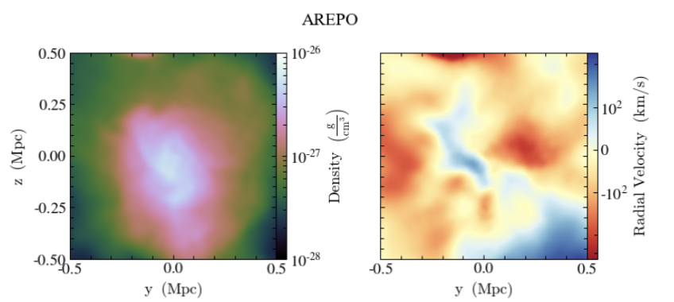
Understanding the angular momentum journey: tracking individual haloes
We can investigate the systematic differences between AREPO/GADGET-3 run by following the same system in both runs. Here is an example.

Slide 35
The key results from these simulations are: a) The correlation between the dark matter spin and gas spin is high in runs that do not include galaxy evolution physics. Hence galaxy evolution physics is playing a key role here. b)Spin is an inherently noisy quantity. This noise is both physical and numerical in origin.

Slide 36
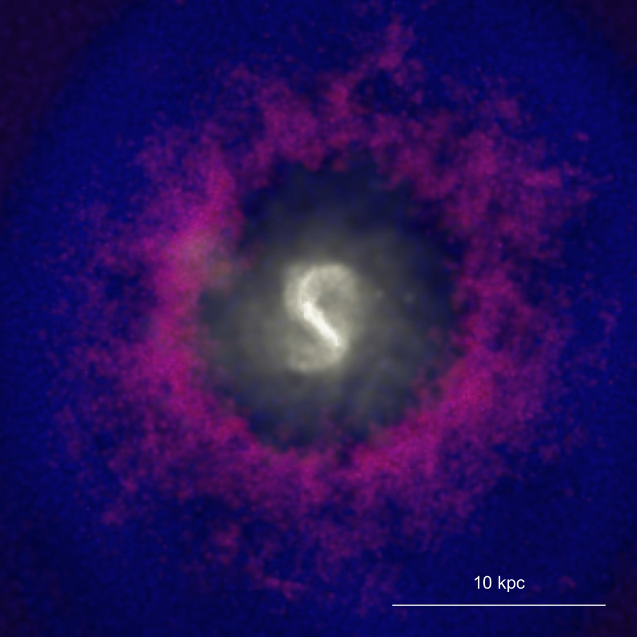
Understanding the angular momentum journey: including galaxy evolution

Slide 37
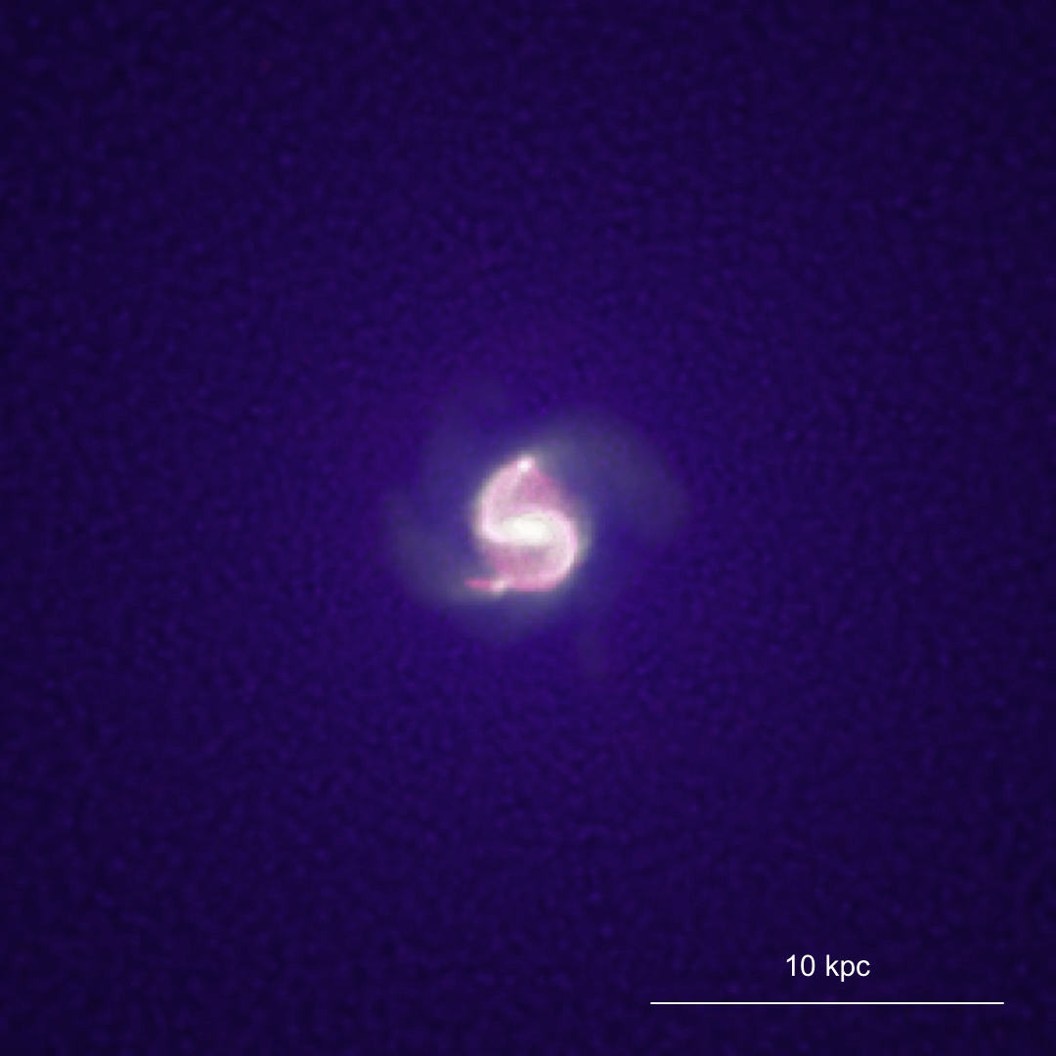
Including stellar feedback
No stellar feedback

Slide 38
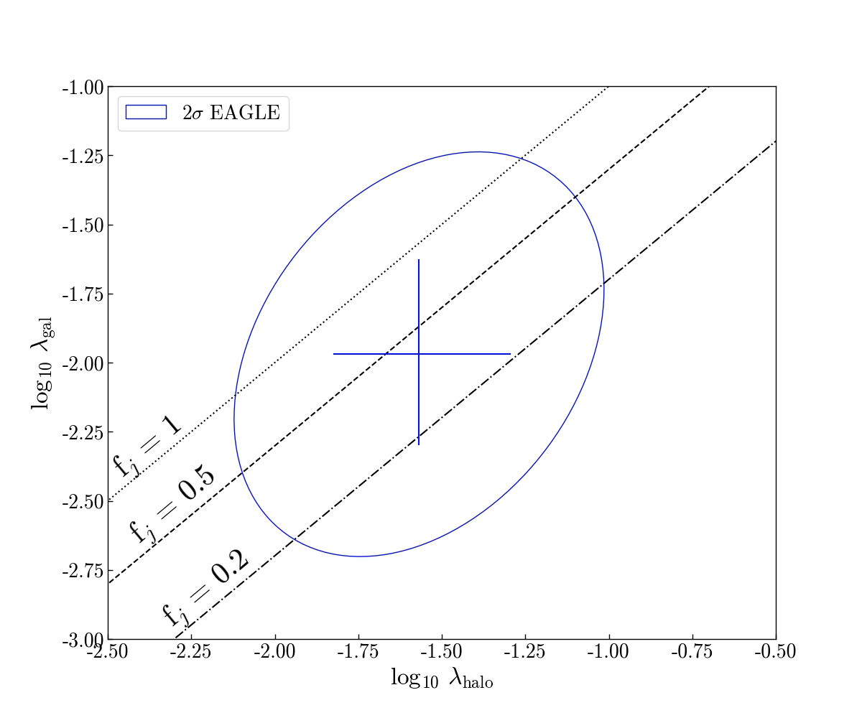
Understanding the angular momentum journey: the role of stellar feedback
GALAXY
The gas cools at the centre of the halo first, where the angular momentum is lower.
The stellar feedback is able to eject this lower angular momentum gas into the CGM…
No feedback
+ Stellar feedback

Slide 39
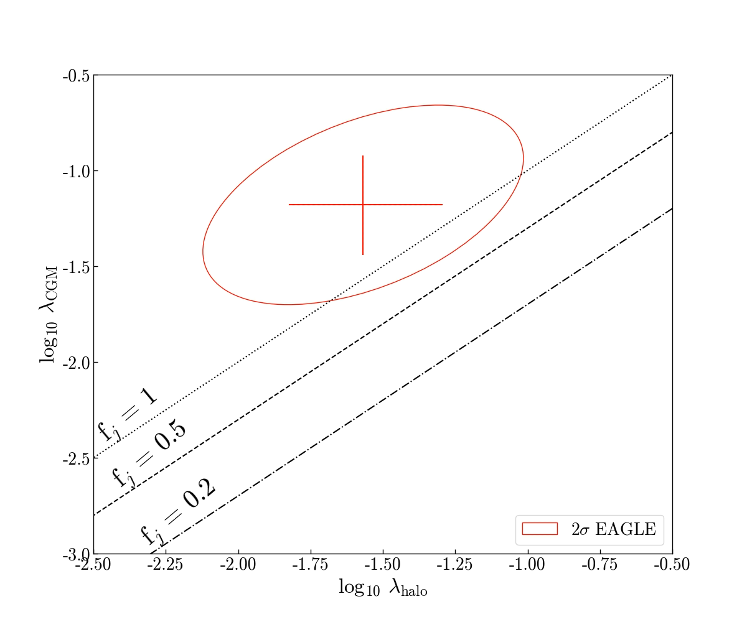
Understanding the angular momentum journey: the role of stellar feedback
CGM
…lowering the spin of the CGM compared with the run that does not include feedback.
No feedback
+ Stellar feedback

Slide 40
How does this result change when we include the hierarchical assembly history of a halo? To answer this, we need to go full-circle - back to zoom simulations.

Slide 41
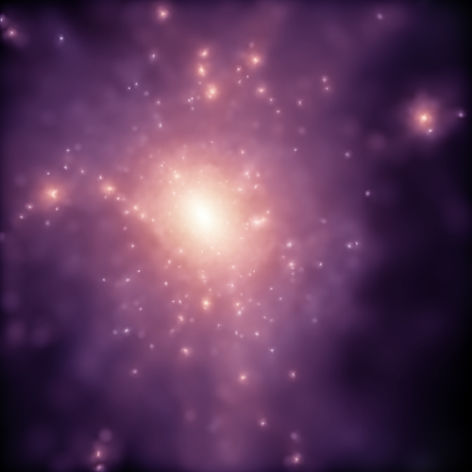
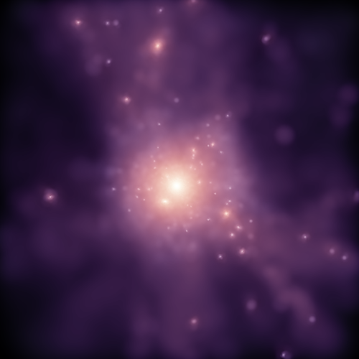
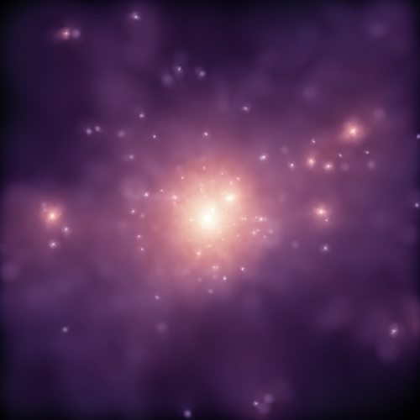
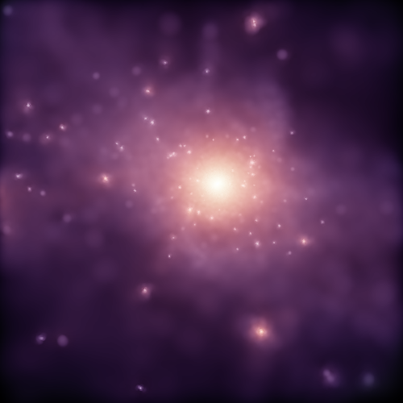
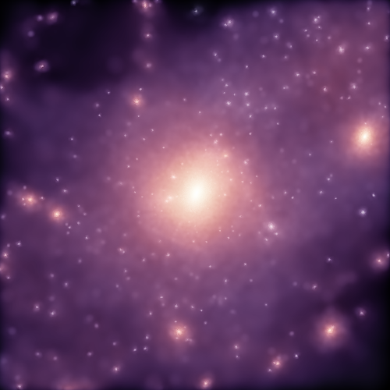
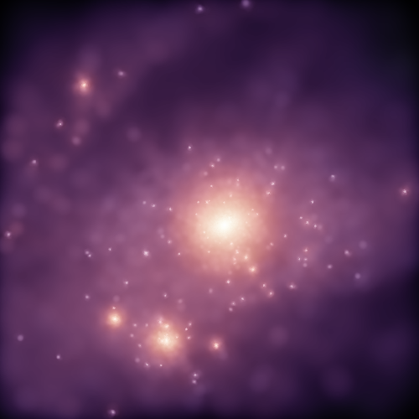
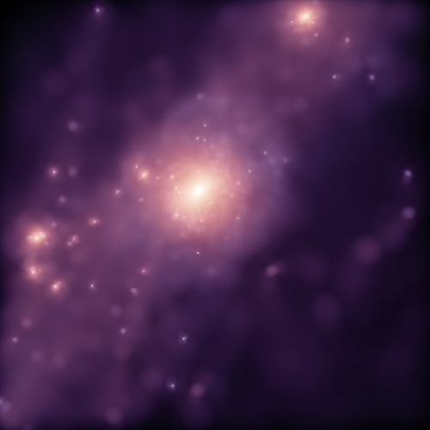
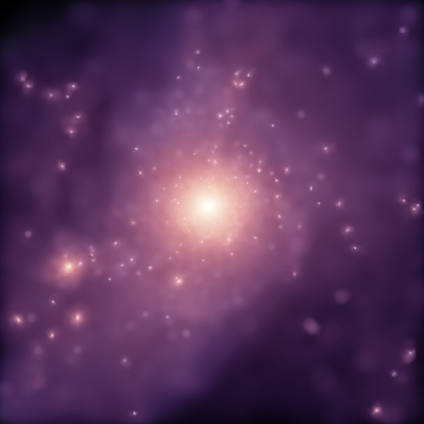
Understanding the angular momentum journey: including hierarchical assembly

Slide 42
Summary
The journey of angular momentum from the large-scale dark matter halo to the galaxy at its centre is complex.
Galaxy evolution physics plays a key role in setting the spin of the CGM.
Simulations offer an excellent way to study this journey – we can use them to focus on different stages.

