Slide 1


xGASS: The connection between angular momentum, mass and atomic gas fraction
Jennifer Hardwick
PhD Candidate
Supervisors: Luca Cortese & Danail Obreschkow

Slide 2

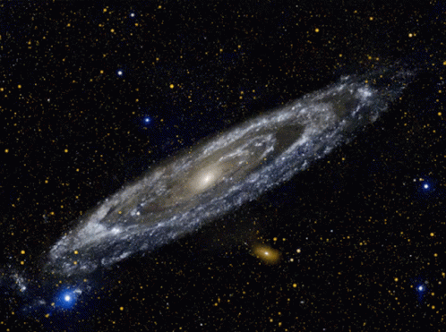
Angular Momentum
Arguably, the most fundamental properties of a galaxy are mass, gas content and angular momentum.
Angular momentum is a fundamental galaxy property which is linked to its formation, evolution and morphology.
Notes:
Some of a galaxies most fundamental properties include its mass, gas content (as this influences its ability to form stars) and angular momentum.

Slide 3
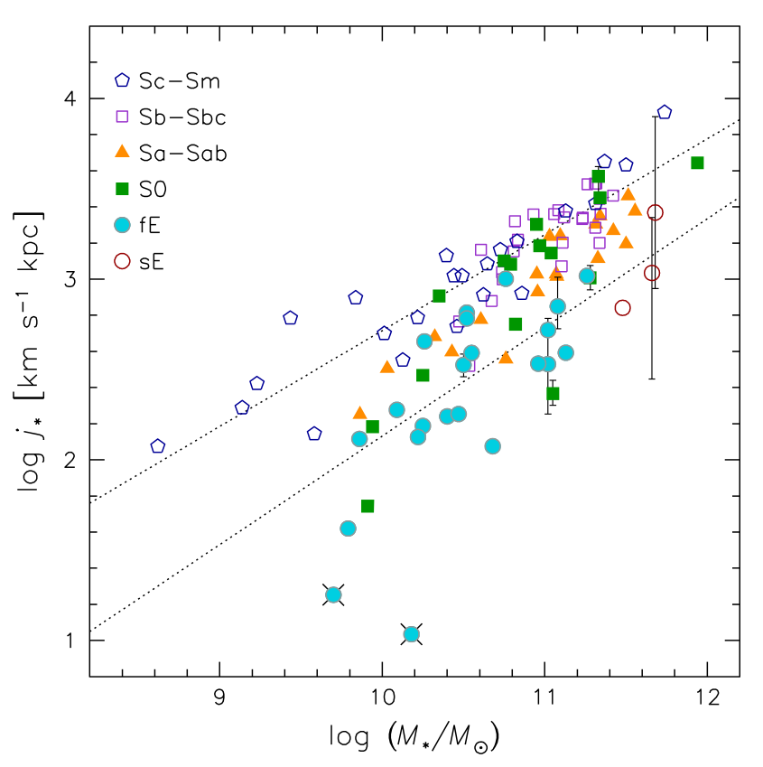
Fall Relation
The Fall relation (specific angular momentum vs. mass relation, Fall 1983) is an important tool to understand how theory is linked to angular momentum.
The slope of the halo mass – angular momentum relation is set to 2/3 by tidal torque theory.
Some works use the slope of the stellar and baryonic relations to study angular momentum conservation.
[Romanowsky & Fall 2012]

Slide 4
Fall Relation Scatter
Fall relation scatter has been shown to correlate with
morphology (Hubble-type; e.g., Romanowsky & Fall 2012, Cortese et al. 2016, Posti et al. 2018, bulge-to-total ratio; e.g., Obreschkow & Glazebrook 2014)
HI-content (e.g., Mancera Pina 2021a).
However, as these both correlate, it is still not known what is the dominant process driving the scatter.
Notes:
A high level summary of what other people have done: i.e., pick 3-4-5 plots from the literature and show how people have characterised the scatter of the Fall relation. Point on the fact that people have either look at morphology/BT (e.g., IFS-based) or HI content (e.g., radio-based), but none on both. Since the two are correlated is important to see which one wins.

Slide 5
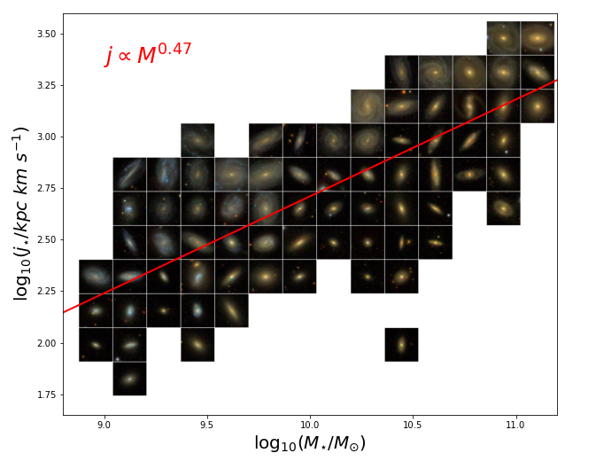
Fall Relation Scatter
Stellar specific AM
Stellar Mass

Slide 6
Fall Relation Scatter
Fall relation scatter has been shown to correlate with
morphology (Hubble-type; e.g., Romanowsky & Fall 2012, Posti et al. 2018a&b, bulge-to-total ratio; e.g., Obreschkow & Glazebrook 2014)
HI-content (e.g., Mancera Pina 2021a).
However, as these both correlate, it is still not known what is the dominant process driving the scatter.
Additionally, previous samples are often small and biased to disk-dominated and gas rich galaxies.
Notes:
Make the point on this slide that we really need a HI complete survey to explore this further

Slide 7
Key Science Questions:
By using a large diverse sample of galaxies, we wanted to know...
If this sample would affect the slope of the Fall relation?
What is the physical quantity driving scatter?

Slide 8
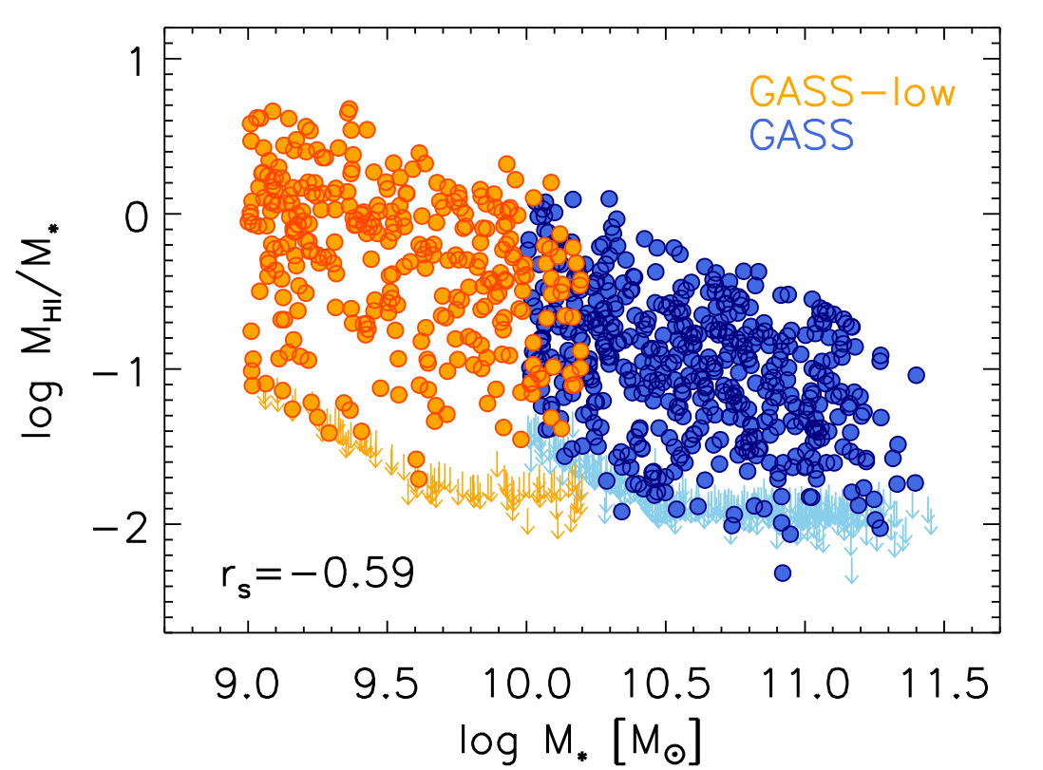
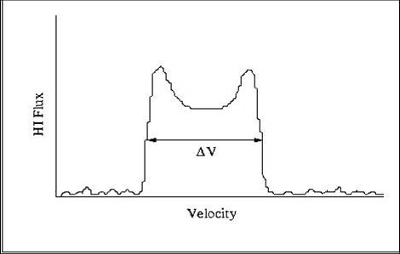
xGASS
[Catinella+2018]
xGASS is a gas fraction limited survey, as each observation was taken until a gas fraction of 2% to 10% was reached. Therefore, we are not biased to gas rich galaxies.
For this work, we used all galaxies with HI detected and an inclination greater than 30.
We use spatially unresolved HI observations and use this to determine angular momentum of stars and baryons.
We assume that each galaxy has a constant rotation profile set by half the FWHM of the HI profile
[Image Credit: ALFAFLA]
Notes:
Here comes xGASS. Keep it simple: e.g., where it improves, and mention briefly how you estimate AM. Say that are happy to answer questions and have back-up slides ready, but do not go into the details.

Slide 9
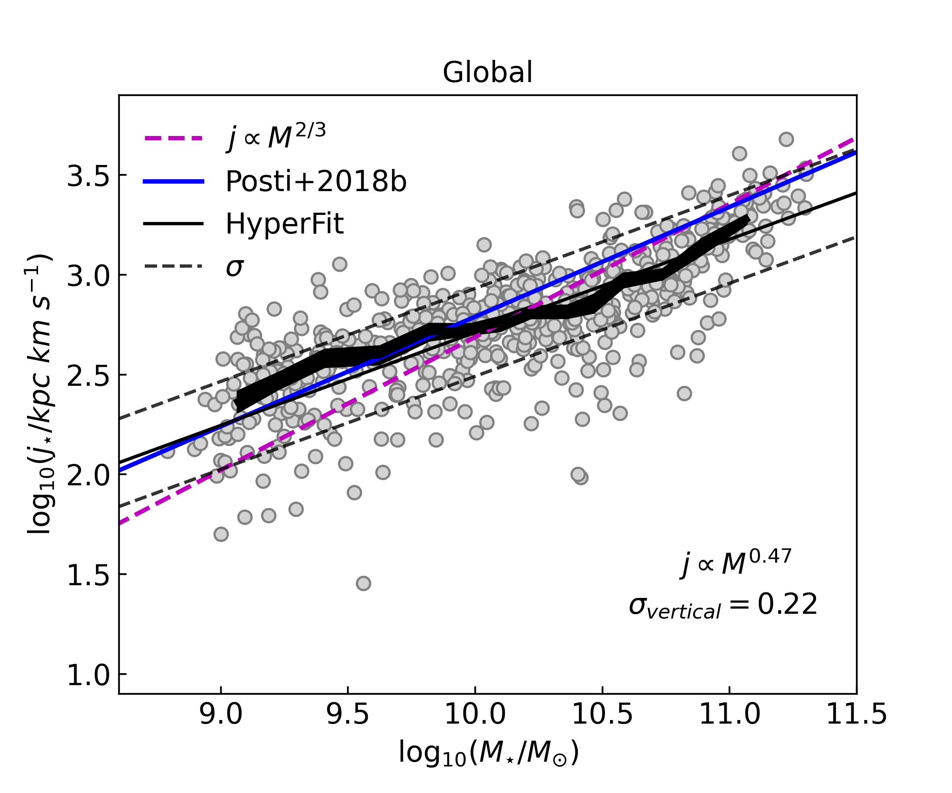
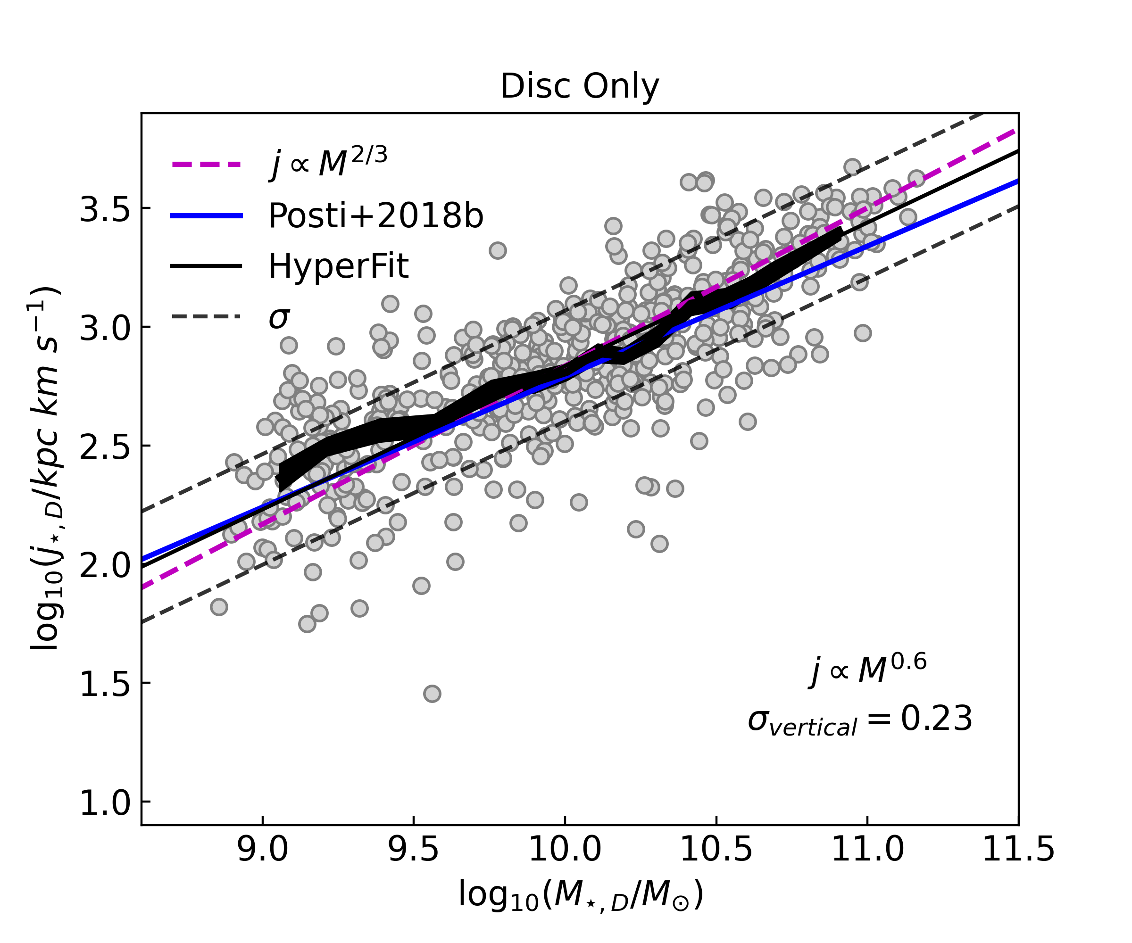
Stellar Fall Relation
Despite these assumptions, our work is consistent with previous studies.
The Stellar Fall relation has a slope of 2/3 when isolating just the disk component. When the whole galaxy is used a shallower slope is obtained, as large bulges in high mass galaxies reduce the average AM.
[Hardwick+2022a]
Notes:
Mention: Posti and others have used the slope as motivation for their theory models of AM conservation, but our work shows that your slope is also sensitive to your sample

Slide 10
Scatter Stellar Fall Relation
B/T
HI gas fraction
All masses
For masses smaller than the Milky Way, HI gas fraction is the strongest correlated parameter with scatter of Fall relation; more so than B/T.
Vertical offset from Fall relation [dex]
log₁₀ Stellar Mass
< 10^{10.25} M⊙
> 10^{10.25} M⊙
[Hardwick+2022a]
HI gas fraction
B/T
Notes:
Analysis of the scatter of the stellar Fall relation…. Gas fraction wins over B/T… at least at low masses… at high masses unclear.

Slide 11
Key science question:
3. Can we gain a deeper understanding of the physical connection between angular momentum and gas fraction?

Slide 12

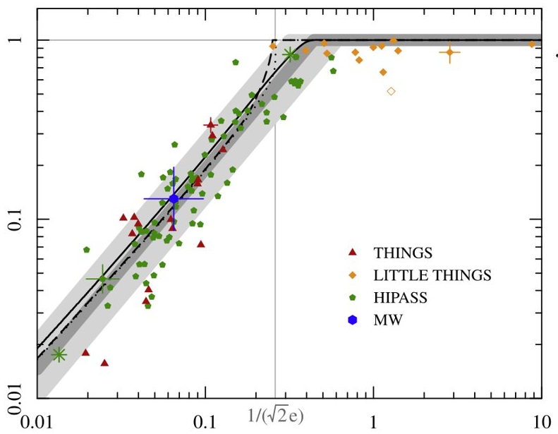
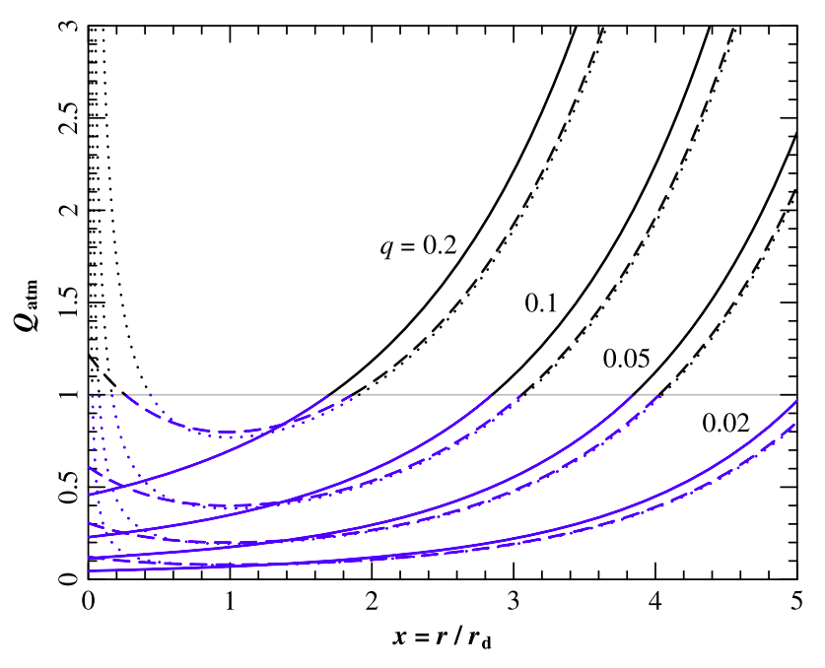
Analytic Models; Obreschkow+2016 (O16)
Many analytic models have been proposed which find that atomic gas fraction is set by a galaxy's angular momentum. One such model is O16.
atomic gas
stars
f_{atm}
[Obreschkow+2016]
q
Notes:
We wanted to explore this connection between j – M and gas fraction more.
The most obvious way to do this seemed to be with the O16 model
This is a model that comes out, if a galaxy has the most amount of HI possible given its stability, what would its gas content be?
If a galaxy has a region of instability given by Toomre Q then it will collapse to form stars.
This model assumes that all regions which have a Q < 1 will be 100% stars and all regions with Q > 1 will be 100% gas.
Assuming a perfectly exponential thin disk we can get a profile of how Q varies within a galaxy.
This only depends on q (defined in slides)
If you sum all the regions with Q > 1 then this will be how much atomic gas you have. This gives the model prediction.

Slide 13
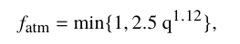
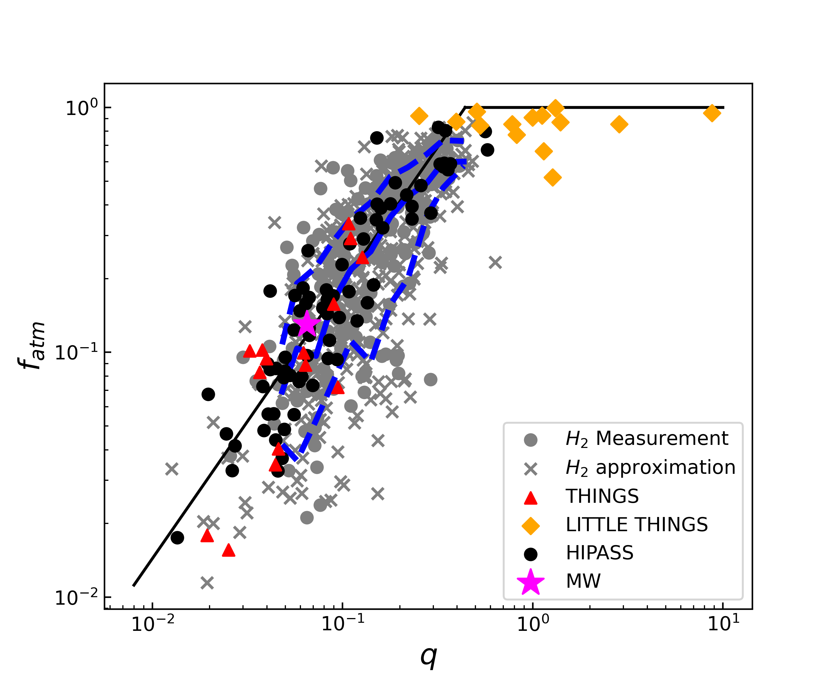
Analytic Models; Obreschkow+2016 (O16)
Qualitatively our data agrees with this model, but does it agree quantitatively?
[Hardwick+2022b]
Notes:
Of course, this is not super-surprising as models have suggested it. For example, Dans model suggest that AM is what set gas fraction… Qualitatively we agree, but is the same quantitatively?

Slide 14
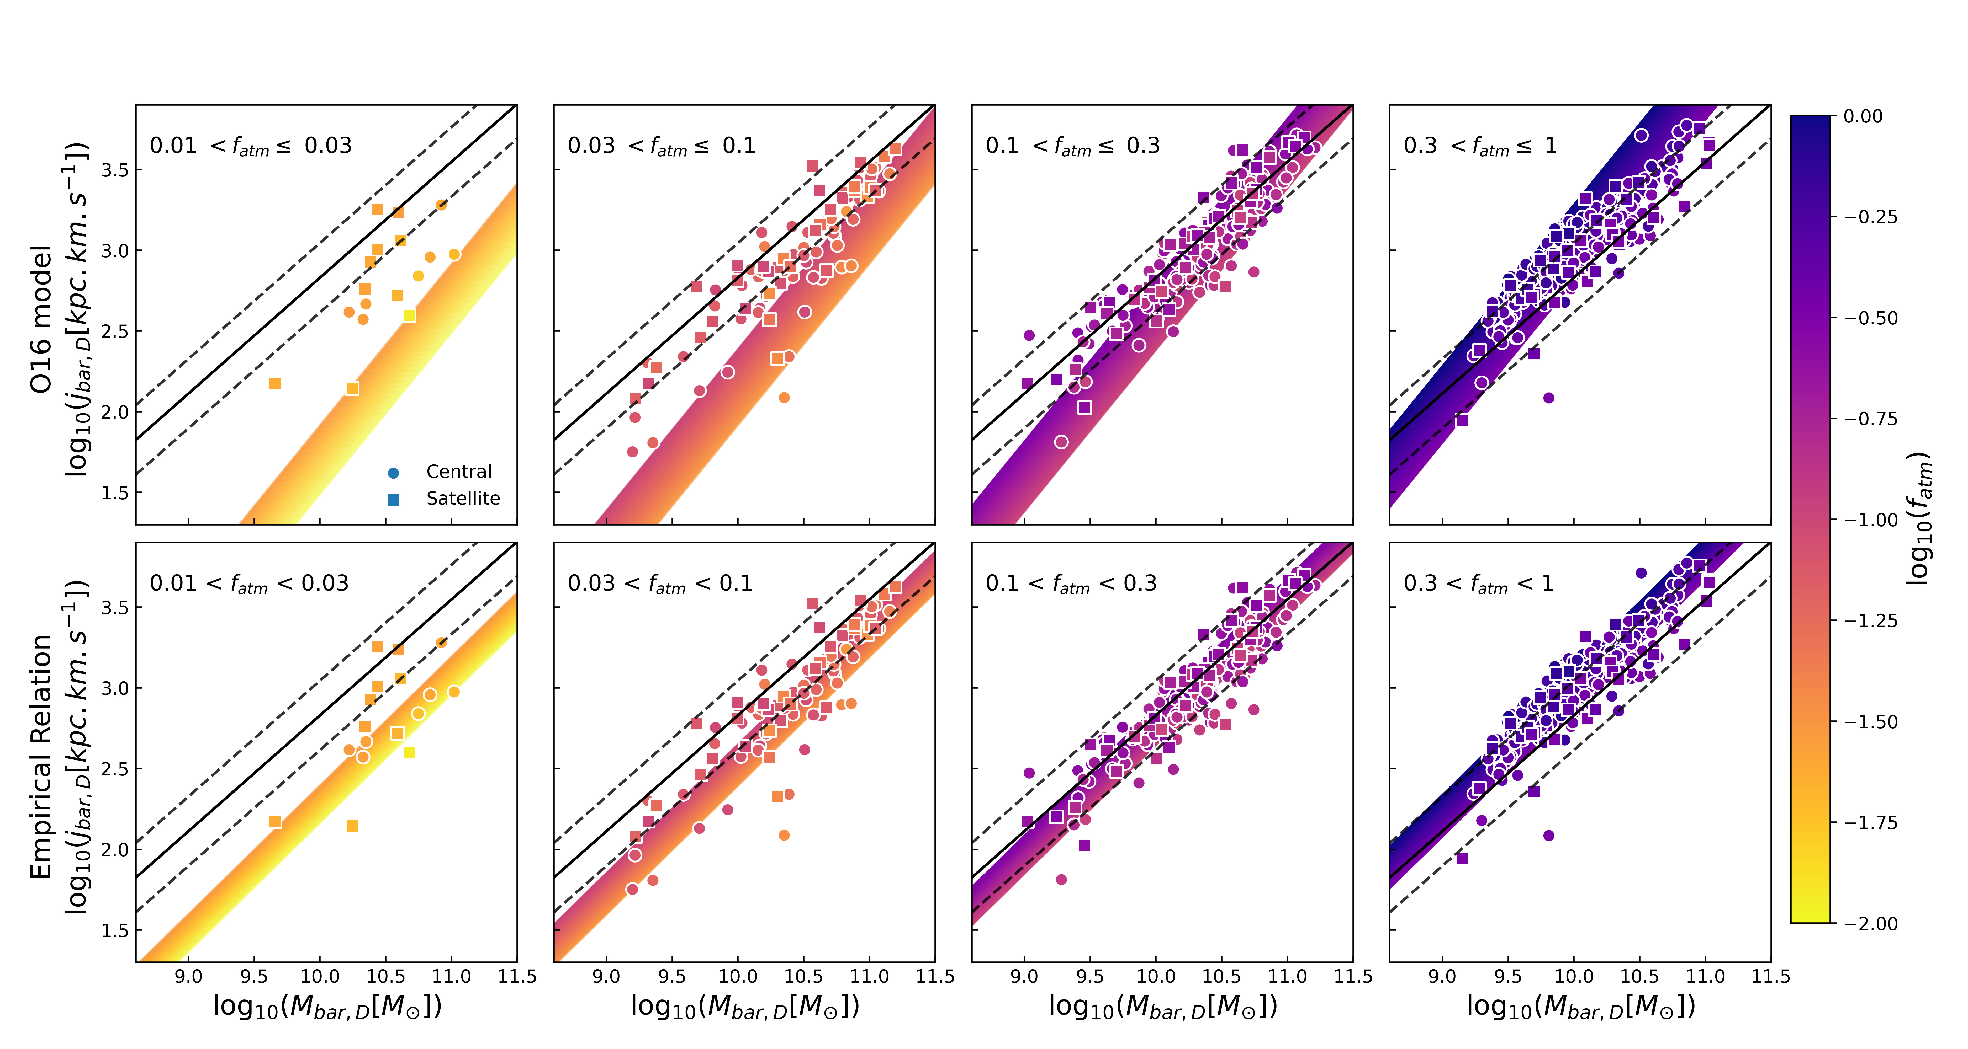
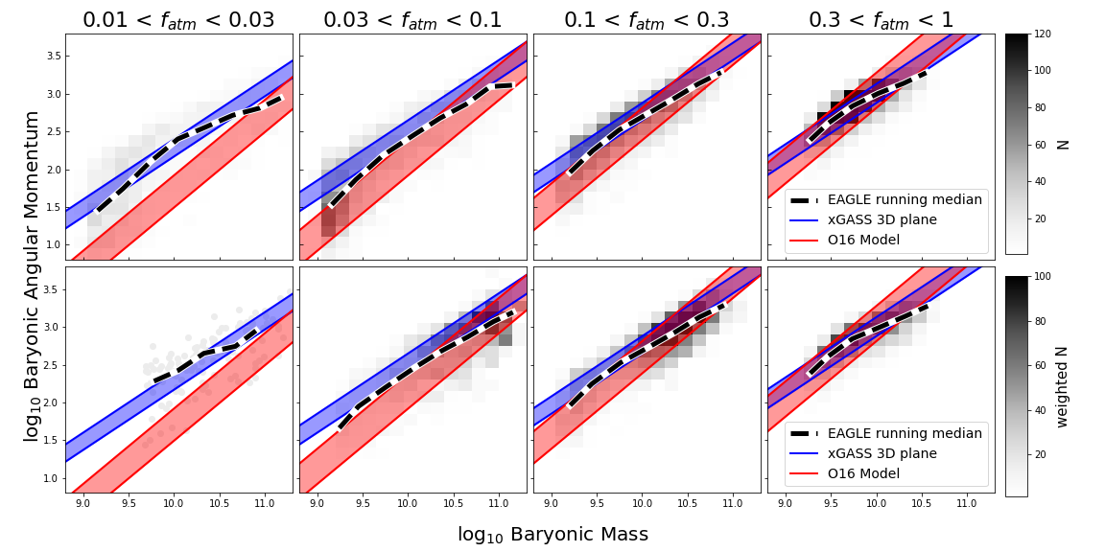
Best-fit 3D Plane to Angular Momentum, Mass and Atomic Gas Fraction
We find that a 3D plane which has a shallower slope and weaker dependence on atomic gas fraction, agrees better with our data.
O16 Model
log₁₀ Baryonic specific AM
log₁₀ f_{atm}
Our best-fit plane
log₁₀ Baryonic Mass
[Hardwick+2022b]
Notes:
You do this with xGASS and demonstrate that quantitatively this is not the case… dependence on HI is weaker and plane has different slope… So we are not yet there in understanding the link between AM and gas content.

Slide 15
Best-fit 3D Plane to Angular Momentum, Mass and Atomic Gas Fraction
Is this result unique to our sample?
If not, what is causing this deviation between O16 model and xGASS?
O16 Model
log₁₀ Baryonic specific AM
log₁₀ f_{atm}
xGASS galaxies have less atomic gas or higher AM than O16 predicts
Our best-fit plane
Cosmological
Simulations
log₁₀ Baryonic Mass
[Hardwick+2022b]
Notes:
You do this with xGASS and demonstrate that quantitatively this is not the case… dependence on HI is weaker and plane has different slope… So we are not yet there in understanding the link between AM and gas content.

Slide 16
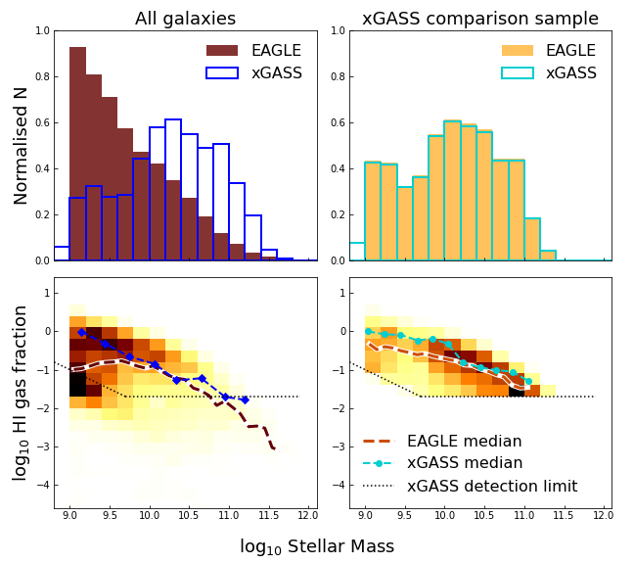
Simulations - EAGLE
WORK IN PROGRESS
Comparing EAGLE galaxies (Lagos+2017) to xGASS
Created a sample for the EAGLE data from Lagos et al. (2017), which mimics the xGASS selection.
EAGLE has a comparable HI gas fraction distribution as xGASS.
[Hardwick+InPrep] Data from Lagos+2017
Notes:
The scatter in the AM-mass relation depends on morphology and/ or gas fraction and the relation with gas fraction seems stronger than with morphology.
Despite its importance, the quantitative link between AM and gas content is not as strong as models like Dan suggests.
In future work, we will use simulations to better understand the exact cause of this.

Slide 17
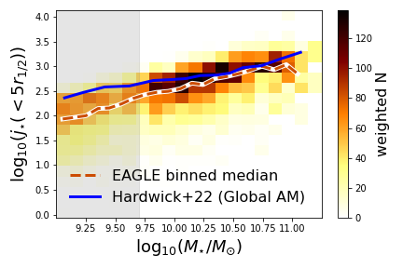
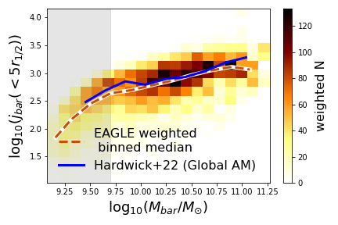
Simulations – EAGLE
WORK IN PROGRESS
Lagos+2017 calculated AM within 5 effective radii for all EAGLE galaxies with M* > 10⁹ M⊙
Stellar Fall Relation
Baryonic Fall Relation
For low masses, EAGLE kinematics may be unreliable due to numerical effects, so we place less emphasis on the comparison in these regions, (grey shaded region).
For both the stellar & baryonic Fall relations, the EAGLE comparison sample is showing good agreement with xGASS.
[Hardwick+InPrep] Data from Lagos+2017
Notes:
The scatter in the AM-mass relation depends on morphology and/ or gas fraction and the relation with gas fraction seems stronger than with morphology.
Despite its importance, the quantitative link between AM and gas content is not as strong as models like Dan suggests.
In future work, we will use simulations to better understand the exact cause of this.

Slide 18
Simulations – EAGLE
WORK IN PROGRESS
All EAGLE
galaxies
EAGLE agrees with the xGASS 3D fit
(more so than the O16 model)
xGASS comparison sample
[Hardwick+InPrep] Data from Lagos+2017
Notes:
The scatter in the AM-mass relation depends on morphology and/ or gas fraction and the relation with gas fraction seems stronger than with morphology.
Despite its importance, the quantitative link between AM and gas content is not as strong as models like Dan suggests.
In future work, we will use simulations to better understand the exact cause of this.

Slide 19
Conclusions
The scatter in the angular momentum - mass relation depends strongly on gas fraction.
However, despite gas fractions importance, the quantitative link between AM and gas content in xGASS is not as strong as models such as O16 suggests.
There is good agreement between EAGLE and xGASS, which we will use to better understand this disagreement.
The scatter in the angular momentum - mass relation depends on gas fraction and the relationship with gas fraction is stronger than with morphology (B/T).
Notes:
The scatter in the AM-mass relation depends on morphology and/ or gas fraction and the relation with gas fraction seems stronger than with morphology.
Despite its importance, the quantitative link between AM and gas content is not as strong as models like Dan suggests.

Slide 20
BONUS SLIDES

Slide 21
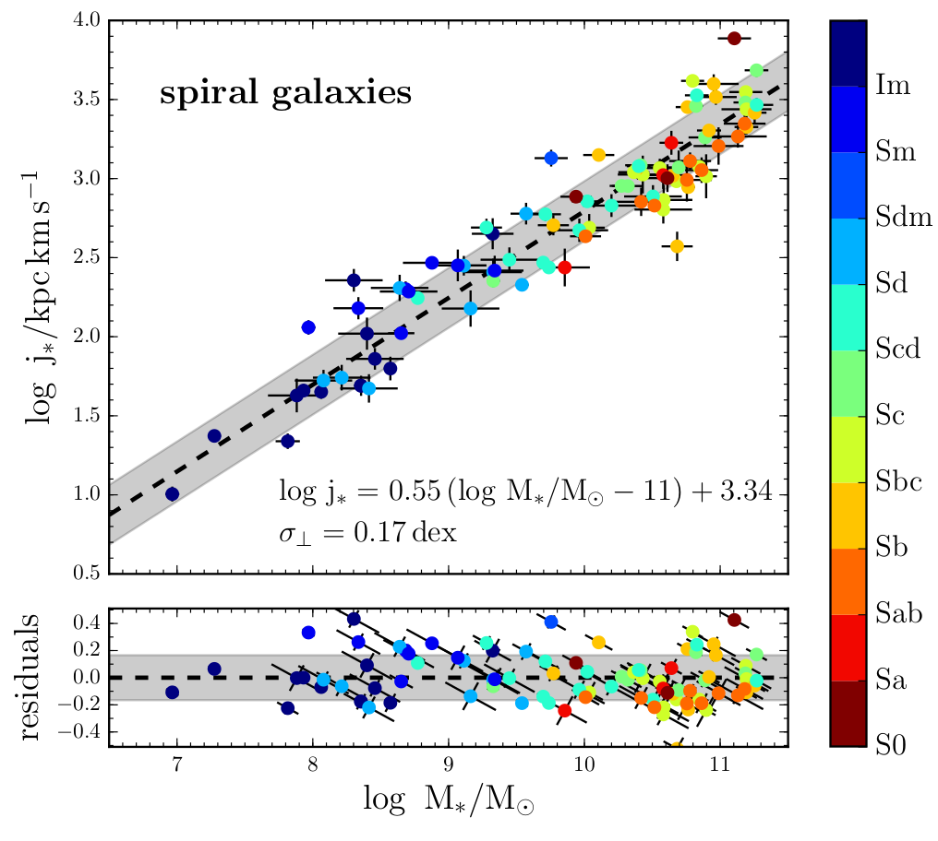
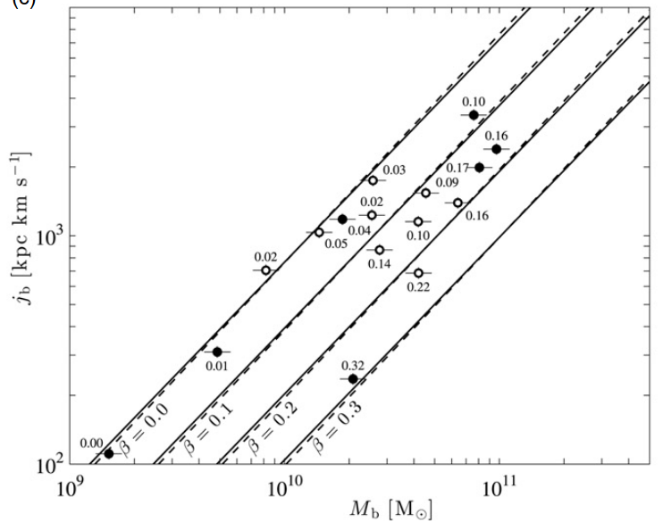
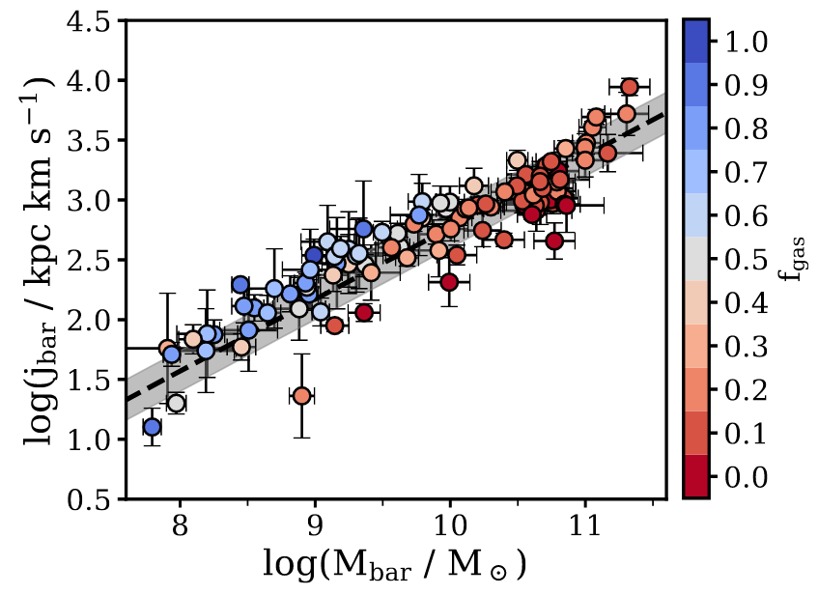
Fall Relation Scatter
Fall relation scatter has been shown to correlate with morphology or HI-content.
However, as these both correlate, it is still not known what is the dominant process driving the scatter.
Additionally, previous samples are often small and biased to disk-dominated and gas rich galaxies.
[Posti+2018]
[Obreschkow&Glazebrook+2014]
[ManceraPiña+2021a]
Notes:
A high level summary of what other people have done: i.e., pick 3-4-5 plots from the literature and show how people have characterised the scatter of the Fall relation. Point on the fact that people have either look at morphology/BT (e.g., IFS-based) or HI content (e.g., radio-based), but none on both. Since the two are correlated is important to see which one wins.

Slide 22
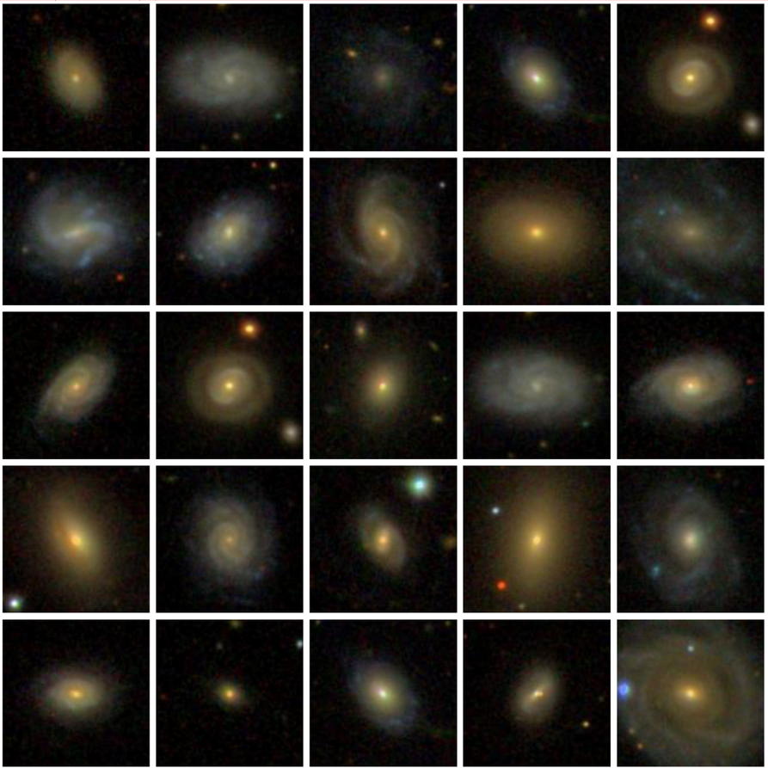
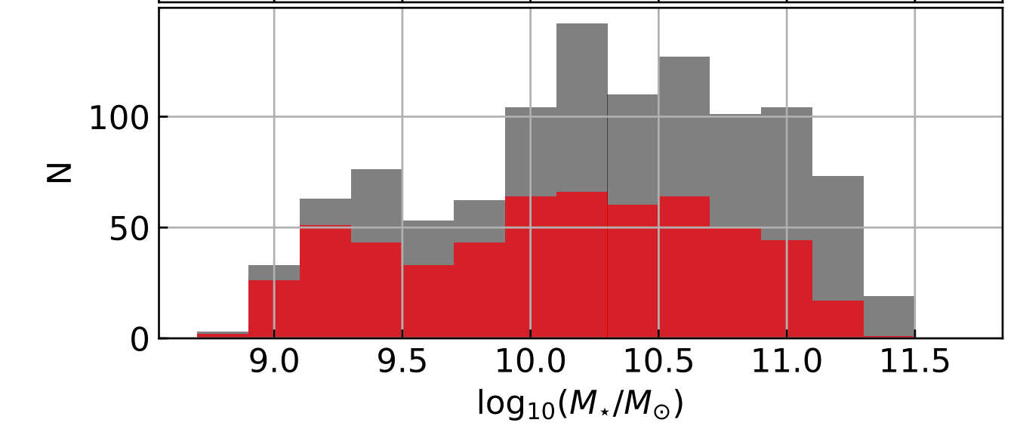
xGASS
In this work we use a subset of the xGASS sample; a sample with sensitive HI observations for a large sample (1179) in the local universe (0.01 < z < 0.05)
Stellar mass selected to be between 10⁹ M_{sol}< M*< 10^{11.5} M_{sol}
These galaxies cover a wide range of morphologies and atomic gas fractions
We use a subsample (564) which have HI detected and inclination > 30°
All xGASS (N = 1179)
Our subsample (N=564)
[Hardwick+2022]
Notes:
In order to test how AM varies for a large representative sample we use xGASS

Slide 23
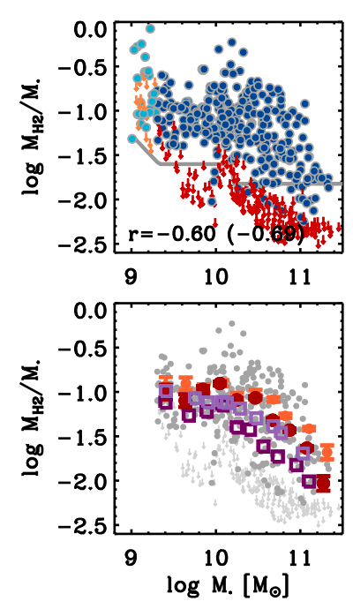
xCOLD GASS
xCOLD GASS is xGASS' sister sample which re-observed just under half of xGASS galaxies to measure CO (1-0) fluxes [Saintonge+2011,2017]
They used a metallicity dependent conversion function to convert this to molecular gas masses.
For our subsample we have molecular gas masses for 196 galaxies.
[Saintonge+2017]
Notes:
We only have H2 measured for 246 of our galaxies, so the rest need to be estimated.

Slide 24
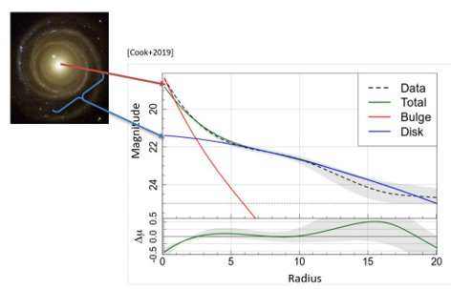
Hardwick+22: Stellar Specific Angular Momentum
In this work to determine specific angular momentum (j) of the stars we use unresolved HI velocity widths from xGASS (to increase our sample size).
We assume the width of the HI is the maximum rotation velocity and it is constant for all radii.
[Cook+2019]
All galaxies have been fit with 2-component Sérsic profiles (Cook+2019), allowing for j to be determined for galactic disks separately.
Notes:
To get our measurements of AM from xGASS data we used unresolved HI line widths and the decompositions from Cook+2019
We only used a subset of xGASS: 564 galaxies, as these were the only ones which we could reliably determine the HI line widths

Slide 25
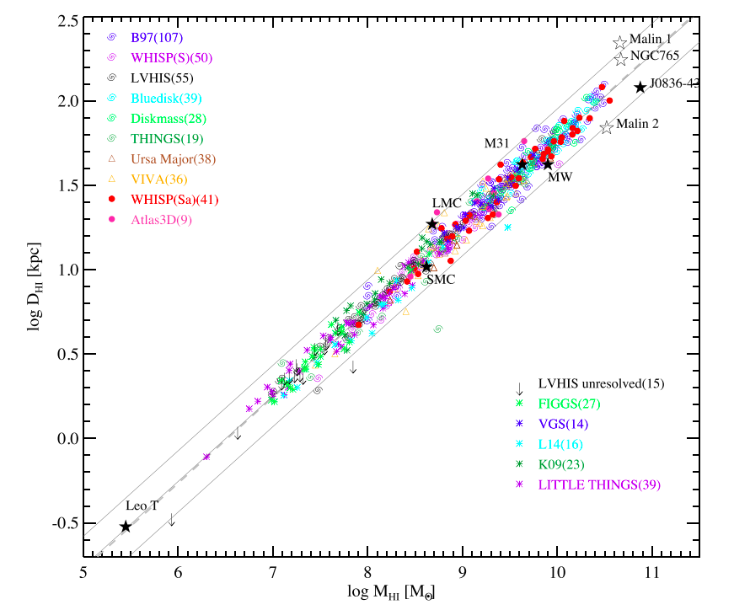
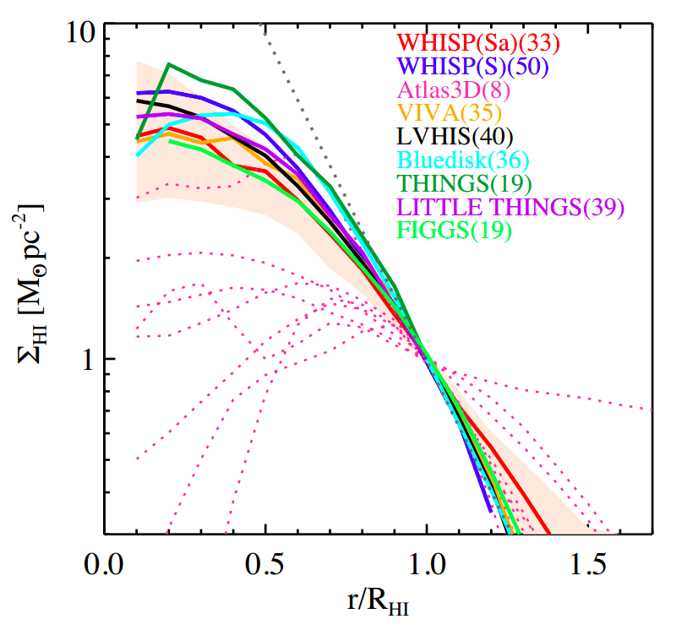
Determining Baryonic quantities
To determine baryonic mass and specific angular momentum we need to make a few assumptions:
Where H₂ mass can't be inferred from a CO(1-0) measurement in xCOLD GASS, we use a SFR to estimate the H₂ mass
We assume H₂ specific angular momentum is the same as stellar, as the surface density profiles of both are very similar, [Bigiel & Blitz 2012, Smith+2016].
HI specific AM is determined using the surface density profile shape and mass-size relation from Wang+2016
log₁₀(D_{HI})
log₁₀(M_{HI})
Notes:
We only have H2 measured for 246 of our galaxies, so the rest need to be estimated.

Slide 26
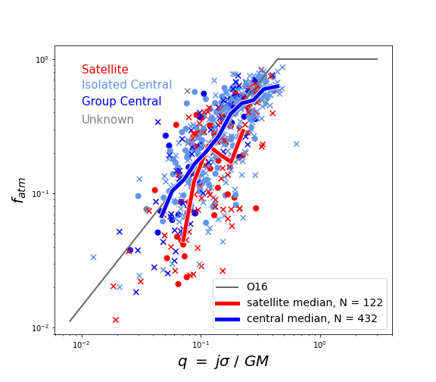
O16 Model
Our data agrees well with O16 data. However, there is considerable scatter.
Environment is a common cause of galaxies scattering below the model (e.g. Li+2020)
O16 Data
[Hardwick+InPrep]
Notes:
Now that we have baryonic parameters we can look at O16 model for our data (grey)
Coloured points are the same I showed from a few slides ago of the data used in the original O16 paper.
Our data agrees surprisingly well seeing we have a very different sample to O16
Noticeable differences; larger scatter, large population of galaxies below the relation but also a large population of galaxies above the relation.
As there was a larger scatter in this we investigated.
Environment is often quoted as a cause of galaxies scattering below the relation, so we looked into this.
Separating into satellite and central (isolated and group) shows that there is an offset of satellites below the relation.
But this isn't the only thing affecting the large offsets as we only have a small part of our sample which are satellites (122 out of 559) and just looking at the central galaxies, the offsets is still larger than O16.

Slide 27
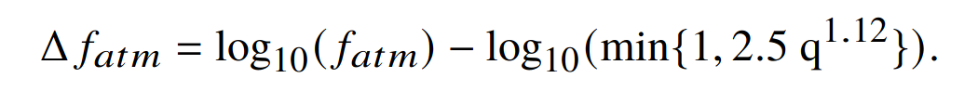
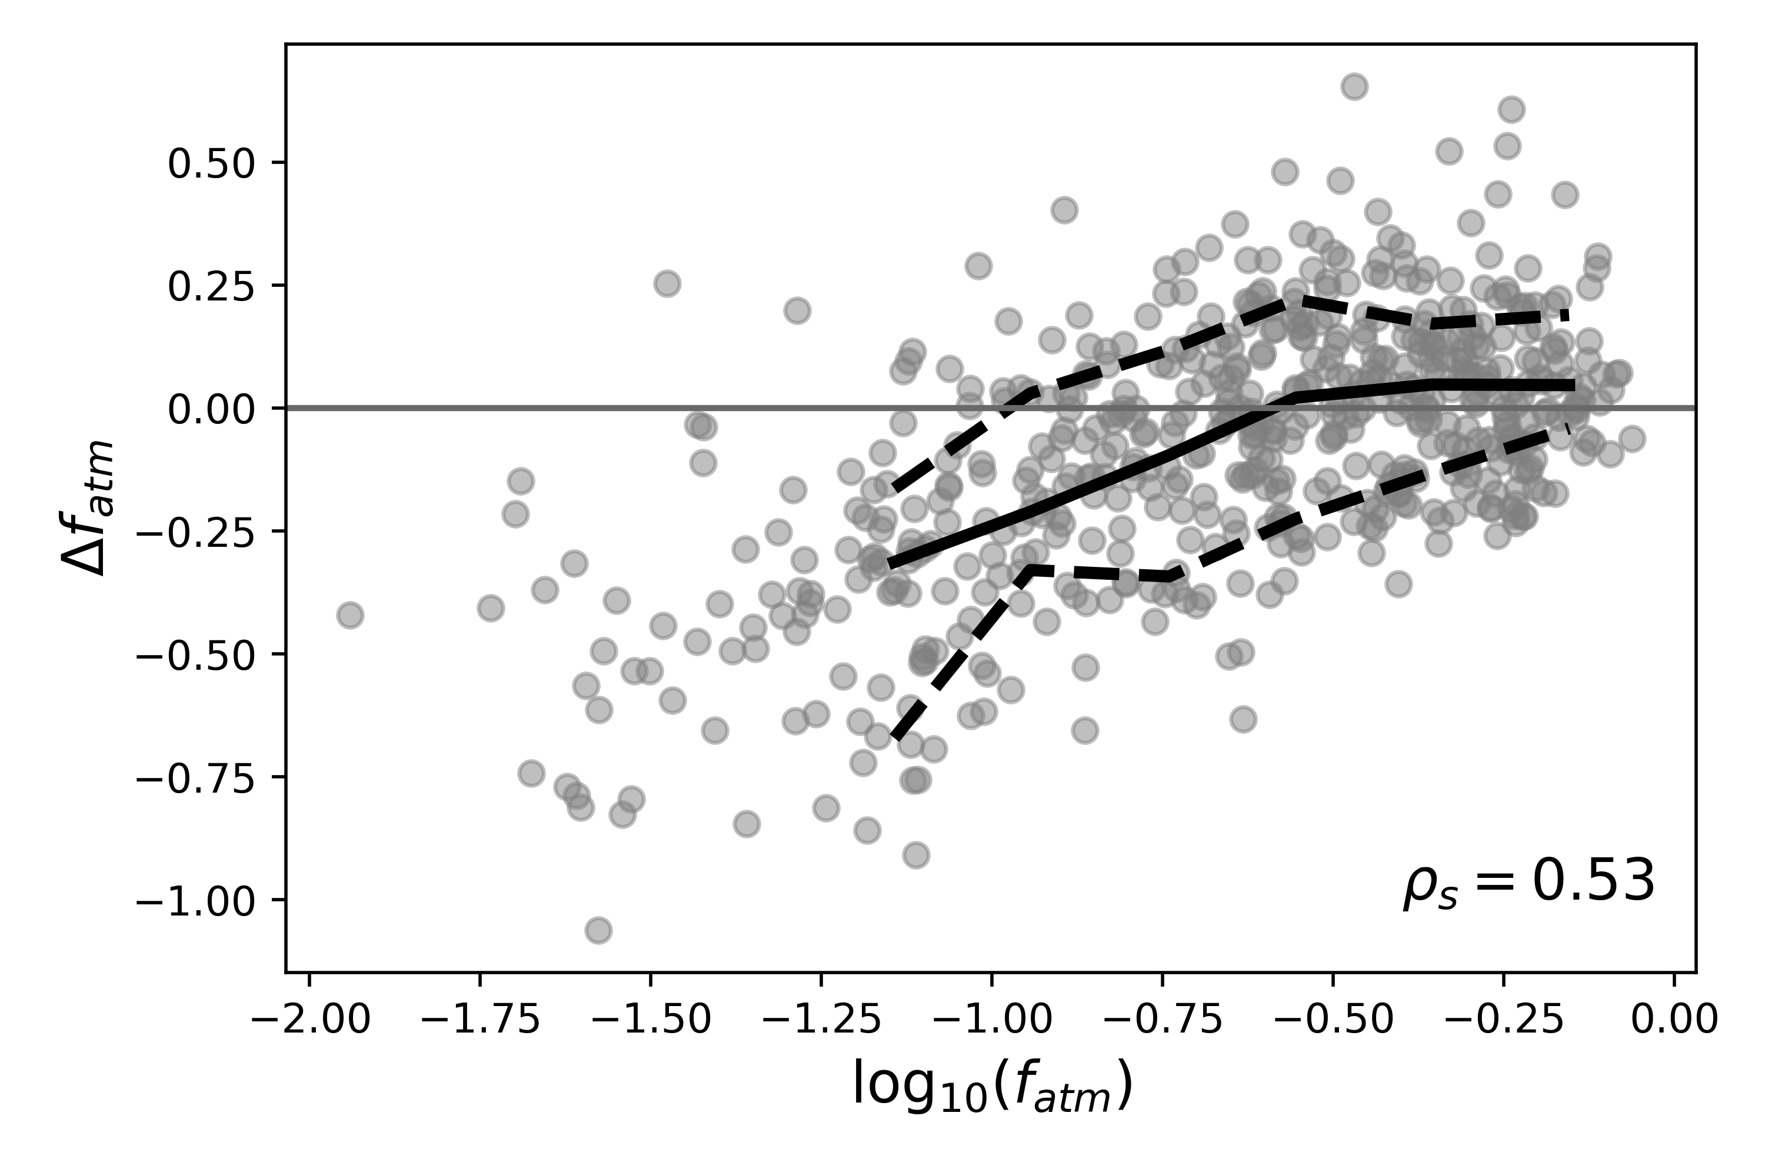
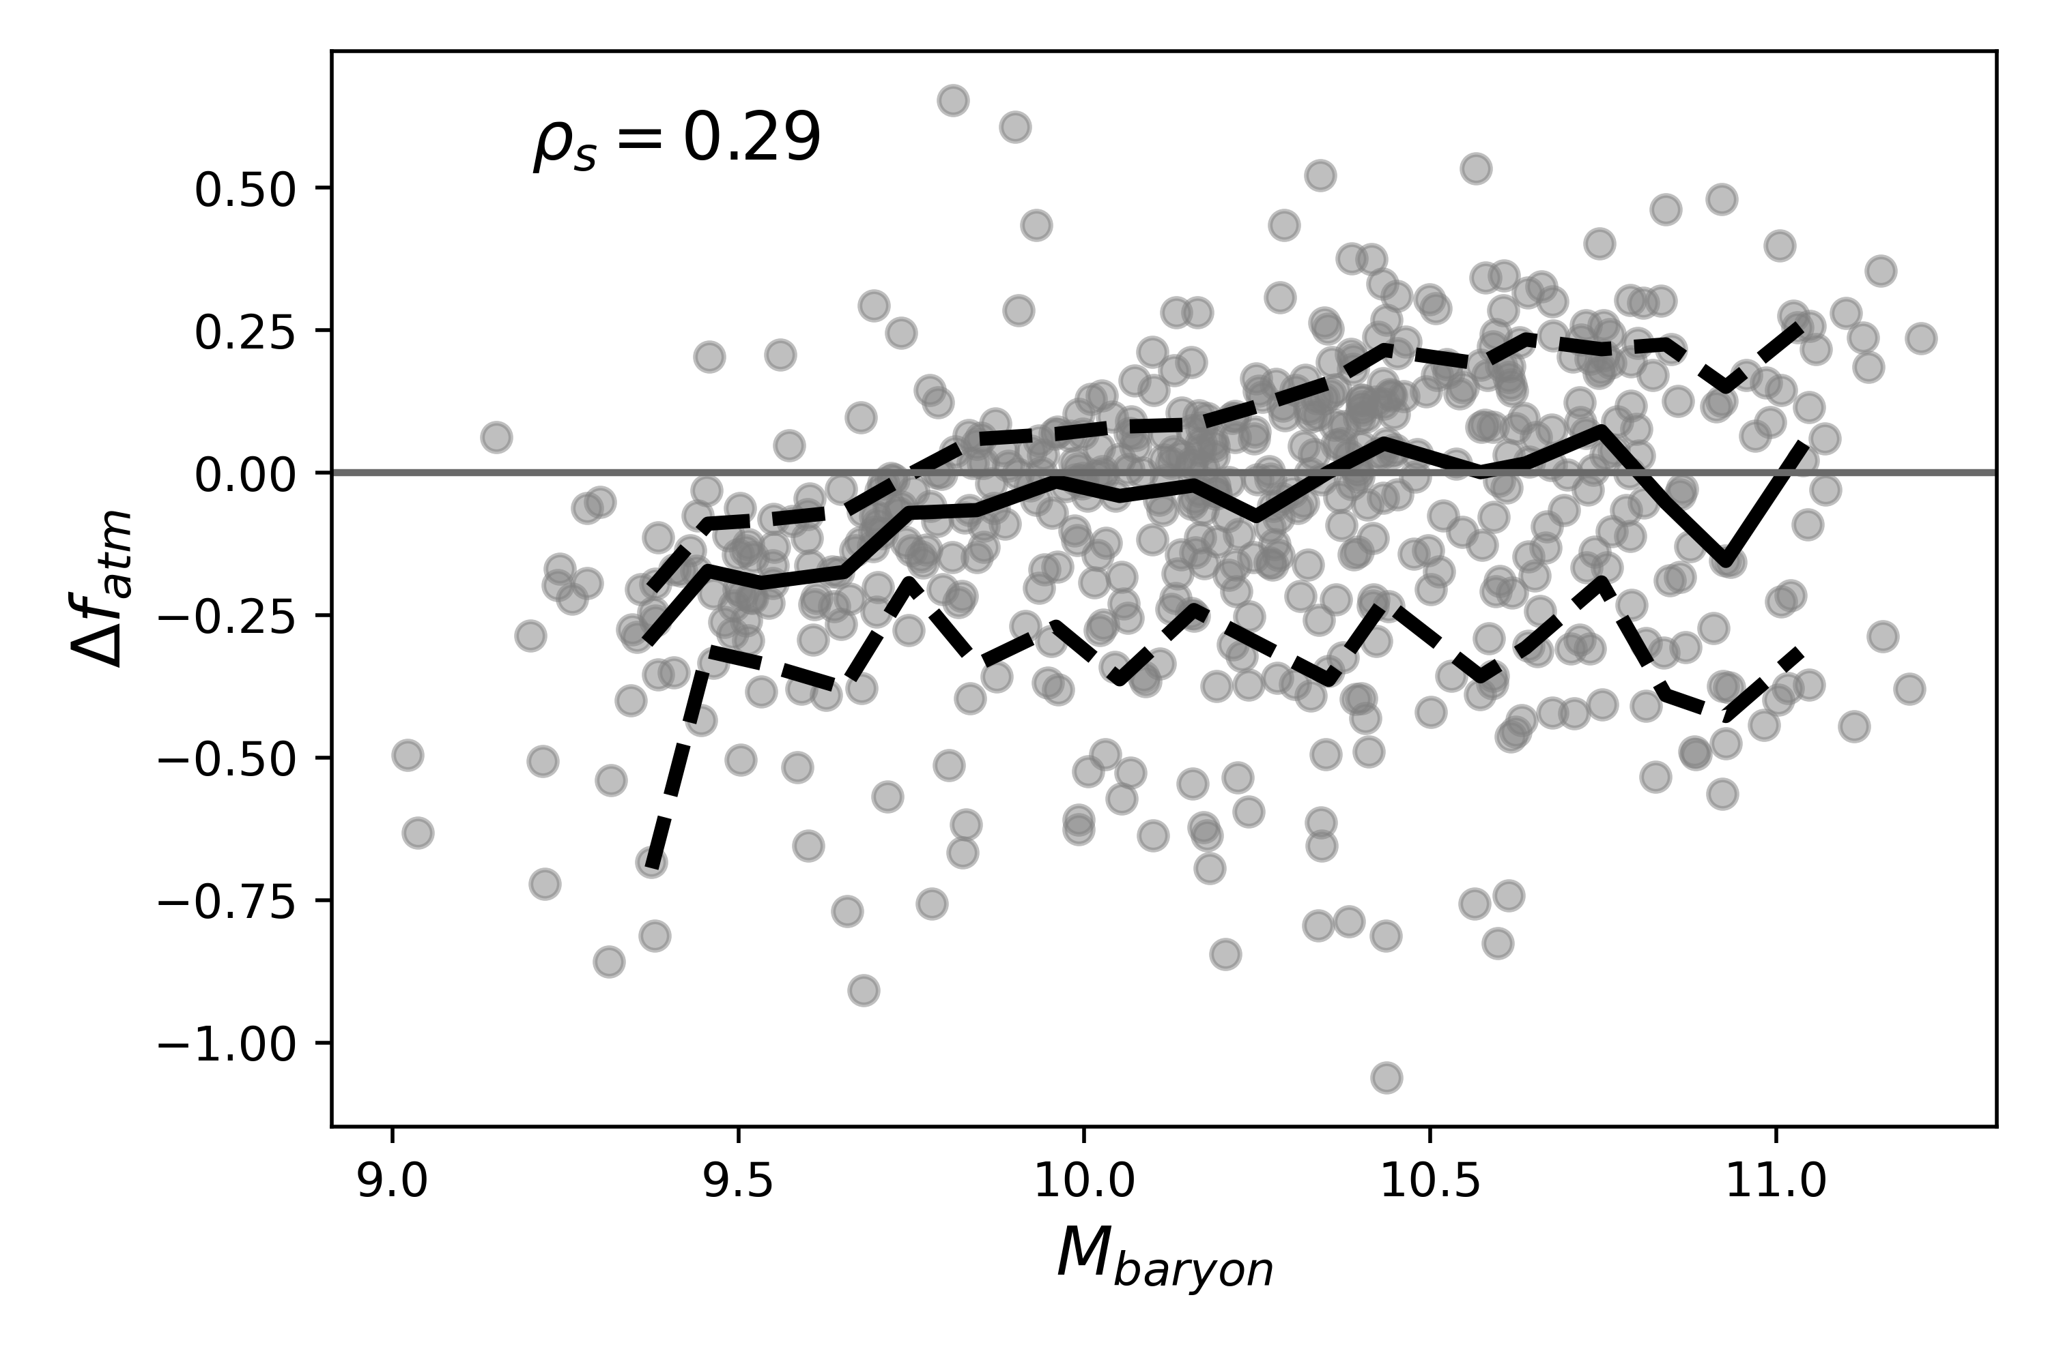
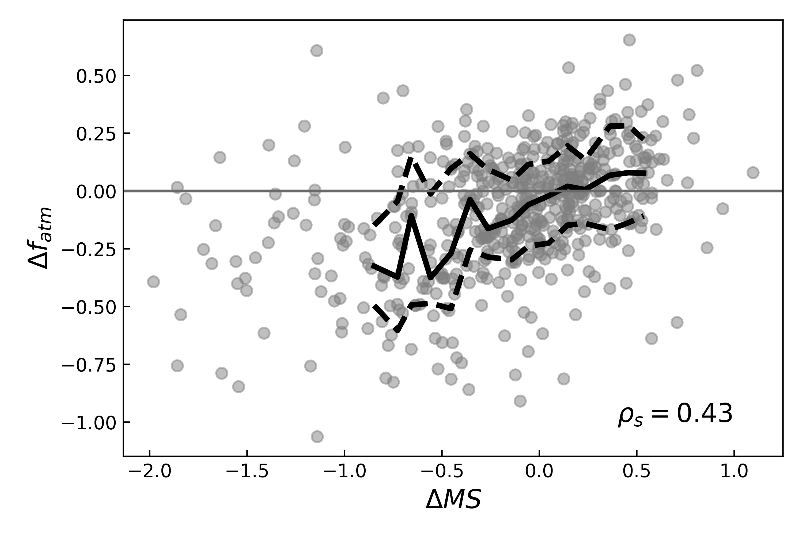
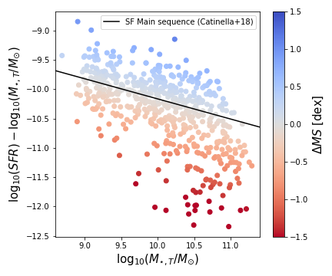
Offset from O16 model
log₁₀(f_{atm})
log₁₀(M_{bar})
f_{atm} and M_{baryon} are both parameters in the O16 model
Trialled fitting a 3D plane to j, M & f_{atm}
[Hardwick+InPrep]
Notes:
Started looking into the parameters which were most strongly correlated with offsets from the O16 model.
Interestingly out of the parameters we tested, the strongest correlation was with f_atm, Delta MS (correlated with f_atm) and M_bar
As these are parameters which are included in the model, it hints that the dependence on them in the model isn't what agrees with our data the best.

Slide 28
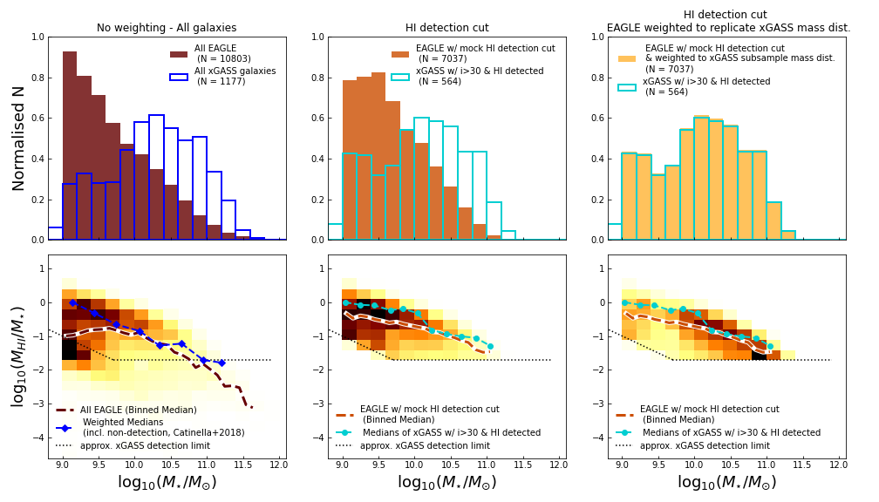
Simulations - EAGLE
WORK IN PROGRESS
Comparing EAGLE galaxies (Lagos+2017) to xGASS
Created a sample for the EAGLE data from Lagos et al. (2017), which mimics the xGASS selection.
EAGLE has a comparable HI gas fraction distribution as xGASS.
[Hardwick+InPrep] Data from Lagos+2017
Notes:
The scatter in the AM-mass relation depends on morphology and/ or gas fraction and the relation with gas fraction seems stronger than with morphology.
Despite its importance, the quantitative link between AM and gas content is not as strong as models like Dan suggests.
In future work, we will use simulations to better understand the exact cause of this.

Slide 29
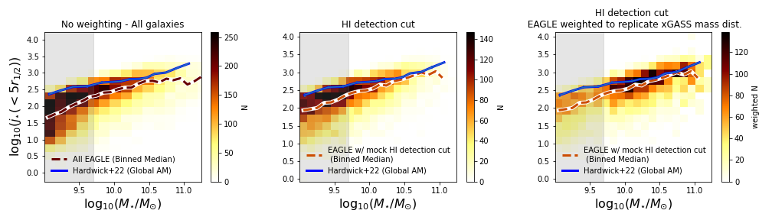
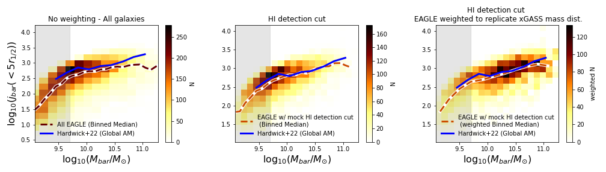
Simulations – EAGLE
WORK IN PROGRESS
For both the stellar & baryonic Fall relations, EAGLE is showing good agreement with xGASS.
For low masses, EAGLE kinematics may be unreliable due to numerical effects, so we place less emphasis on the comparison in these regions, (grey shaded region).
[Hardwick+InPrep] Data from Lagos+2017
Notes:
The scatter in the AM-mass relation depends on morphology and/ or gas fraction and the relation with gas fraction seems stronger than with morphology.
Despite its importance, the quantitative link between AM and gas content is not as strong as models like Dan suggests.
In future work, we will use simulations to better understand the exact cause of this.

