Slide 1






The Origin of Ultra-Diffuse Galaxies:
Challenging the galaxy formation paradigm
Jean Brodie
North American Collaborators
Aaron Romanowsky, Alexa Villaume, Asher Wasserman, Adebusola Alabi
Roberto Abraham, Pieter van Dokkum, Shany Danieli
Swinburne Collaborators
Duncan Forbes
Warrick Couch
Anna Ferrè-Mateu
Steve Janssens
Jonah Gannon
Luisa Buzzo

Slide 3
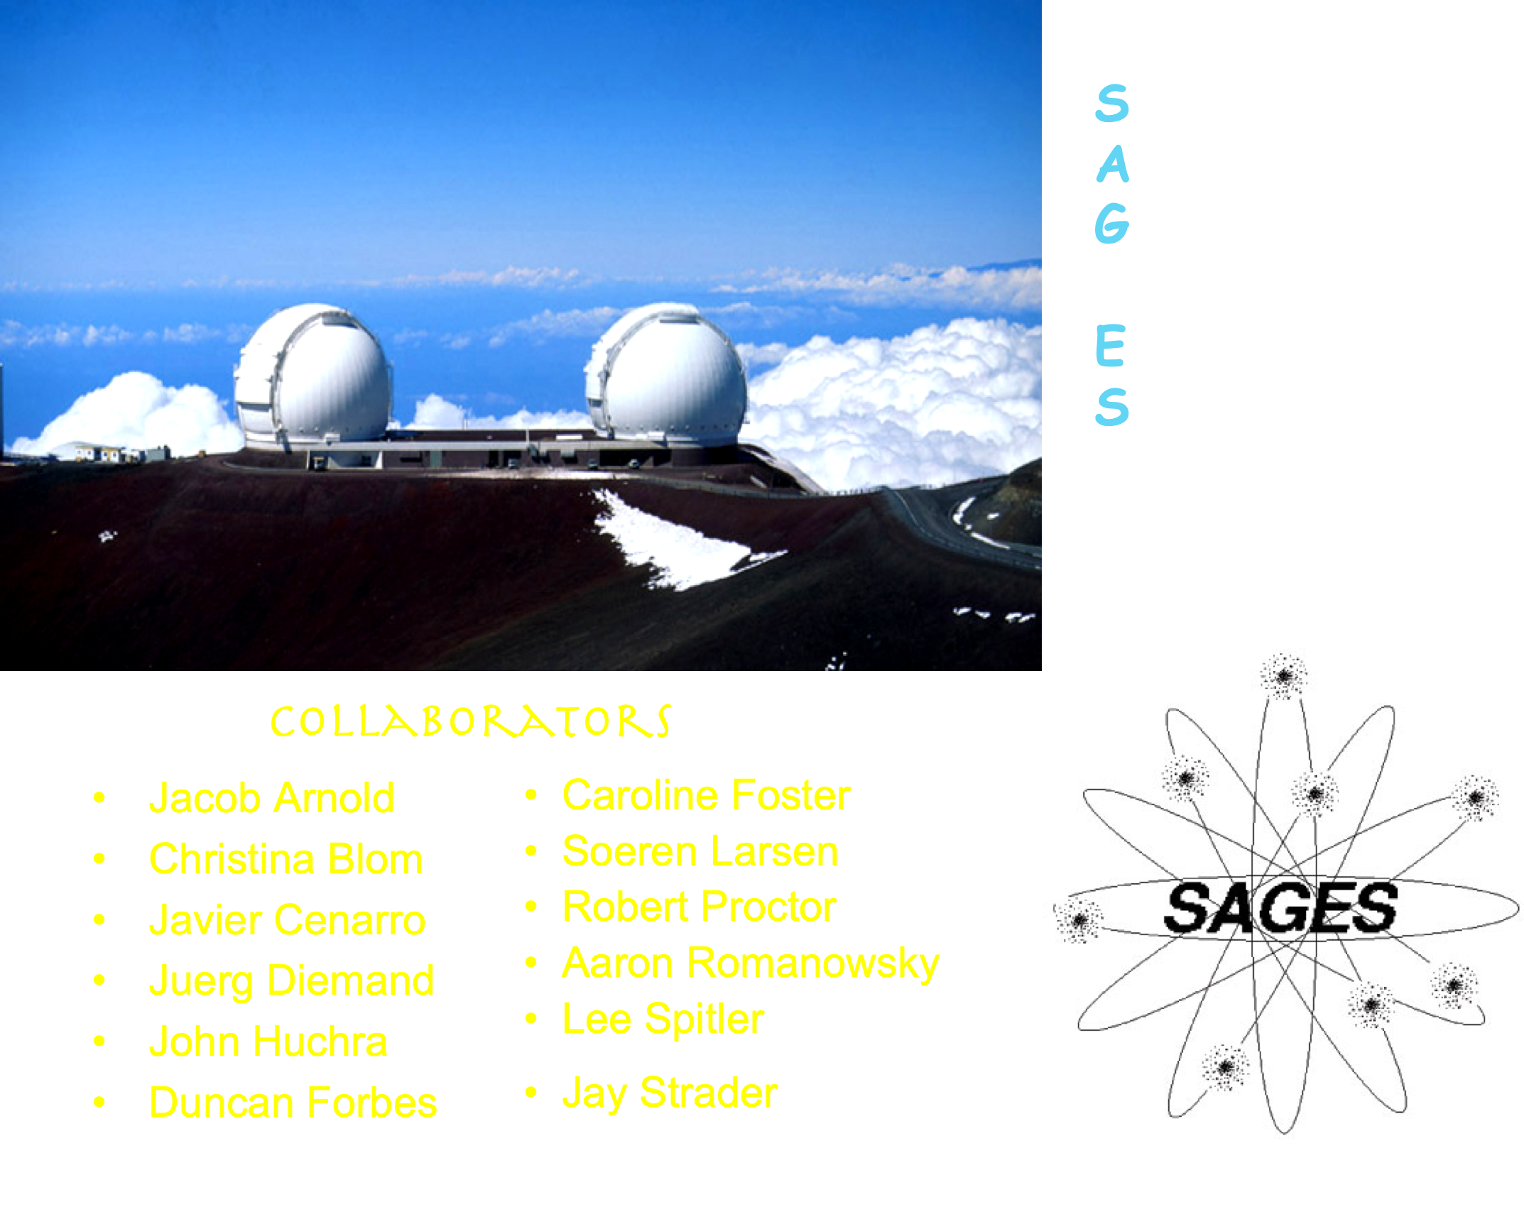
Talk Outline
  The Globular Cluster – Galaxy Connection
  What are Ultra Diffuse Galaxies (UDGs)?
  Why are Globular Clusters particularly important for understanding UDGs?
  Multiple types of UDGs
  The Challenge for Simulations
  Summary
Keck twin 10-metre telescopes on Mauna Kea

Slide 4
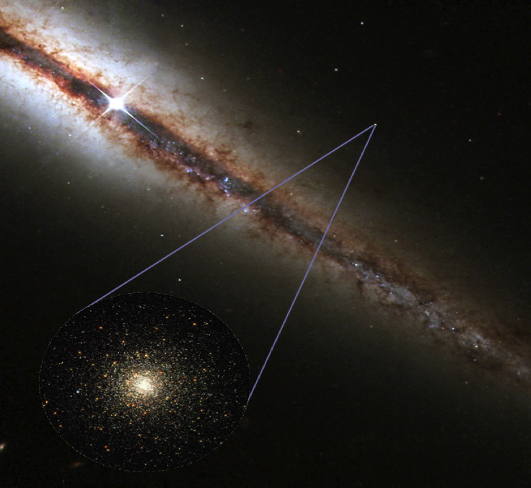
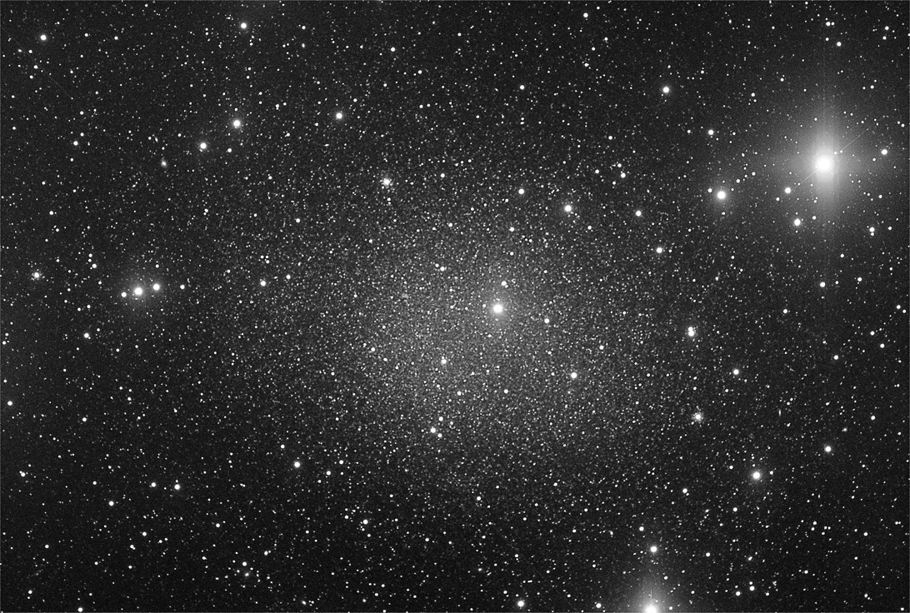
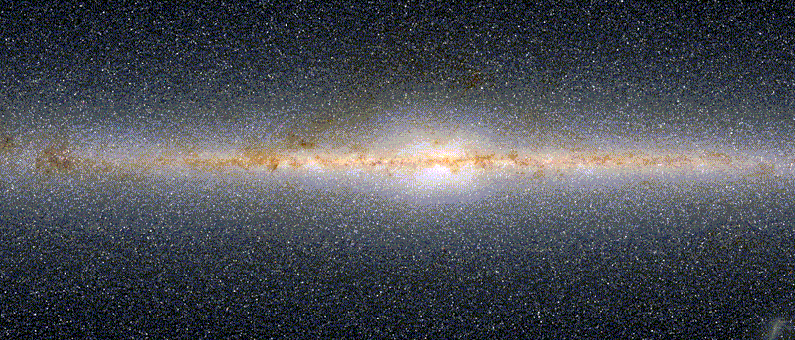
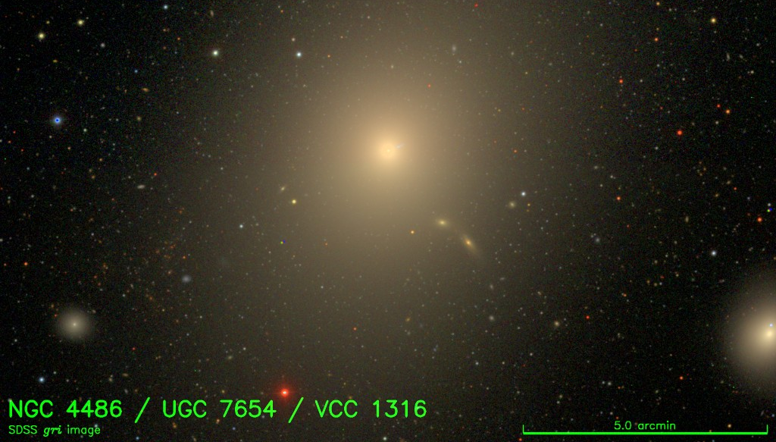
Globular Clusters
Spherical aggregates of stars
(10⁵­−10⁶ M☉)
Almost all galaxies
(>10⁹ M☉) host GC systems
GC formation accompanies all major star formation
Vast majority are old
Bright fossil tracers of galaxy formation
Spectroscopy feasible to
~ 50 Mpc
Dwarfs: 0 to 10s
Spirals: 10s to 100s
Ellipticals: 100s to10,000+
Notes:
Almost all galaxies >10⁹ M☉ host GC systems
GC formation accompanies all major star formation
Bright (10⁵­10⁶ M☉) fossils
Spectroscopy feasible to ~ 50 Mpc

Slide 5
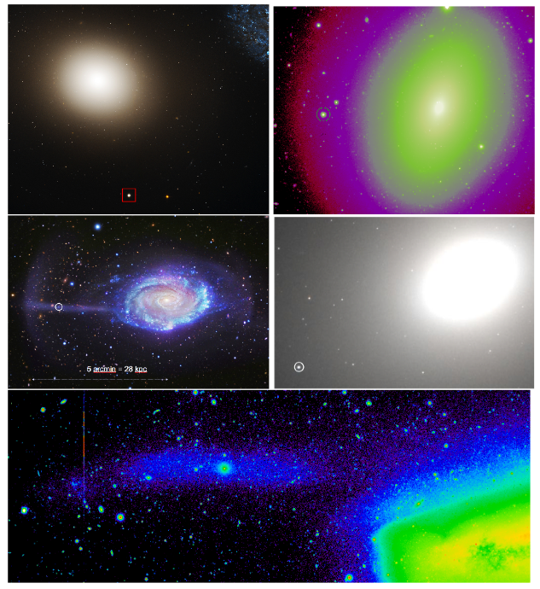
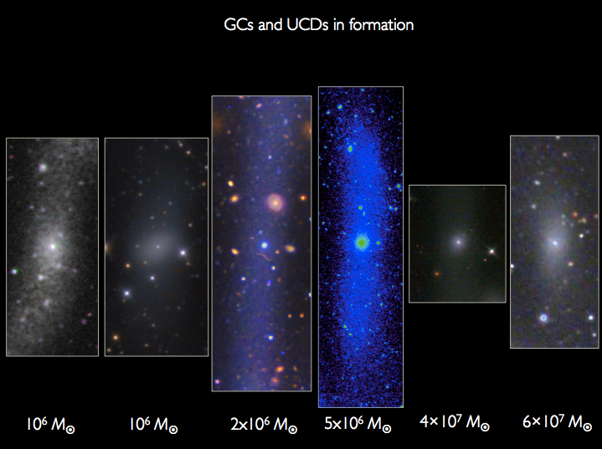
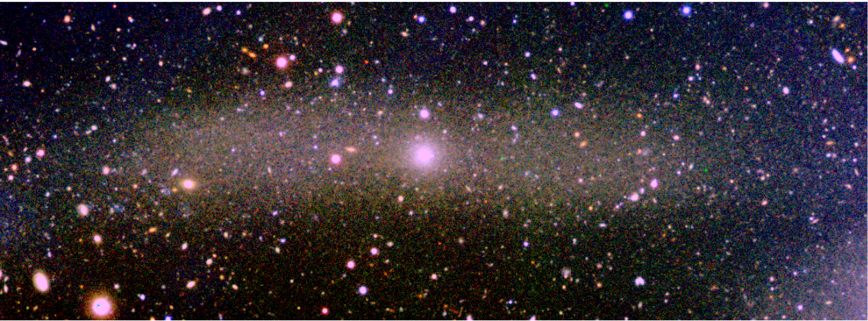
Ultra Compact Dwarfs (UCDs)
Larger and more massive than GCs
Merged GCs, stripped nuclei or galaxy merger products?
ω Cen in formation!
Foster+ 2014
NGC 4651
Red nugget NGC 4342 is being stripped by NGC 4365: GCs and stream stars share velocity and stellar pop characteristics
UCDs in formation!
Subaru/Suprime-Cam
Many UCDs have Super Massive Black Holes at their centres
→
At least some UCDs are stripped galaxy nuclei
NGC 3628
disturbed spiral→
Jennings, Romanowsky, Brodie+ 2015
Notes:
UCDs are easily observable tracers of dynamically significant minor mergers, and smoking gun for
MC origins as NSCs.
i-band luminosity for the UCD is ~1.2 x 10^6, with a size of ~10 pc. Uncertainty on the luminosity is ~10% from the distance, while the size has an uncertainty of +/- 3 pc from distance and systematic uncertainties in the fitting.
For the progenitor, the total i-band luminosity is ~8x10^8, although that should be considered a lower limit given the uncertainties involved; there's almost certainly additional starlight below our detection threshold, or possibly behind the galaxy itself. The approximate size of the stream is around 2000 pc, but that should be taken with a very large grain of salt, it's not a very quantitative measurement at all. I wouldn't really use that number to infer the size of the progenitor at anything more than the order of magnitude level. It's probably more informative to just assume a size typical of a dwarf galaxy for that particular luminosity.

Slide 6
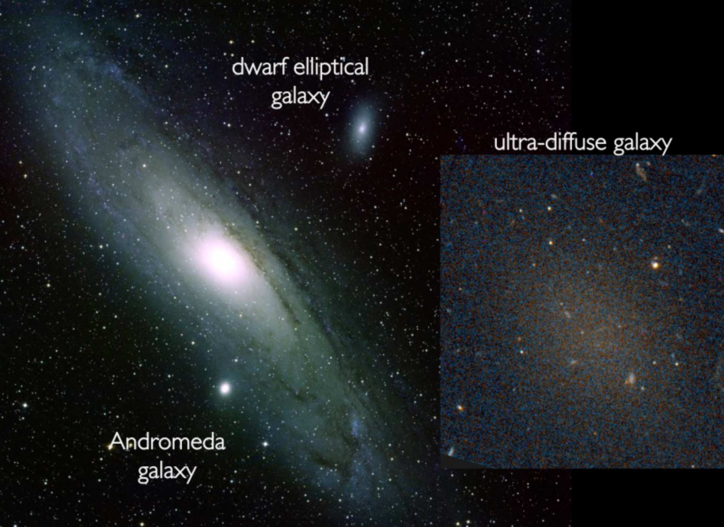
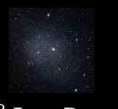
Ultra Diffuse Galaxies (UDGs)
dwarf spheroidal
Image to scale
Working definition:
UDGs are LSB galaxies (𝜇>24 m/arcsec²), sizes Re > 1.5 kpc

Slide 7
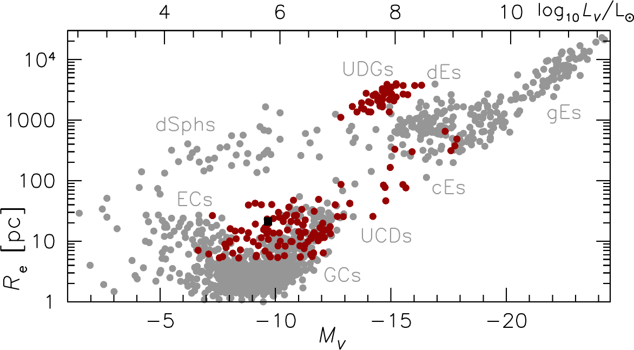
The “Everything” Plot
⦁
Distance-confirmed hot stellar systems
• added since Brodie+ 2011

Slide 8
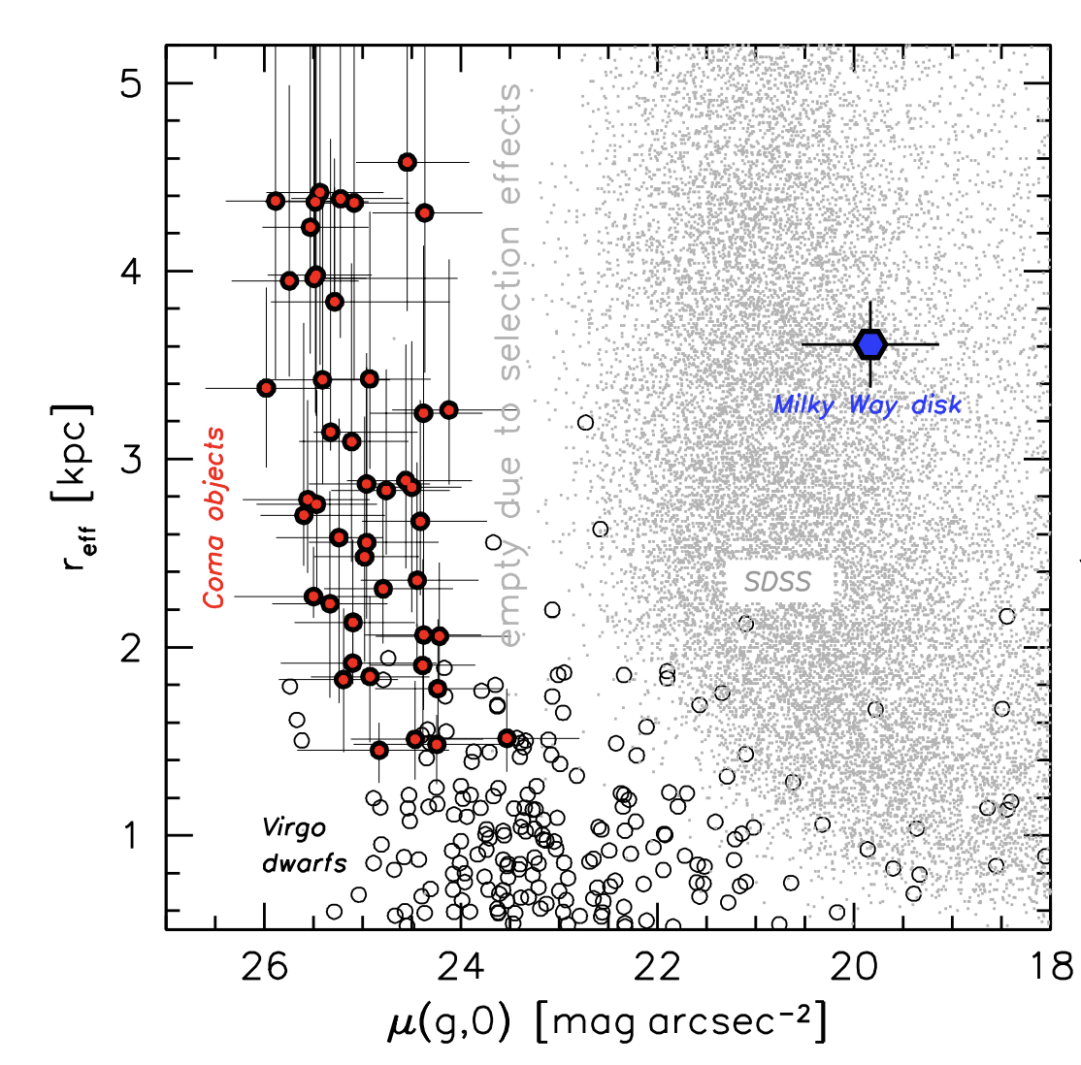
A bit of history
Low Surface Brightness galaxies with UDG properties are not new
Handful discovered much earlier
Impey+ 1988, Bothun+ 1991, Dalcanton+ 1997
Identified in large numbers, originally in Coma, and suggested as a new class of galaxy
van Dokkum+ 2015
van Dokkum+2015
Then found in groups and field
e.g., Martinez-Delgado 2016, Roman & Trujillo 2017,
Leisman+ 2017

Slide 9
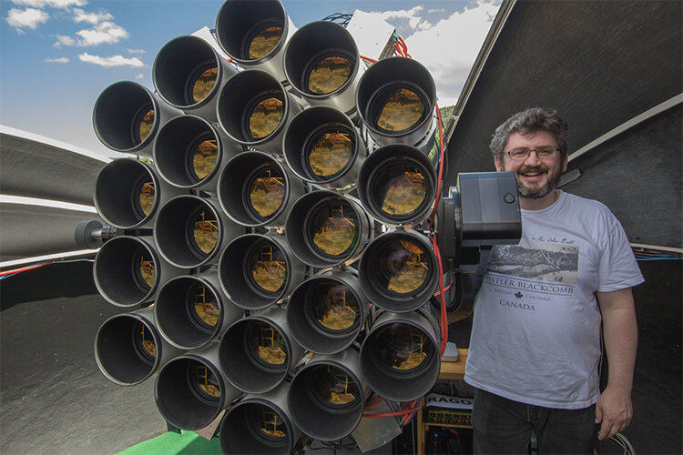

Slide 10
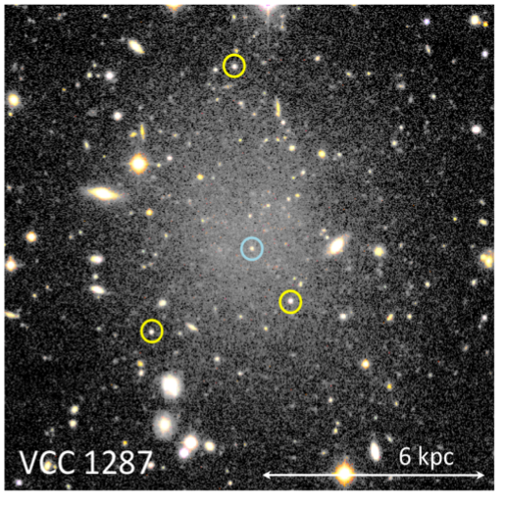
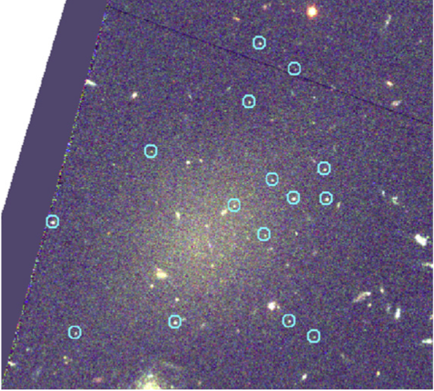
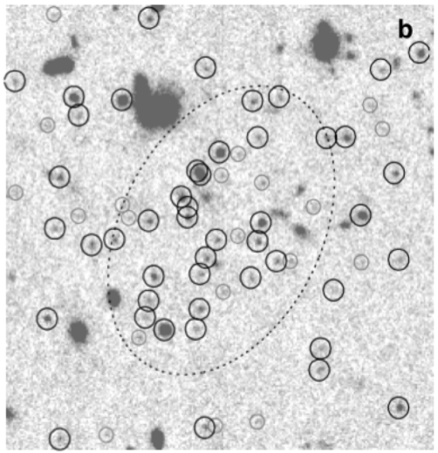
Globular clusters in ultra diffuse galaxies
DF17
DF44
How do we measure the mass of a UDG?mass:
Estimate from stellar velocity dispersion (extremely telescope time intensive)
Weak lensing (few results, stacking, only limits)
X-rays/UV – no detections
GC dynamics
Count number of GCs (mass in GCs)
Notes:
GM/R ~ sigma^2

Slide 11
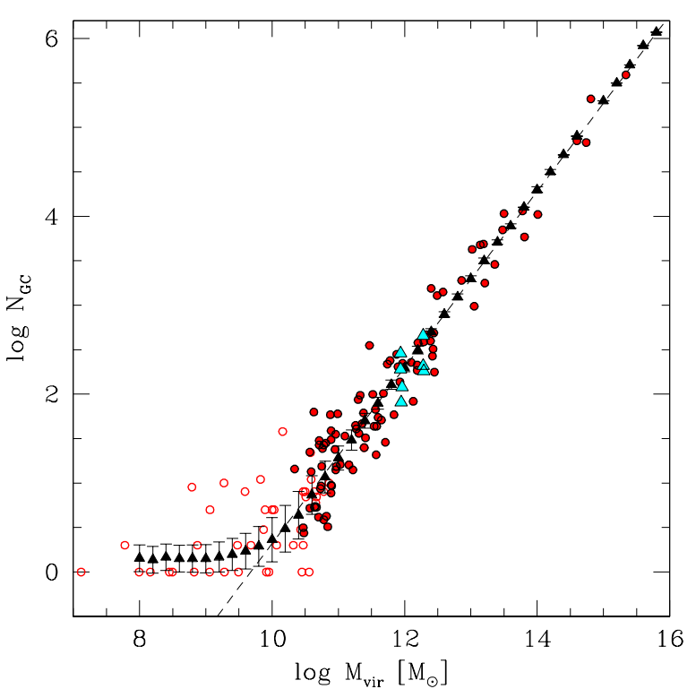

Globular Clusters Indicate Halo Mass
$M_{Halo}=5 ×{10}^{9} M_{ʘ}{ N}_{GC}$
Dragonfly 44
van Dokkum+ 2019
Globular Cluster Number
Halo Mass
Burkert & Forbes (2020)
Notes:
Just mention that the masses come from variety of sources but you don’t need to care about where

Slide 12
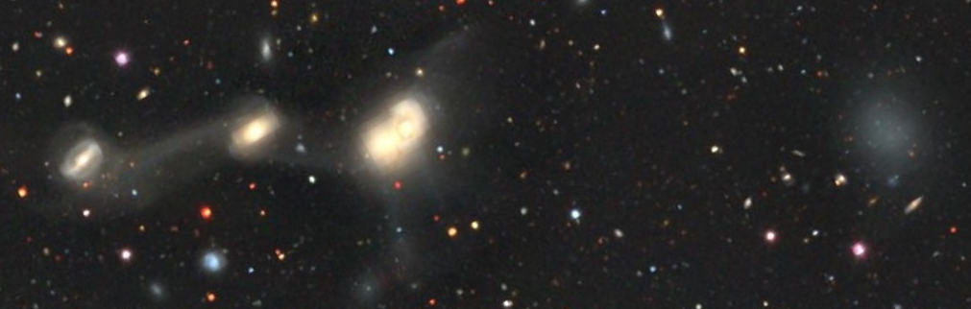
3 UDG TYPES
Old, gas poor
Puffy Dwarfs
Dwarf galaxies that were puffed-up and made “ultra diffuse”
Candidate processes: tidal interactions; high spin; strong feedback
Expect modest halo mass, low velocity dispersion, few GCs
Failed Galaxies
Dark matter halo ~ 10¹¹ solar masses
Formed stars at an early epoch but ceased subsequent star formation
Candidate processes: tidal heating, ram pressure stripping (but what about the field UDGs?) Violent, early massive star cluster formation → gas ejection
Expect high halo mass, high velocity dispersion, many GCs
Dark Matter Free
Not expected!
Notes:
It is this “Puffy Dwarf” type of UDG that has been successfully simulated
Failed giants, by some, as yet unknown, mechanism ceased subsequent star formation.
Failed galaxies lie above the SMHM relation for normal galaxies
DM Free – not initially expected

Slide 13
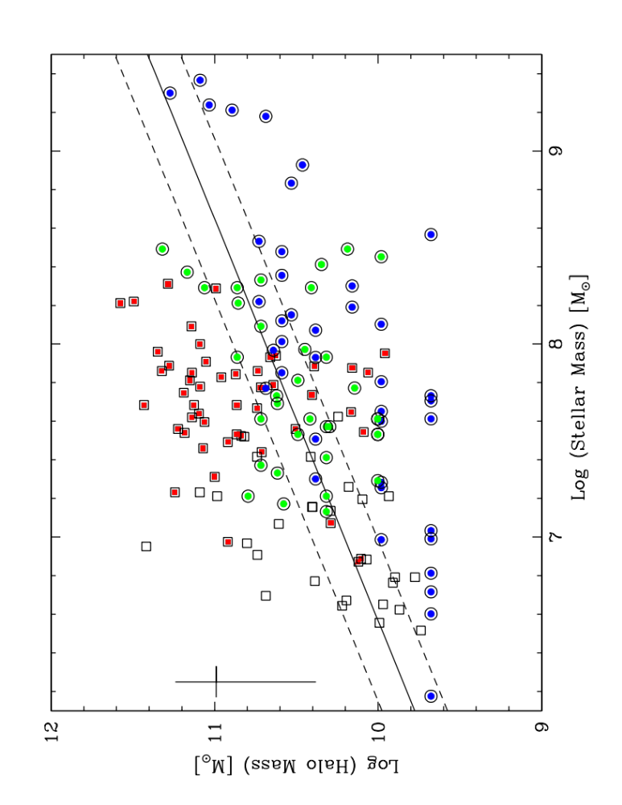
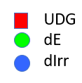
Observations
Forbes et al. (2020)

Slide 14
Observations
Forbes et al. (2020)

Slide 15
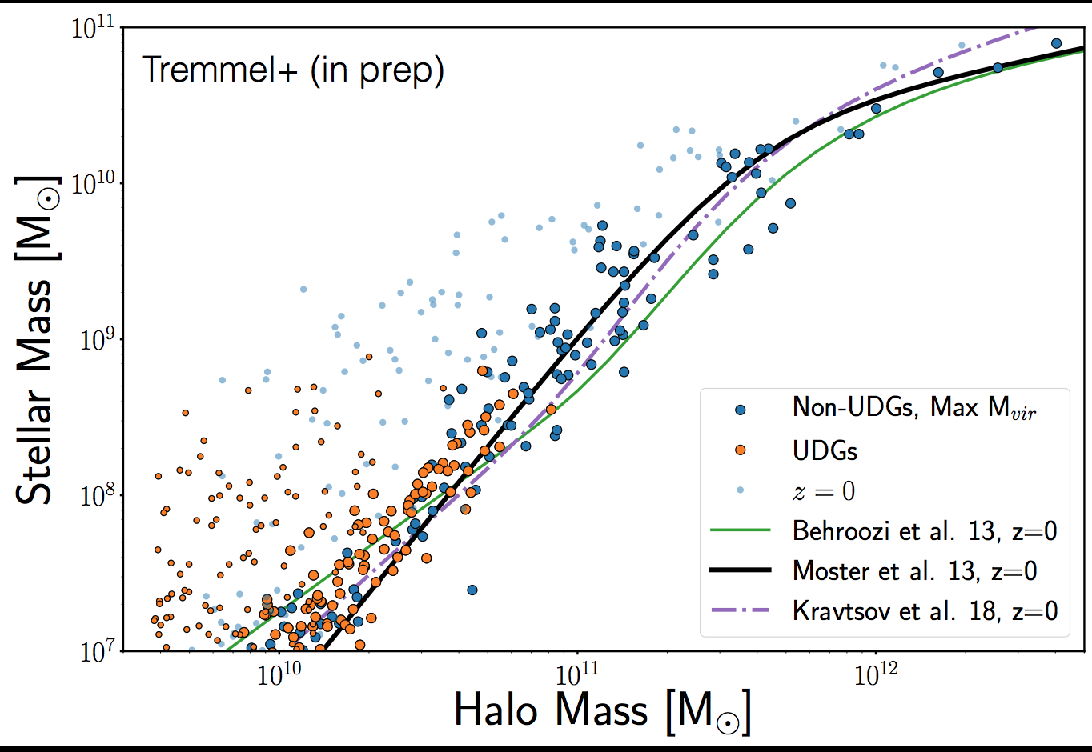
Simulations
2020
Romulus-C cosmological hydrodynamical simulation

Slide 16
Simulations
2020
Romulus-C cosmological hydrodynamical simulation

Slide 17
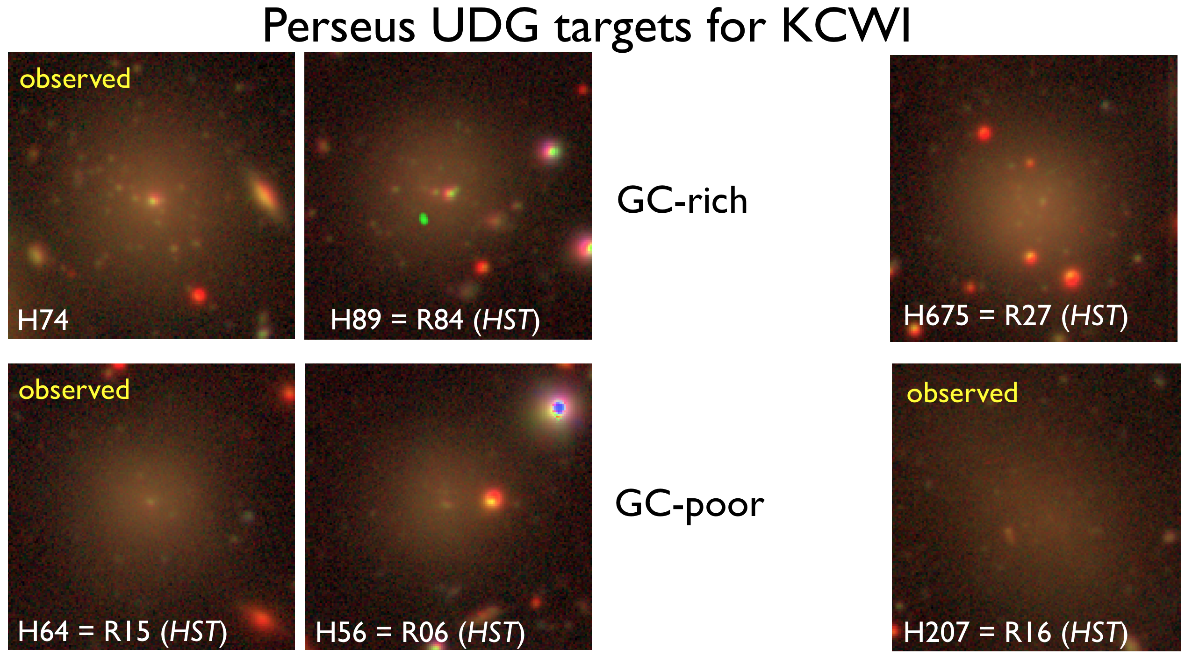
GC rich – failed galaxies?
GC poor – puffed up dwarfs?
Globular Cluster Rich Globular Cluster Poor

Slide 18
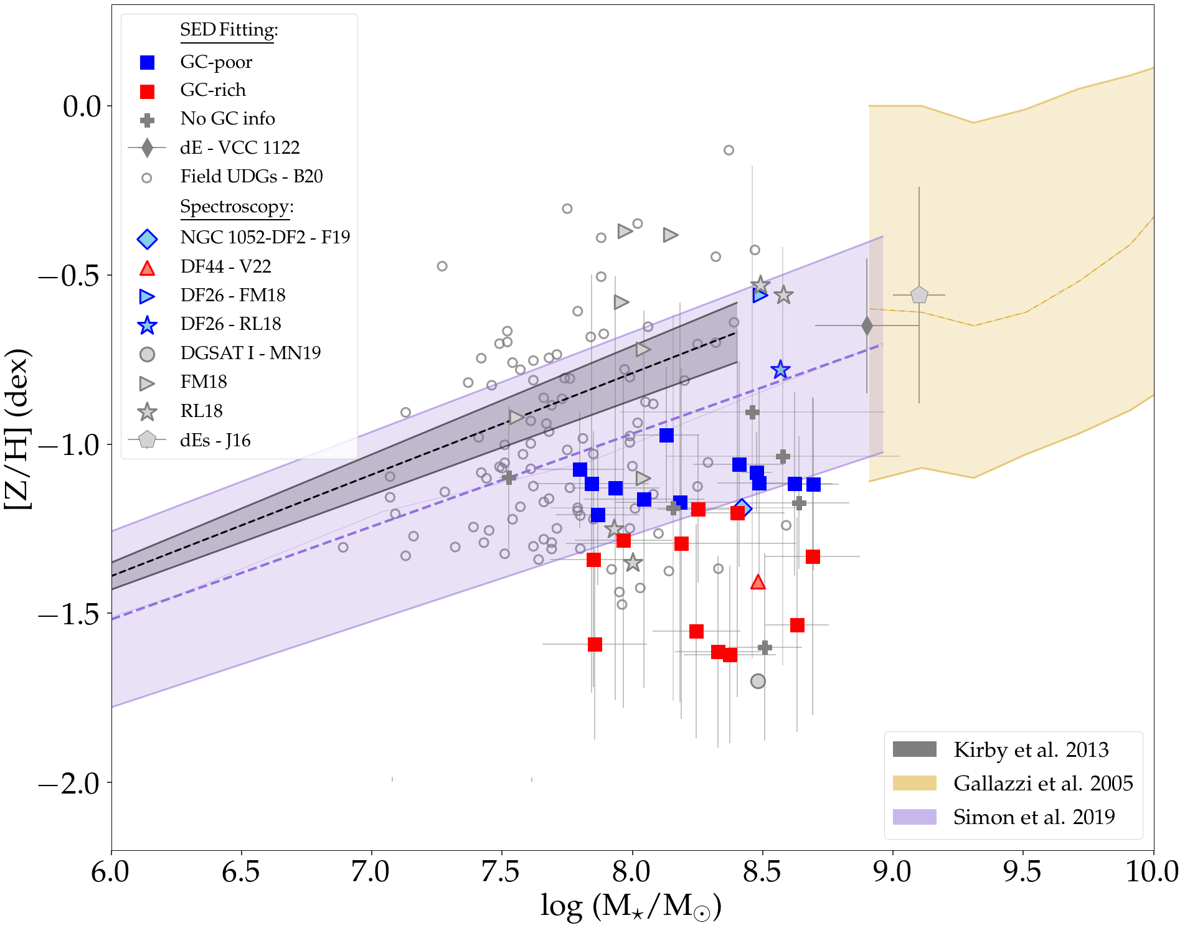
Stellar Mass-Metallicity Relation
SED fitting of multi-band photometry with Prospector
MZR for UDGs does not look like MZR
for dwarfs
GC poor UDGs
more consistent
with dwarfs
→
puffed-up
dwarfs
GC rich UDGs
much more
metal-poor
→
failed galaxies
Buzzo+ 2022

Slide 19
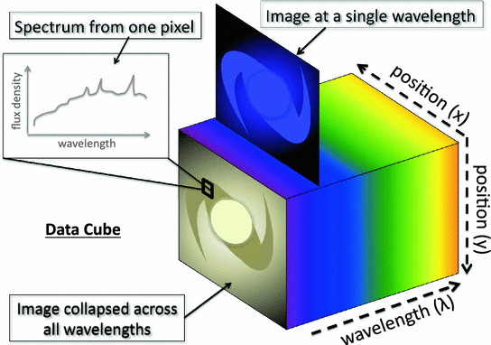
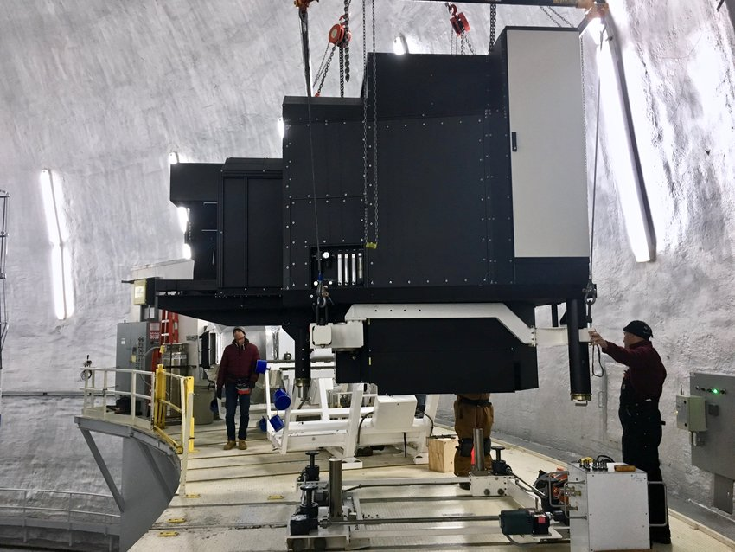
Integral Field Spectroscopy
➔ Spatial and Spectroscopic information
The Keck Cosmic Web Imager (KCWI)
Optimised for low surface brightness astronomy
From Harrison C.M. PhD Thesis (2016)

Slide 20
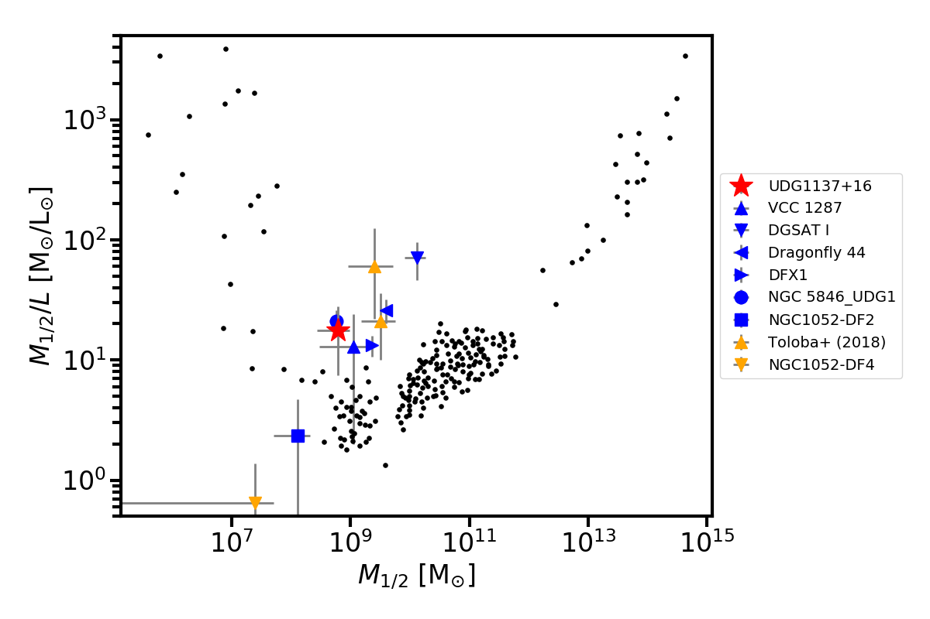
Mass To Light
Gannon, J+ (2020)
Mass-to-light ratio within half-light radius
GCs Stars
Extreme variations in UDG M/L ratios
Dynamical mass
within half-light radius

Slide 21
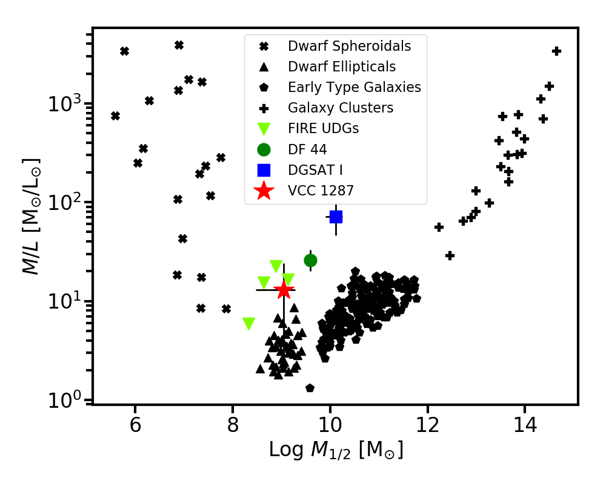
Mass To Light
Gannon, J+ (2020)
Mass-to-light ratio with half-light radius
GCs Stars
Extreme variations in UDG M/L ratios
Dynamical mass
within half-light radius
FIRE cosmological simulations of dwarf galaxy formation
can reproduce some UDGs, but not all, and GCs remain tbd

Slide 22
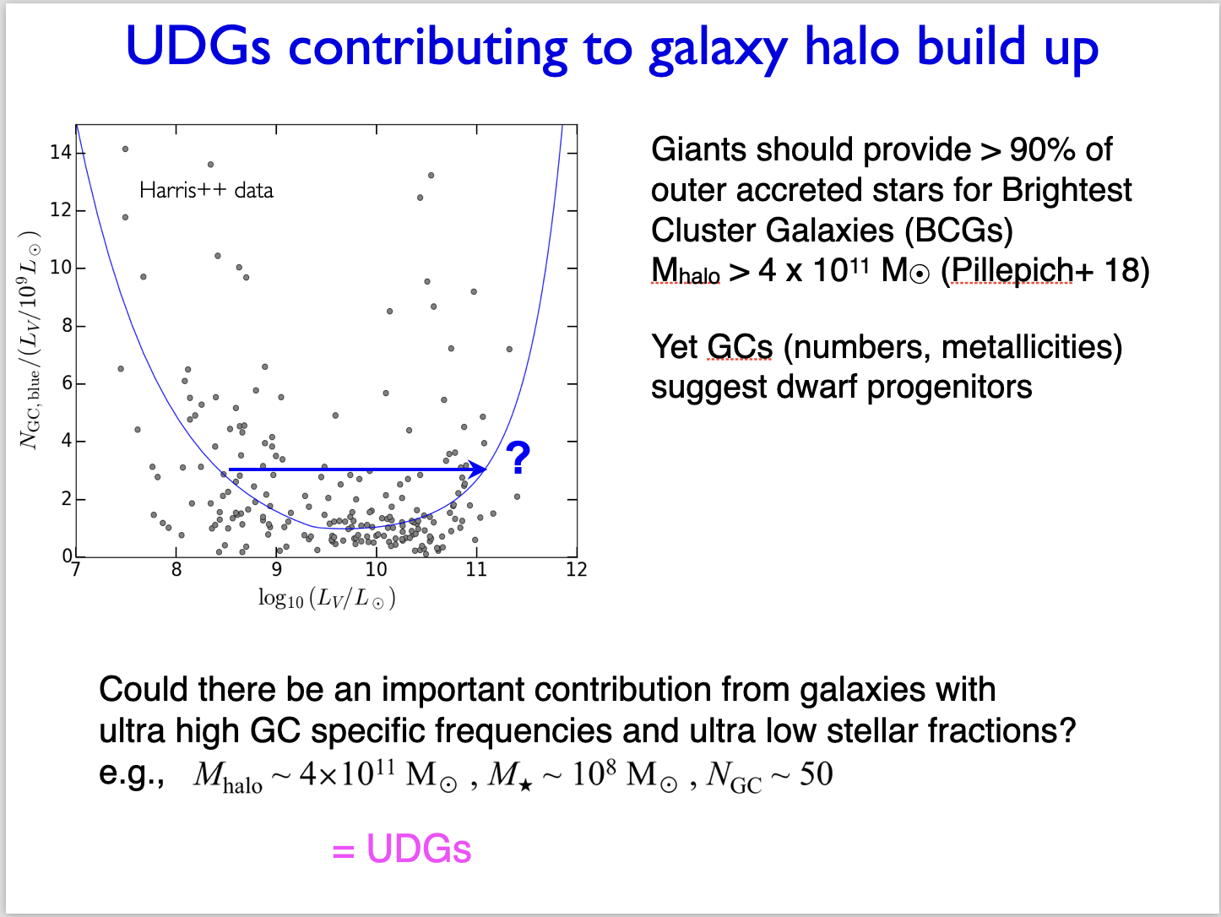

Slide 23
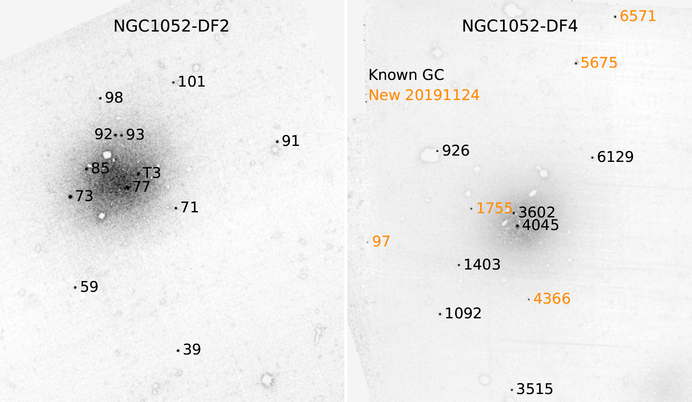
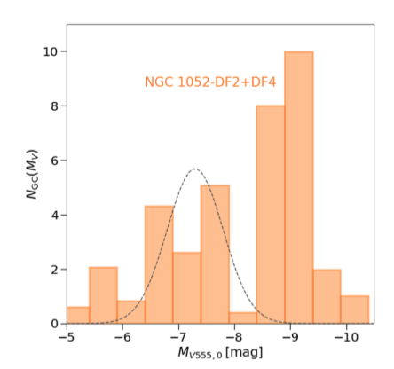
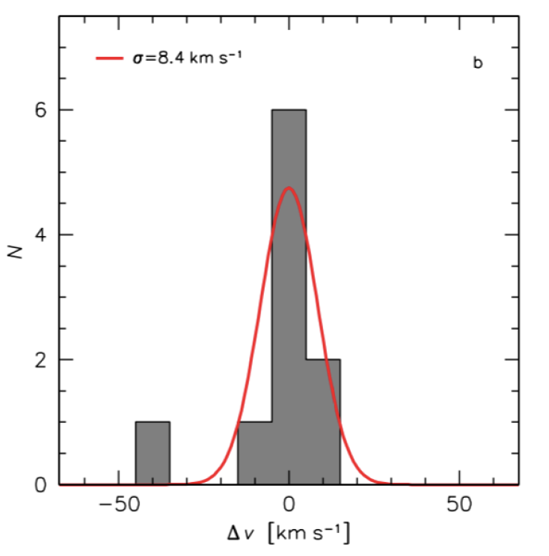
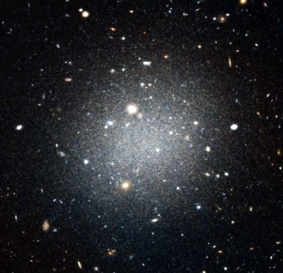
UCDs in UDGs lacking DM
🤨
Population of luminous, extended, flattened star clusters = Ultra Compact Dwarfs (UCDs)
M★ = 2 x 10⁸ M⦿
Mhalo < 3.4 x 10⁸ M⦿
Mhalo/M★ ~ 1 consistent with zero dark matter
DF2
DF2
Notes:
With the revised distance, all of the GCs in NGC 1052–DF2 are 0.2 mag more luminous than previously reported. The GC luminosity function now peaks at Mv ≈ −9.3, even further from the canonical value of−7.5 (see Rejkuba 2012).

Slide 24
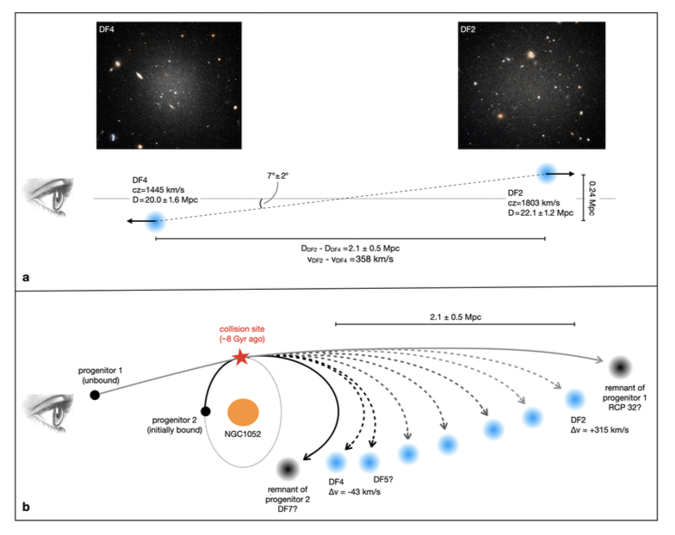
Bullet formation scenario
NGC 1052 group
van Dokkum+ 2022 Nature
Two gas rich galaxies collide
Creates trail of UDGs
stripped of DM
Also creates massive star clusters + feedback expands UDGs
Stellar pops will be key:
are DF2 and DF4 the same?
DF5? Similar but fainter
Can we use the star clusters as proxies?
Notes:
Self-interaction cross section for DM
Search for other examples – simulations suggest 8 within 20Mpc
Star cluster ages in DF2 ≳ 8 Gyr,
[Fe/H] ≅ –1.35

Slide 25
Summary
1) Puffed up dwarfs
GC poor
2) Failed galaxies
GC rich
3) DM free
GCs and UCDs
UDGs may be important for understanding the build-up of massive galaxy halos
Some UDGs appear to be DM dominated based on:
NGC, GC dynamics, stellar velocity dispersion
Two+ UDGs have little/no DM and strange (over-luminous) star clusters/UCDs
Notes:
Contour for UGC 2162 is the 26 mag/sq arcsec countour

Slide 26
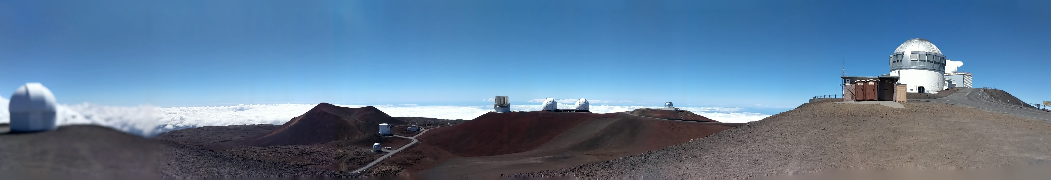
What have we learned about UDG origins?
Simulations do best with Puffy Dwarfs (FIRE, ROMULUS-C …. NIHAO, TNG50)
Failed Galaxies need quenching mechanism to prematurely halt SF
Tidal heating, ram pressure stripping potentially work in galaxy clusters
Quenching field UDGs is challenging
Can we explain DM-free UDGs? – maybe
UDGs preferential hosts of UCDs? e.g., Bullet model
Next steps:
Need statistically significant observational samples with detailed characteristics
to inform simulations
Establishing UDG properties directly is prohibitively telescope time intensive
Understanding GC formation in UDGs is essential
Needs to be explicitly simulated
Notes:
We have at least learned what we need.

Slide 27

Happy Birthday, Ken!

