Slide 1
Scaling Relations in HI-selected
Star-forming galaxies
Gerhardt R Meurer

Slide 2
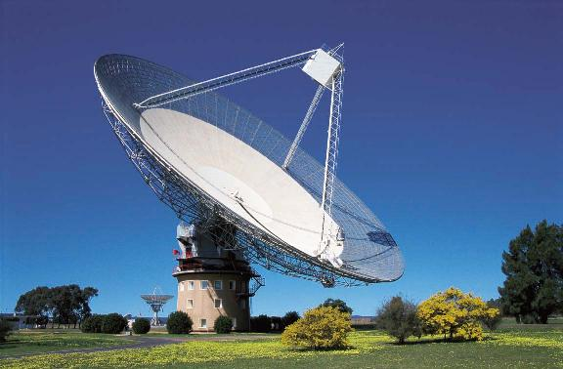
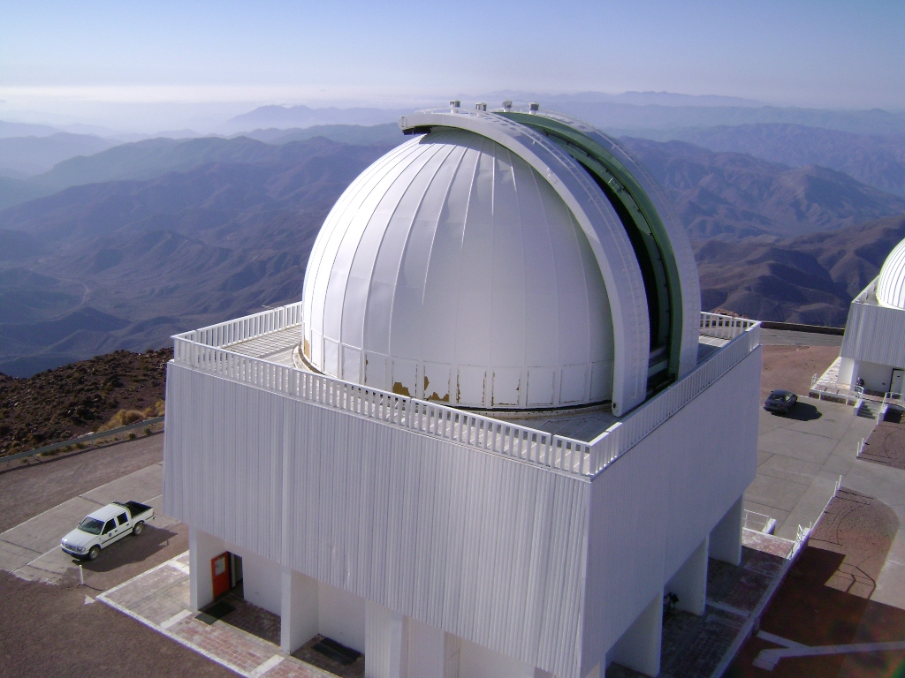
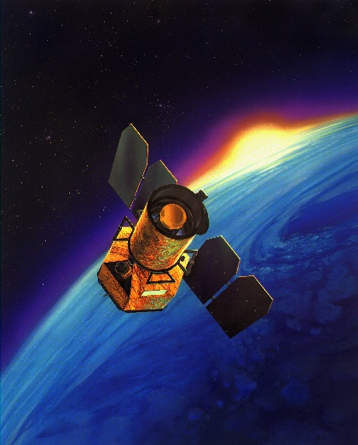
HIPASS + SINGG + SUNGG
HI Parkes All Sky Survey
    HI 21cm
    Parkes 64m
    4315 sources
Survey of Ionization in Neutral Gas Galaxies
    Hα & R band
    CTIO 1.5m
    468 sources selected
    331 observed
Survey of Ultraviolet emission in Neutral Gas Galaxies
    FUV & NUV
    Galex 0.5m
    139 selected
    ~200 observed

Slide 3
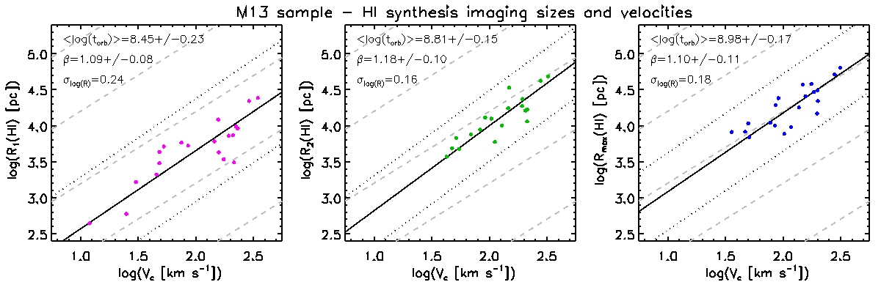
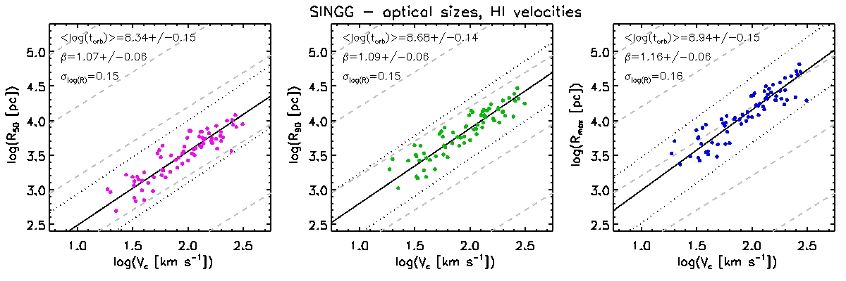
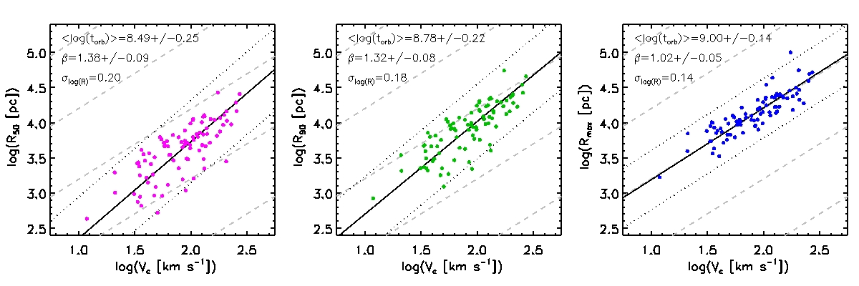
The Radius - Velocity Relation
HI sizes and V_{rot}
Optical sizes, HI V_{rot}
Ultraviolet sizes, HI V_{rot}

Slide 4
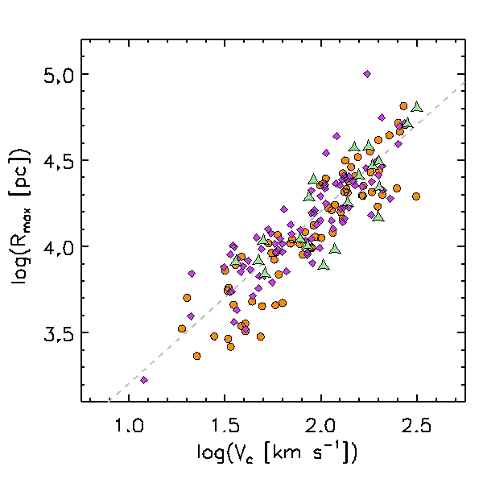

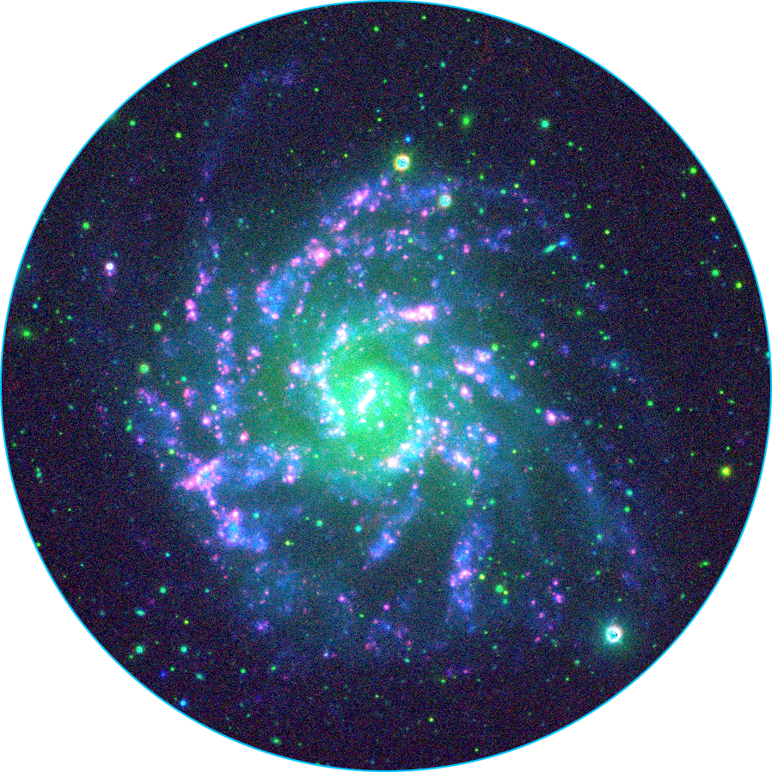
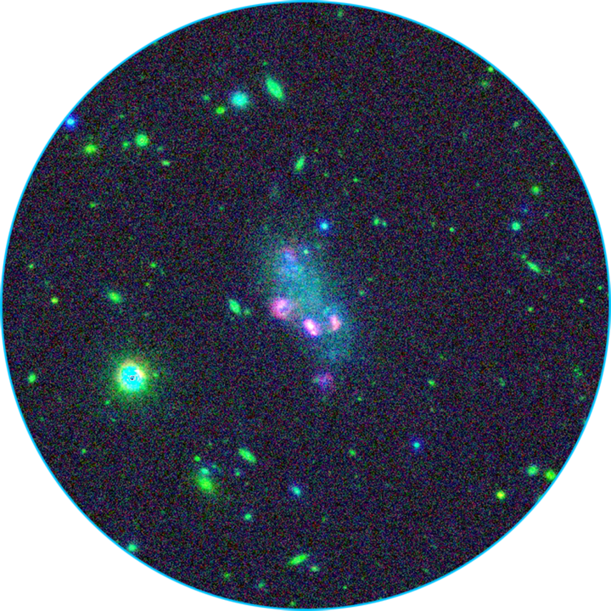
Galaxy sizes approximately to scale
Spiral
Dwarf Irregular

Slide 5
Spiral
Dwarf Irregular

Slide 6


Galaxies behave like clocks they rotate once per Gyr at the outer edge irrespective of size
t_{orb} = 1 Gyr
Spiral
Dwarf Irregular

Slide 7
Implications / expectations
Constant t_{orb} = 1 Gyr → avg density: ρ_{G} = 2.1x10⁻³ M_{sun} pc⁻³
In CDM scenario, virial radius R₂₀₀ defined where ρ = 200ρ_{c}
  So t_{orb,200} also constant at “edge” of DM halos [ t_{orb,200} = 8.9 Gyr at z=0 ]
  Inside this radius structure is nominally self-similar (NFW profile)
From Mo, Mao & White (1998) radius of the baryons (b)
  (R_{b}/R₂₀₀) = sqrt(2)*(j_{b}/m_{b})λ ( = t_{orb,b}/t_{orb,200} for flat RC)
    j_{b} - fraction of angular momentum in baryons; m_{b} - fraction of mass in baryons; λ - spin parameter
  (R_{b}/R₂₀₀) = 0.11 ; λ = 0.15 (j_{b}/m_{b})
Naïve expectations: j_{b} = m_{b} = constant ; λ = constant
→ Constant t_{orb} expected for baryon collapse in CDM halos

Slide 8
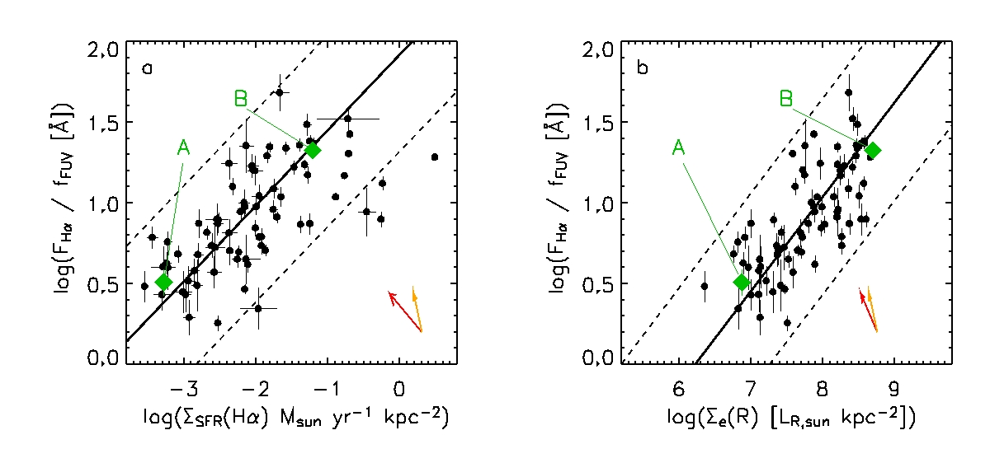
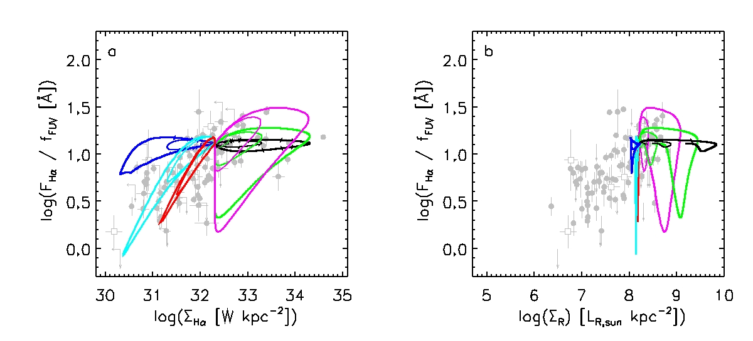
Hα/FUV versus surface brightness
From Meurer+ 2009, ApJ, 695, 765
Hα -> O stars; UV -> O+B stars; ratio sensitive to bursts and IMF
Can’t be due to “Starbursts” or “gasps”
-> LSB galaxies (e.g. A) are typically dwarfs
-> Normal & HSB galaxies (e.g. B) are typically spirals
Best explanation of correlation: upper end of the IMF varies

Slide 9
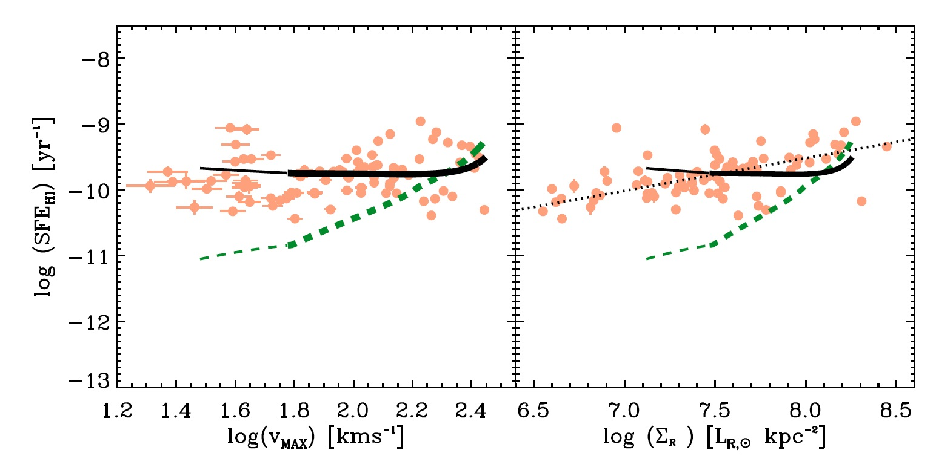
Constant SFE(FUV)
SFE(HI) = SFR(FUV)/M_{HI}
Model assumes
  a family of rotation curves
  ISM in hydrostatic equilibrium
  Stars form in mol gas
  ”Two speed” Star Formation Law
        (higher eff. at highest H2 density)
  O.I. Wong+ 2016 (MNRAS, 460, 1106)

Slide 10

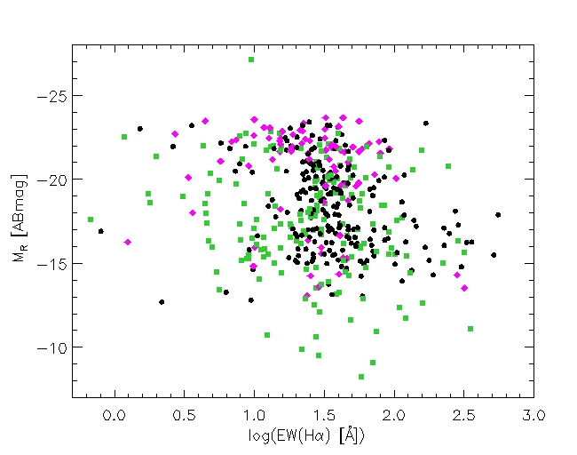
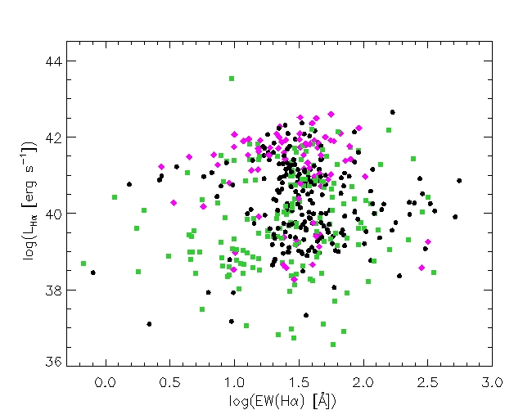
A preferred EW(Hα)
High-mass star formation occurs at a preferred EW(Hα) = 30Å
Most noticeable for M_{R} = –14 to –22 ABmag
Related to the Kennicutt – Schmidt Star Formation Law?
(Meurer+2022 in prep)

Slide 11
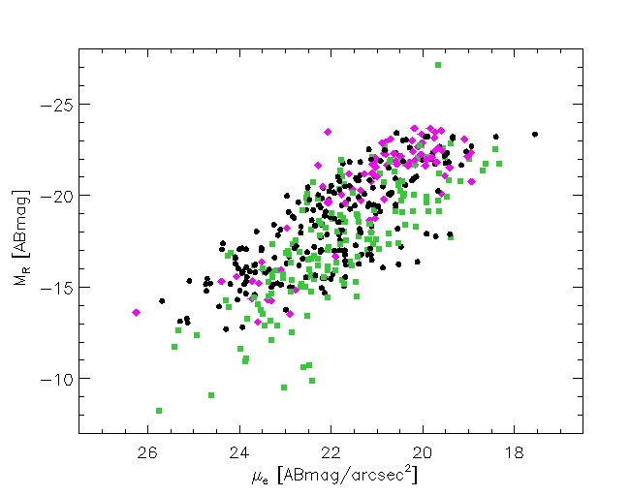
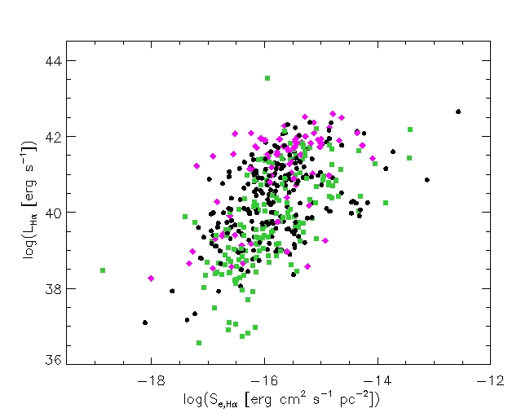
Luminosity – Surface Brightness
Noticeable thickness to correlations
Beware limits due to sky at low SB & faint L
Different slopes in R , Hα ?
Hα closer to a constant S_{e,Hα}
(Shades of Freeman 1970 ???)
(Meurer+2022 in prep)

Slide 12
Summary
Observations of HI and Star Formation in galaxies
  Isolates the disk
  Probe relationships between the disk and other components of galaxies
Results covered here
Constant t_{orb} at disk edge
  Shows the extent of the collapse of disks
  Constrains the spin of the halo
Correlation of Hα/FUV & Σ*: the IMF is not constant
Constant SFE(FUV) -> Well modeled with 2 speed SFL
A preferred EW(Hα) – related to the SFL(?)
The Luminosity Surface brightness relationship
  Steeper in Hα compared to R band
  Don’t know how to square that with preferred EW(Hα)

Slide 13
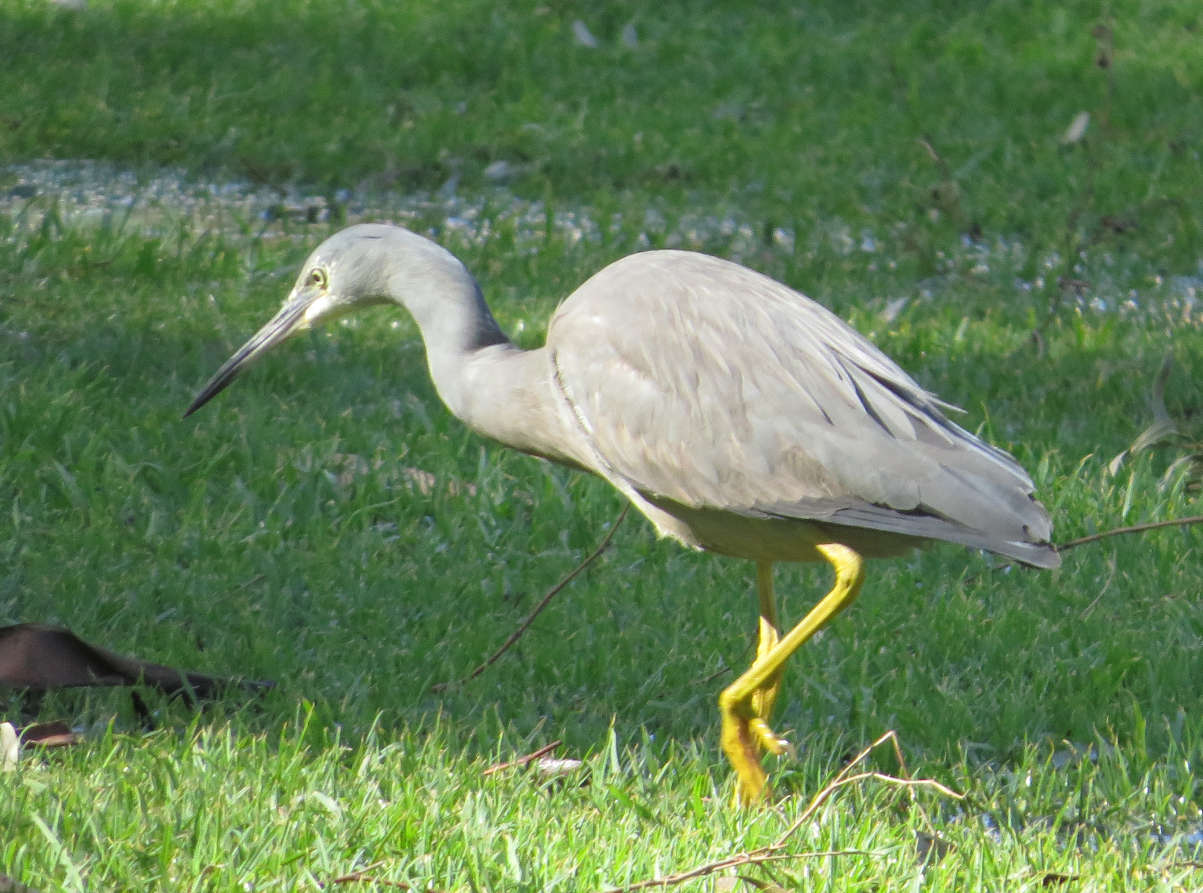
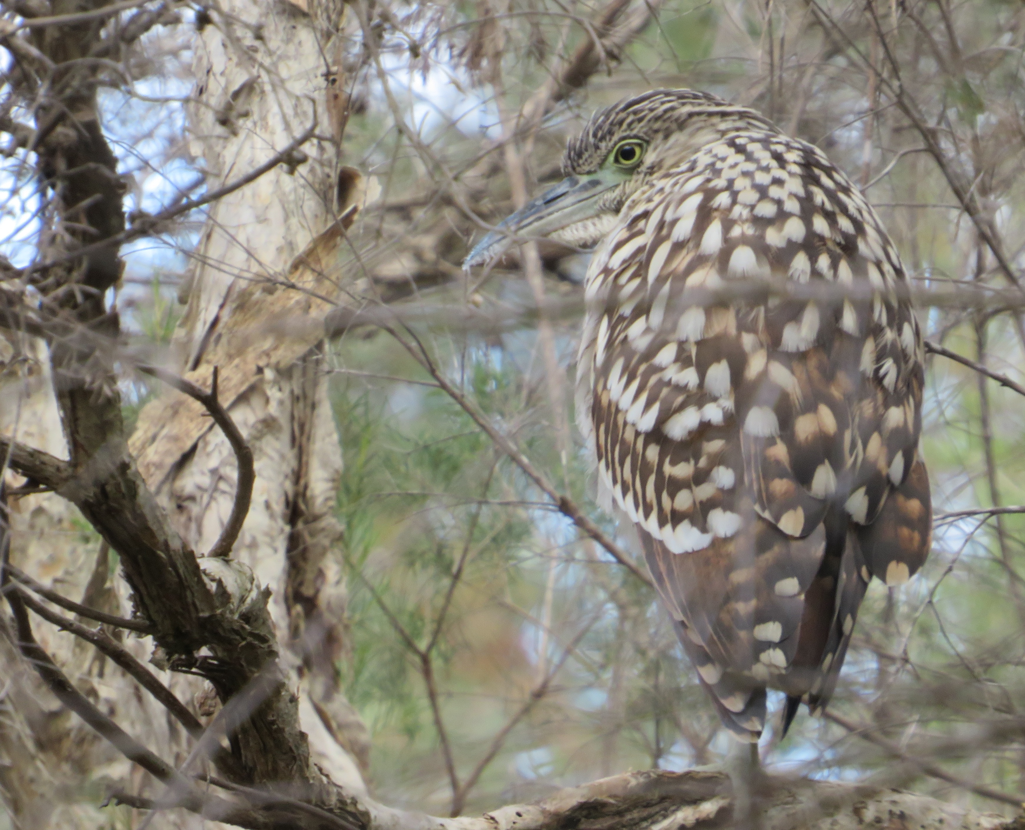

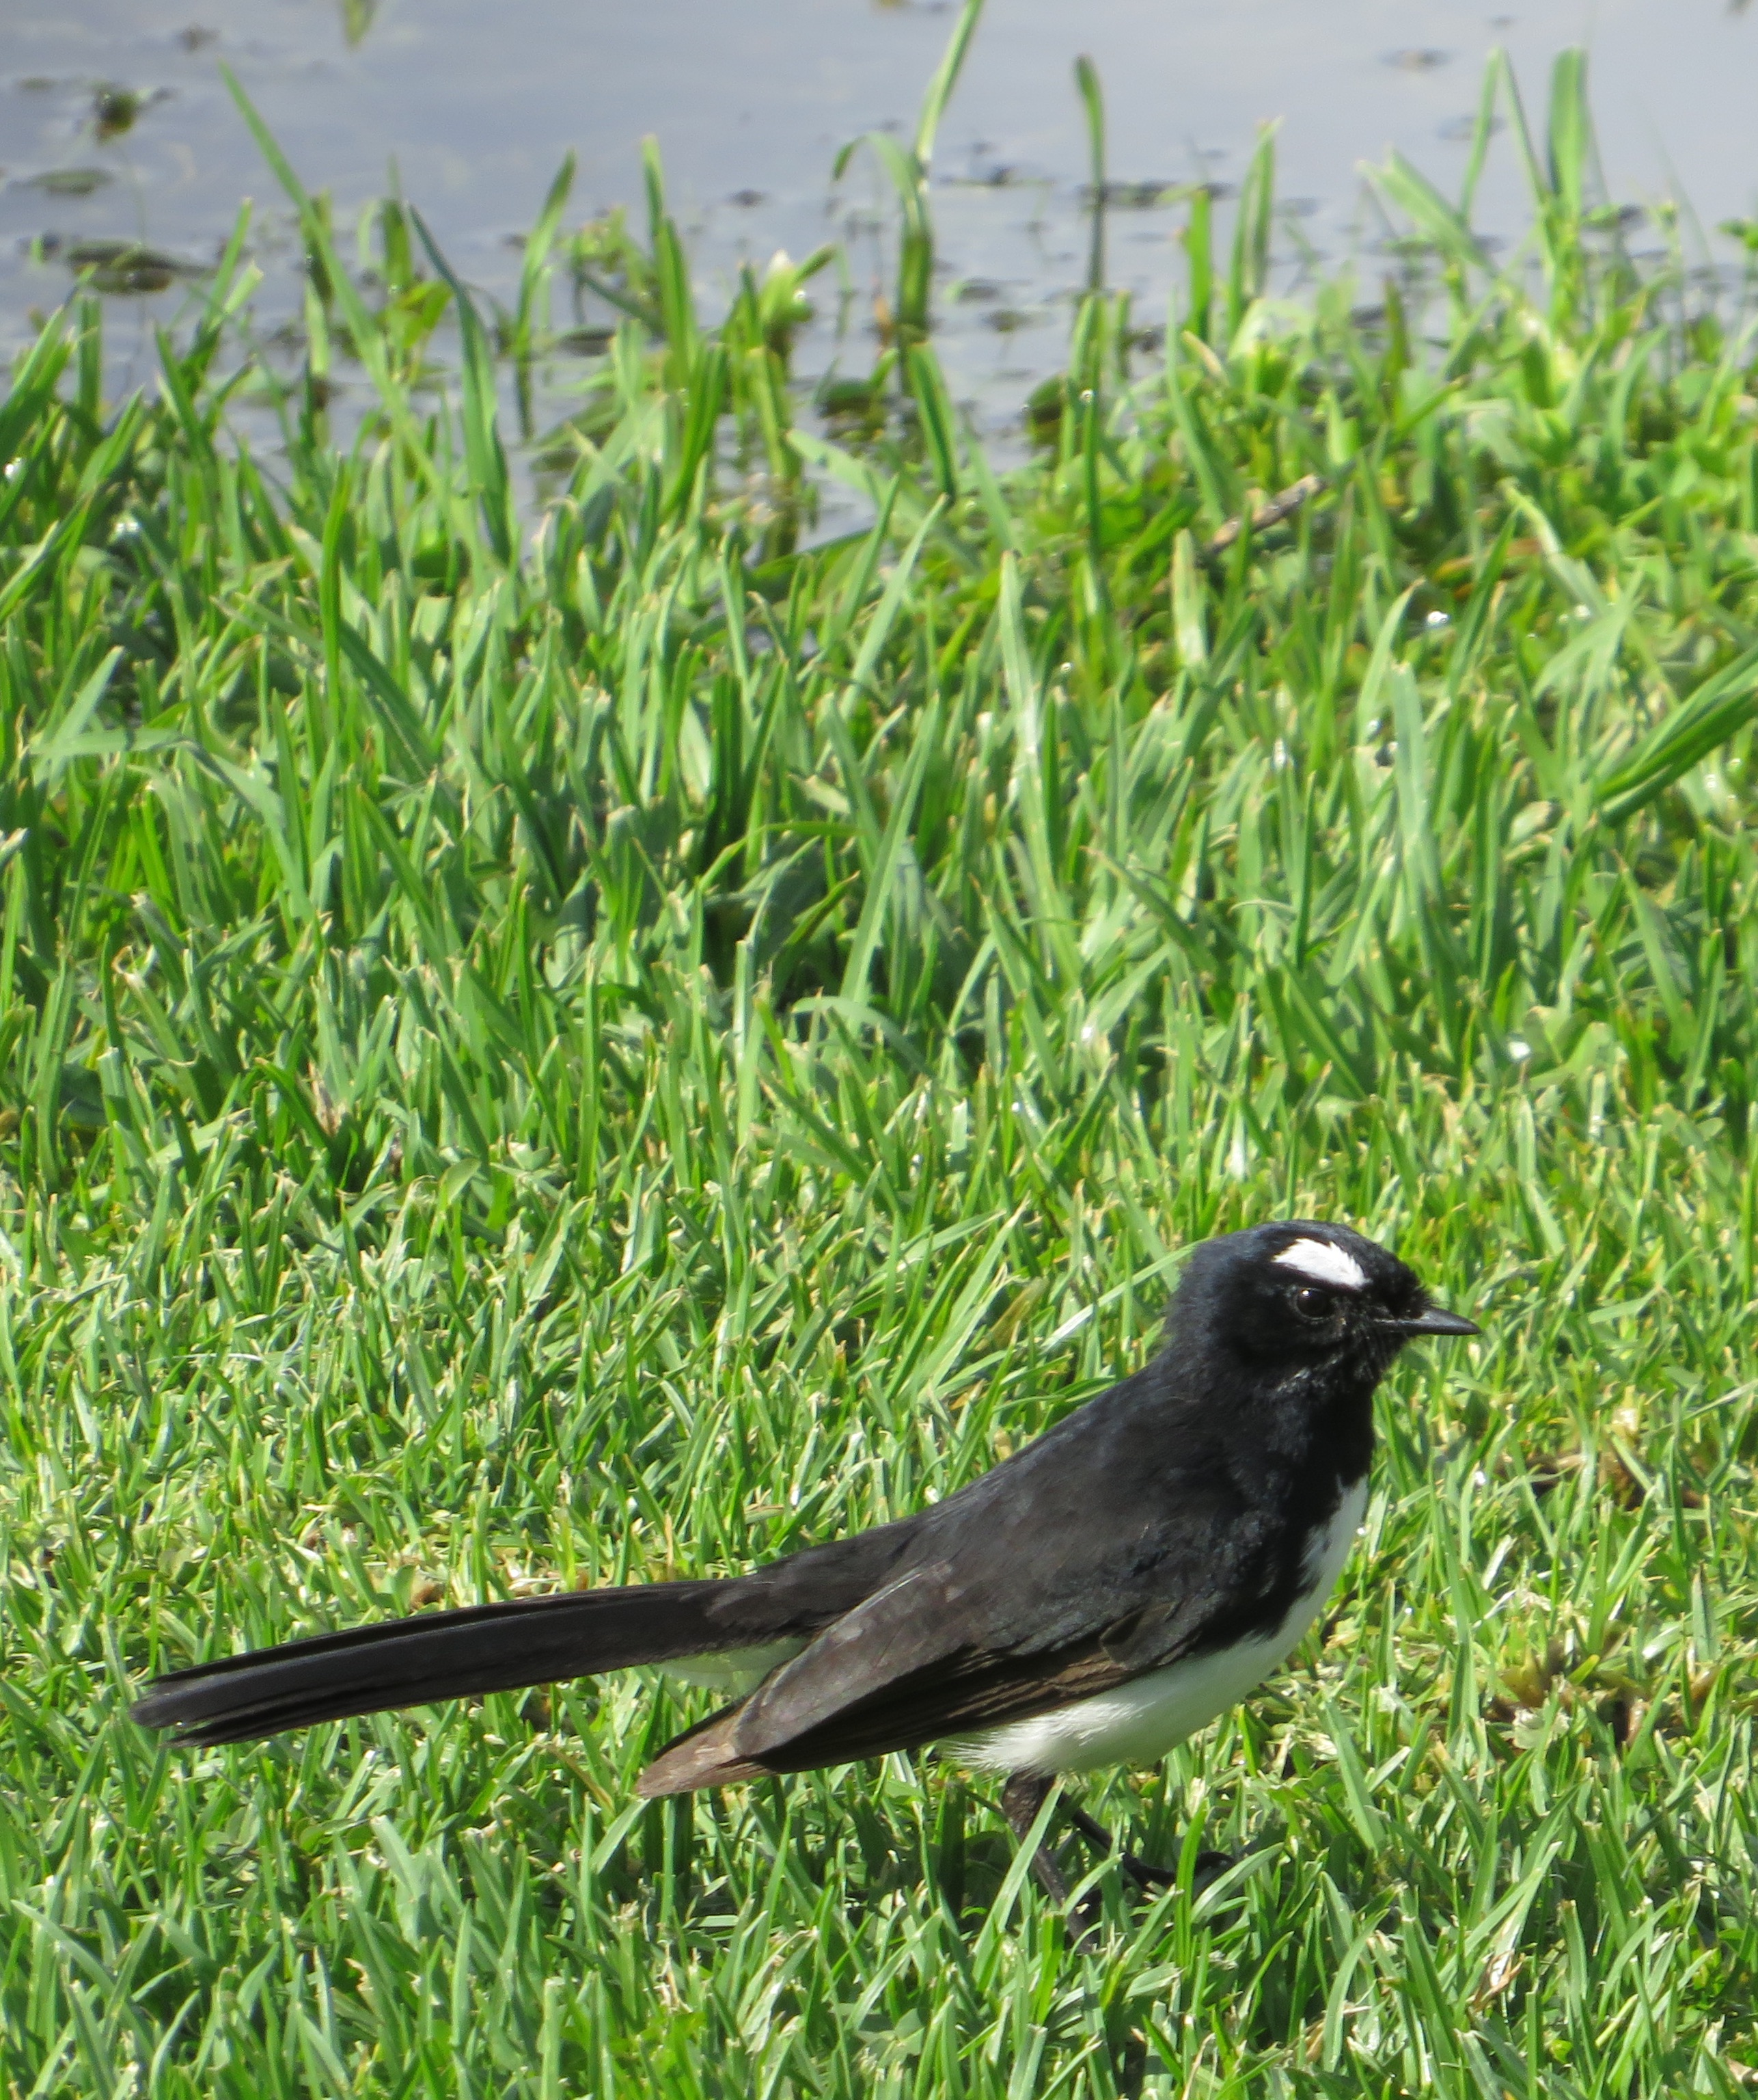

Any Questions?

Slide 14
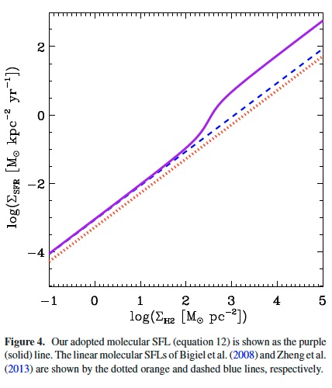
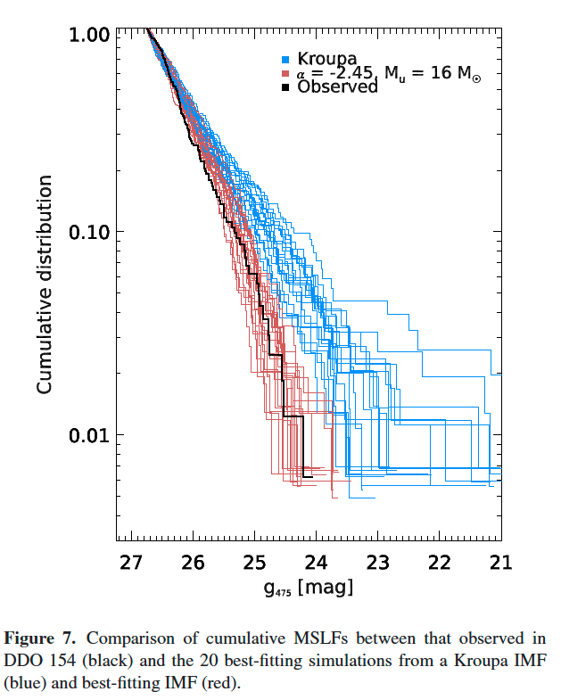
Extra figs

