Slide 1
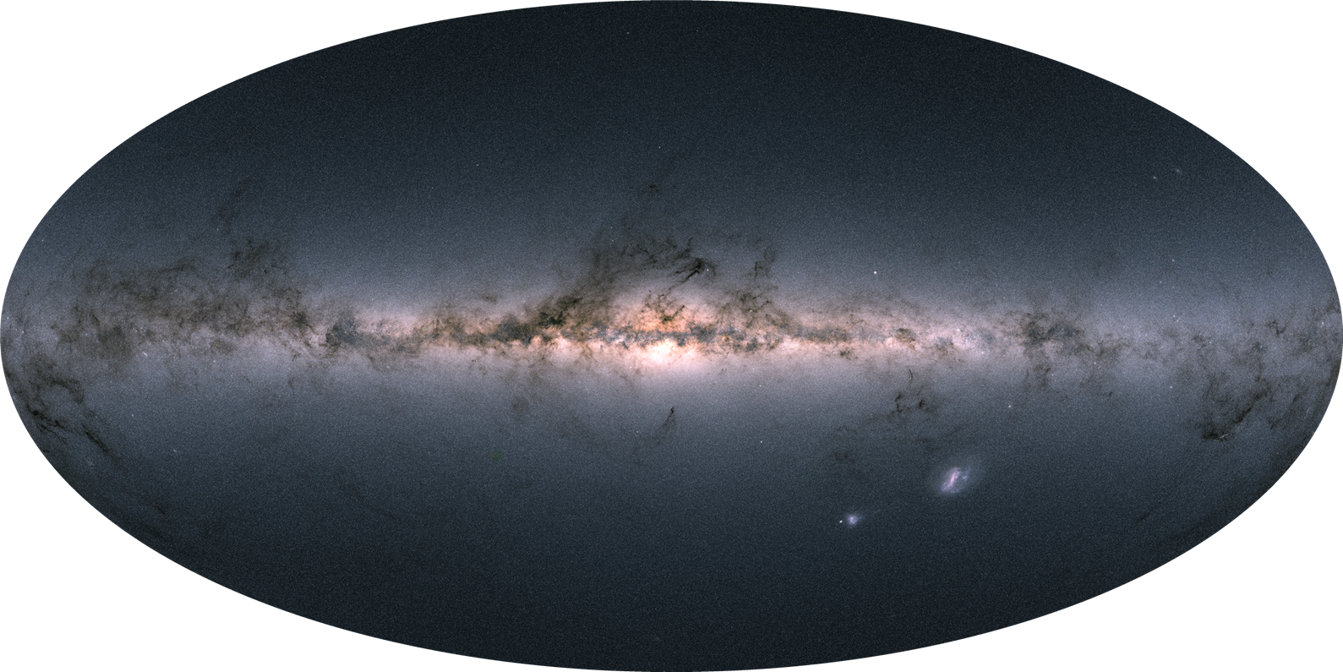
Chemical Evolution of the Milky Way
Michael Hayden
Boquan Chen
Sanjib Sharma
Purmortal Wang
Joss Bland-Hawthorn
GALAH Team
APOGEE Team
University of Sydney

Slide 2
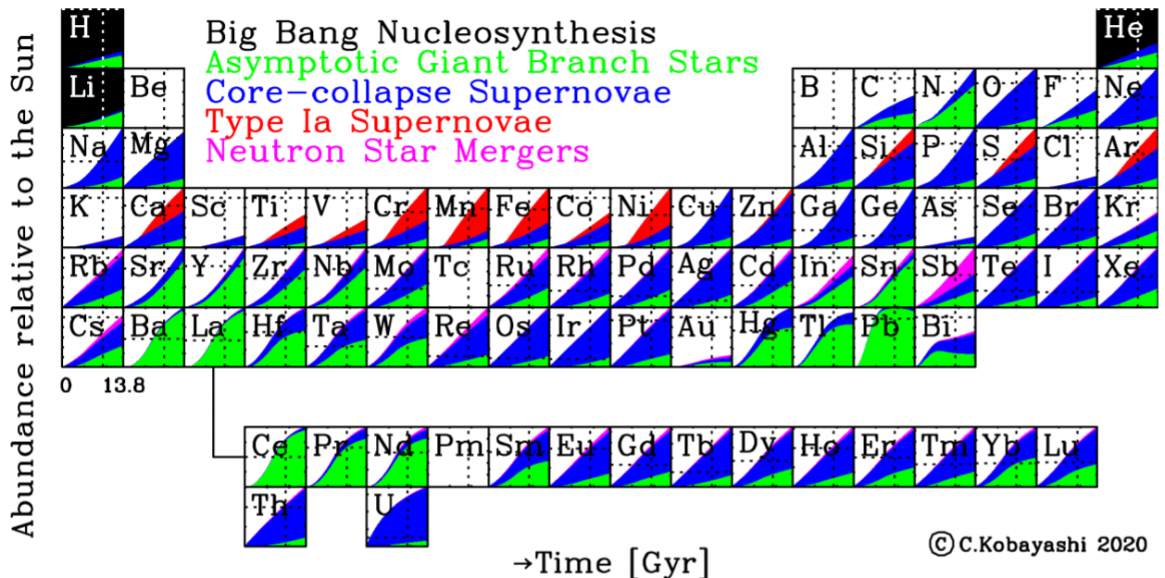
Where Do the Elements Come From?

Slide 3
Simple Scenario: What Happens If Star Formation Is Rapid/Slow?
[Fe/H]
Time
Young Stars
Old Stars

Slide 4
Simple Scenario: What Happens If Star Formation Is Rapid/Slow?
Turnover/Knee Metallicity:
SNIa start going off at knee
Function of Star
Formation Rate
[Fe/H]
[α/Fe]
~Age
Time
Young Stars
Old Stars
[Fe/H]

Slide 5
The Solar Neighborhood
Solar neighborhood: easiest to observe, stars nearby, bright (Furhmann, Bensby, etc.)
Take stars within 100 pc of the Sun, what do we see?

Slide 6
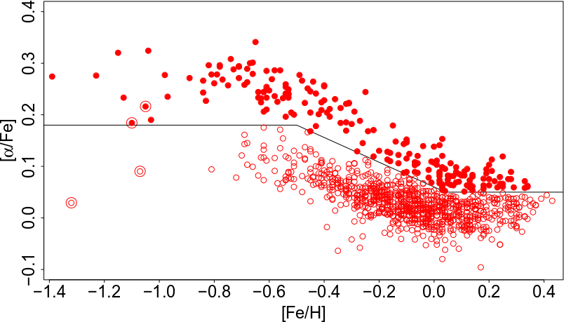
The Solar Neighborhood
[α/Fe]
~Age
[Fe/H]
Adibekyan+2012, Haywood+ 2013

Slide 7
The Solar Neighborhood
[α/Fe]
~Age
[Fe/H]
Adibekyan+2012, Haywood+ 2013

Slide 8
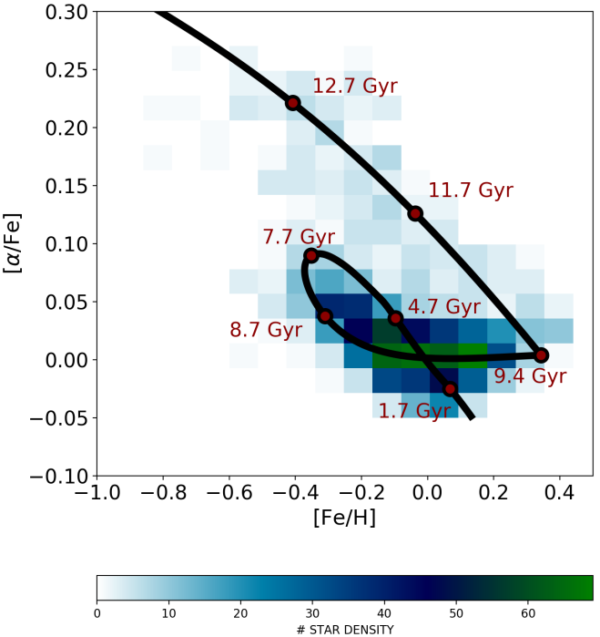
The Solar Neighborhood- Hmmm
Two-infall model: major accretion event resets chemical evolution
Explains both the high and low alpha disk
Potential issue: very specific age-metallicity relation, metal-rich stars can only be old!
Spitoni+2019

Slide 9
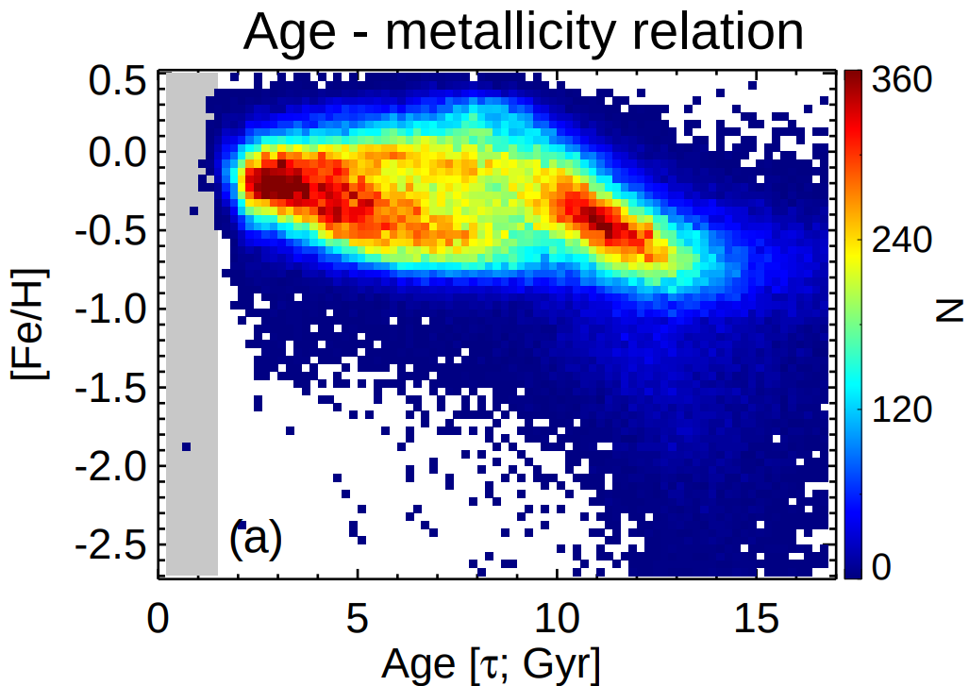
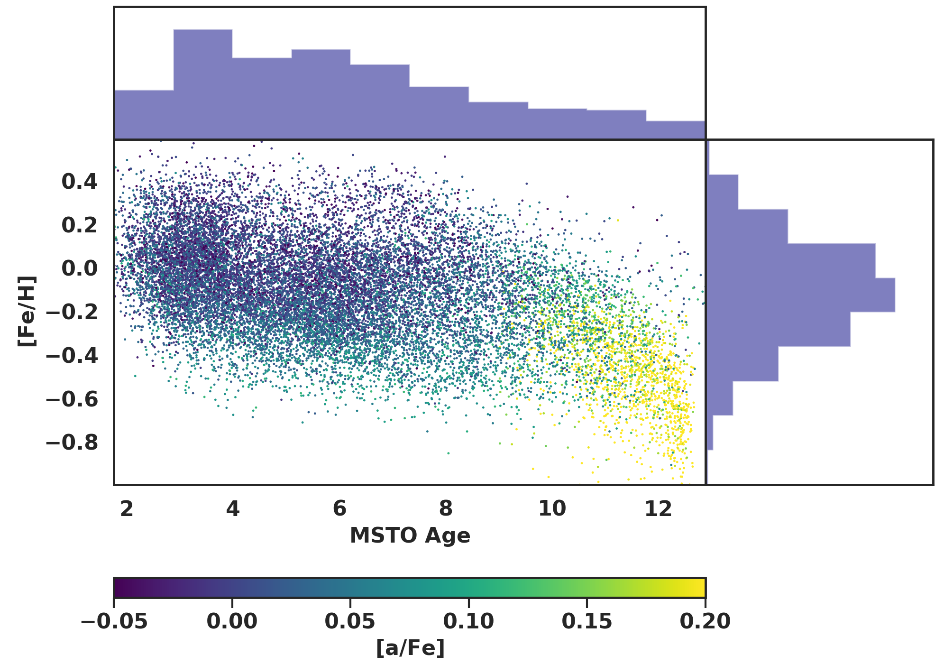
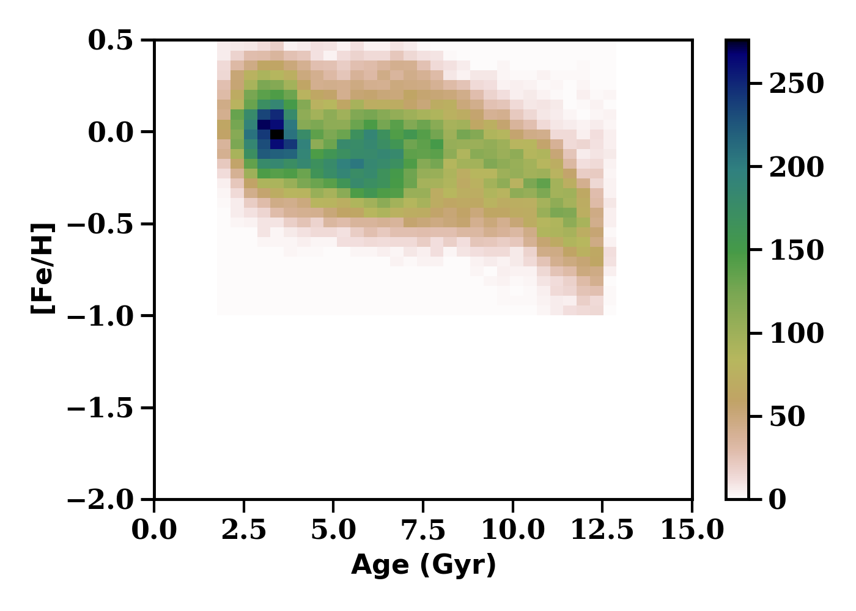
Age-Metallicity Relation: Oops!
Xiang+Rix 2022
Hayden+ 2022

Slide 10
Age-Metallicity Relation: Oops!
Xiang+Rix 2022
Hayden+ 2022

Slide 11

Radial Mixing
Radial Mixing: Stars Move!!!
Blurring: stellar orbits heated with time, eccentricity +, angular momentum conserved (non-axisymmetric structures, GMC, satellites)
Migration: Angular momentum exchange with non-axisymmetric time dependent perturbations (transient spiral arms), eccentricity conserved
Rg

Slide 12

Migration Efficiency
Credit:
Neige Frankel

Slide 13
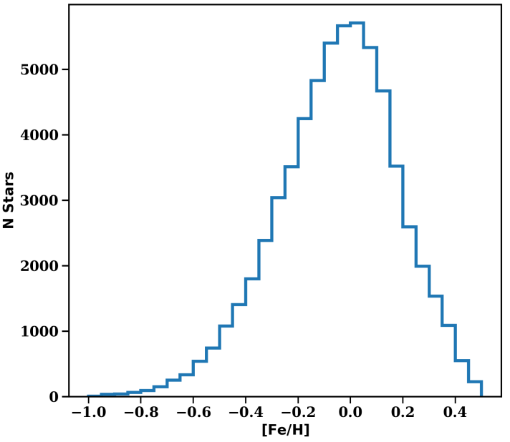
Solar Neighborhood MDF: Metal-Rich?
Local ISM: ~solar metallicity (-0.05 from B stars)
30% of stars more metal-rich than this: how did they get here? (Migration)
30% is lower limit: the metal-poor stars don’t have to be insitu either, can come from inside or out!

Slide 14
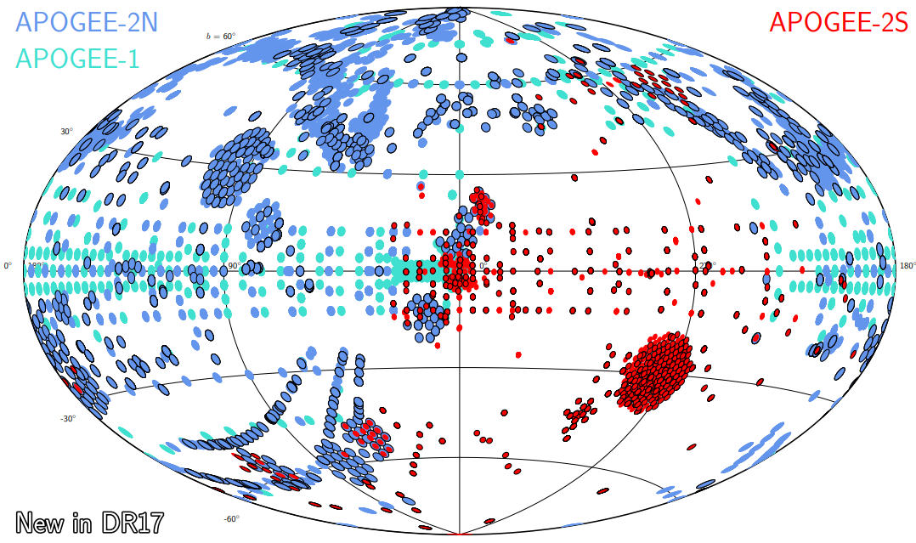
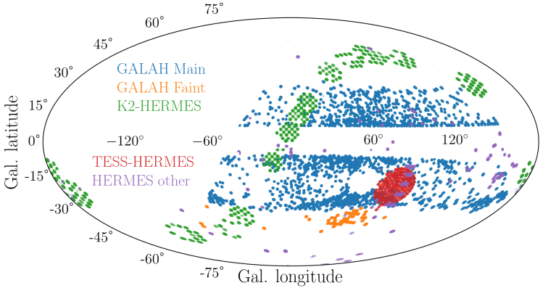
Large Scale Surveys
Several Ongoing Spectroscopic Surveys of the Entire Sky: APOGEE, GALAH, LAMOST
Millions of Stellar Spectra, Dozens of Abundances
Future: 4MOST, WEAVE, DESI, SDSS5: Nearly 100 million high quality stellar spectra!
SDSS DR17
GALAH DR3

Slide 15
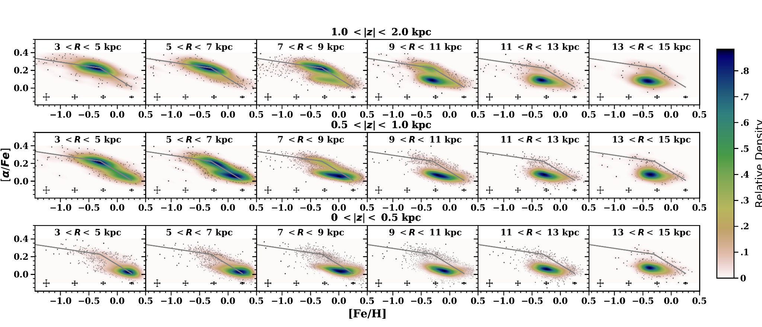
Milky Way Disk: Chemical Map
Hayden+2015

Slide 16
Milky Way Disk: Chemical Map
Hayden+2015

Slide 17
Milky Way Disk: Chemical Map
Hayden+2015

Slide 18
Milky Way Disk: Chemical Map
Hayden+2015

Slide 19
Milky Way Disk: Chemical Map
Hayden+2015

Slide 20

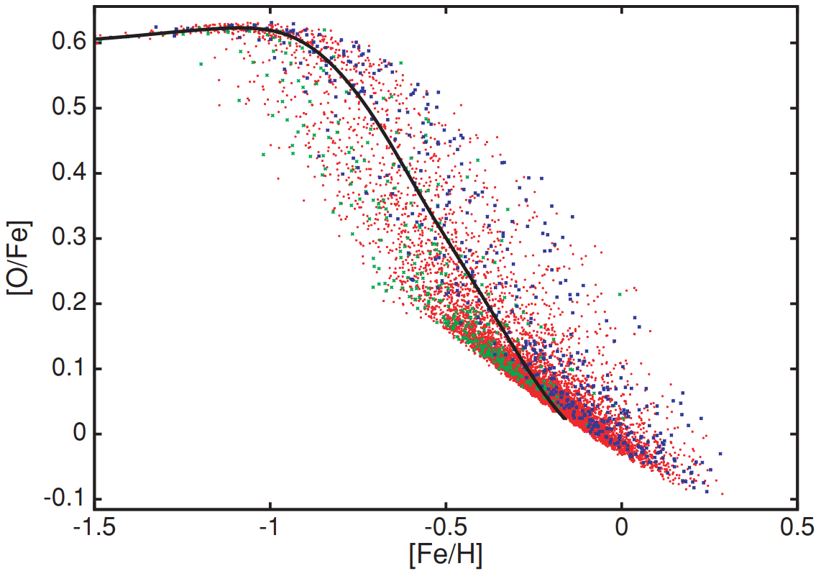
Chemical Evolution with Radial Mixing
Want to explain the detailed chemical abundances of the Galaxy
How the abundances vary with position in the disk
Identify Likely Formation Pathway for Thick/high-α disk
Build upon pioneering work from Schoenrich & Binney 2009
Boquan (Erwin) Chen (ANU)
arXiv:2204.11413
Schoenrich+Binney 2009

Slide 21
Model Ingredients
Multiple Radial Zones: Need to track abundances /w position!
Two Phase ISM: Cold+Warm
Gas: Accretion, cooling, radial flow→ try and maintain exponential gas disk
Star Formation+Stellar Evolution
Supernovae Yields, AGB Yields, Delay Time Distributions (Kobayashi, Karakas)
Radial Mixing of Stars and Gas (Sanders+Binney 2015)
Blurring of Stars (from Sharma & Hayden 2020)
30 Myr Time Step: Maximum Age of SNII Progenitor
Smooth Gas Accretion History: No Mergers!

Slide 22
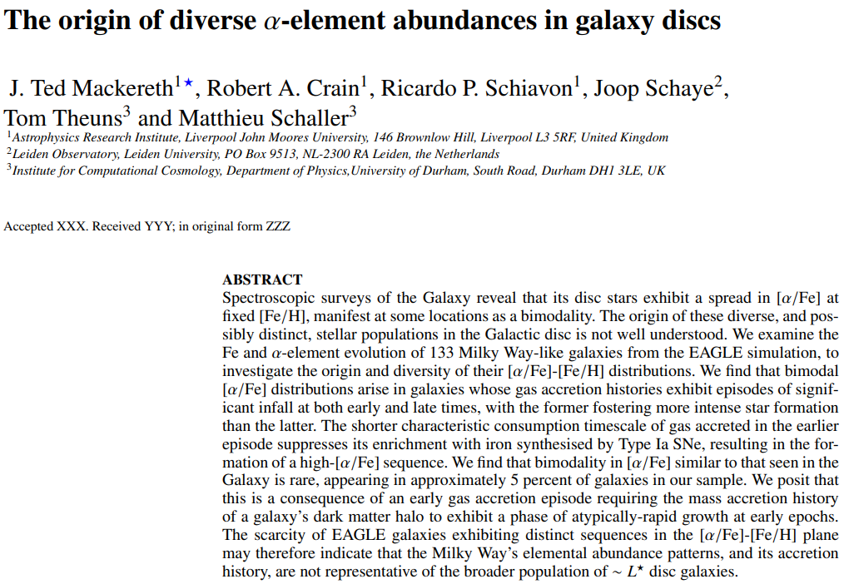
How Common is the Milky Way?

Slide 23
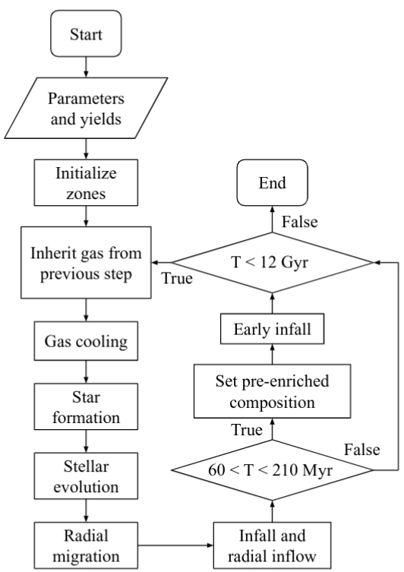
Model Ingredients
Chen,Hayden+2022

Slide 24
Model Ingredients
Chen,Hayden+2022

Slide 25
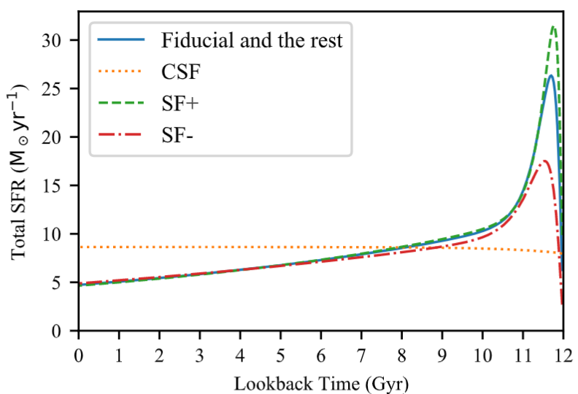
SFR/SFH
Chen,Hayden+2022

Slide 26
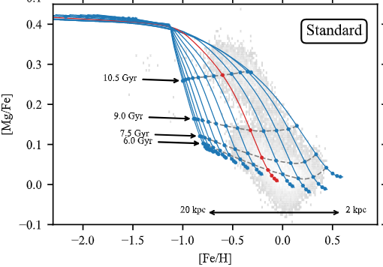

The Model
Solar neighborhood data in greyscale
Strong radial gradient→ inner Galaxy metal rich, outer galaxy metal poor
Rapid chemical enrichment early on, slow enrichment later
[α/Fe]
Chen,Hayden+2022
[Fe/H]

Slide 27
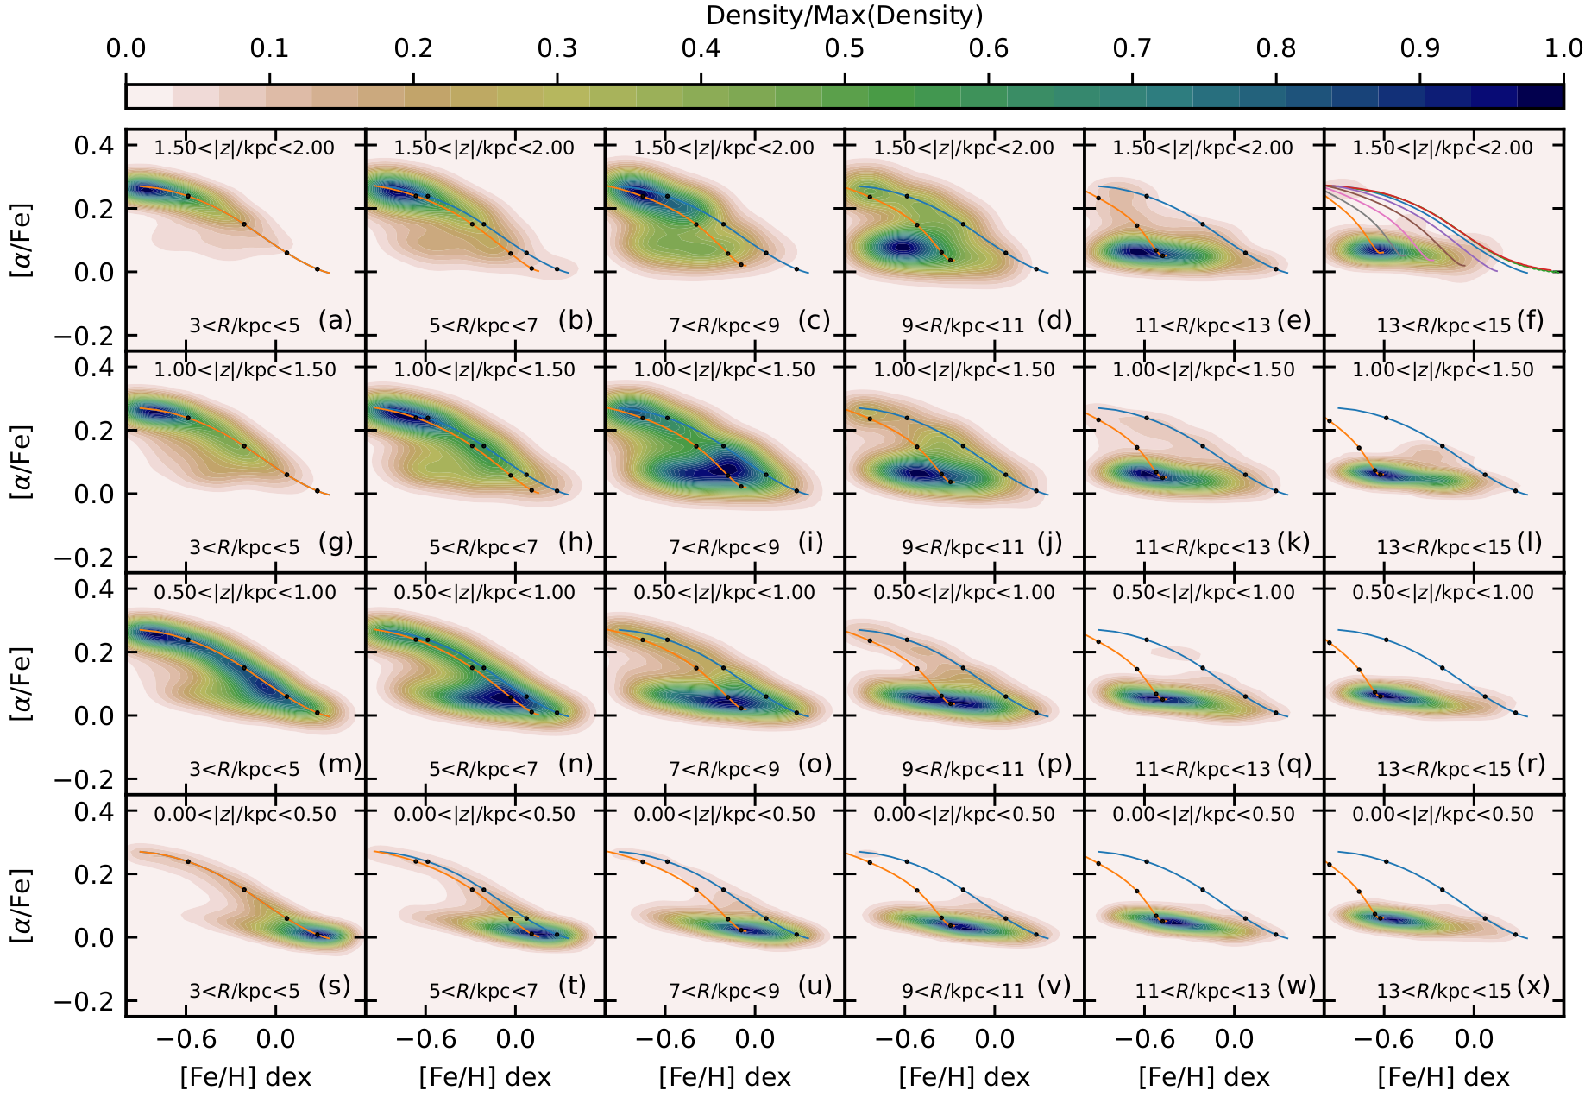
Model: Chemical Map of the Disk
Chen,Hayden+2022

Slide 28
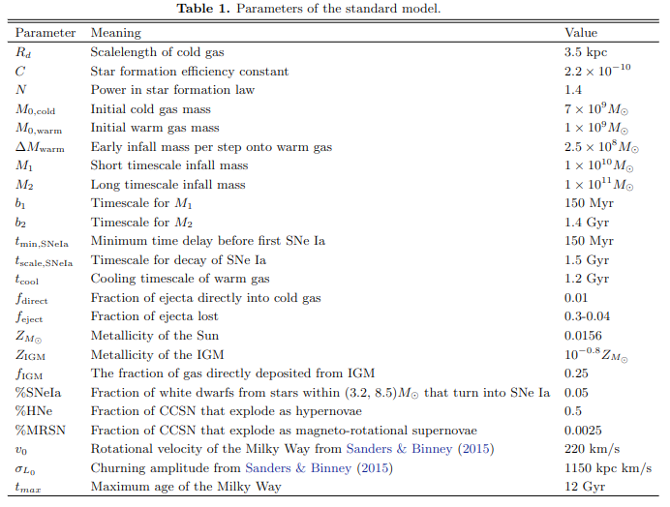
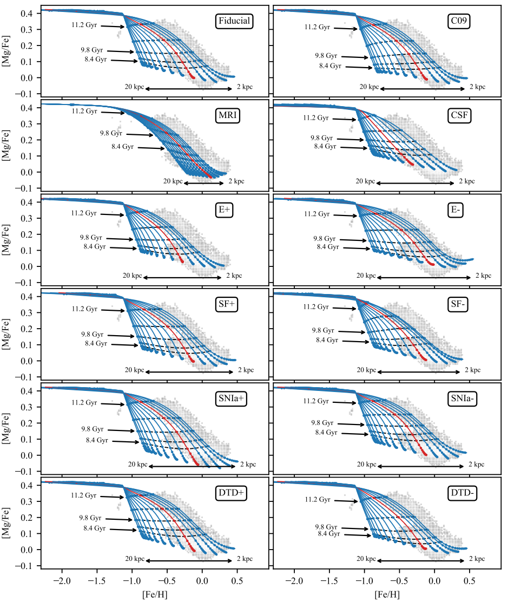
Model Parameters

Slide 29
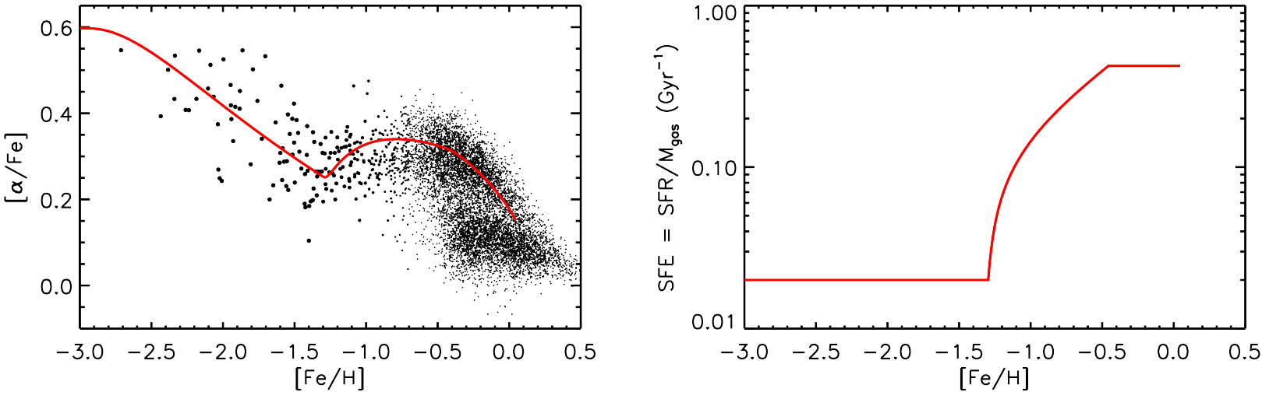
What’s Next: Simmering Phase
Conroy+22

Slide 30
Chemical Evolution Summary
Developed a detailed chemical evolution model that takes into account many physical processes including radial mixing
First chemical evolution model that closely matches the entire chemical distribution of stars in the Galaxy
Able to reproduce the high-α disk and bimodal distribution of stars in solar neighborhood with no mergers required!
Implies that this might be natural evolution of disk galaxies, rather than rare event
Lots more things to look at: Simmering phase, 2D, s-process abundances, more gas processes, etc!

Slide 31
The Milky Way in Context
MW is only a single galaxy: can’t constrain all of galaxy evolution with one data point!
Can compare detailed chemical evolution models to simulations→ identify MW analogues, look at range of formation pathways. Use several suites of simulations (FIRE-LATTE, TNG50, EAGLE, Auriga, etc.). Determine which processes are critical to producing realistic chemical maps
Build data cubes of our chemical evolution model to directly compare to external observations

Slide 32


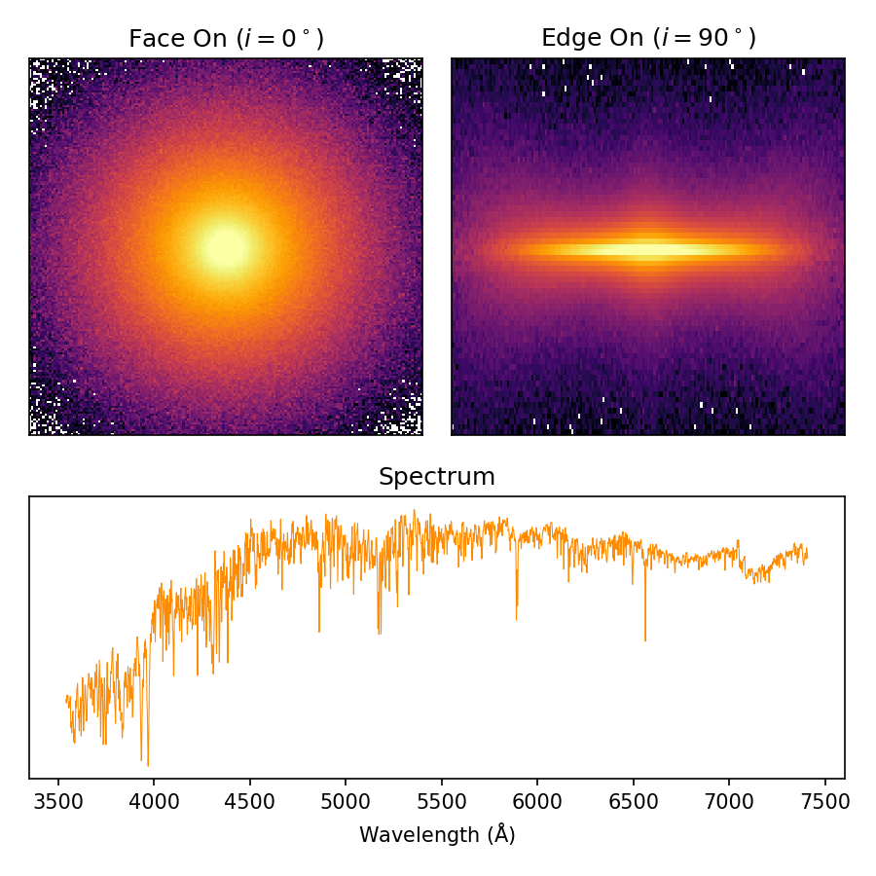

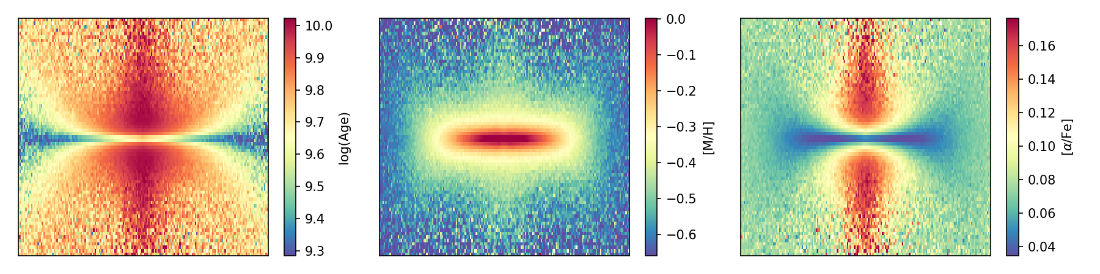
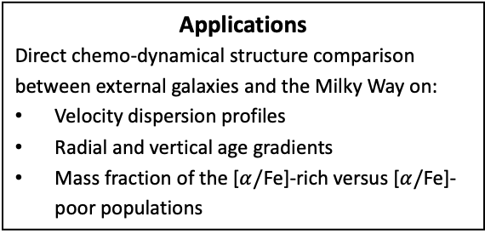
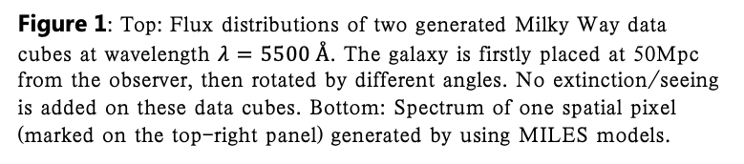
The Milky Way in Context: Building an IFS Data Cube of the Galaxy
Purmortal (Zixian) Wang (zwan0382@uni.sydney.edu.au), Michael Hayden, Sanjib Sharma, Jesse van de Sande, Joss Bland-Hawthorn
Sydney Institute for Astronomy, School of Physics, A28, The University of Sydney, NSW, 2006
Synopsis
In this work, we present a novel approach to generating the mock IFS data cube of the Milky Way by making use of the SSP spectral libraries and E-Galaxia. This tool is flexible about adjustable the galaxy distance, inclination, spatial and spectral resolution, instrument properties (SAMI/Hector, MUSE, etc) and observation properties (seeing, SNR, etc.)
Ingredients
E-Galaxia (Sharma et al. in prep 2022)
Milky Way model (Sharma et al. 2020)
SSP spectra libraries (MILES, PEGASE-HR, etc.)
pPXF (Cappellari 2017)
Data-cube properties
Instrument properties

Slide 33
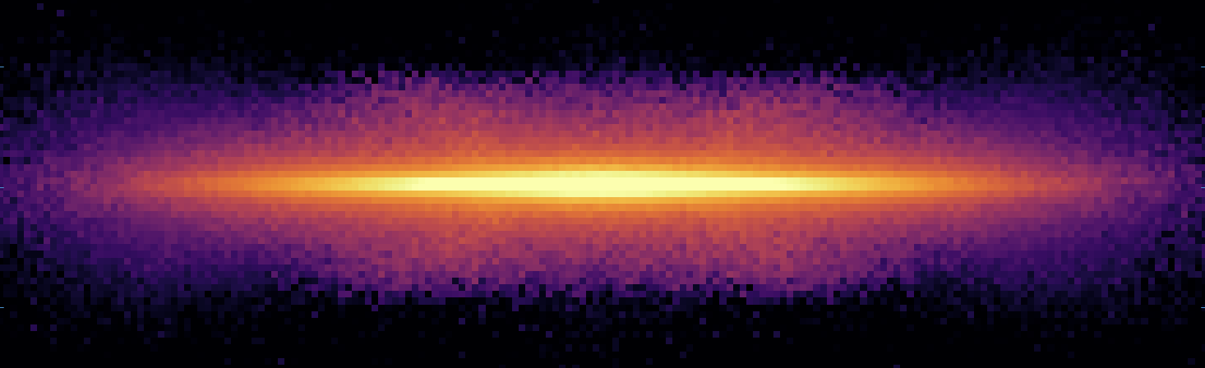
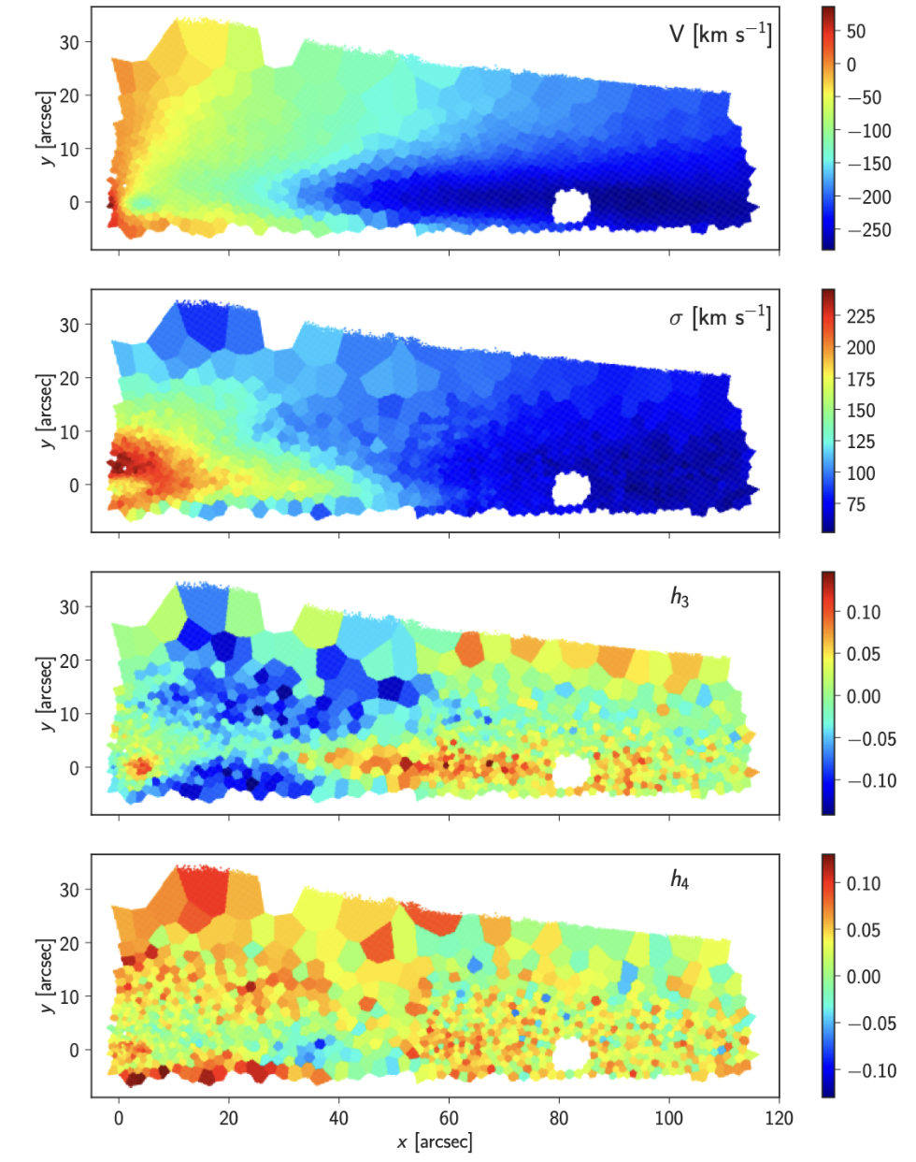
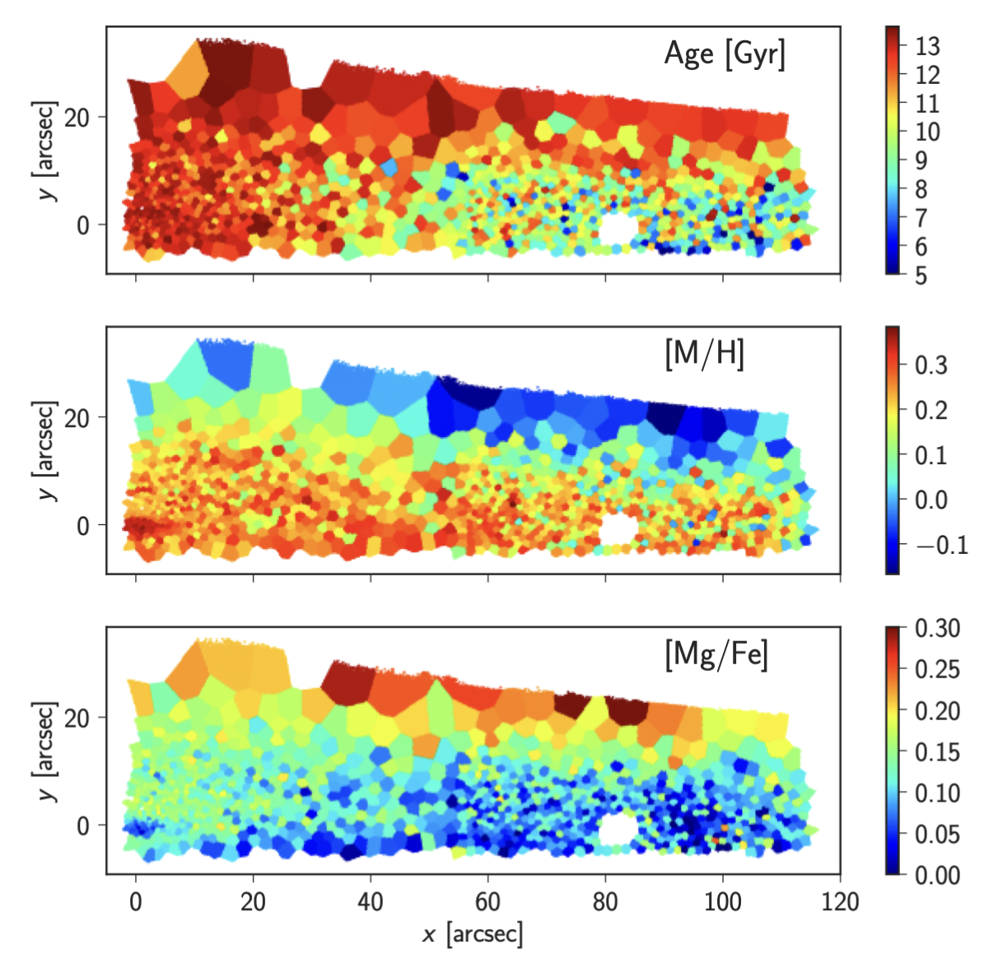
For external galaxies...
For MW datacubes…
Integrated spectrum
PPXF+MILES, etc
Kinematics (v, v_sig, h3, h4)
PPXF+MILES
Chemical composition
Instrument properties
Integrated spectrum
MILES SSP
Particles (mass, age, [Fe/H], [α/Fe], V_los)
Spatial binning
MW view externally
Distance, inclination
MW analytical model (~10e8 particles)
Galaxia
Age, [Fe/H], [α/Fe], LOSVD distributions from Chen+Hayden
Martig et al. 2021
Notes:
Here I just show on the left side the pipelines of measure chemical composition and kinematic information from extragalactic data cubes.

Slide 34

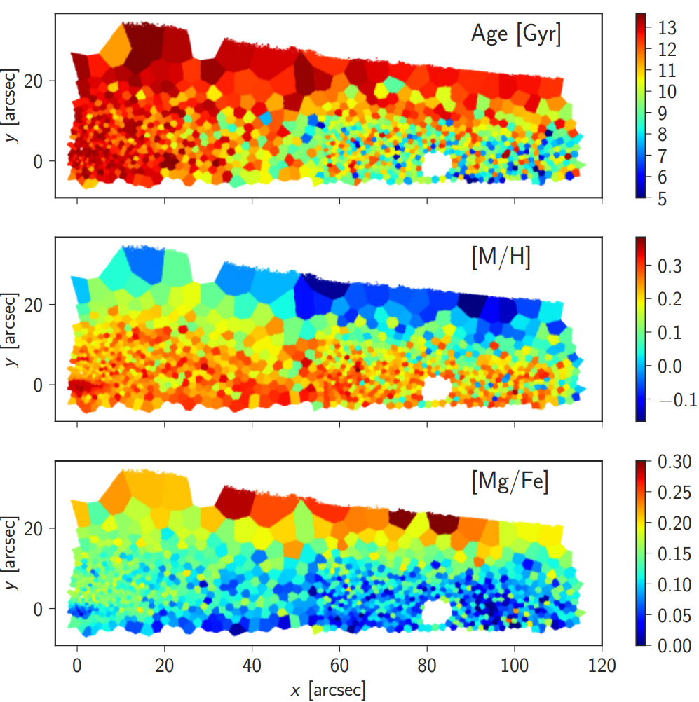
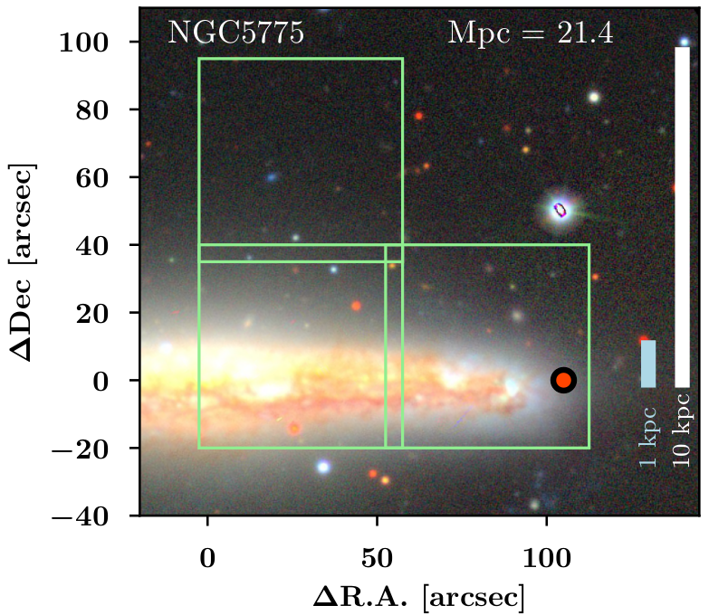
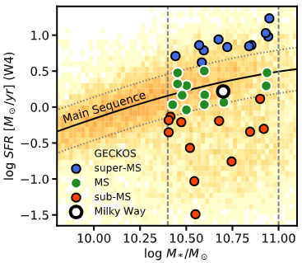
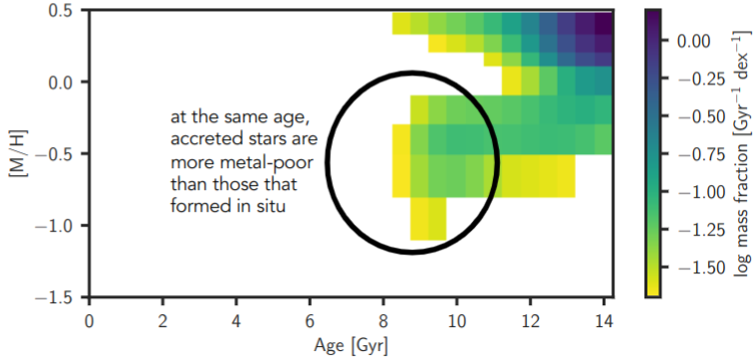
NGC 5746
GECKOS: Large ESO Program /w MUSE: 340h observing time
Observe 35 edge-on galaxies to very high S/N out to large Re (~3Re)
Range of star formation rate+histories: What drives disk galaxy evolution?
Measure stellar populations of disks, identify accreted structures, measure outflows
Apply detailed chemical modeling from MW to these external systems
Martig+2022

Slide 35
Conclusions
Developed the first chemical evolution model that reproduces most observables (chemical maps, MDF skewness, etc)
  Radial mixing important to match observations
  No Major Merger Needed →bimodal chemical disks potentially common
  Lots of Room to Explore: neutron capture abundances, galactic fountains, non-axis symmetric structure (bar, spiral arm) → azimuthal variation
Using the Milky Way as a Testbed for Galaxy Evolution:
  Building MW Datacubes for a range of distances, inclinations, stellar libraries, instruments
  Comparing Models to Simulations
  GECKOS: ESO MUSE Program to Obtain High Quality Observations for Detailed Comparisons

