Slide 1
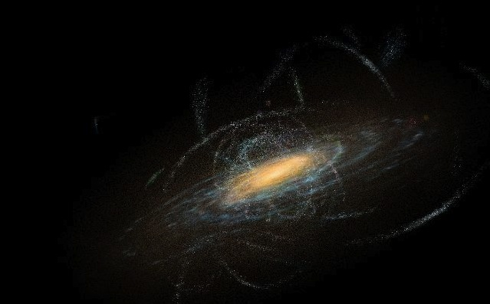

Extending Globular Cluster Tidal Streams
Carl Grillmair
20 September, 2022
Credit: Don Dixon

Slide 2
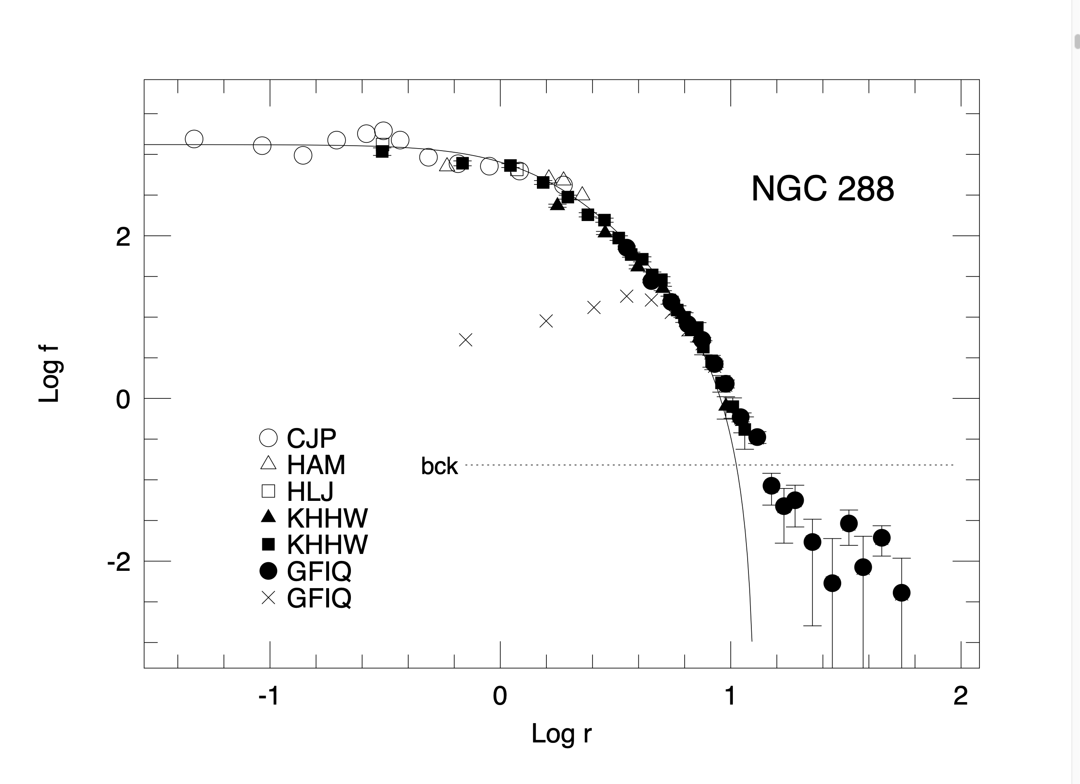
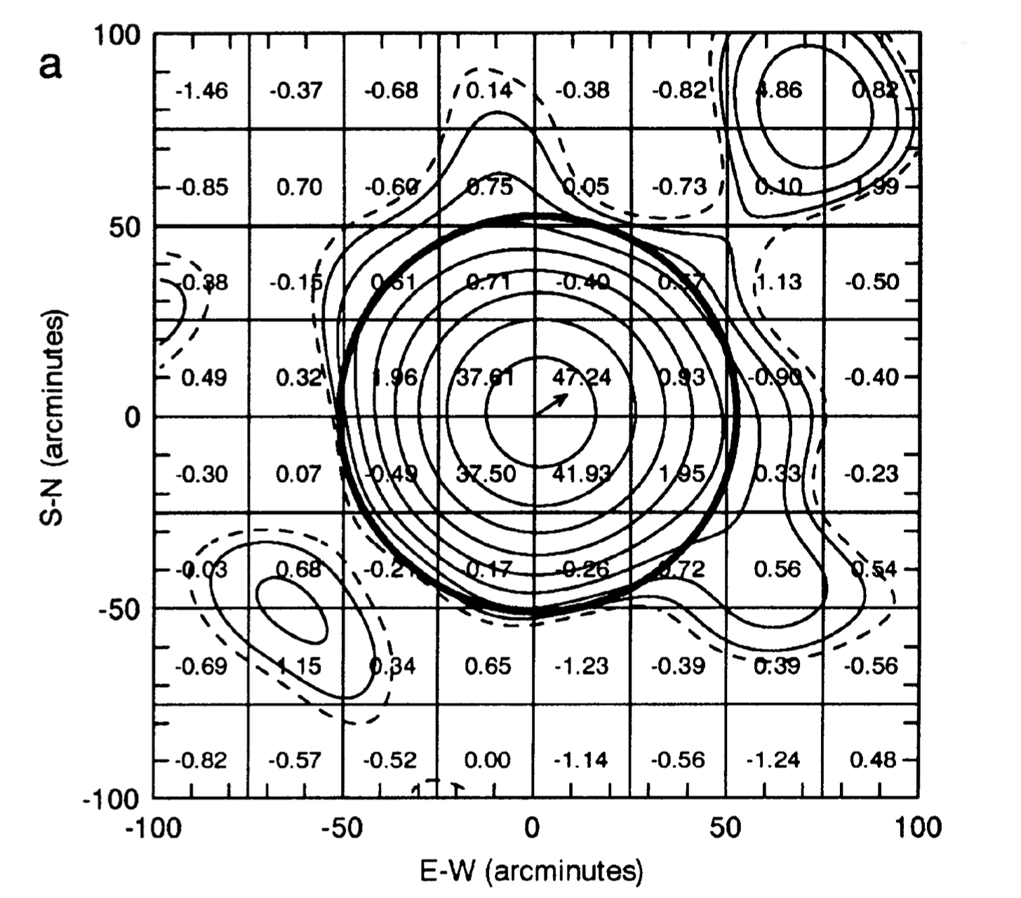
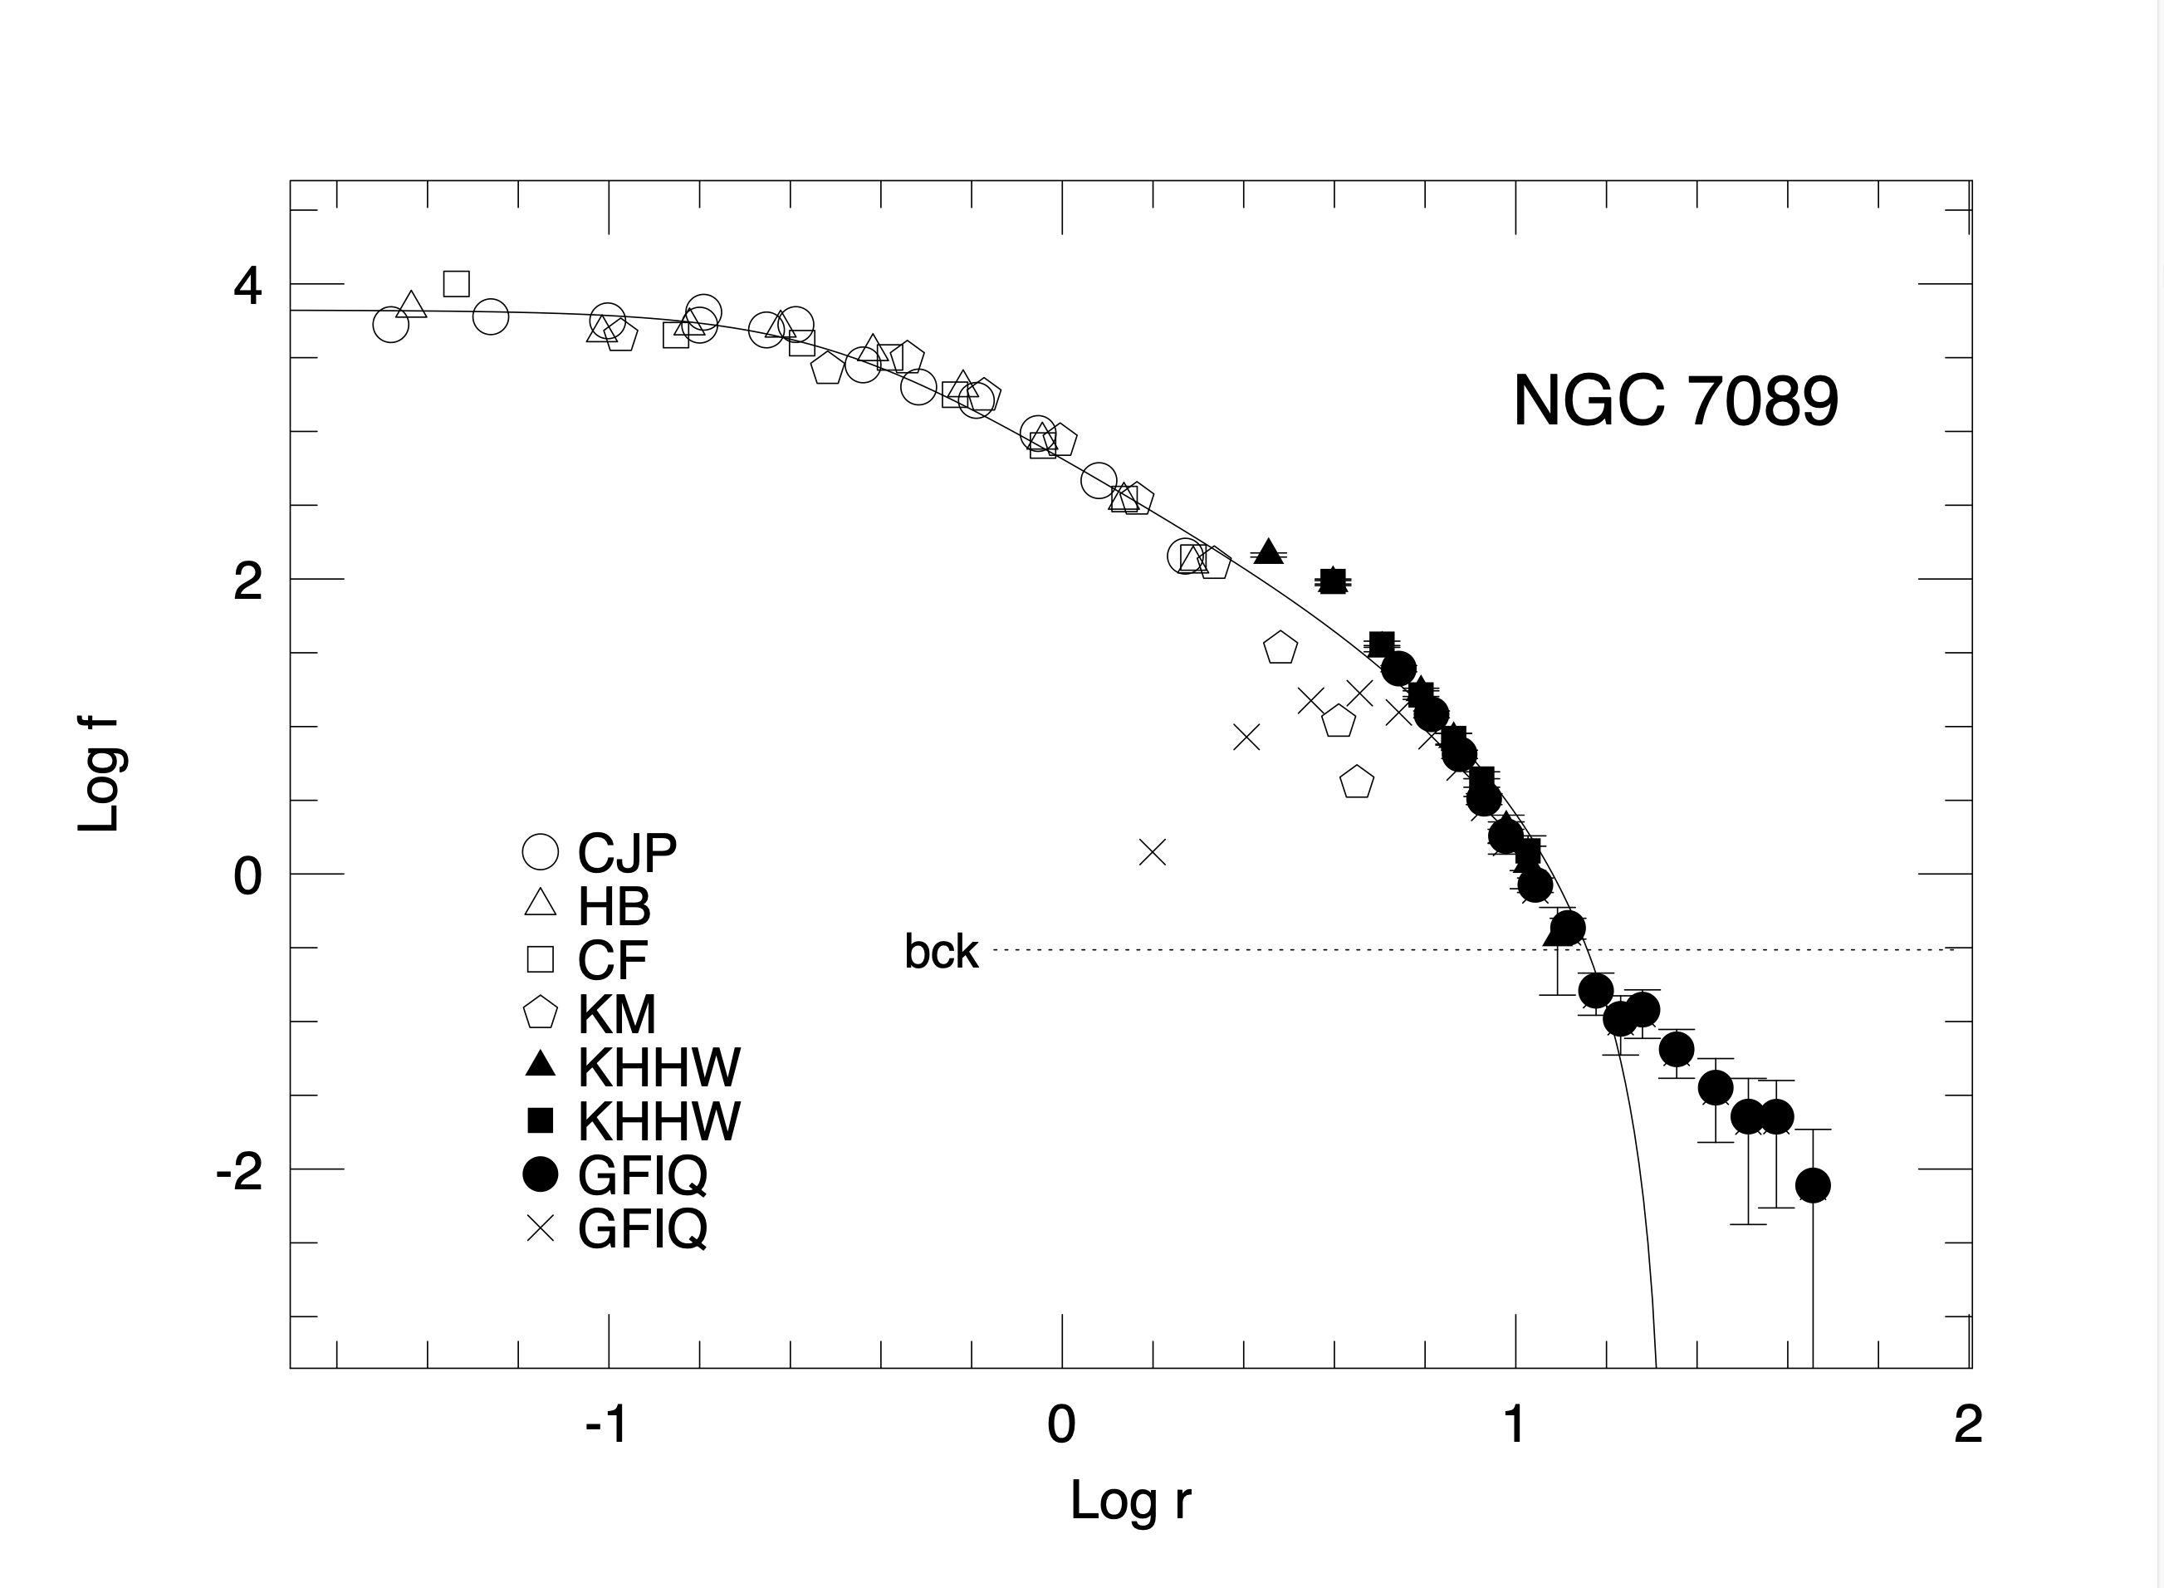
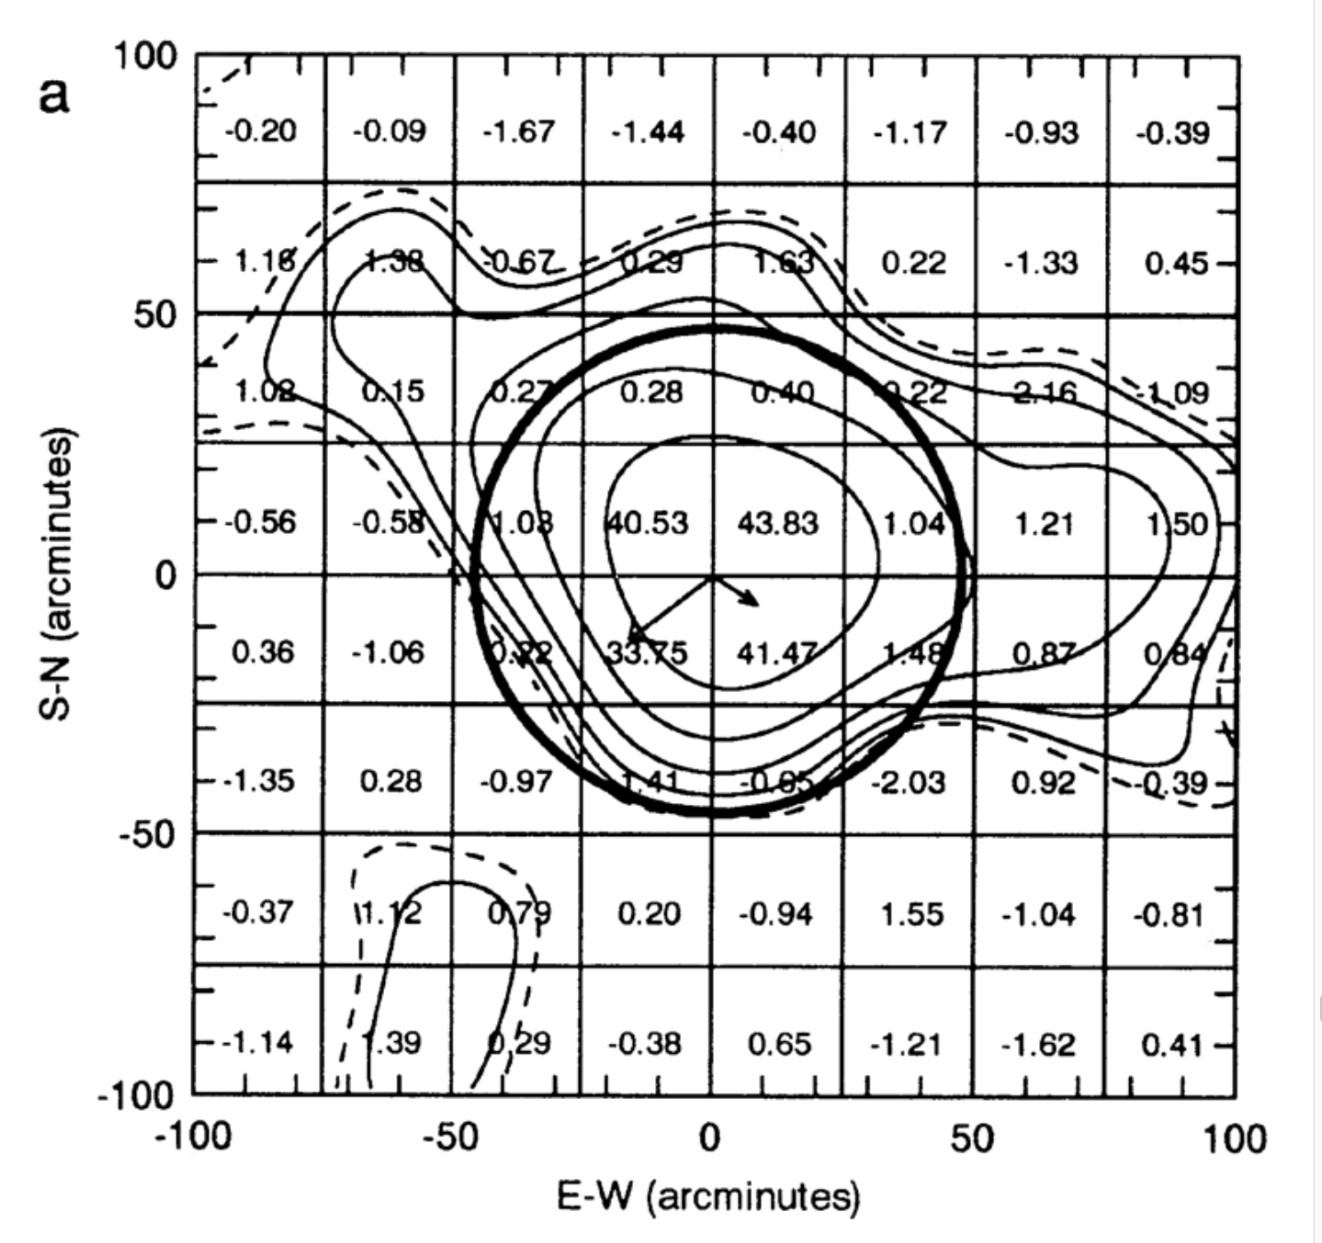
A Long, Long Time Ago…
Grillmair, Freeman, Irwin, & Quinn 1995

Slide 3
Why Extend Globular Cluster Streams?
Known globular cluster streams are very cold, with velocity dispersions of ~2 km/sec (eg. GD-1, Gialluca et al. 2021, Pal 5 – Kuzma et al. 2022).
  Trajectories and velocities of stars are extremely sensitive to perturbations (e.g. dark matter subhalos – Carlberg 2009) and variations in the global potential.
The physical characteristics of globular clusters (distances, radial velocities, proper motions, stellar populations) are generally very well measured.
An extant progenitor enables better modeling of the stripping process and the expected trajectories of stripped stars.
The information content of individual streams depends strongly on length, and streams on high-Z, eccentric orbits better constrain the shape of the potential (Bonaca & Hogg 2018).

Slide 4
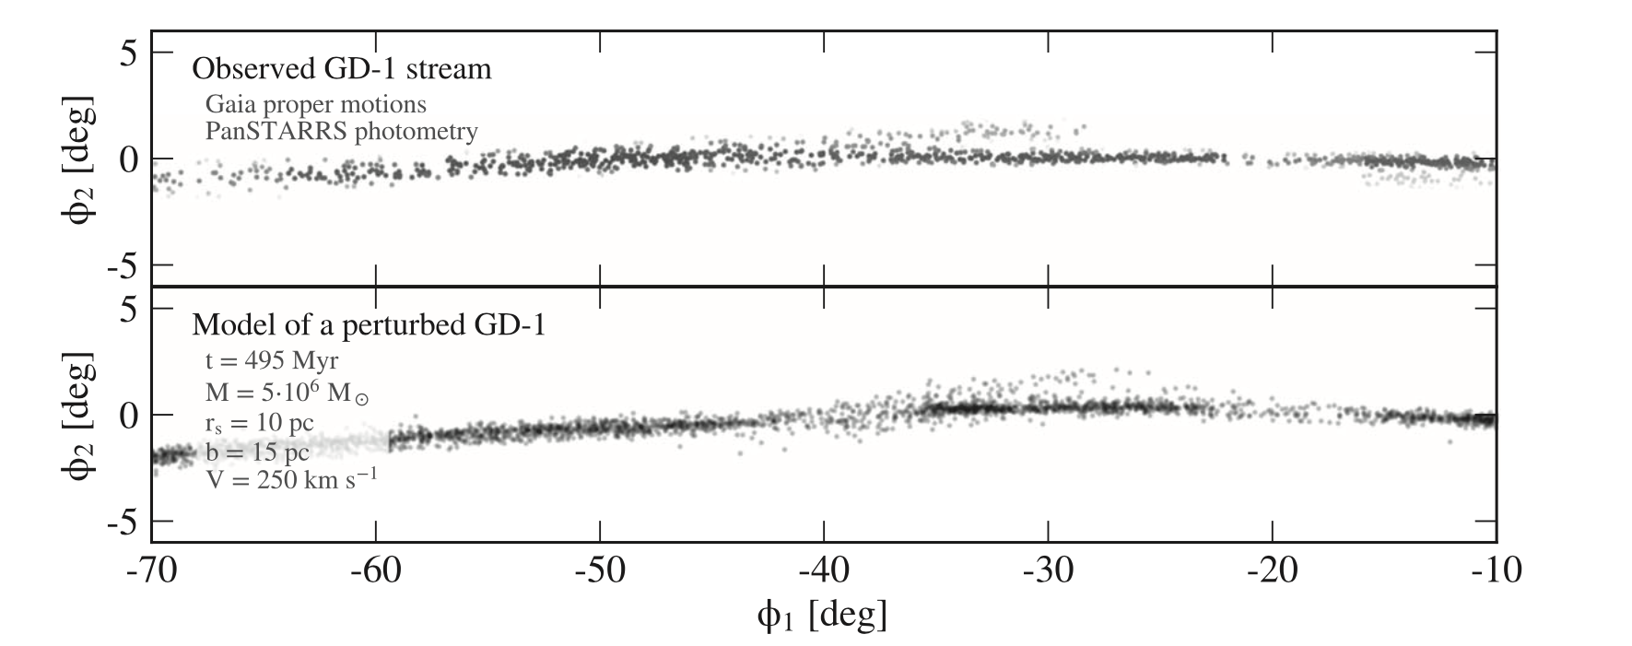
GD-1 Impact
Bonaca et al. 2019

Slide 5
Why Extend Globular Cluster Streams?
Known globular cluster streams are very cold, with velocity dispersions of ~2 km/sec (eg. GD-1, Gialluca et al. 2021, Pal 5 – Kuzma et al. 2022).
  Trajectories and velocities of stars are extremely sensitive to perturbations (e.g. dark matter subhalos – Carlberg 2009) and variations in the global potential.
The physical characteristics of globular clusters (distances, radial velocities, proper motions, stellar populations) are generally very well measured.
An extant progenitor enables better modeling of the stripping process and the expected trajectories of stripped stars.
The information content of individual streams depends strongly on length, and streams on high-Z, eccentric orbits better constrain the shape of the potential (Bonaca & Hogg 2018).

Slide 6
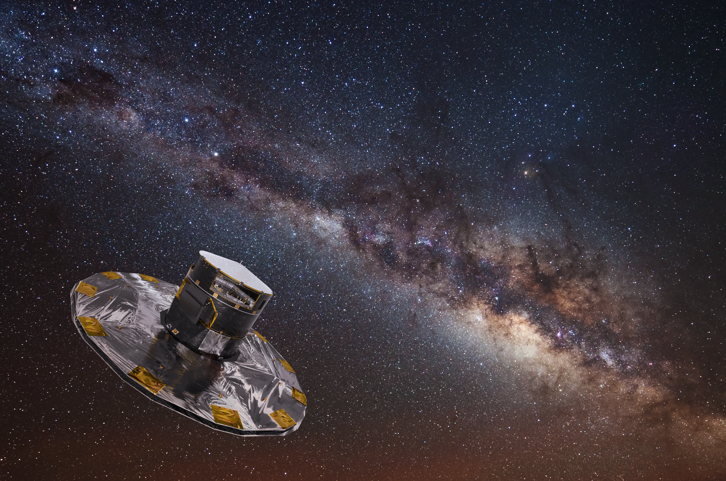
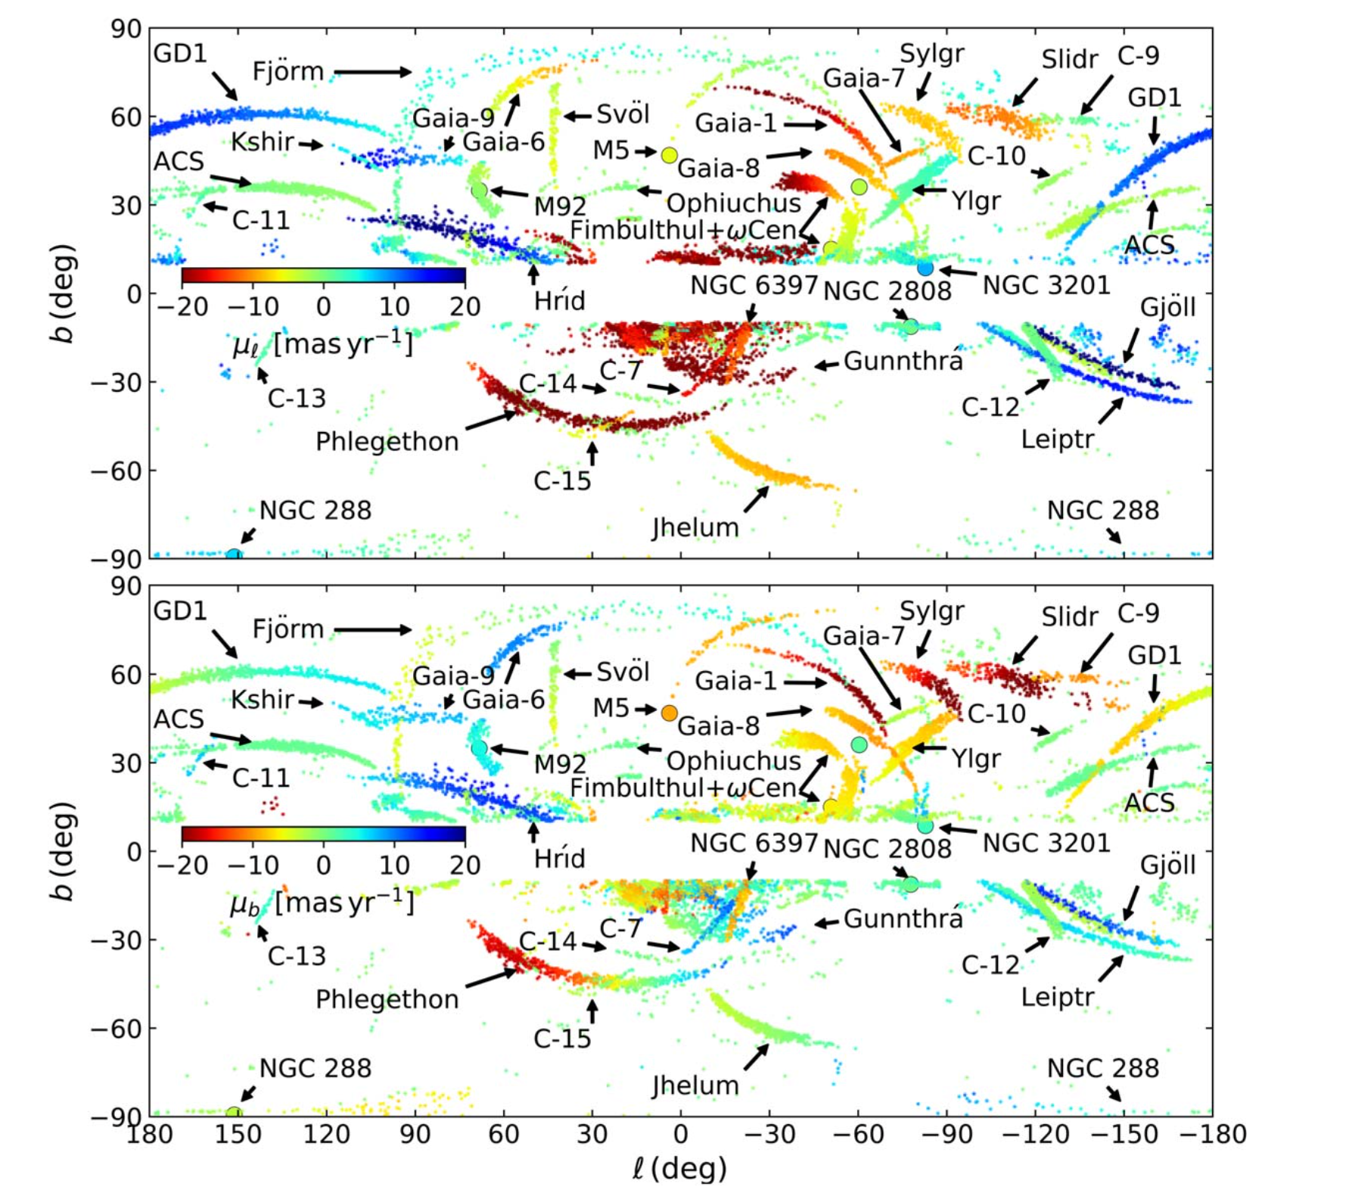
Gaia!
Ibata et al. 2021

Slide 7
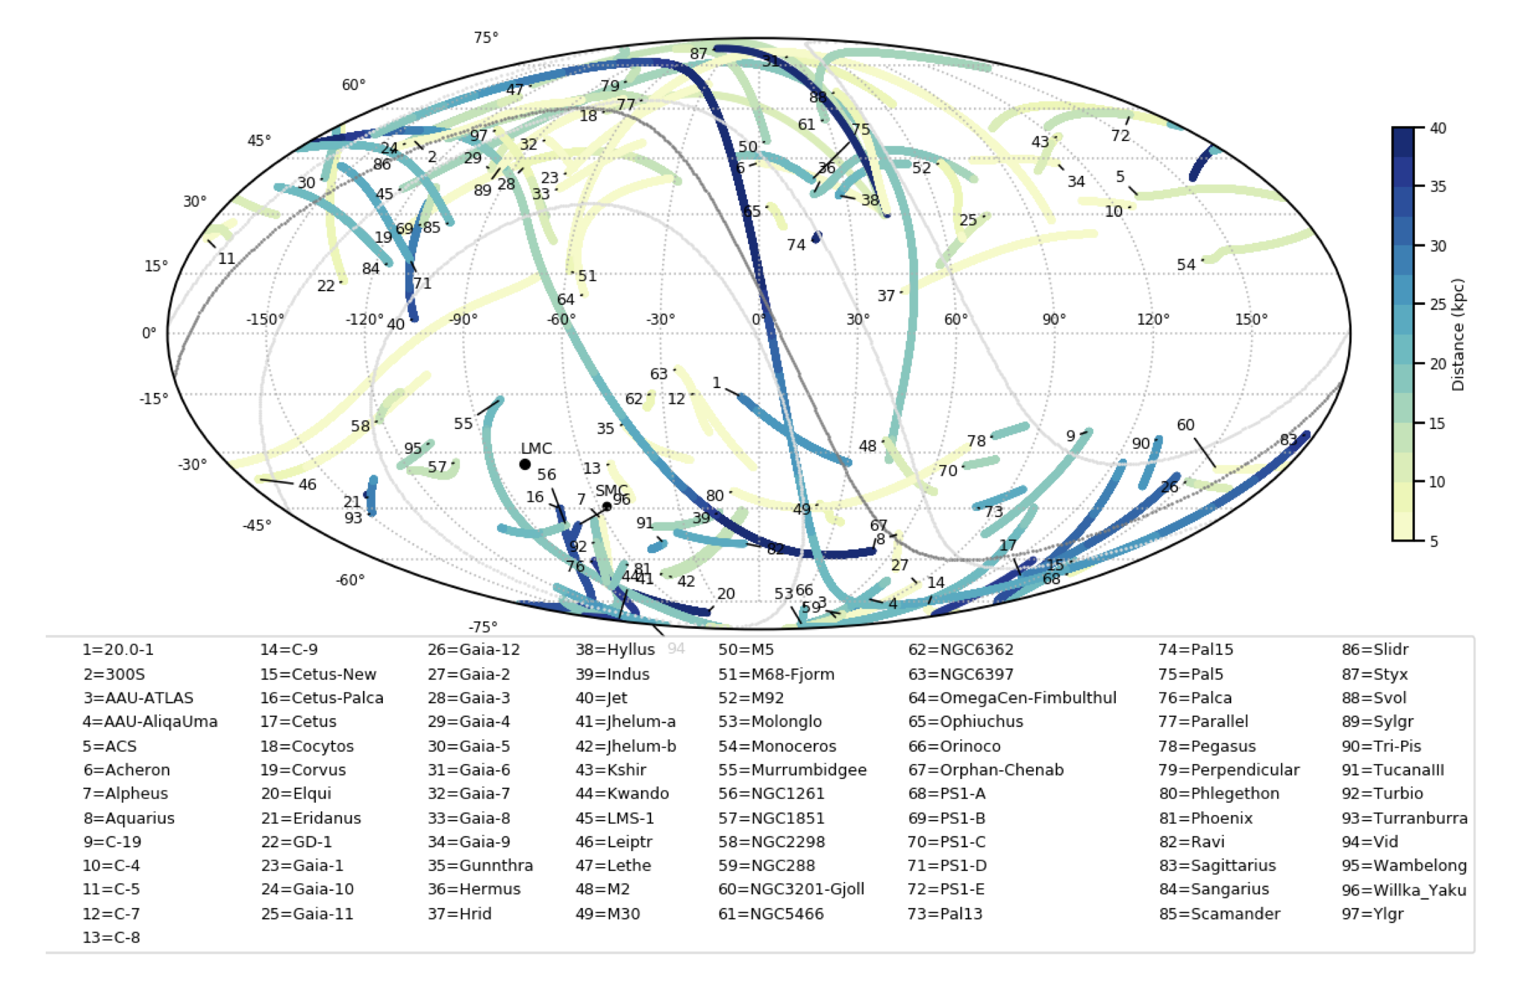
Streams, Streams, and More Streams
Mateu 2022

Slide 8
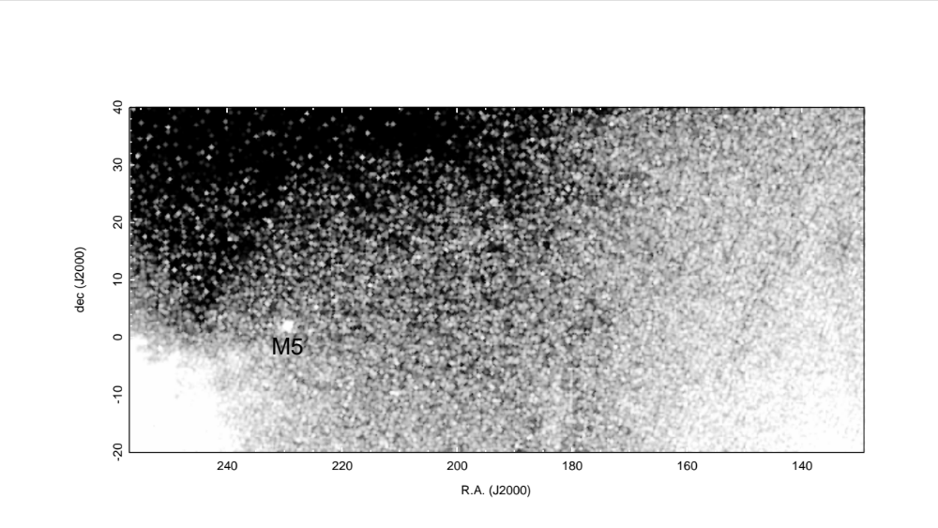
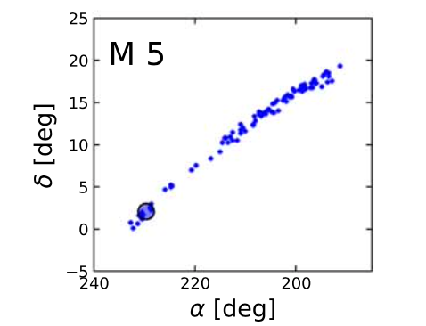
Gaia Proper Motions Are REALLY Good
Grillmair 2019
Ibata et al. 2021

Slide 9
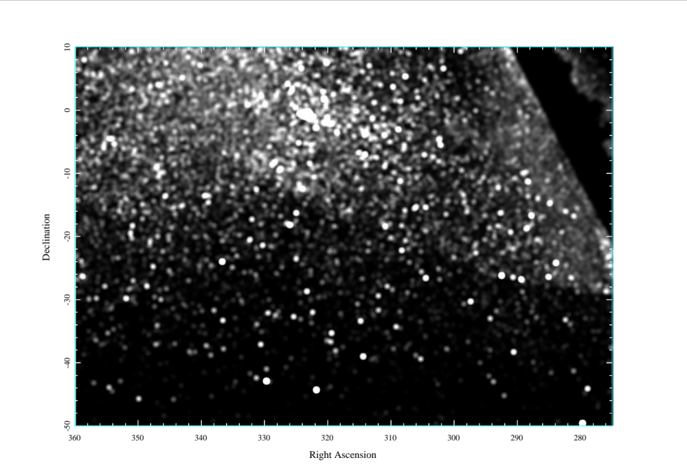
NGC 7089
Grillmair 2022

Slide 10
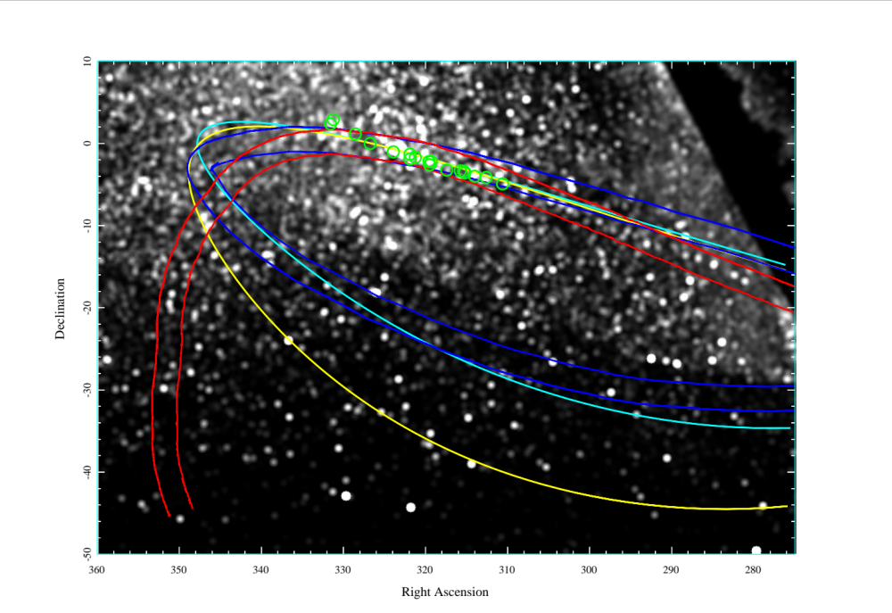
NGC 7089
Grillmair 2022

Slide 11
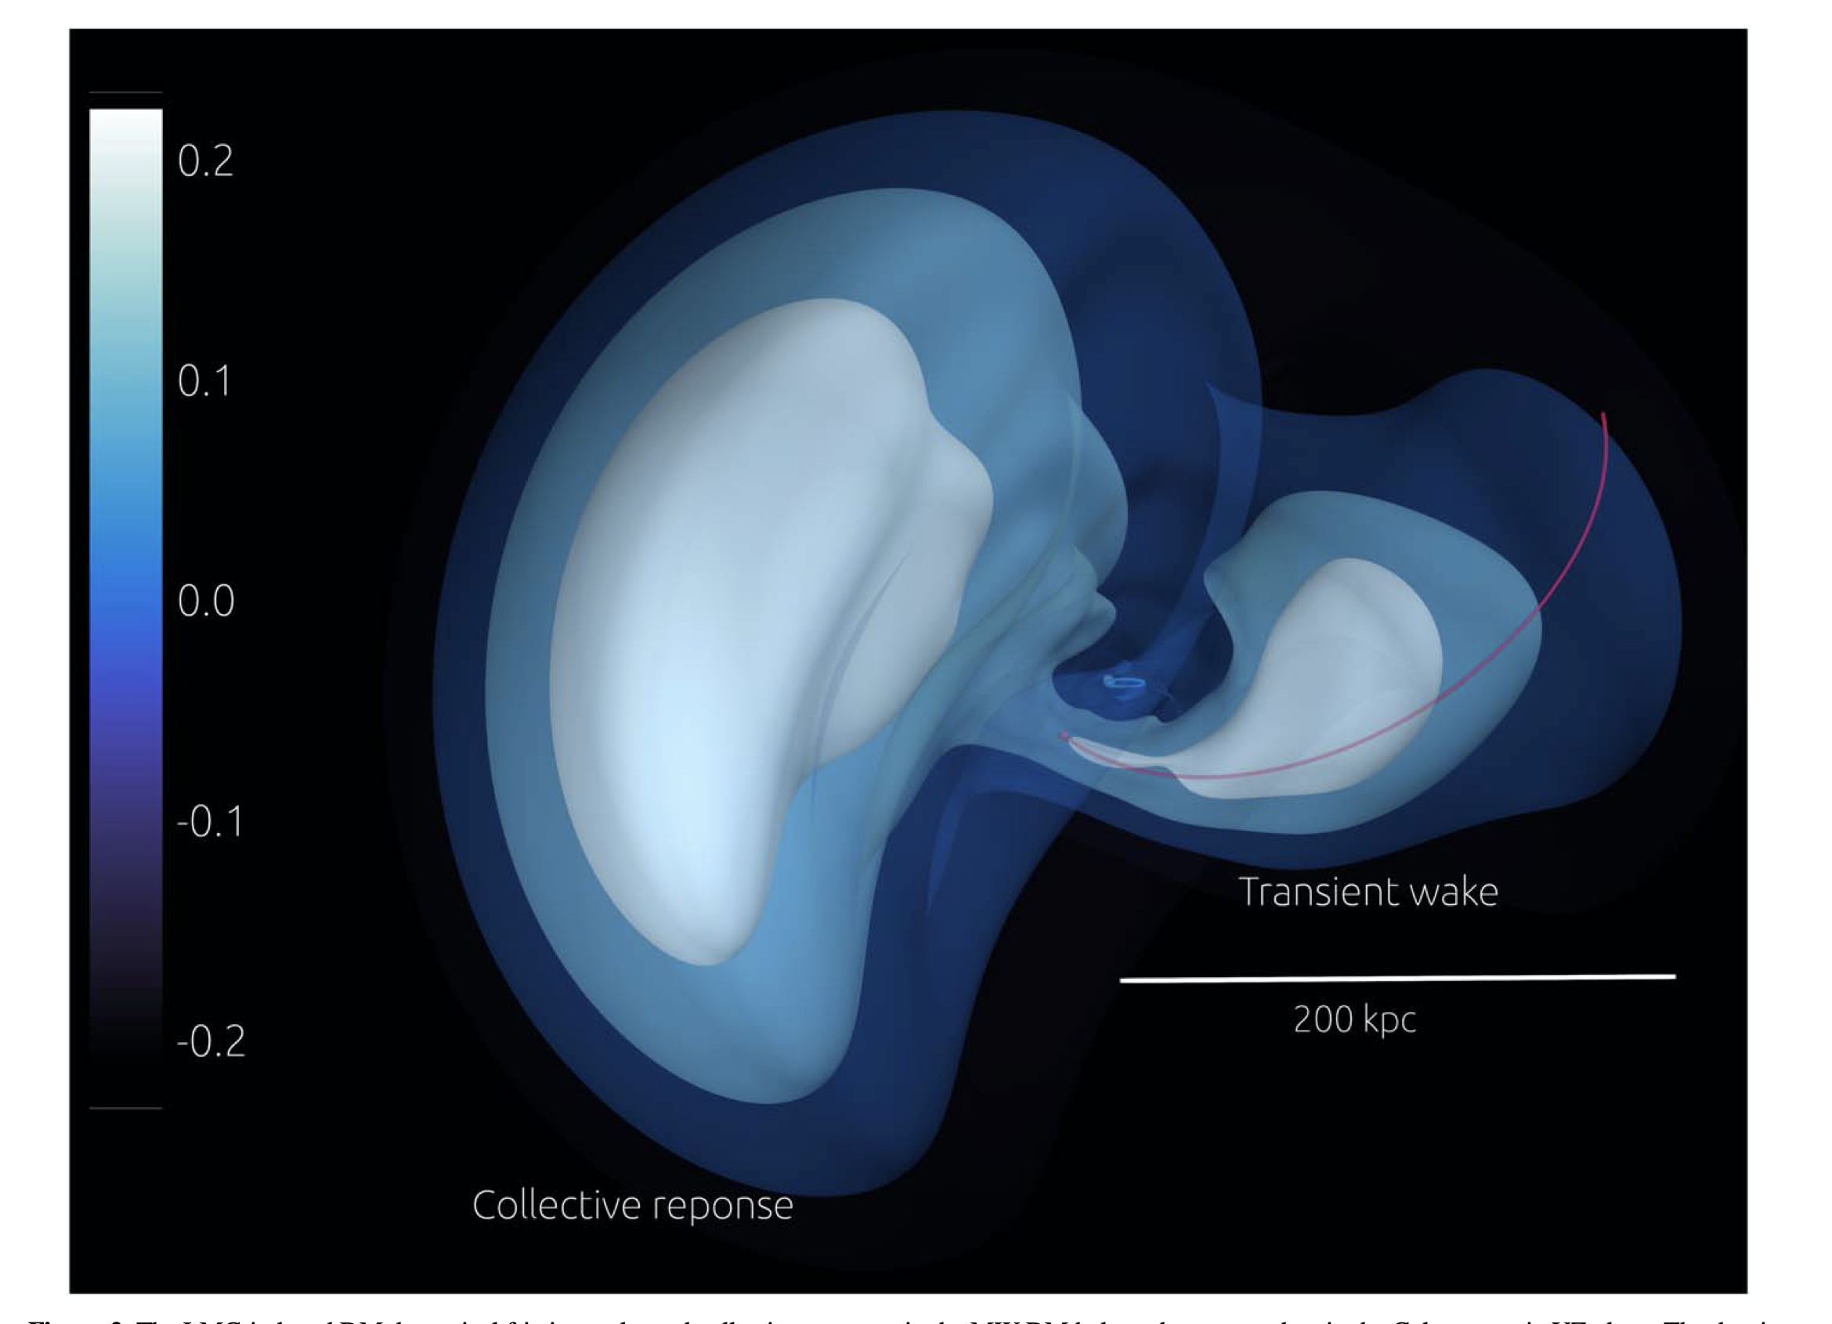
Effects of a Massive LMC
Garavito-Camargo et al. 2021

Slide 12
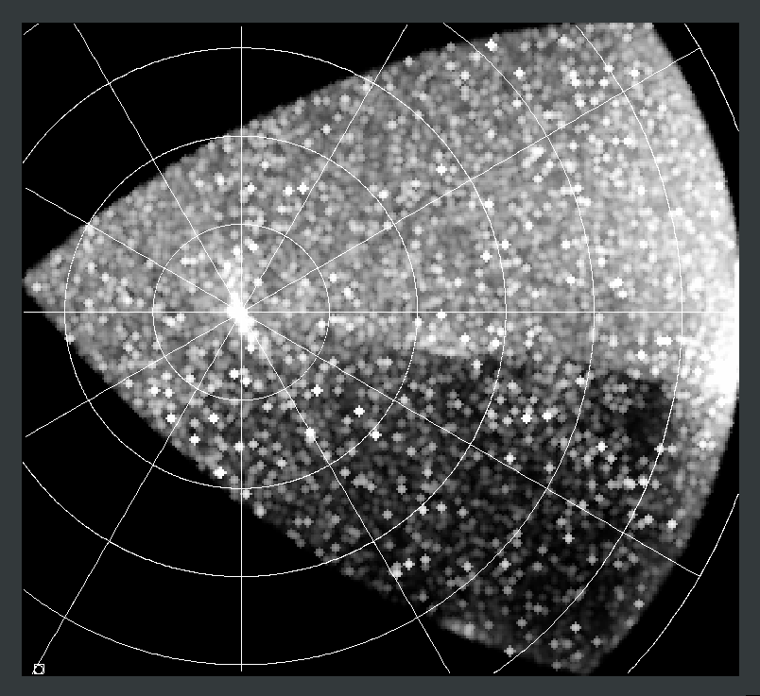
NGC 288

Slide 13
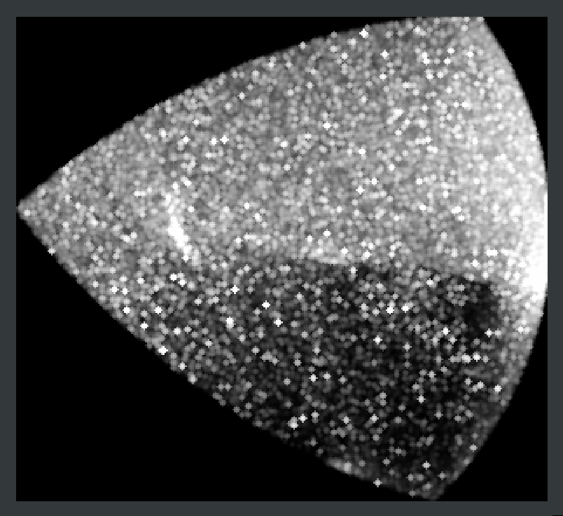
NGC 288

Slide 14
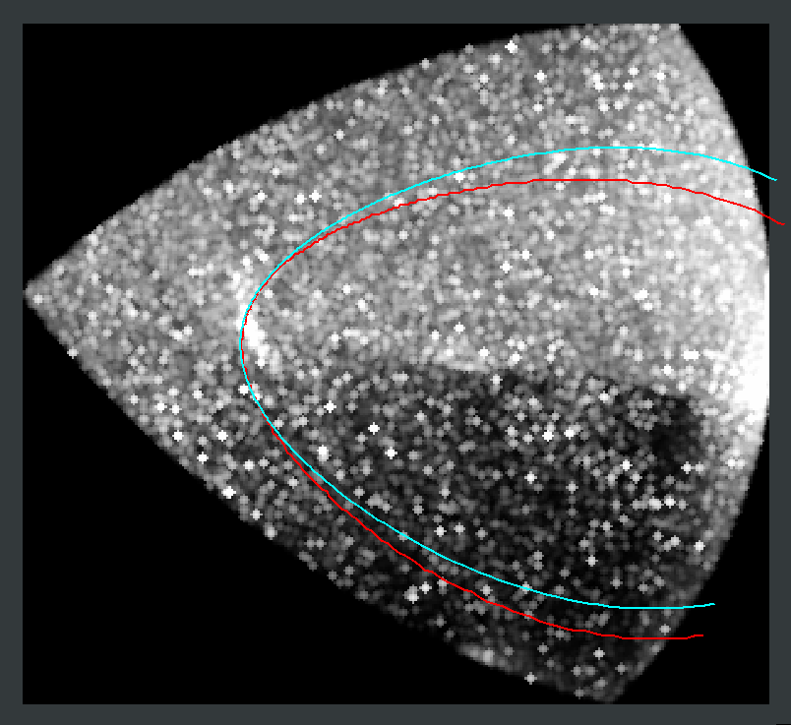
NGC 288

Slide 15
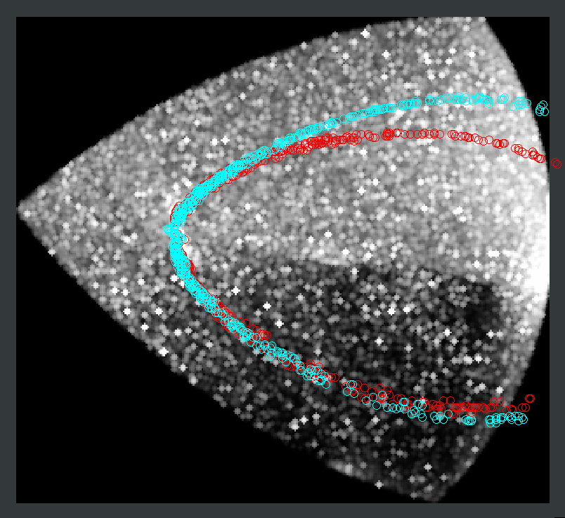
NGC 288

Slide 16
NGC 288

Slide 17
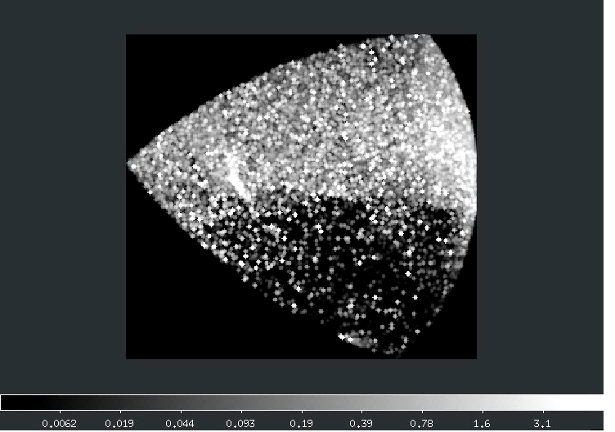
NGC 288

Slide 18
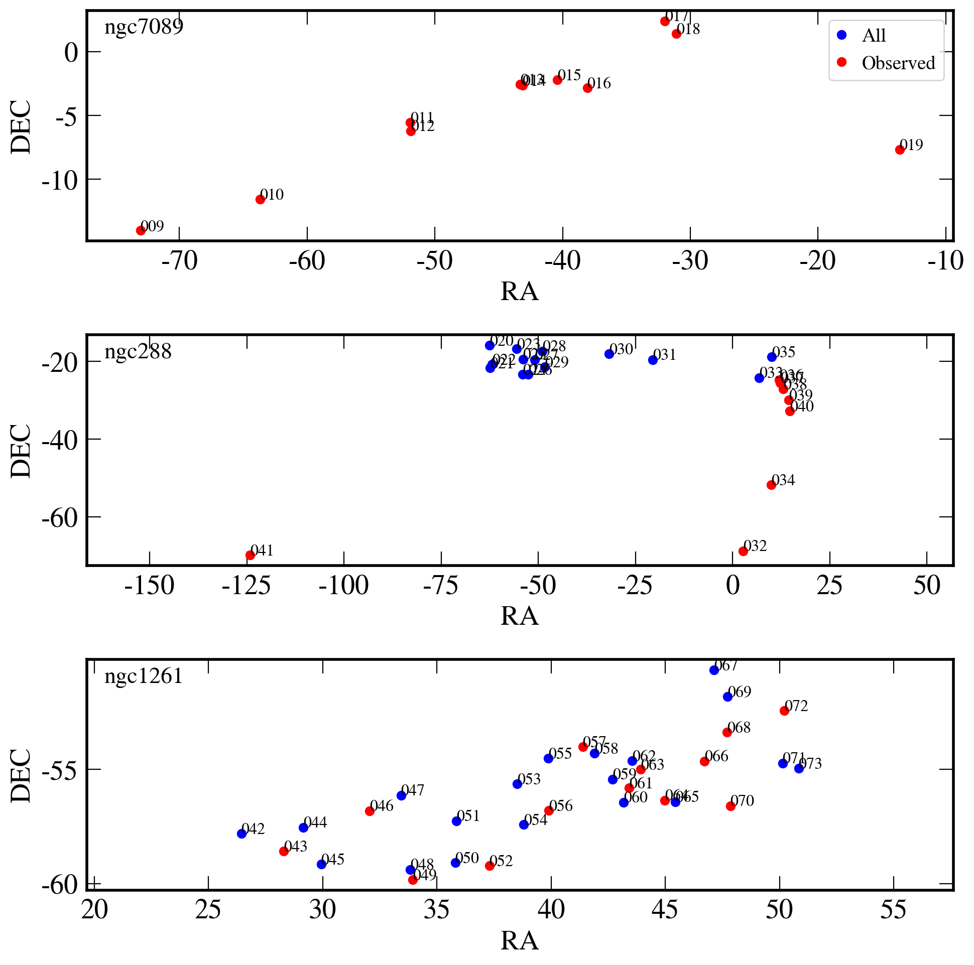
Next Step – Radial Velocities
Ana Bonaca awarded 3 nights this semester on Magellan/MagE for measuring radial velocities.
Results from August 15 look promising:
Several promising globular clusters are in the pipeline.

