Slide 1


Galactic seismology:
The corrugated disc in the Milky Way
Joss Bland-Hawthorn
Director, Sydney Institute for Astronomy
ARC Laureate Fellow, Professor
ASTRO^{3D} Centre of Excellence
University of Sydney
With thanks to:
Thor Tepper-García, Ken Freeman
& the GALAH team
Notes:
Also called near field cosmology
Miller lecture, Mar 6, 2018
Cosmology focusses on the origin and evolution of the Universe.
The study of the Universe on the largest scales, pushes us to greater distances.
Recognized now by the Gruber Prize…
Since we overlapped at Princeton in the 1980s, Ken Freeman and I have taken a
different tack, to unravel the oldest clues from the near field. We referred to this
discipline as near-field cosmology.
With your eye, you can see disk and bulge – after a lot of work, the halo.

Slide 2
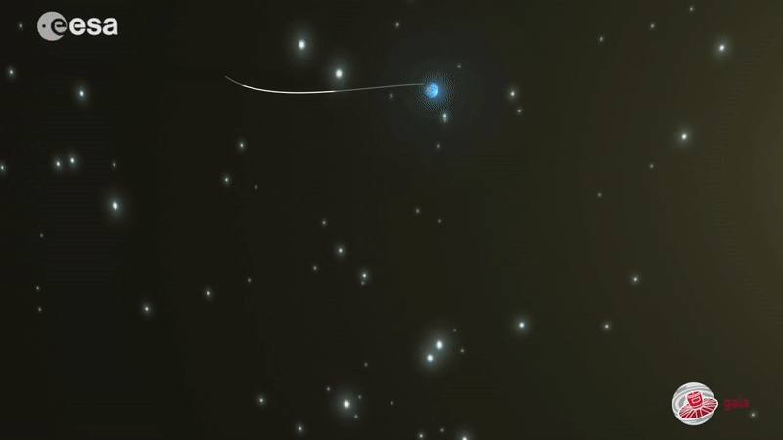
ESA Gaia revolution (2013-2025) now joined by JWST

Slide 3
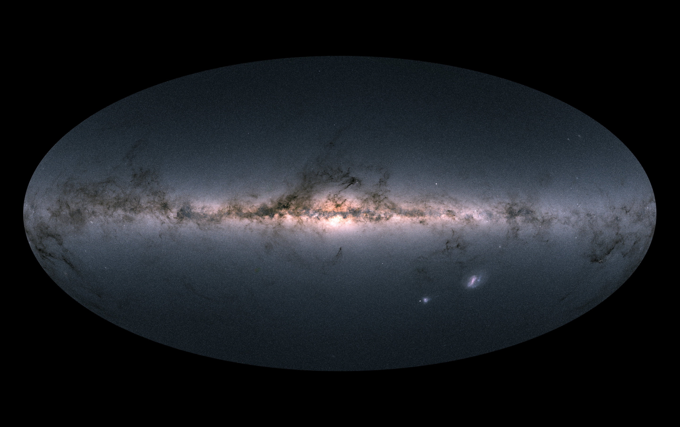
The impact of satellites like ESA Gaia, NASA Kepler & NASA Tess has been profound for assaying the Galaxy. ESA Gaia measures properties for 2 billion stars; 33M stars now have exquisite 6D phase space information. The best chemistry and RVs have come from the ground-based MOS surveys.

Slide 4
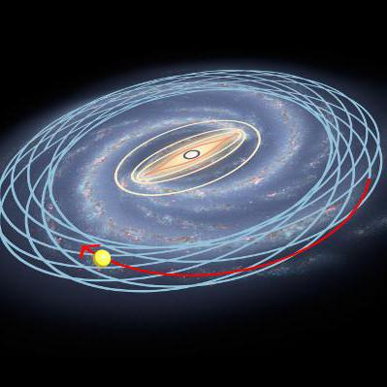
Axisymmetric (+bar) models: understand the Galaxy’s current state before we can begin to unravel the past.
We now have good 6D orbit information for millions of (mostly) local stars. Now we can work in terms of velocities V_{i} or actions J_{i}.
J_{Z}
V_{Z}
J_{Φ}
V_{Φ}
J_{R}
V_{R}
The search for a ( Φ, ρ ) pairing associated with the DF is a profoundly difficult challenge to engage us for decades. The task assumes the Galaxy is in dynamical equilibrium, but is it ?
Notes:
AGAMA uses actions, so relevant to setting up Galaxy
McMillan figure, Binney’s group
Df/dt=0 because these are constants, invariants
Any steady state solution of the CBE depends on phase space coord only
Through (isolating) integrals of motion
e.g. Kepler potential

Slide 5
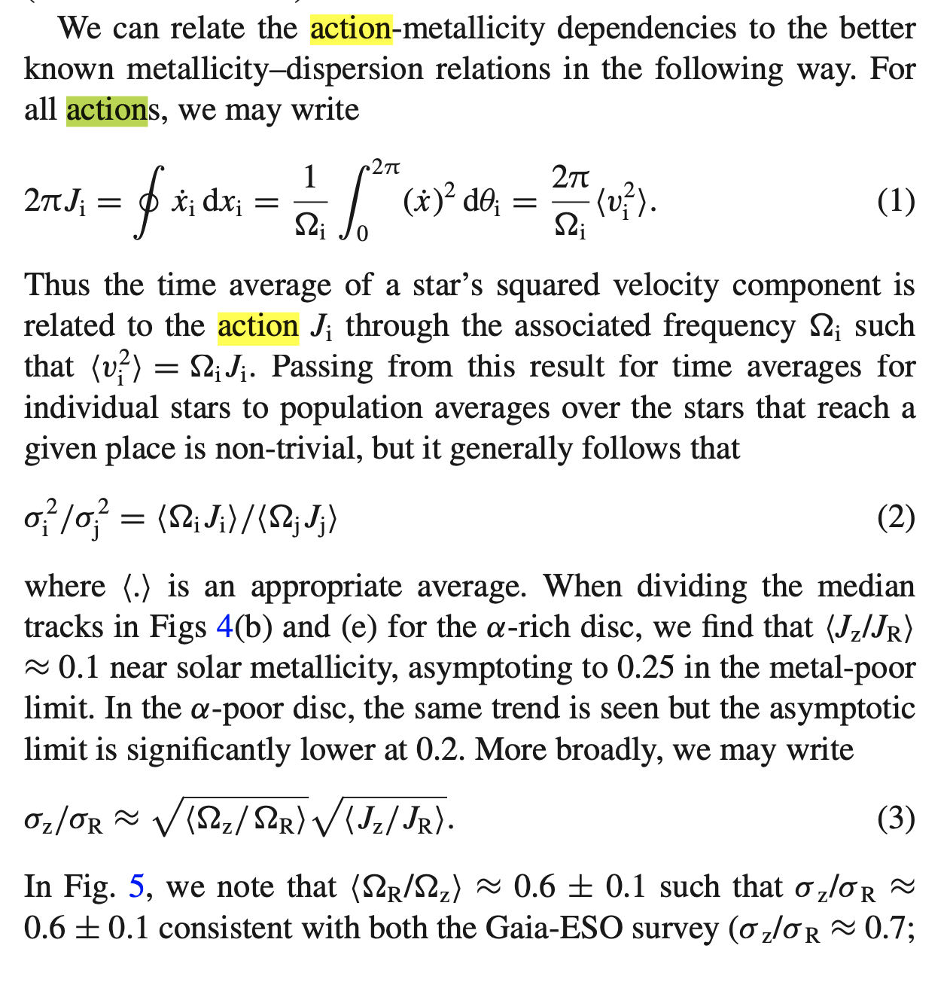
Bland-Hawthorn et al 2019
Notes:
JBH+2019

Slide 6
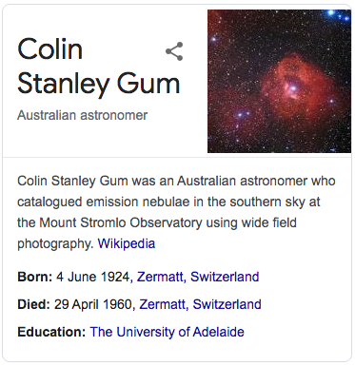
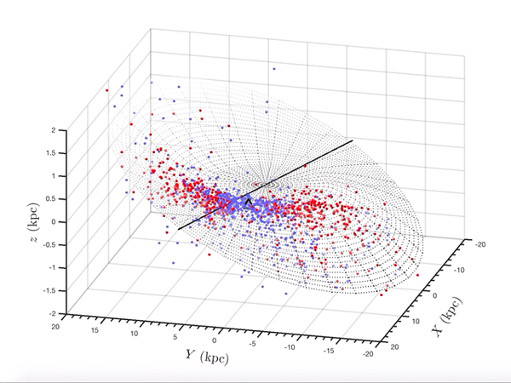
We have known since Colin Gum, Australian astronomer,
that the outer disc is warped. His paper was published
after he was killed in a skiing accident (1960).
Chen et al 2019: 1339 classical CVs from WISE
Notes:
CVs ??
Senior Lecturer, Usyd
Adelaide u/g

Slide 7
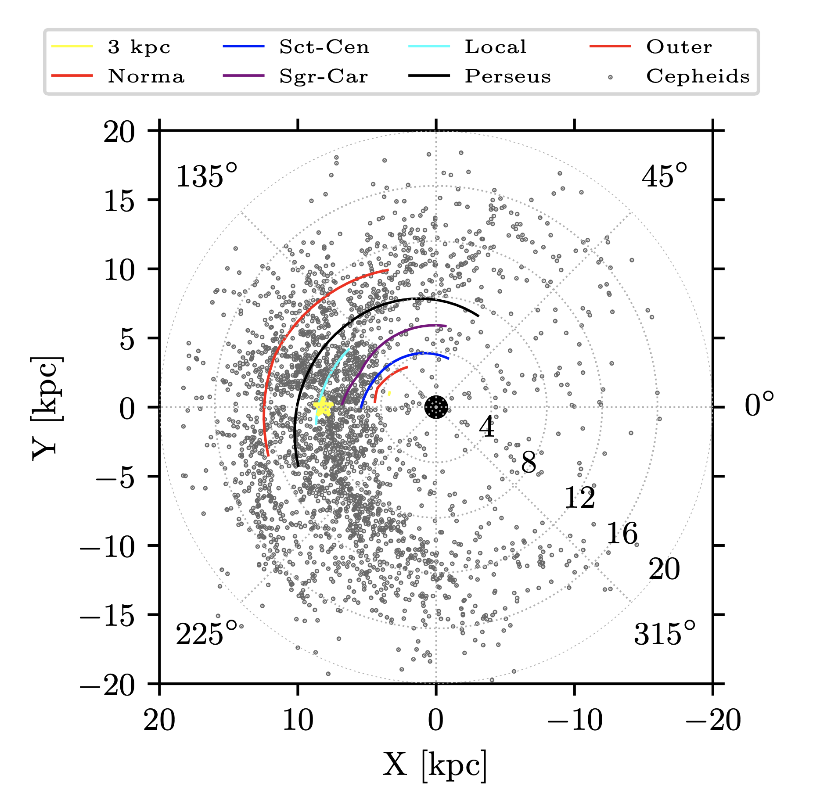
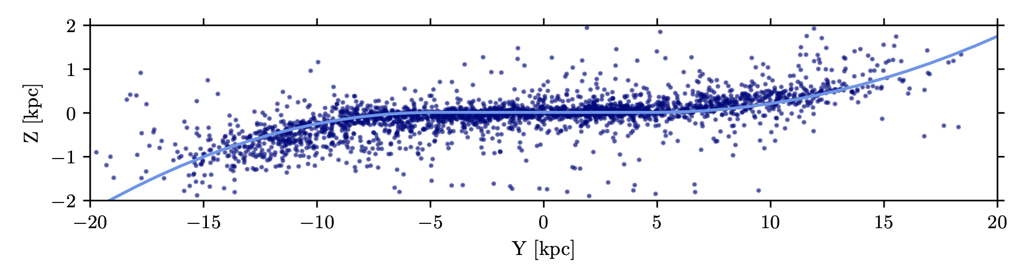
The warp: a modern perspective from (young) classical Cepheids
These show a radial instantaneous metallicity (therefore age) gradient, and a small amount of flaring.
Lemasle et al (2022)

Slide 8
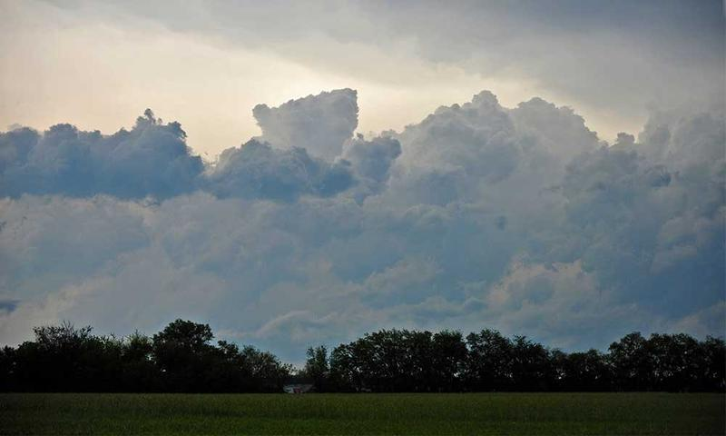
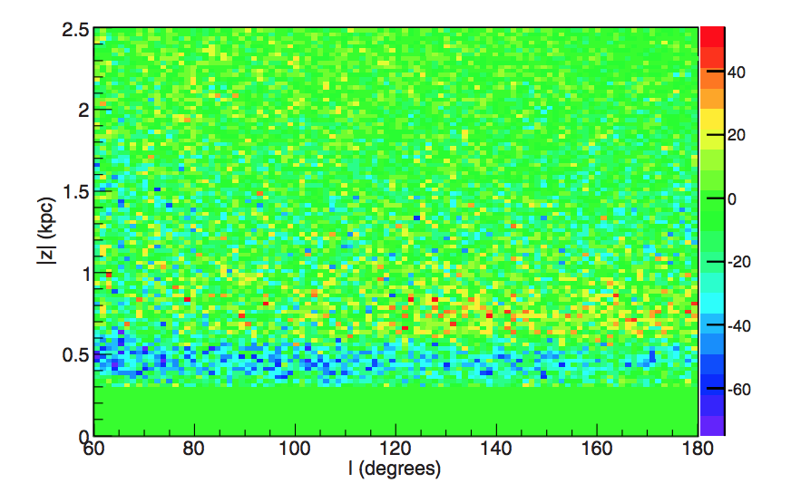
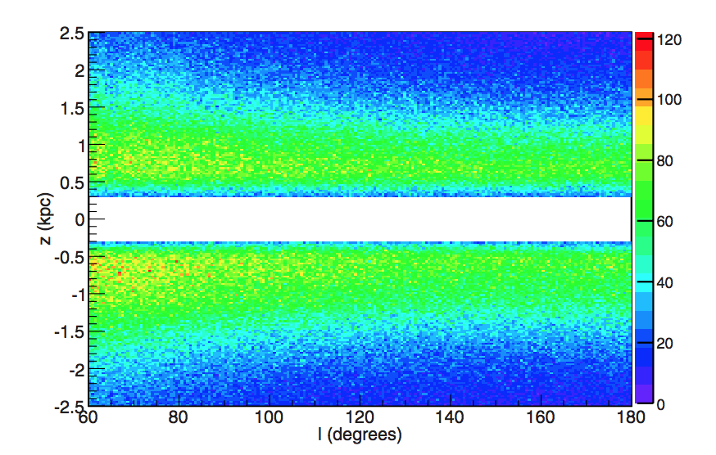
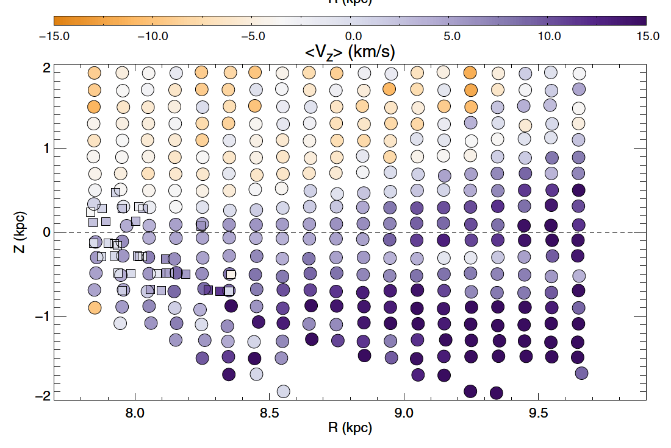
Stormclouds on the horizon
Non-equilibrium structures:
Hercules Stream (Dehnen 1998)
Monoceros Ring (Newberg+ 2002)
Hercules Thick Disk Cloud (Parker+ 2003)
TriAndromeda Ring (Rocha-Pinto+ 2004)
Virgo Overdensity (Newberg+ 2007)
Hercules-Aquila Cloud (Belokurov+ 2007)
Non-equilibrium kinematics:
SDSS (Widrow+ 2012)
RAVE (Williams+ 2013)
LAMOST (Carlin+ 2013)
North-south star counts:
SDSS (Yanny & Gardner 2013)
PanSTARRS1 (Slater+ 2014)
SDSS (Xu+ 2015)
SDSS (Yanny & Gardner 2013)
LAMOST (Carlin+ 2013)
Notes:
Kansas – similar stuff seen in M31
Some of this associated with Sgr??
Low latitude stellar rings

Slide 9
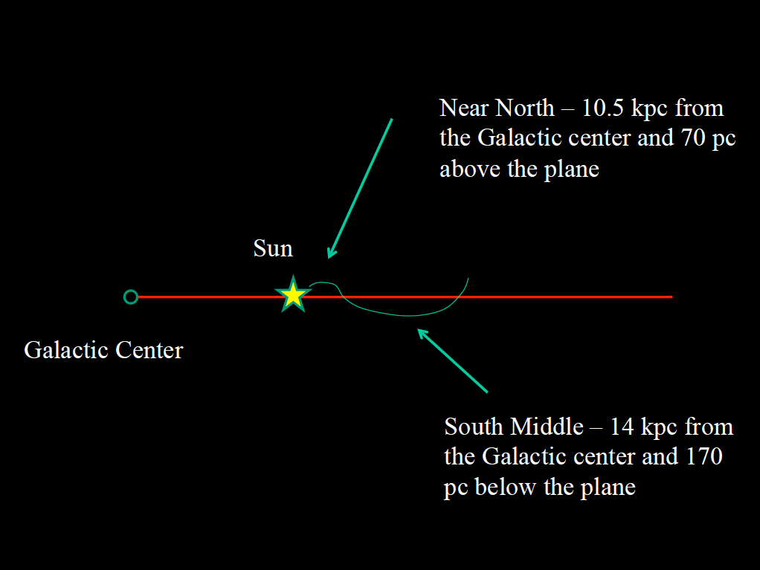
Heidi Newberg’s team: it’s even more complex than a simple warp
(to explain ripples in star counts)
Notes:
Xu, Newberg

Slide 10
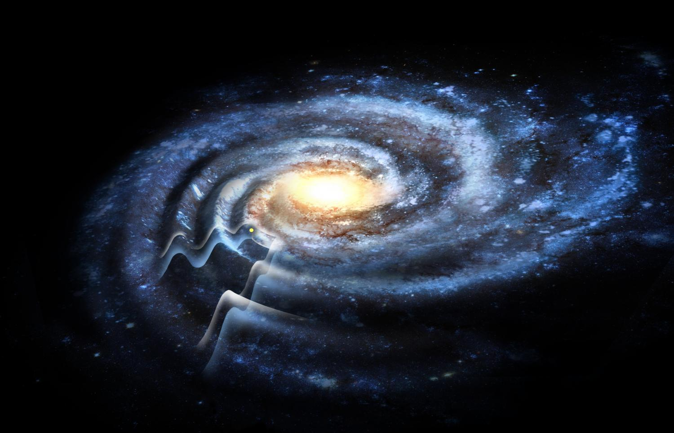
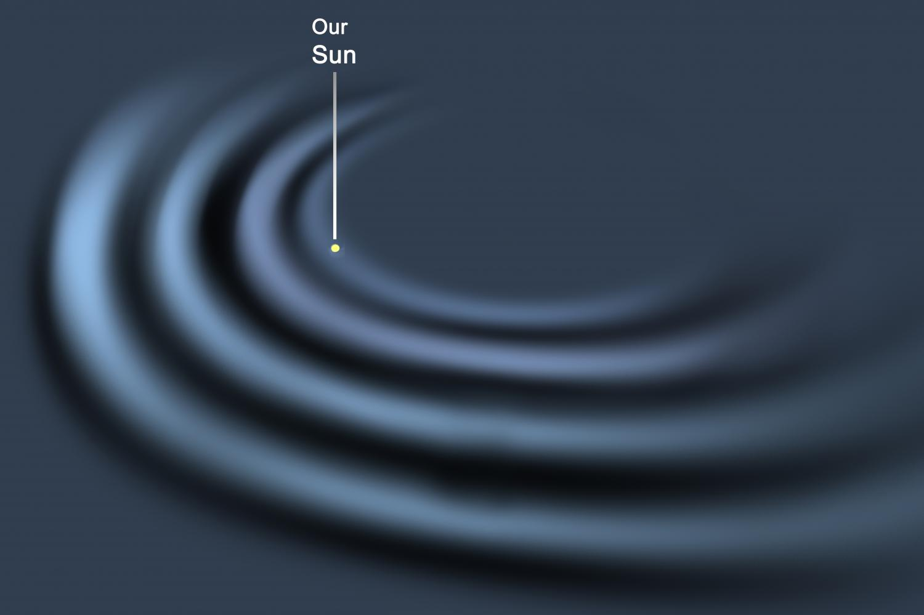
Heidi Newberg – is this what we are seeing?
TriAndromeda Ring
Monoceros Ring
Dana Berry

Slide 11
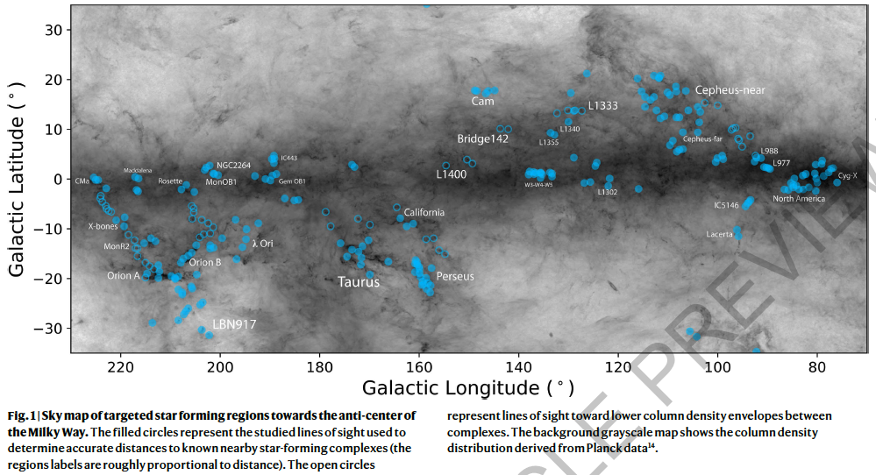
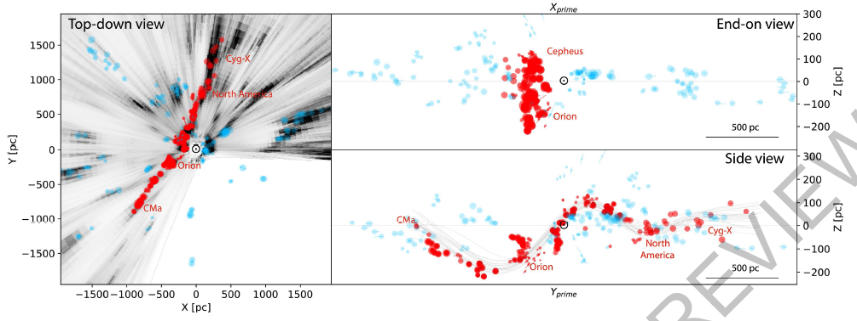
Local gas and star-forming regions
appear to be “riding the waves”
(Alvez et al 2020)
Notes:
See Quillen et al 2020, corrugated SF regions;
Also find Harvard HI image of nearby wave

Slide 12
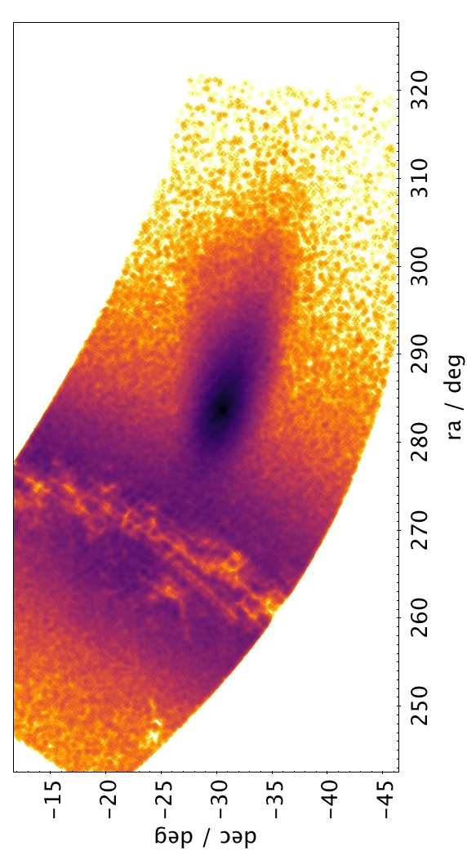
Galactic seismology:
How does the Milky Way ring?
Are stellar & gas corrugations related?
Sgr

Slide 13
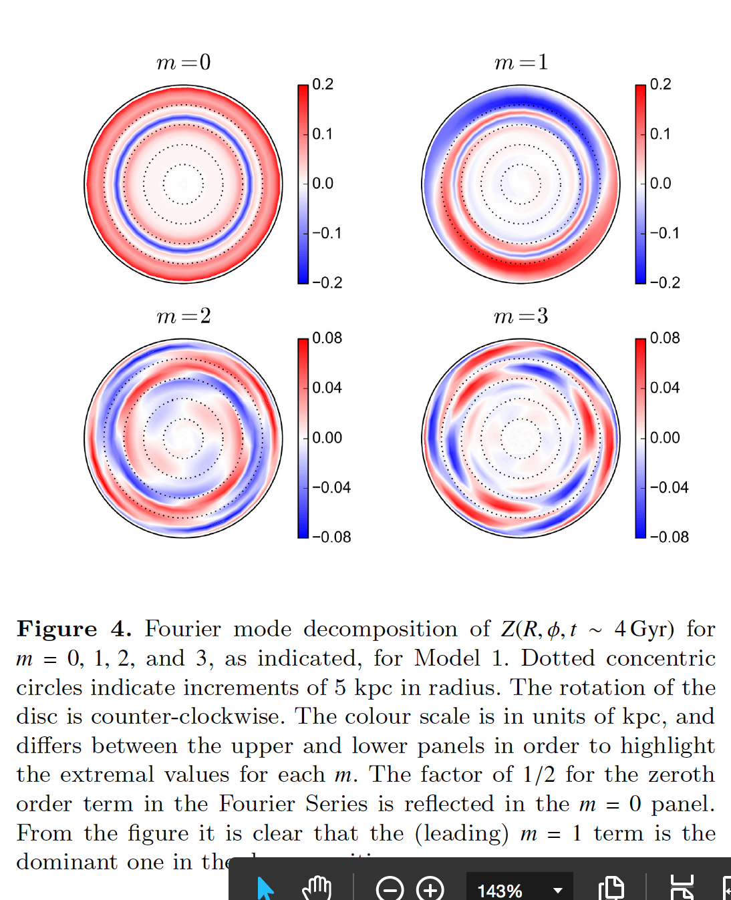
Galactic seismology
Iye 1985
Galactoseismology
Widrow+ 2012
Δz
Can we interpret time-dependent
modal behaviour?
cf. M51; Salo & Laurikainen 2000
cf. MW; Quillen+ 2011
cf. M31; Dierickx+ 2014
Notes:
Asteroseismology declared as a field in 1985, Gough. See Aerts 2021 RMP.
Chequers & Widrow 2017
Salo & Laurikainen, FT analysis of M51, could do same for M31

Slide 14
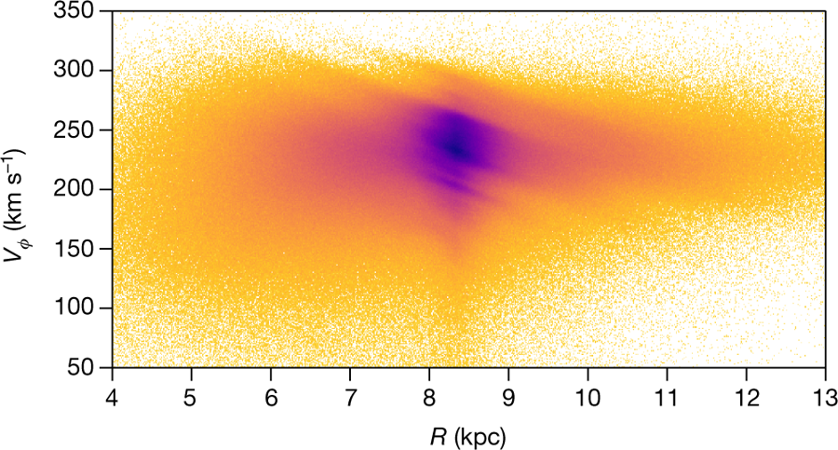
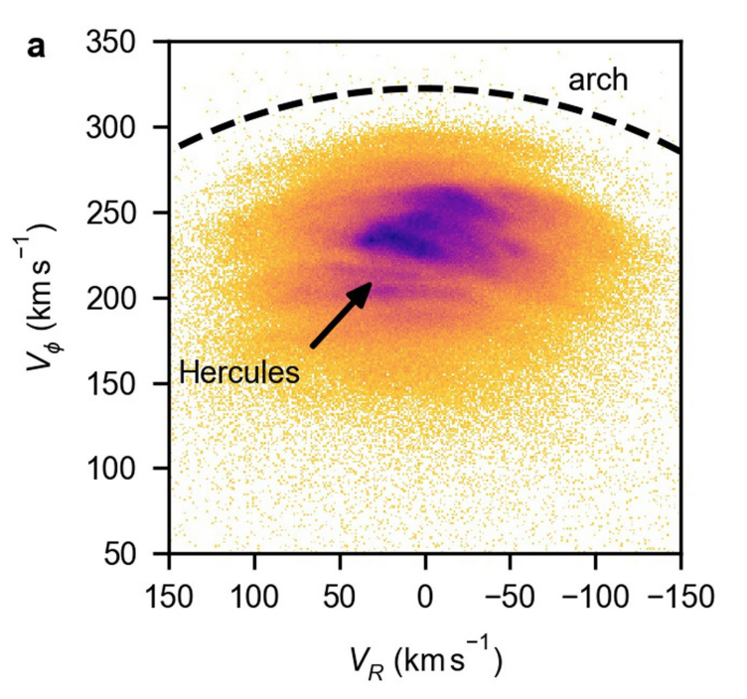
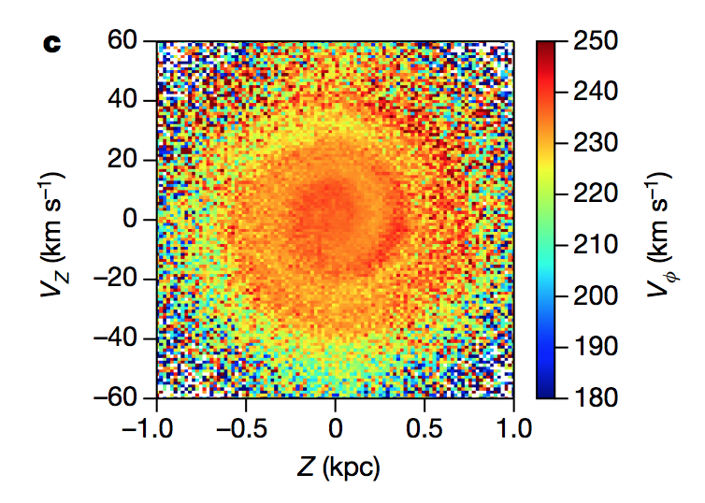
Arches & ridges
ESA Gaia
ridge
Antoja et al (2018)
Fragkoudi et al (2019)
Hunt et al (2019)
Kawata et al (2018)
Khanna et al (2019)
Martinez-Medina et al (2019)
Quillen et al (2018)
Ramos et al (2018)
Phase spiral
Antoja et al (2018)
Binney & Schönrich (2018)
Bland-Hawthorn et al (2019, 2021)
Darling & Widrow (2019)
Khoperskov et al (2019)
Laporte et al (2019), Tian et al (2019)
Michtchenko et al (2019)
Wang et al (2019), Xu et al (2020)

Slide 15
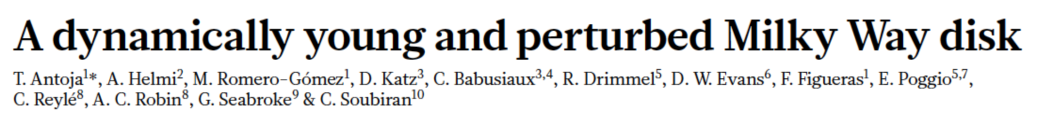
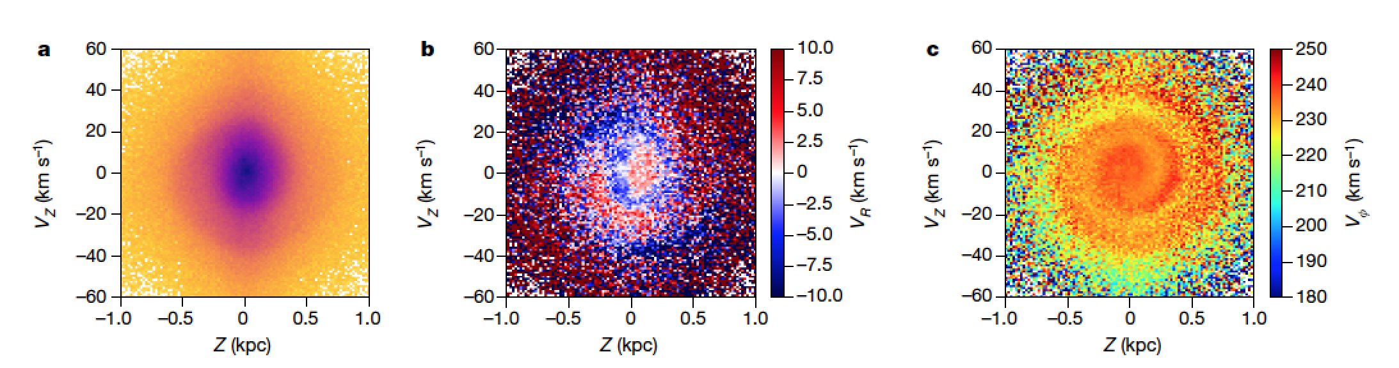
Σ★
V_{R}
V_{Φ}
An important question still not fully appreciated – why is the phase spiral
so prominent when coded as V_{Φ} but barely visible in projected density ?
Secondary question – what links V_{Φ} and V_{R} ?
Binney & Schönrich (2018) are first to supply an answer, revisited by JBH & Tepper-Garcia (2021) who replicate analytic model with AGAMA, N=10⁸ particle simulation. This is later repeated with N-body/hydro by Tepper-Garcia, JBH & Freeman (2022).

Slide 16
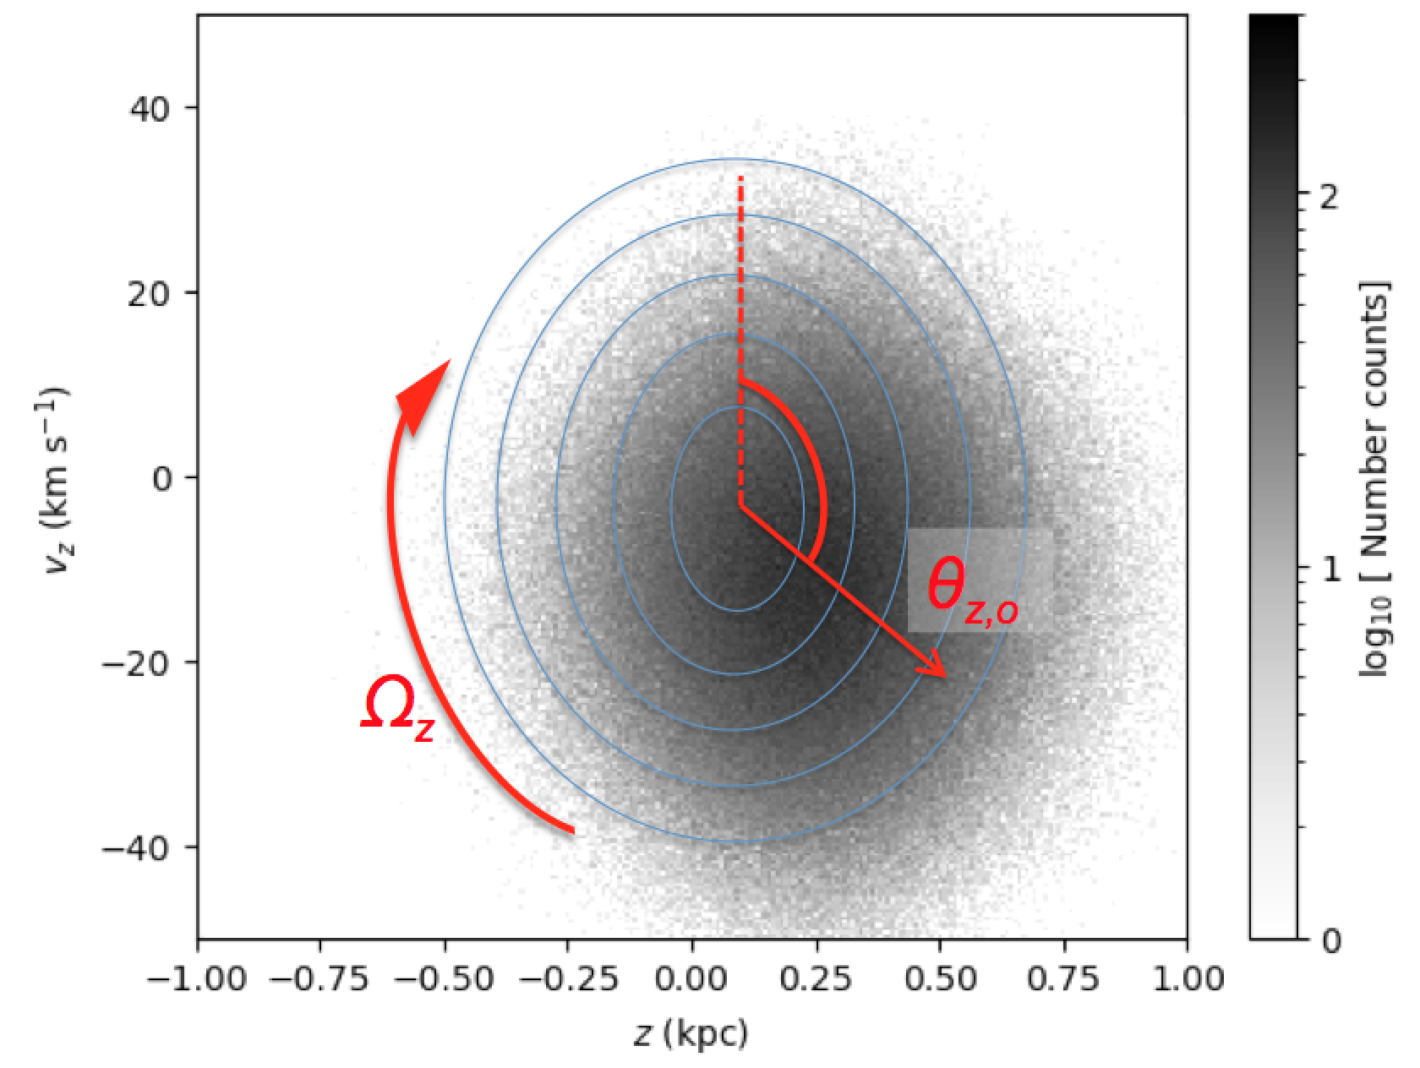
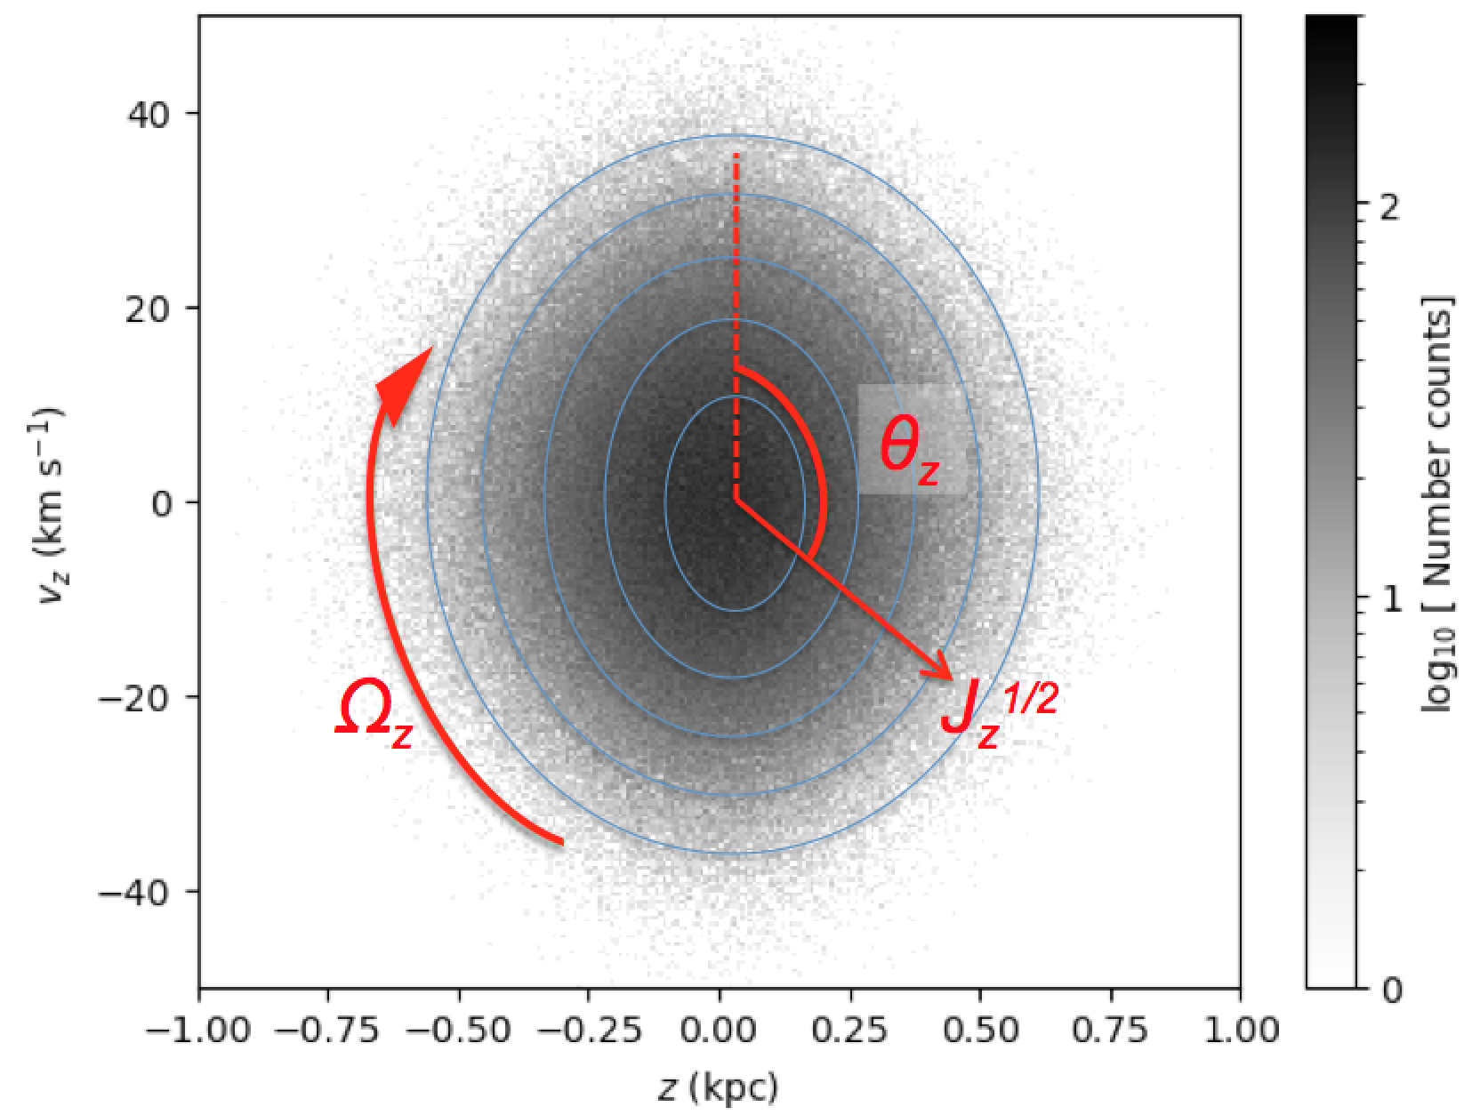
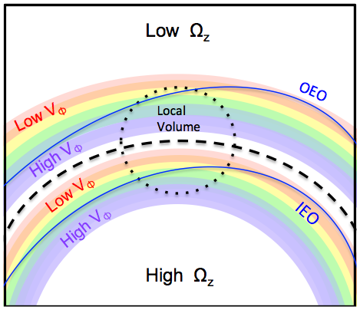
JBH & Tepper-Garcia 2021
Notes:
Omega_z couples to the orbit

Slide 17
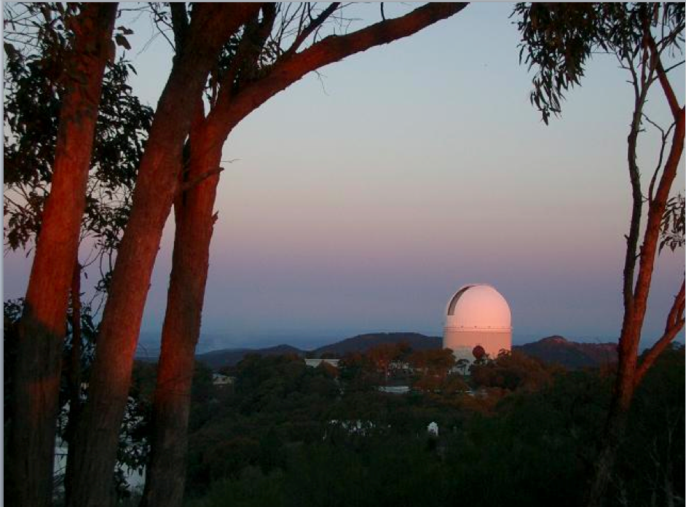
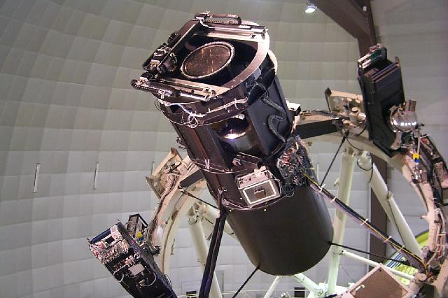
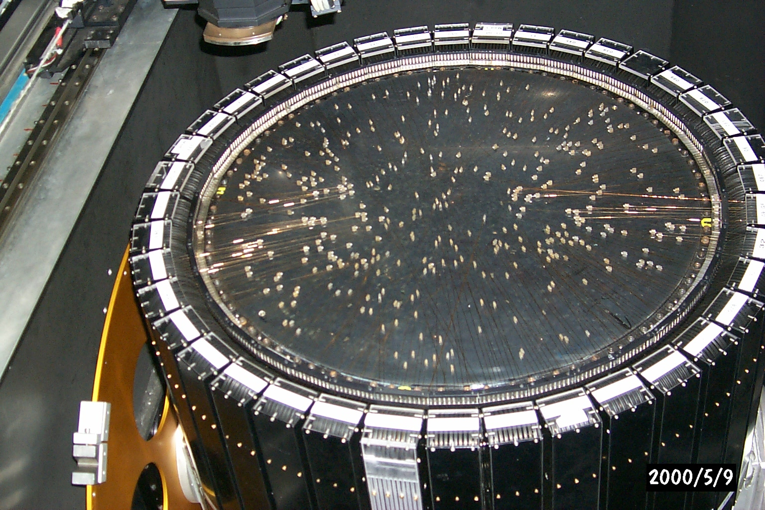
GALAH survey @ AAT, Siding Spring
Ten year mission to measure up to 30 elements and velocities in a million
stars across the Galaxy.
Major surveys, past, present, future:
2MASS, SDSS, APASS, PanStarrs, LSST...
RAVE, Gaia-ESO, APOGEE, LAMOST…
Kepler, K2, TESS, PLATO…
Hipparcos, Gaia...
400 optical fibres positioned robotically
Notes:
Photometric
Spectroscopic
Seismic
Astrometric
Sven Buder’s talk…
First spectroscopic, next seismic, last astrometric
Coming: LSST, WEAVE, 4MOST, TESS, PLATO, …

Slide 18
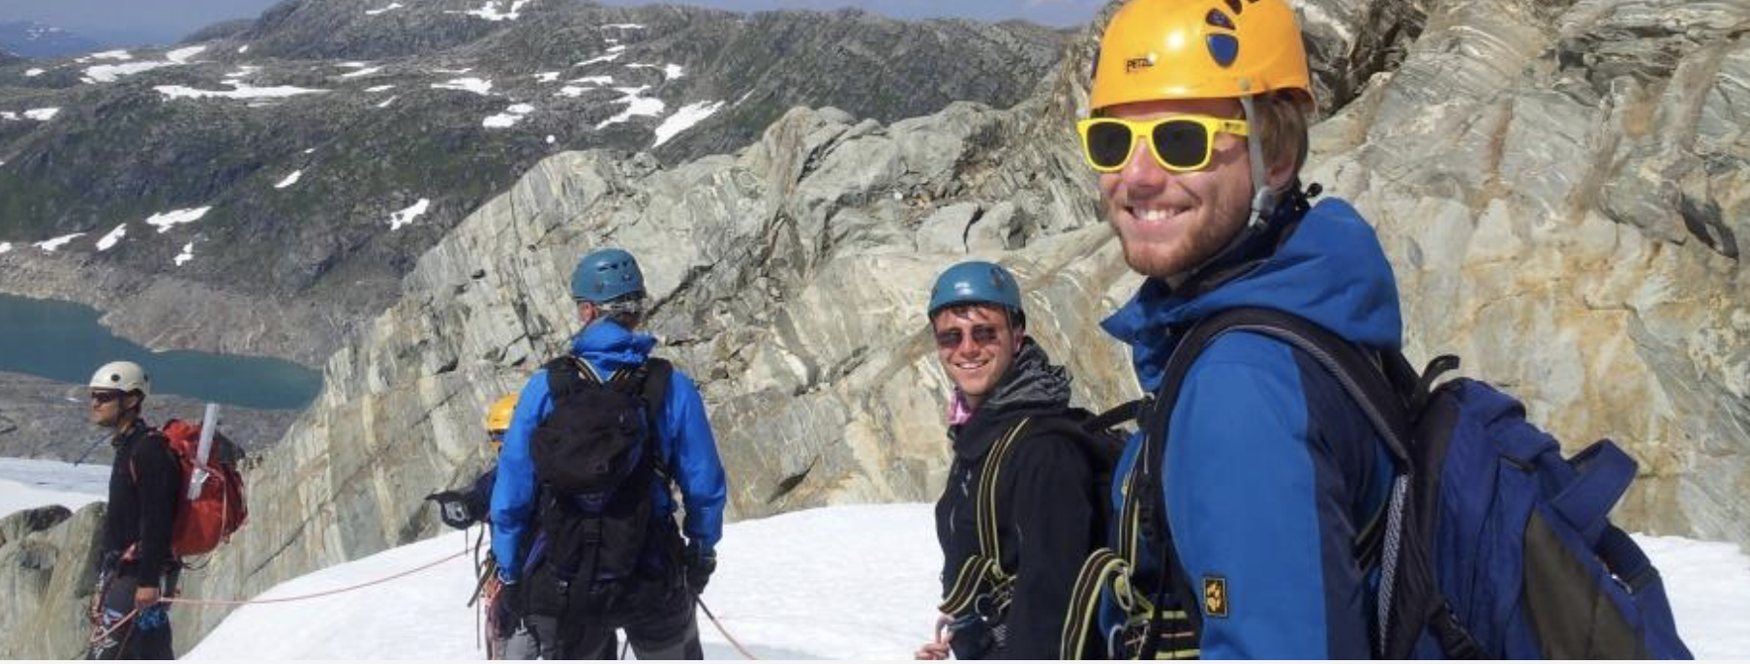
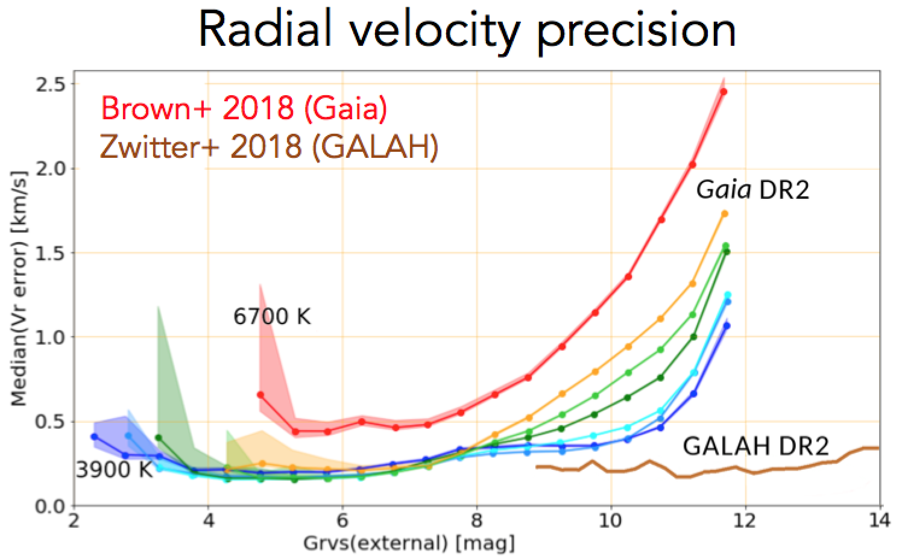
GALAH DR2 Release (Buder+ 2018)
GALAH DR3 Release (Buder+ 2021)
GALAH DR4 Release (Buder+ 2022)

Slide 19
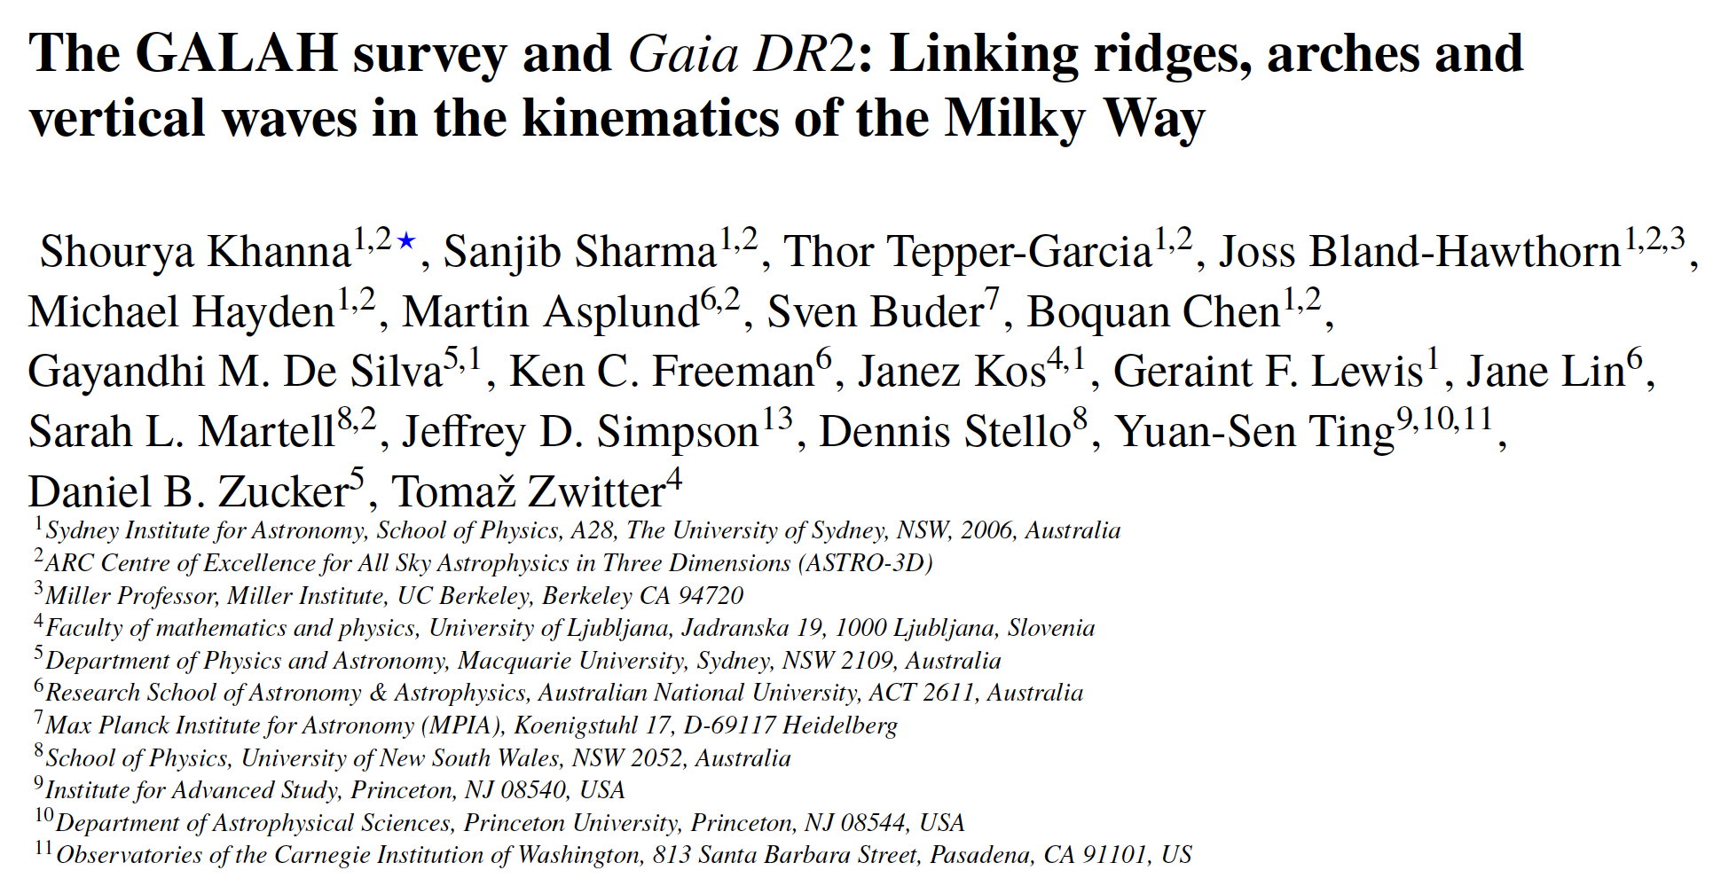
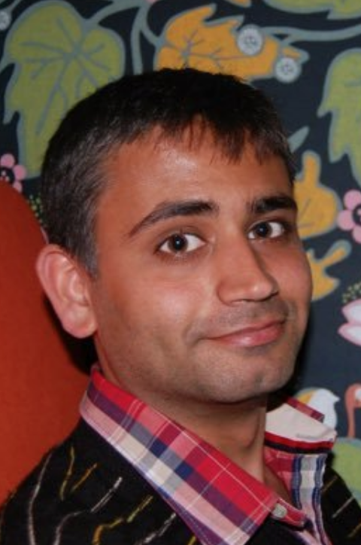
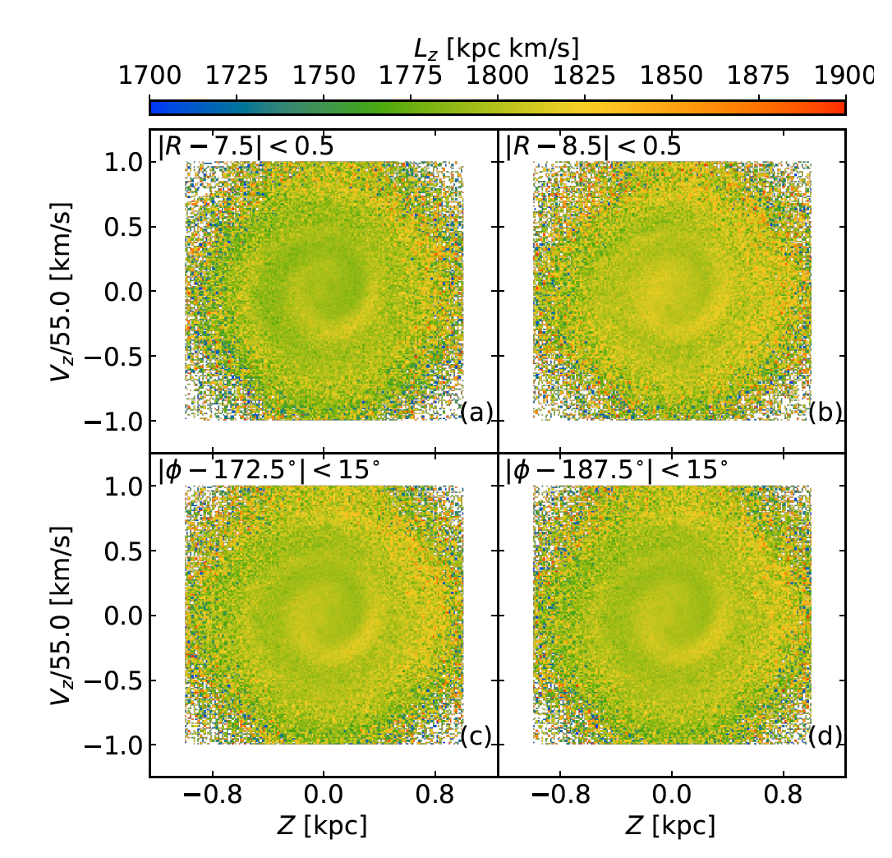
Smoothest regional variations in phase spiral are seen in L_{z} moving in radius and azimuth
Recall how highly structured the phase spiral appears using V_{Φ} or V_{R} coding

Slide 20
Galactic seismology:
A new class of disc simulations that conform to the specified initial conditions and have extreme long-term stability
A combination of AGAMA & RAMSES with added features
Sgr
JBH & Tepper-Garcia (2021) carry out first simulation of Binney & Schönrich’s (2018) impulse model with same parameters, e.g. M_{SGR} ~ 2 x 10¹⁰ M, using recommended 100M particles.

Slide 21

www.physics.usyd.edu.au/~tepper/proj_galseismo.html

Slide 22
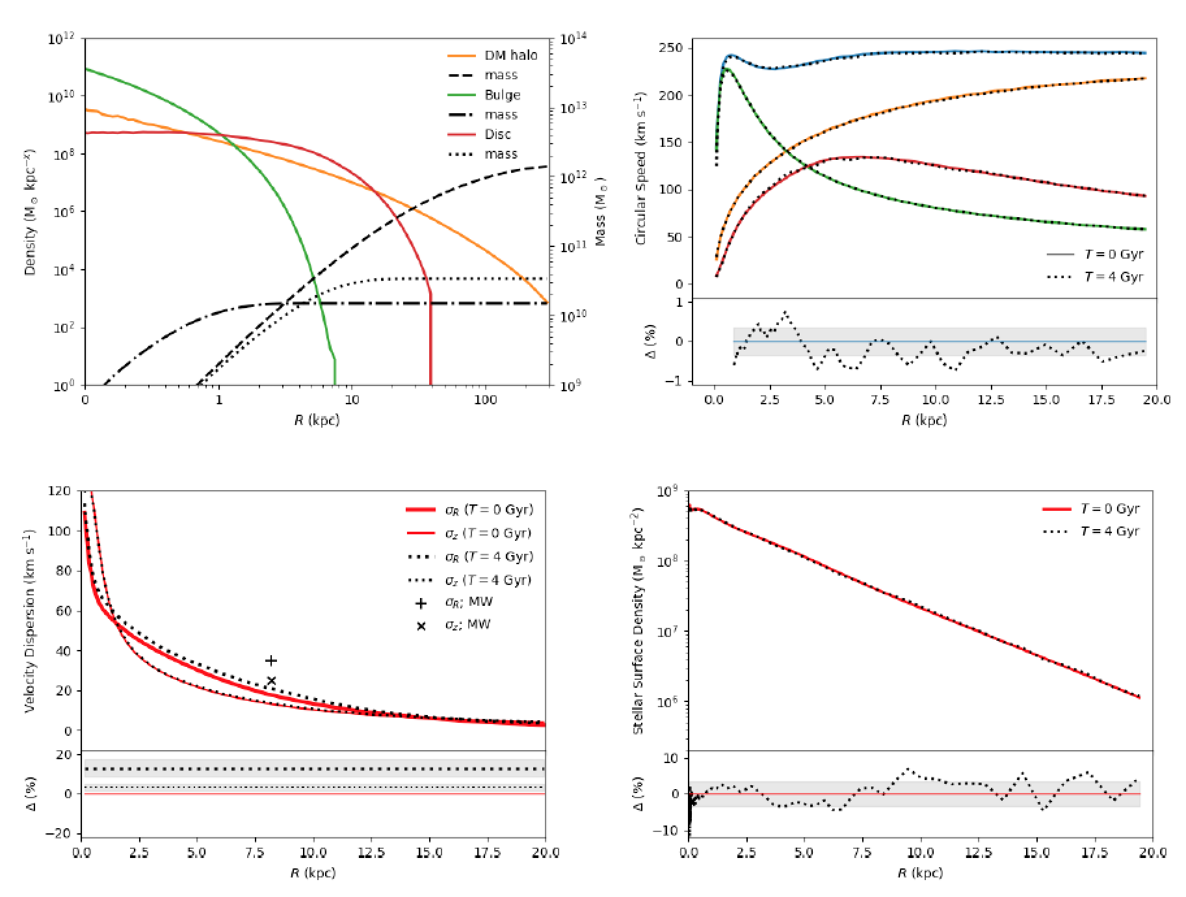

Slide 23
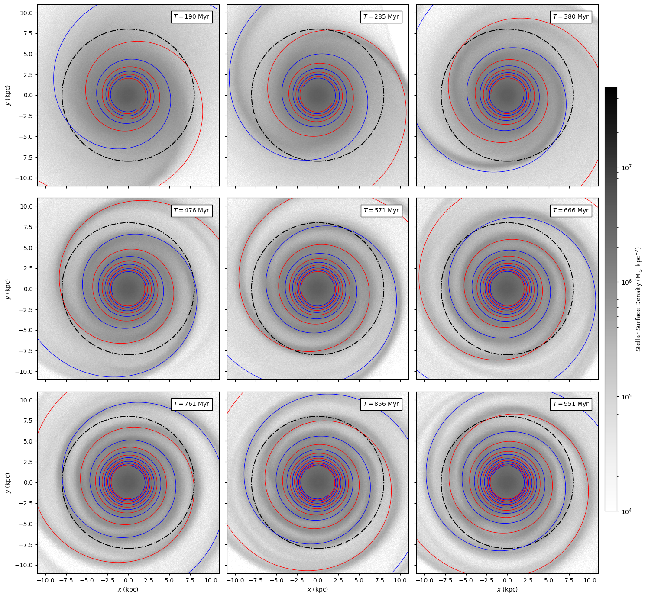
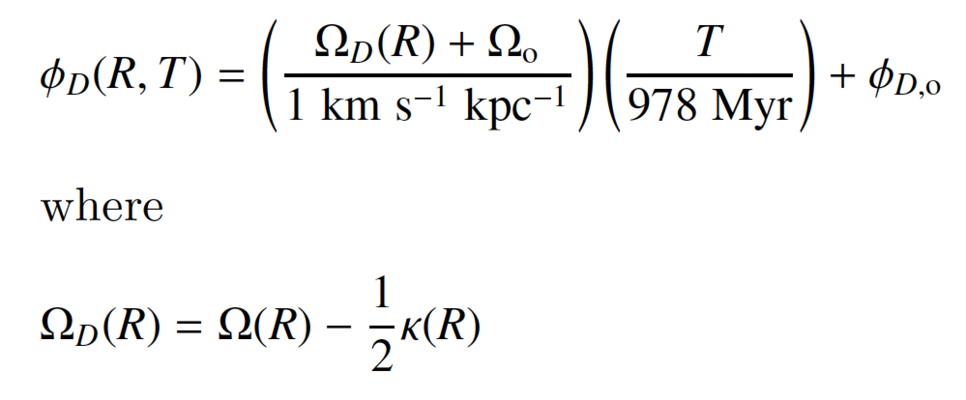
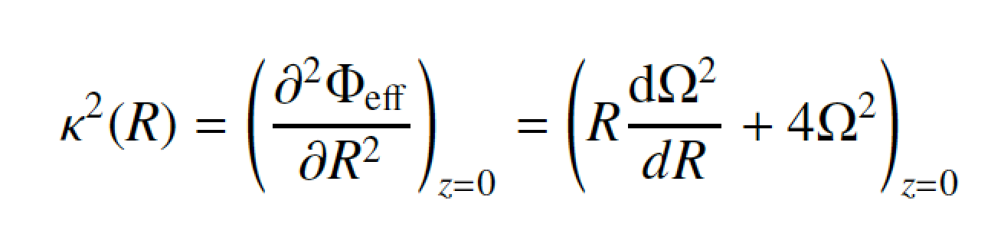
Spiral density wave wrapping up from 200 Myr to 1 Gyr.
One simple model fits all mid to late timesteps.
Notes:
CRUCIAL to stress that differential shear wraps up spiral TOO FAST.
You need differential shear DELAYED by kappa/2. For a flat V®,
This is 3x slower than pure differential shear.

Slide 24
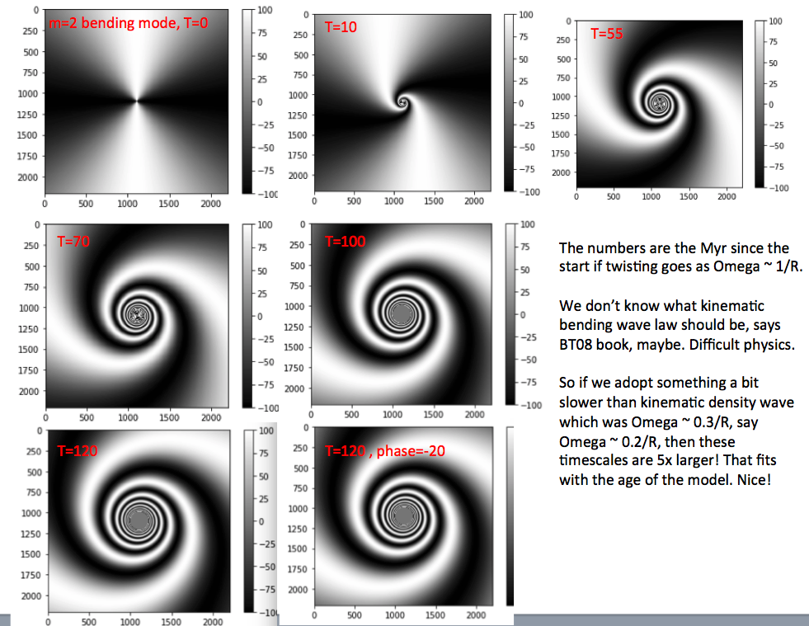
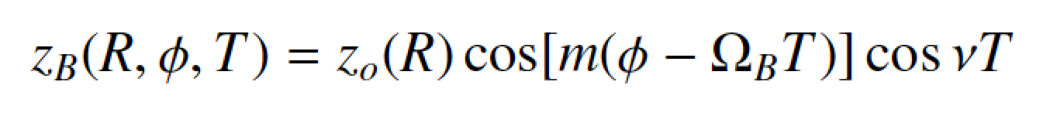
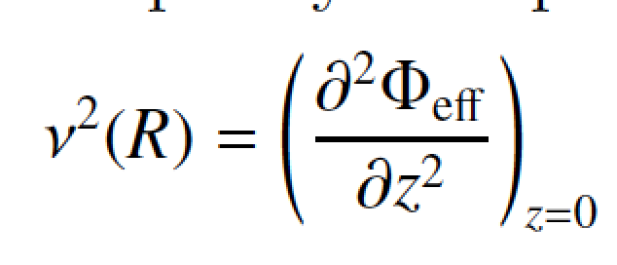
Underneath the in-plane (XY) spiral density wave is a vertically oscillating (Z) bending wave that also wraps up.
There are vertical Lindblad resonances
as well as in plane.
The shear is due to the flat rotation curve of the Galaxy.

Slide 25
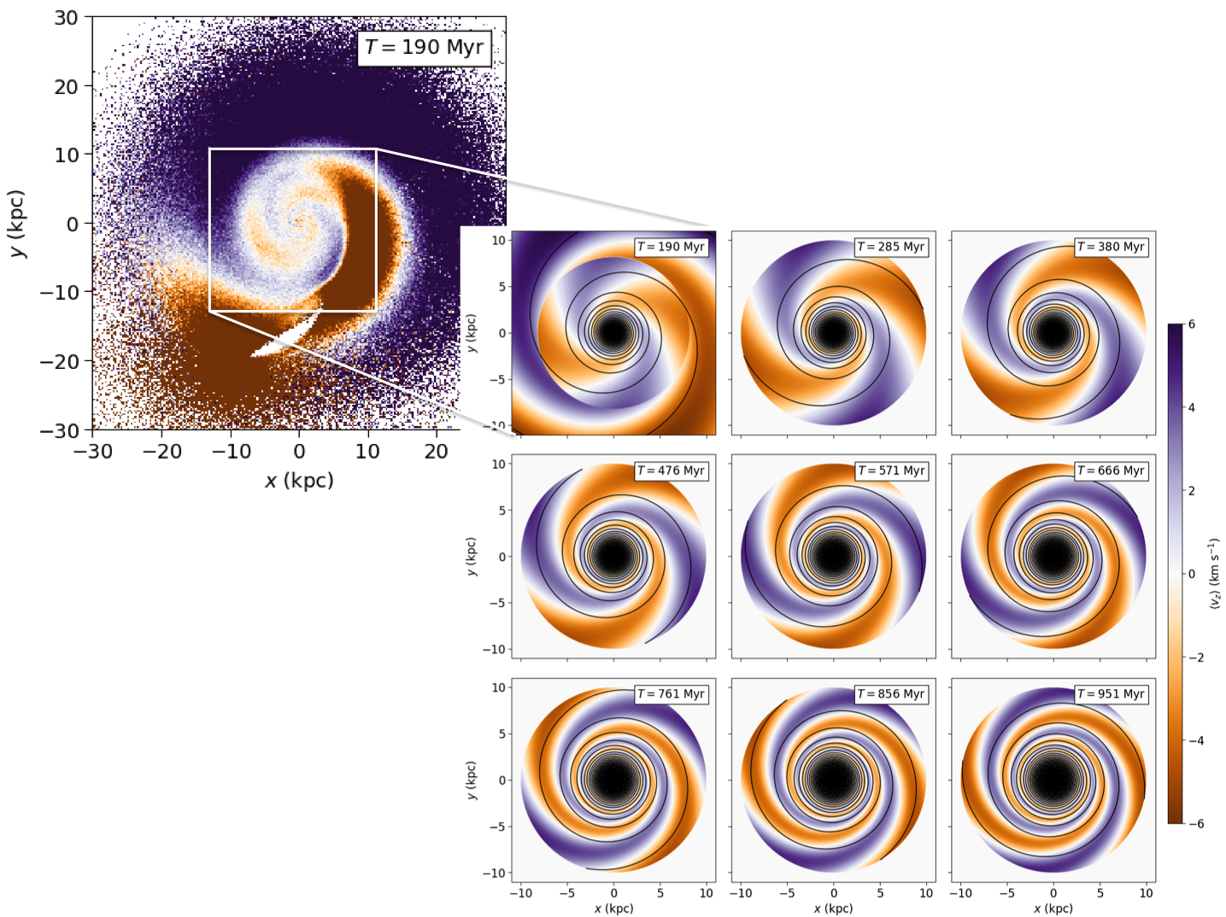
Work with Thorsten:
Spiral density wave wraps up at different rate to bending wave.
The wrapping up of the bending wave is slower than the wrapping spiral wave
JBH & Tepper-Garcia (2021)
“Rollercoaster model”
The gas corrugation tracks the stellar corrugation for 500-700 Myr then dampens
Tepper-Garcia, JBH & Freeman (2022)

Slide 26
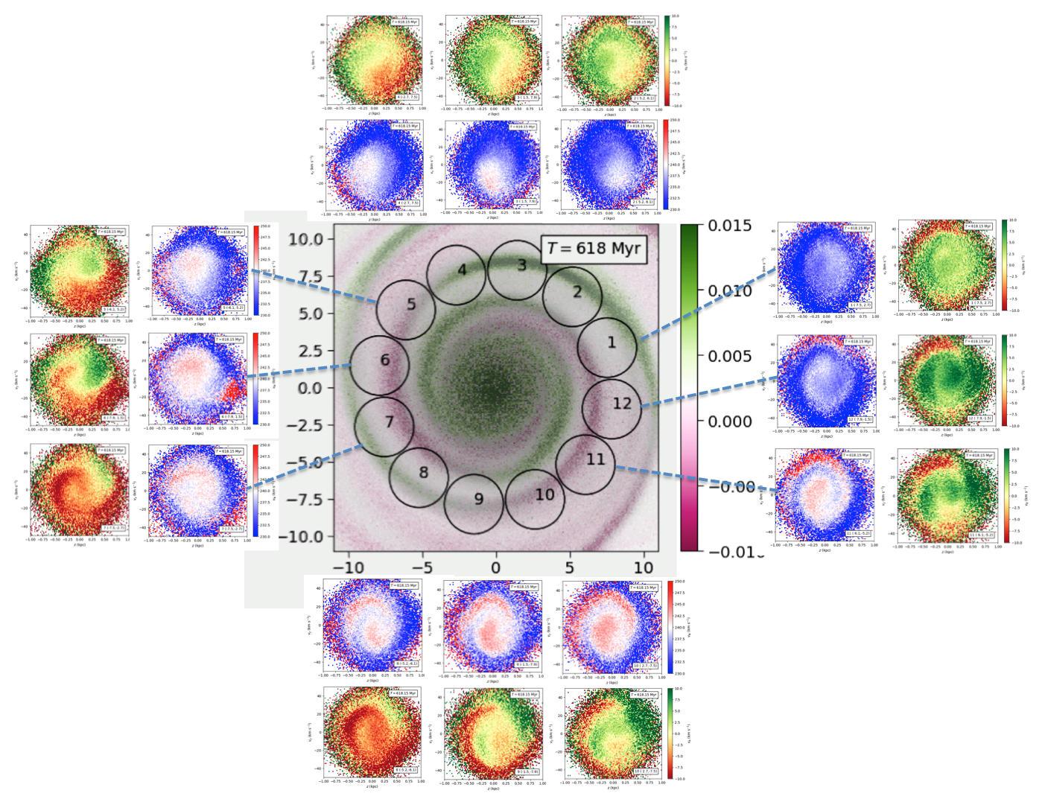
“Rollercoaster model”

Slide 27
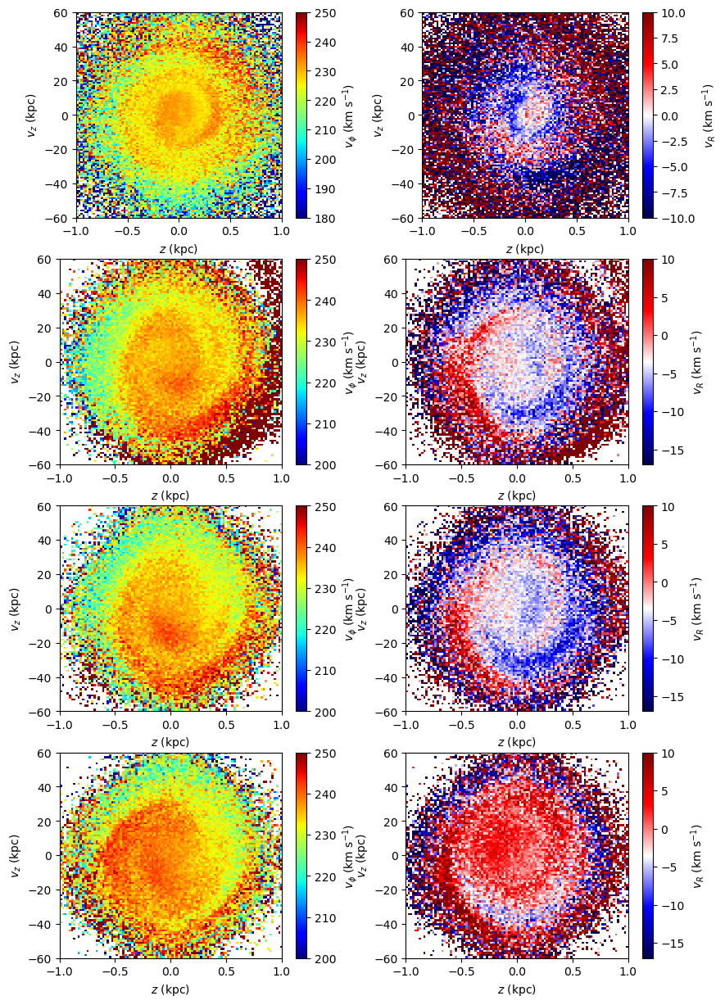
We reproduce Antoja’s PS result but today’s mass limit for Sgr is ~10x less.
Because the PS builds for ~400 Myr and survives ~1.5 Gyr, the previous crossing before the last excited the PS. This is an ancient signature.
data
models
Neighbouring volumes at T = 951 Myr
JBH & Tepper-Garcia 2021

Slide 28
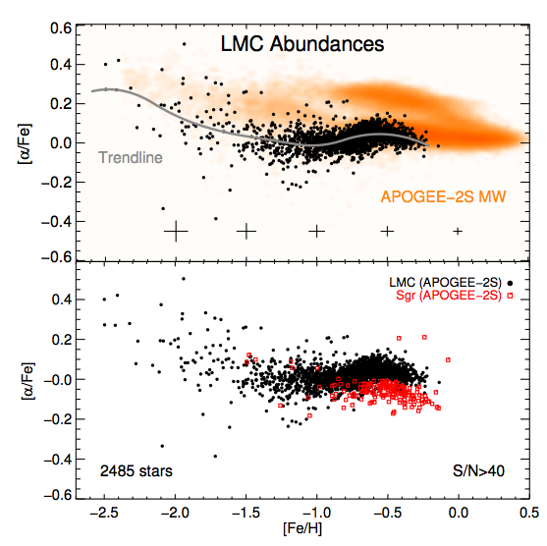
We reproduce Antoja’s PS result but today’s mass limit for Sgr is ~10x less.
Because the PS builds for ~400 Myr and survives ~1.5 Gyr, the previous crossing before the last excited the PS. This is an ancient signature.
Sgr infall mass ~ LMC mass today if we are to account for its metallicity.
Thus, Sgr has lost 0.5-1 dex in mass per loop in the last full orbit.
data
models
Neighbouring volumes at T = 951 Myr
JBH & Tepper-Garcia 2021
Nidever et al 2020

Slide 29
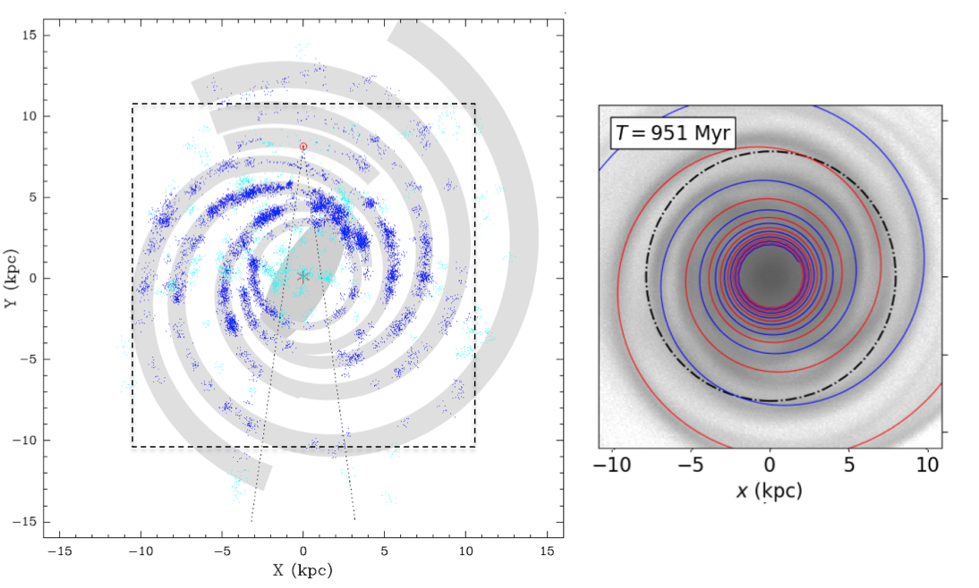
So what if most of what we see was triggered by Sgr?
This is how the disc looks at the same time step, T = 951 Myr, induced by the merger, wrapping up as Ω-κ/2, i.e. 1/√2 = 70% slower than pure differential shear.
For this to be true, the corrugated wave cuts across the arms.
(Reid et al 2019) masers
Notes:
= 1/√2 slower when V®=const
850 Myr after penultimate crossing
Bar coming in next simulations…

Slide 30
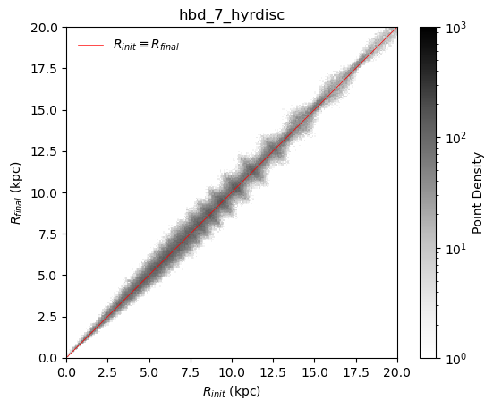
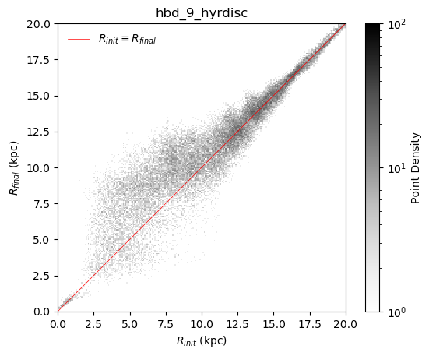
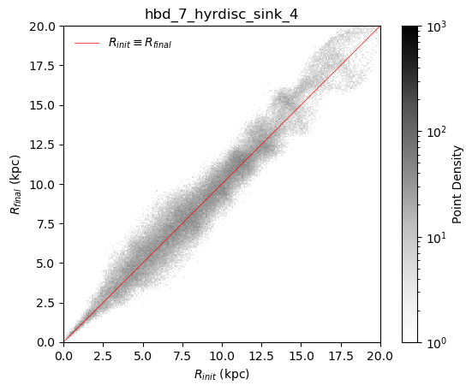
Transitory spiral arm phases triggered by passing satellites cannot be the whole story. They do not drive strong migration.
There must be other transitory disturbances.
Winding Spiral
BAR
These are circularized orbits (e < 0.1) at T=0 and T=2 Gyr. There is minimal blurring.

Slide 31
Looking forward
If you accept the idea of spirals winding up, rather than standing waves, this raises many questions, some with early answers:
When and how were the arms triggered?
Is there a meaningful pattern speed? Are there resonances?
Do the natural frequencies of the perturber play a role?
What is the relationship with the bar?
What does the gas do? Does it corrugate?
How can we test for winding spirals?
This is a different kind of transience – does it drive migration?
What is the end state of wind up?
Why is the literature largely silent on spiral wind-up?
Notes:
WE have not brought abundances or ages into the seismology models yet

Slide 32
Looking forward
Gaia shows us a different future for Galactic studies and how little we know – the Galaxy is not an equilibrium figure. Unravelling the past is now more challenging.
What is the impact of galactoseismology on prior structure? What does it mean to derive parametrized relations today? We need to revisit what we thought we knew.
How does galactoseismology work with secular evolution (e.g. migration) and more generally with the bar and spiral arms?
When and how did it all start? How much information is lost, how much survives? The dynamical clock requires a deeper understanding of how the disc responds.
Future Galaxy models will need to be far more sophisticated using all baryon phases along with the dark matter.
The search for the “true” DF (and Φ, ρ pair) continues… 2021 ff promise to be golden years for Galactic studies.
Near future? – nano-arcsecond astrometry (proposed by C. Boehm for ESA Theia satellite) may be technically feasible and would provide an astonishing probe to unwinding and forward-evolving the Galaxy, on the nature of dark matter, inter alia.
Notes:
WE have not brought abundances or ages into the seismology models yet

Slide 33
GALACTIC SEISMOLOGY
What caused the phase spiral?
How long ago? Where? How?
How fragile? How robust?
What is the specific mechanism?
Is Newtonian gravity enough?
We can reproduce Antoja’s PS result but current mass limit for Sgr is 10x less. Because the signal survives 1.5 Gyr, it may be the previous crossing that did it.

Slide 34


Bland-Hawthorn et al 2019
E = circular orbit at R; 2π J_{z} = const. for outer contour
Interpreting the “phase spiral” depends critically on local disc properties. For a useful dynamical clock, the vertical structure (prior to perturbation) must be established. (AGAMA+Piffl2014)
Notes:
“binney plot” – bovy14 mcmillan12 piffl14 – it matters, piffl best for vertical density
Different degrees of phase mixing at each radii…

Slide 35
Never got to talk about V_R, V_Phi coupling and how we see ellipsoid tilt directly for the first time (JBH+2019)

Slide 36
revision
Omega = angular freq
Kappa = radial freq
Nu = vertical freq
Phi_eff = effective potential !!
V® flat ->Omega-Kappa/2= 0.7 Omega = Omega/Root 2

Slide 37

RAMSES (Teyssier) adapted by TTG to include time-dependent perturber mass

Slide 38


